Slide 1
DEVELOPING A NEW HOUSING STRATEGY FOR TENDRING
PETER RUSSELL
EXECUTIVE PROJECTS MANAGER
TENDRING DISTRICT COUNCIL
Notes:
Walton-on-The Naze Beach

Slide 2
OUR CHALLENGES
DEPRIVATION
AGEING POPULATION
HEALTH INEQUALITIES
LOW EDUCATIONAL ATTAINMENT
LOW EARNINGS
HOMELESSNESS
INCREASING DEMAND
Notes:
Bungalow in Jaywick Sands

Slide 3
OUR HOUSING MARKET
Notes:
70% owner-occupied
20% private rented
9% social/affordable rent
1% shared ownership

Slide 4
TENDRING DC AS A LANDLORD
3130 HOMES
262 SHELTERED HOMES
Notes:
Eagle Avenue, Walton-on-the Naze, constructed c.1921
Spendells House, Sheltered Housing Scheme, decommissioned in 2018

Slide 5
BUILDING NEW HOMES
10 NEW HOMES IN JAYWICK SANDS
27 HECTARES OF LAND PURCHASED
180 COUNCIL HOMES COMMITTED BY 2024
CABINET BACKING FOR 200 MORE
Notes:
Site of new 10 new council homes, Jaywick Sands

Slide 6
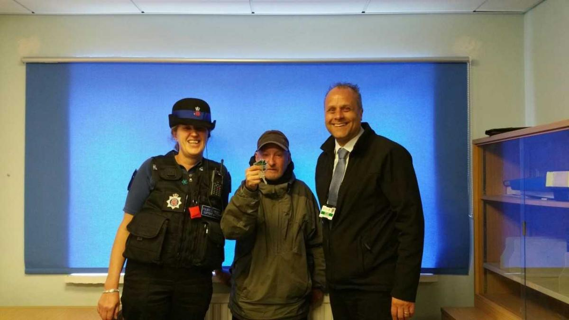
OUR FUTURE AIMS:
DELIVER HOMES TO MEET THE NEEDS OF LOCAL PEOPLE
REDUCE AND PREVENT HOMELESSNESS & ROUGH SLEEPING
Notes:
3 bed bungalow to be delivered to the council in Summer 2019
Local rough sleeper from Walton-on-the-Naze housed by Tendring District Council in May 2019

Slide 7
OUR FUTURE AIMS:
MAKE THE BEST USE OF AND IMPROVE EXISTING HOUSING
SUPPORT RESIDENTS IN THEIR HOMES & COMMUNITIES
Notes:
House in Berkeley Road, Clacton-on-Sea, compulsory purchased and adapted to create a 5 bedroom home for a family of 7 with a 3 disabled children.
Residents in sheltered housing celebrate the Queen’s 90th birthday at a tea dance in 2015.

