Slide 1
Helen Neal Your Homes Newcastle
YHN and our Housing Plus Vision …….

Slide 2
YHN… who we are ……..
YHN formed in 2004 as an ALMO and is contracted by NCC to deliver housing functions to its 26,000 homes. We also deliver housing services for other landlords.
YHN has two subsidiaries; a commercial company, Abri, owns NFS and QBOT and a charitable company, Asfaleia, delivers support services.
YHN are on a journey of transformation, we have restructured the workforce and transformed our vision, purpose, values and strategic objectives.
YHN’s three Business Strategy identifies the strategic projects that will bring our vision into action. Developing and implementing our Housing Plus Vision is one of the strategic projects.

Slide 3
YHN’s vision, purpose, values and strategic objectives……

Slide 4
YHN Support Services structure….
YHN deliver a full range of support services, directly employing over 140 support staff in Newcastle.
Short term interventions by our Support and Progression team help people access housing, achieve independent living and prevent homelessness. Last year we supported 3200 customers, generated £6.5 million income for them and helped YHN achieve tenancy sustainment of 8.5% of turnover.
Long term interventions by our Housing Plus team support our customers to maintain their independence and live fulfilling lives. Last year we supported over 4000 Customers.
UK Housing Award - Best Supported Housing 2019.

Slide 5
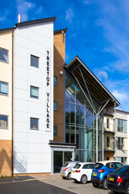
YHN current housing and services for older people….

Slide 6
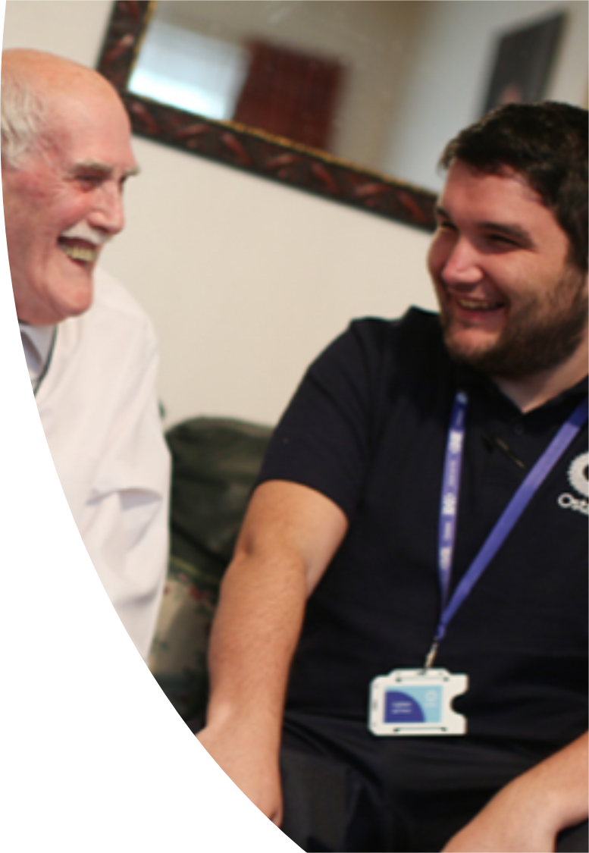
Ostara …. YHN’s mobile response and support service in Newcastle.
In house 24/7 call handling and monitoring.
24/7 Mobile response team.
Dedicated Ostara assessors to assess customers needs and recommend products.
Skilled staff able to install equipment.
2 different levels of priced service tailored to customers preferences.
Individual service offers to businesses and other landlords.
High performing service accredited by TSA

Slide 7
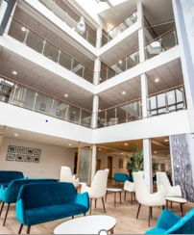
Housing Plus Vision…..
YHN intends to revolutionise how it provides services which supports successful living for older people. The Housing Plus vision is the strategy which details our approach and reflects our purpose to make living easier.

Slide 8
Working with the Housing Lin
Housing Plus Strategy based on local evidence, national trends, predicted trends and customer characteristics.
Focus groups with YHN tenants living in general needs and age-designated housing including sheltered housing and extra care.
a sample of older Asian/British Asian Newcastle residents and some LGBT+ YHN residents.
Staff/stakeholder perspectives
…. data on the views and aspirations of older people on current and future needs and preferences in relation to housing and support services.

Slide 9
Implications of the evidence
Older people are seeking greater diversity in support and services offered.
Menu of services including a contemporary telecare offer, advice, practical help and access to social interaction.
Support Services should be extended to people living in general needs homes and not just age designated homes.
More attractive age designated accommodation to appeal to older people in the future.

Slide 10
North East Ambulance Service and YHN Pilot….
Long standing partnership with Newcastle Gateshead CCG since September 2018
YHN respond to 999 calls from uninjured fallers across Newcastle
Aims:
Reduce pressures on NEAS
Improve patient experience- reduce wait time (can be 4-8 hours for uninjured fallers), knock on implications of ‘long lie’)
Outcomes:
Wait time reduced to an average of 22 mins
Added value; reassurance, follow up visit, contact with next of kin
Reduction in hospital admissions
Referral to existing Falls Pathway

Slide 11
For further information
Helen Neal Assistant Director Supported Services – helen.neal@yhn.org.uk
Helen Sammut-Smith Senior Manager Housing Plus – helen.sammut-smith@yhn.org.uk
Website- www.yhn.org.uk
Website- www.ostara.org.uk

