Slide 1
What makes a good housing development Lee Heley Head of Housing Growth Essex County Council 11 June 2019

Slide 2
Introduction
> Start with people
> Understand the system
> Manage the process
> Stick with it

Slide 3
Start with people
Over 75
Health condition
Care package

Slide 4
75+ population
In Essex

Slide 5
Understand the system
Landlord
Planning
Land owner
Housing department
Care provider
Social Care
Benefits
Funders
Demand from people
Build Contractor

Slide 6
Manage delivery
Social Care
Planning
Housing
Land owner
Landlord
Demand from people
Care provider
Funders
Benefits
Build Contractor

Slide 7
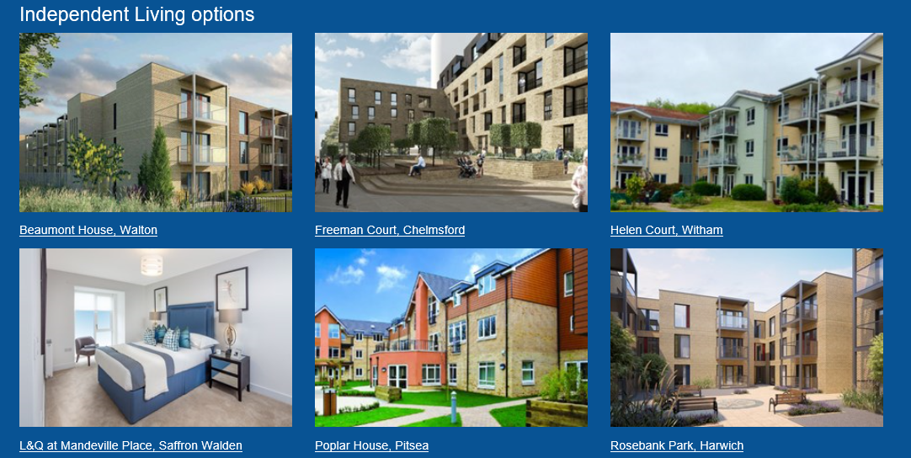
Stick with it

Slide 8
Summary
Notes:
In summry: What are the lessons from working with the county and the district?
Having a housing function in the county helps. It is a bridge between the county and the district. It shows that we have common objectives.
Capacity remains a major constraint. Some districts are well resourced, others much less so. Ability to drive housing growth, garden communities, and respond to homesslessness issues. Be ready to use it flexiblty.
Recognise that we share the same territory. District and the county are in the same place – in Essex. We have the same residents. We have different legal responsibilities – but if we dial down our egos, we can see that we are stronger delivering together. It is not “us” and “them”, it is “we”, even if “we” disagree sometimes.
I started by noting that climate change is very much in the news. The international approach to reducing climate changes was to agree a common goal, and ask different nations to pledge their contribution, and then for them to work out how to deliver that.
We can learn from this in housing. To agree we have common goals: housing growth, great places, ending homelessness. And that we can each contribute differently to reach those goals.

