Slide 1

----------
Angela Currie
Director of Operations
----------
Notes:
Share with you some of our new approaches

Slide 2
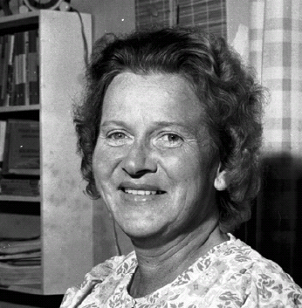
Our History
Founded in 1972 by Dr Margaret Blackwood MBE
Campaigner for the rights of disabled people
Accessible, bespoke housing where people need it
Technology and equipment to promote independence
“People can determine the paths of their own lives if they are granted a voice”
Notes:
Diagnosed with Muscular Dystrophy at an early age. Famously led a protest march in Princes Street with wheelchair users because of the lack of facilities for people with disabilities.

Slide 3
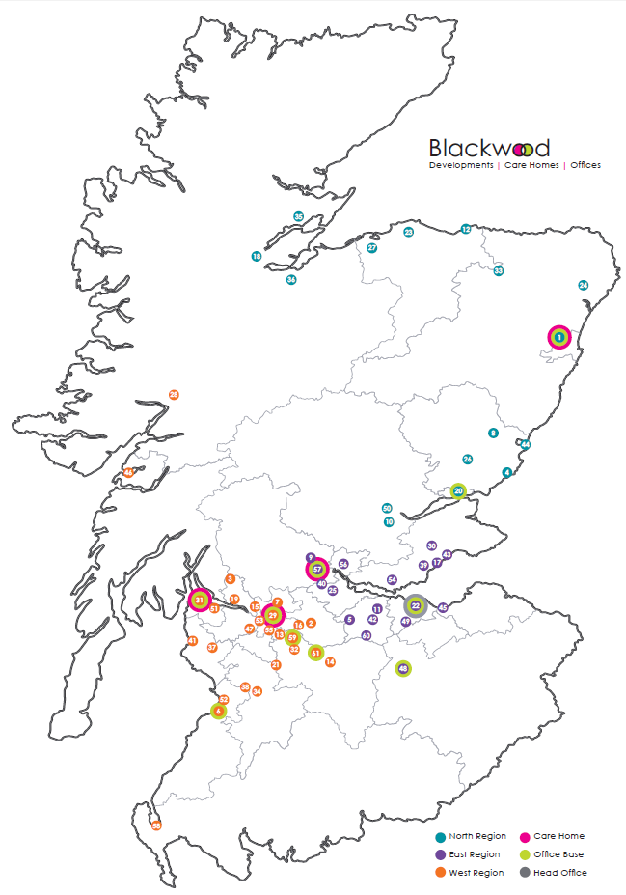
Our Geography
1535 homes
29 local authorities
4 residential care homes
11 care at home / housing support services
Notes:
One big challenge we have is being in 29 of Scotland’s local authorities
All mainland local authorities!
Margaret helped her original customers by buying them properties where they wanted to live and adapting them to suit their needs
Not a business model you would choose today!
What do you think the challenges are?
- Travel
- 30 developments with 5 or less properties
- Average development size: 15
- Consistency of service
- 29 different approaches to things like welfare reform

Slide 4
Tenant Profile
Notes:
Drivers……

Slide 5
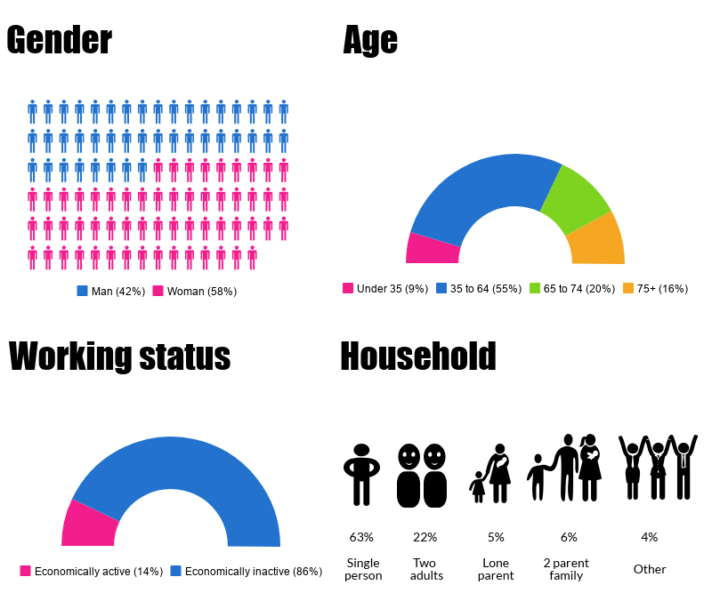

Slide 6
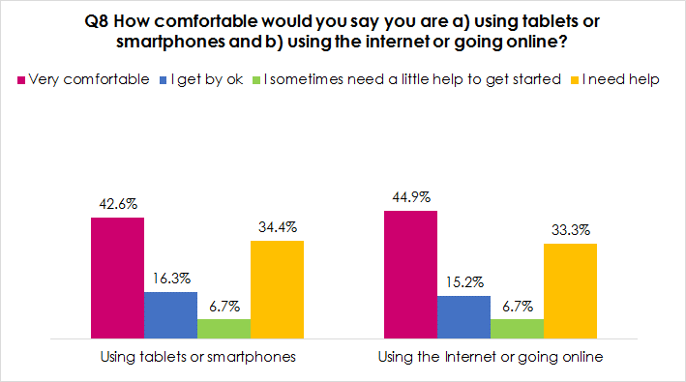

Slide 7
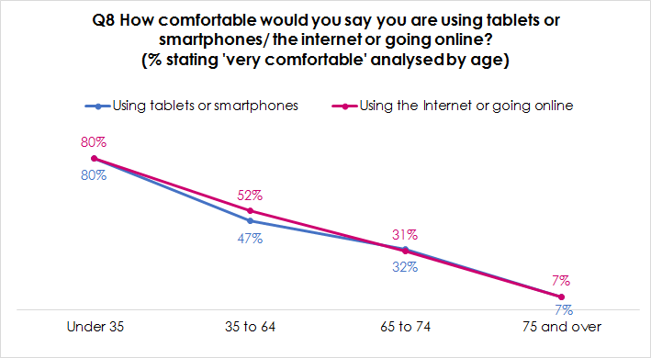

Slide 8
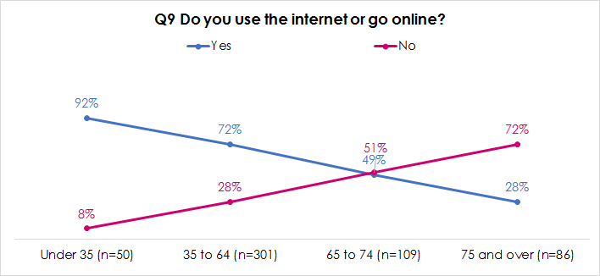

Slide 9
Independent Living Offer
Homes
Care
Housing Service
Notes:
Drivers……

Slide 10
Homes
Notes:
Drivers……

Slide 11
Design Guide
Higher spec than current Housing for Varying Needs standard
70m2 floor space (for 2 bed)
Co-production approach
Higher cost – higher subsidy required
Online version of the guide https://www.blackwoodgroup.org.uk/our-homes
Notes:
Beautiful philiosophy

Slide 12
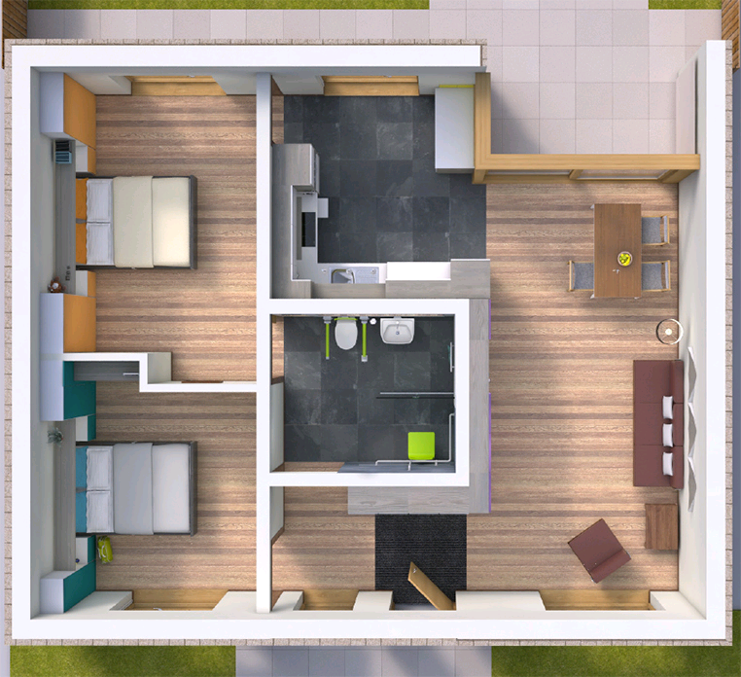
Blackwood Design Guide
INSERT PICTURE OF FRONT PAGE??
Notes:
Beautiful philiosophy

Slide 13
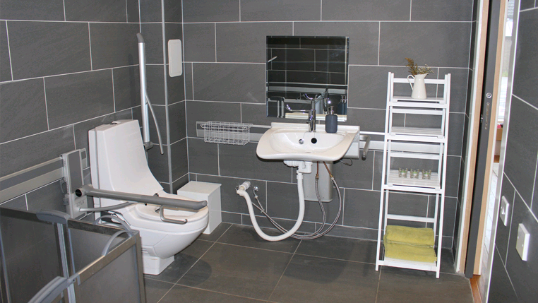
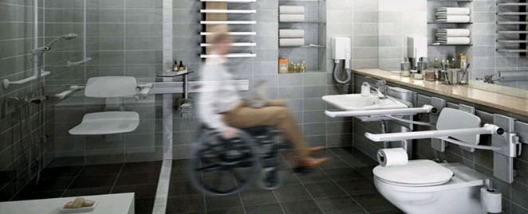
Blackwood House
Notes:
Beautiful philiosophy

Slide 14
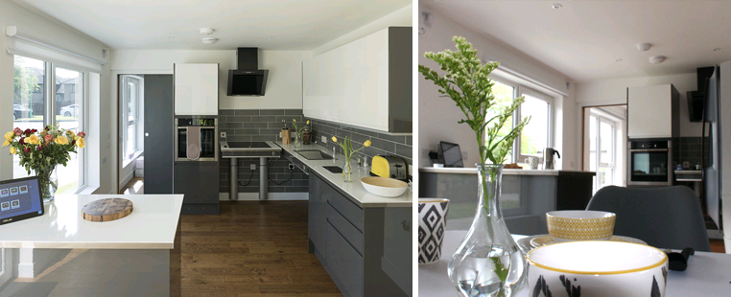
Blackwood House
Notes:
Beautiful philiosophy

Slide 15
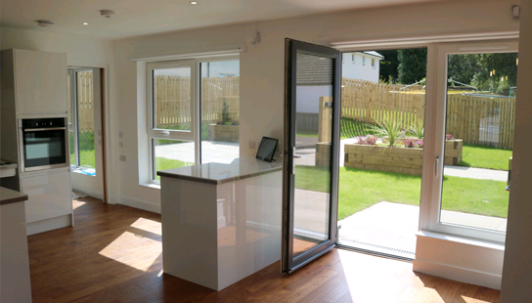
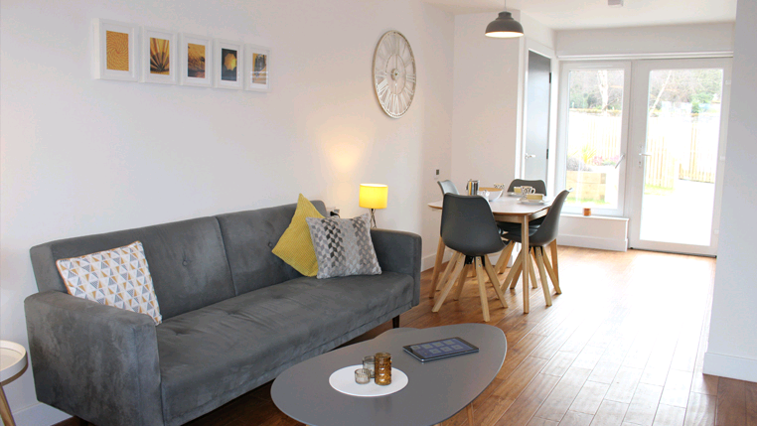
Blackwood House
Notes:
Beautiful philiosophy

Slide 16
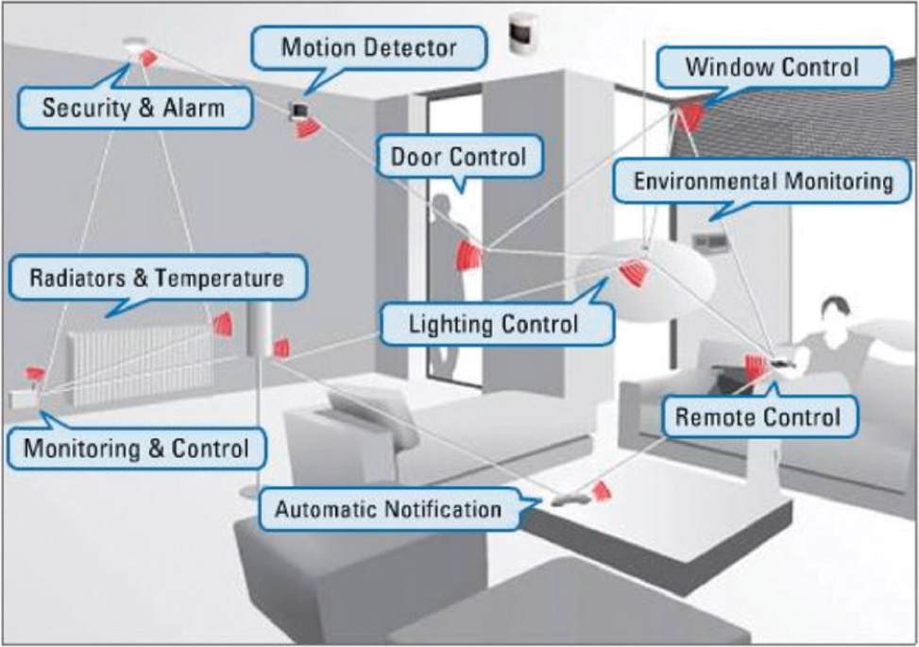
Home Automation

Slide 17
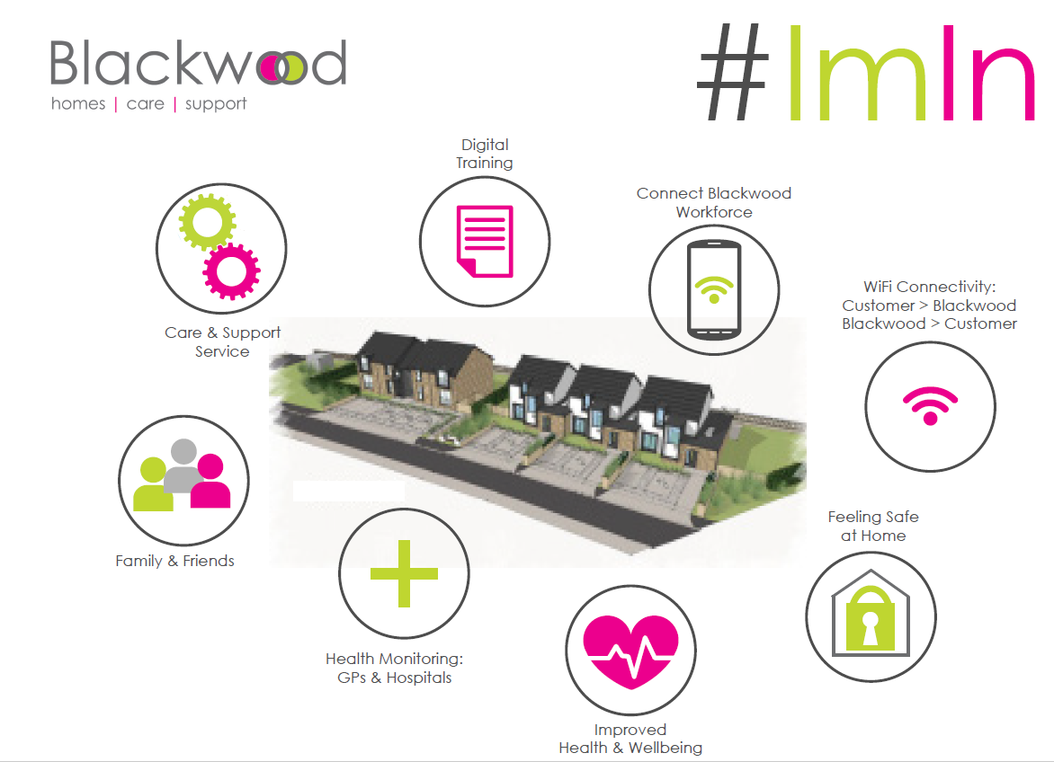
Neighbourhood
Notes:
Beautiful philiosophy

Slide 18
Blackwood Independent Living Offer
Housing Service
Notes:
Drivers……

Slide 19

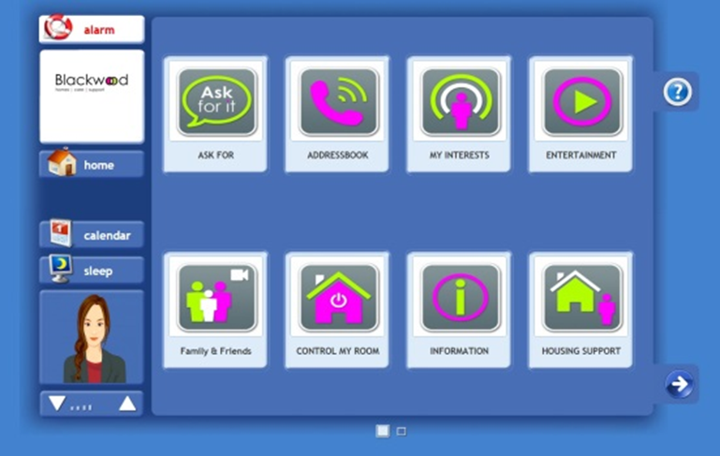

Service for Tenants
Wi-fi: rolling out to all homes
Device – tablet for all tenants
Training & Support – tailored to suit needs
Housing APP - repairs reporting, rent payment in development
Handyperson: trying out a few approaches being mainstreaming
Notes:
Existing Homes: review our planned maintenance programme

Slide 20
Blackwood Independent Living Offer
Existing Homes
Notes:
Drivers……

Slide 21
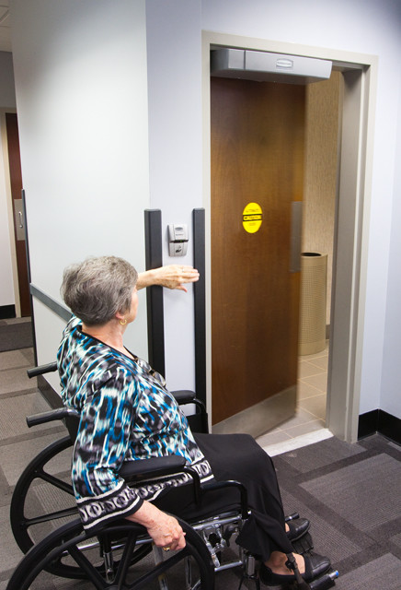
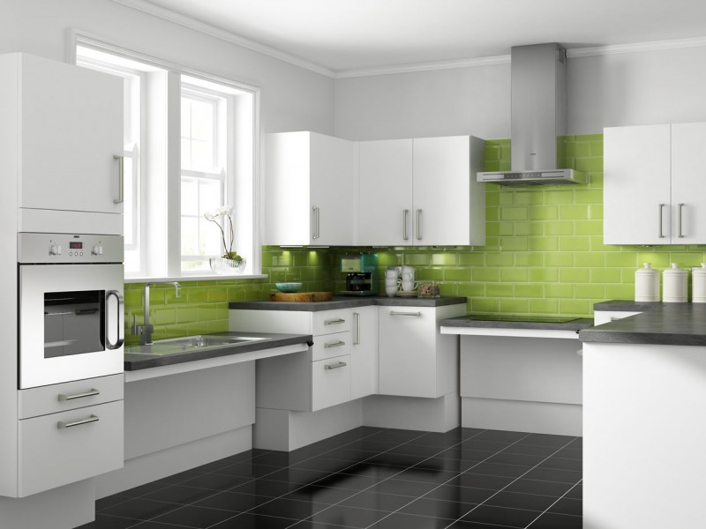
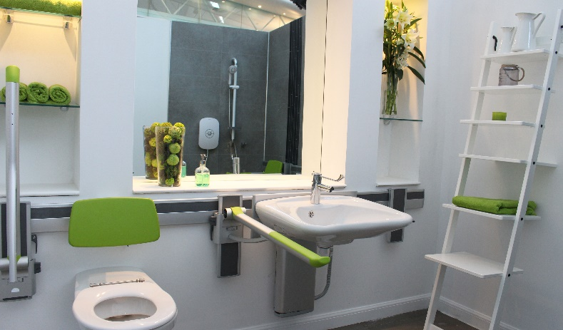


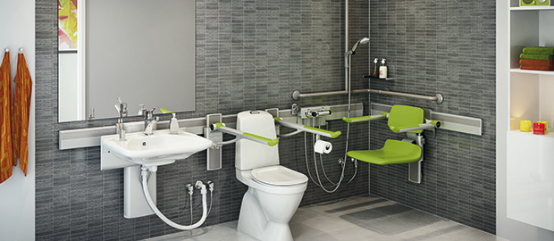
Future of Planned Maintenance?
Notes:
Existing Homes: review our planned maintenance programme

Slide 22
Blackwood Independent Living Offer
Care Service
Notes:
Drivers……

Slide 23
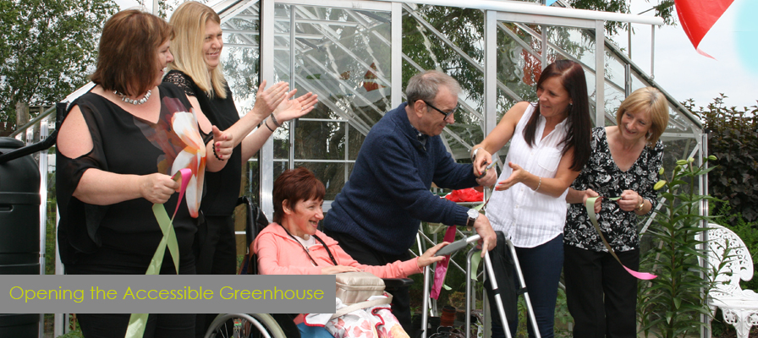
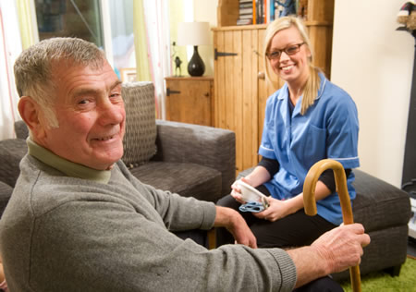
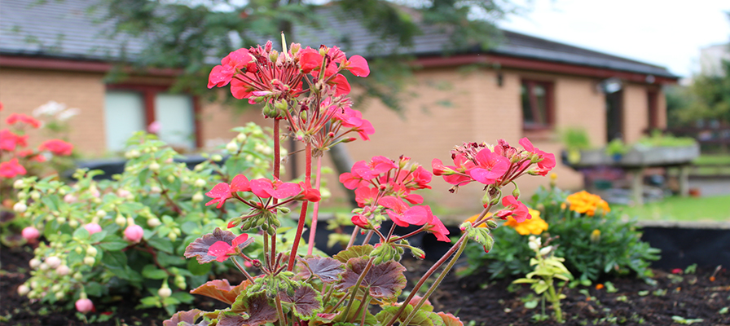
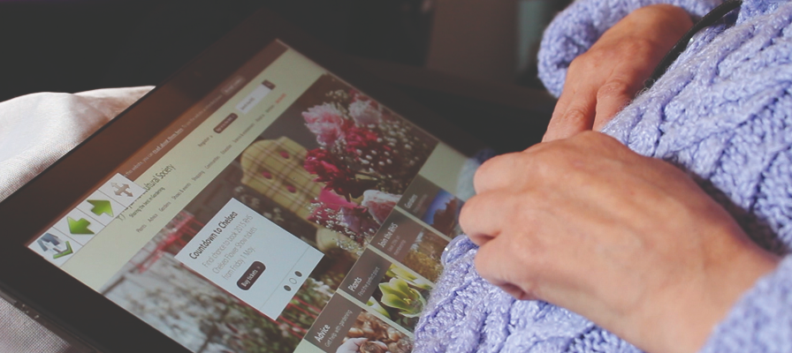
Care Services
Care Homes
Care at Home & Housing Support
Notes:
The system is cloud based - fully digital end to end
Customer touchscreen ‘hub’ – more choice and control
Staff mobile app – fully remote working/planning
Live video and audio – triage situation
Customisable responses
Update care notes in the ‘field

Slide 24

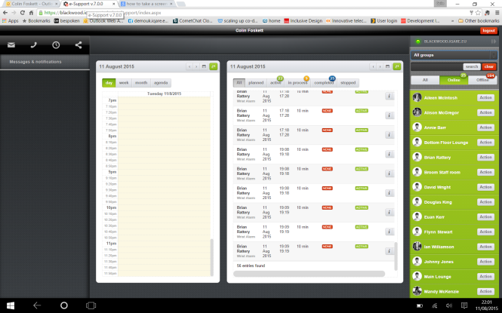
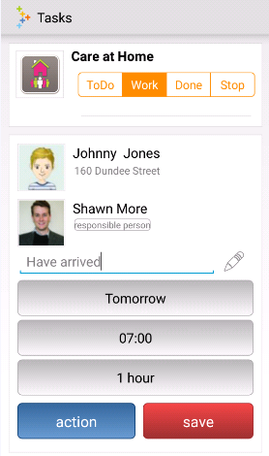
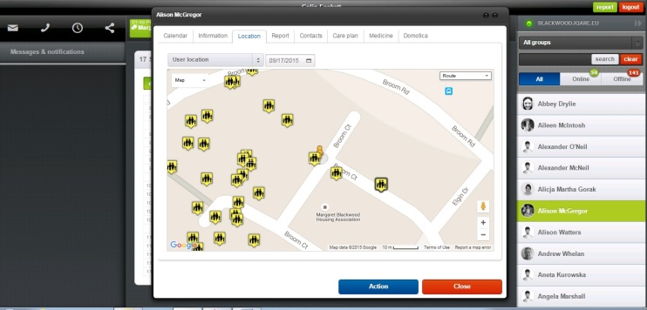
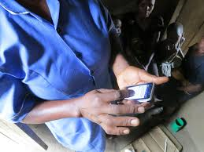
TEC: CleverCogs
Customer’s Home Hub
Care Service Management
Employee’s Phone & APP
Notes:
The system is cloud based - fully digital end to end
Customer touchscreen ‘hub’ – more choice and control
Staff mobile app – fully remote working/planning
Live video and audio – triage situation
Customisable responses
Update care notes in the ‘field

Slide 25

https://techousing.co.uk/
Notes:
Contact Colin or Angela or our New Business Manager, Elaine Rose.
Our contact details are at the stand.

Slide 26
7 TEC PLEDGES
1 Opportunity And Solution Focused
We will clearly define the issues we face in meeting customer needs and understand the opportunities TEC can bring.
2 Engaging With The Customer
As more of our customers are living longer and often in poor health, we will maximise the benefits that TEC solutions can bring.
3 Working In Partnership
We will share ideas with others and work collaboratively with colleagues in our own organisation, as well as the wider housing sector, allied professions, universities and other research institutions.
4 Preventative Analytics
We will work in partnership with customers and others, including health and social care colleagues (commissioners and providers) to investigate the use of preventative analytics to achieve the greatest impact for vulnerable people.
5 Service Redesign
We will use technology as a key element of service redesign, providing preventative and supportive TEC solutions for existing and future customers, so that we produce better outcomes for individuals and their families and/or carers.
6 Supporting The Workforce
We will provide leadership and support staff to enable them to adapt to the changes brought about by TEC. We will give our staff opportunities to increase their knowledge of the role of TEC and digital healthcare.
7 Getting The Infrastructure Right
We will think ahead and ensure we obtain the advice and support we need to enable good decision-making when investing in any technological infrastructure or equipment used for delivering TEC solutions.
Notes:
Contact Colin or Angela or our New Business Manager, Elaine Rose.
Our contact details are at the stand.

Slide 27
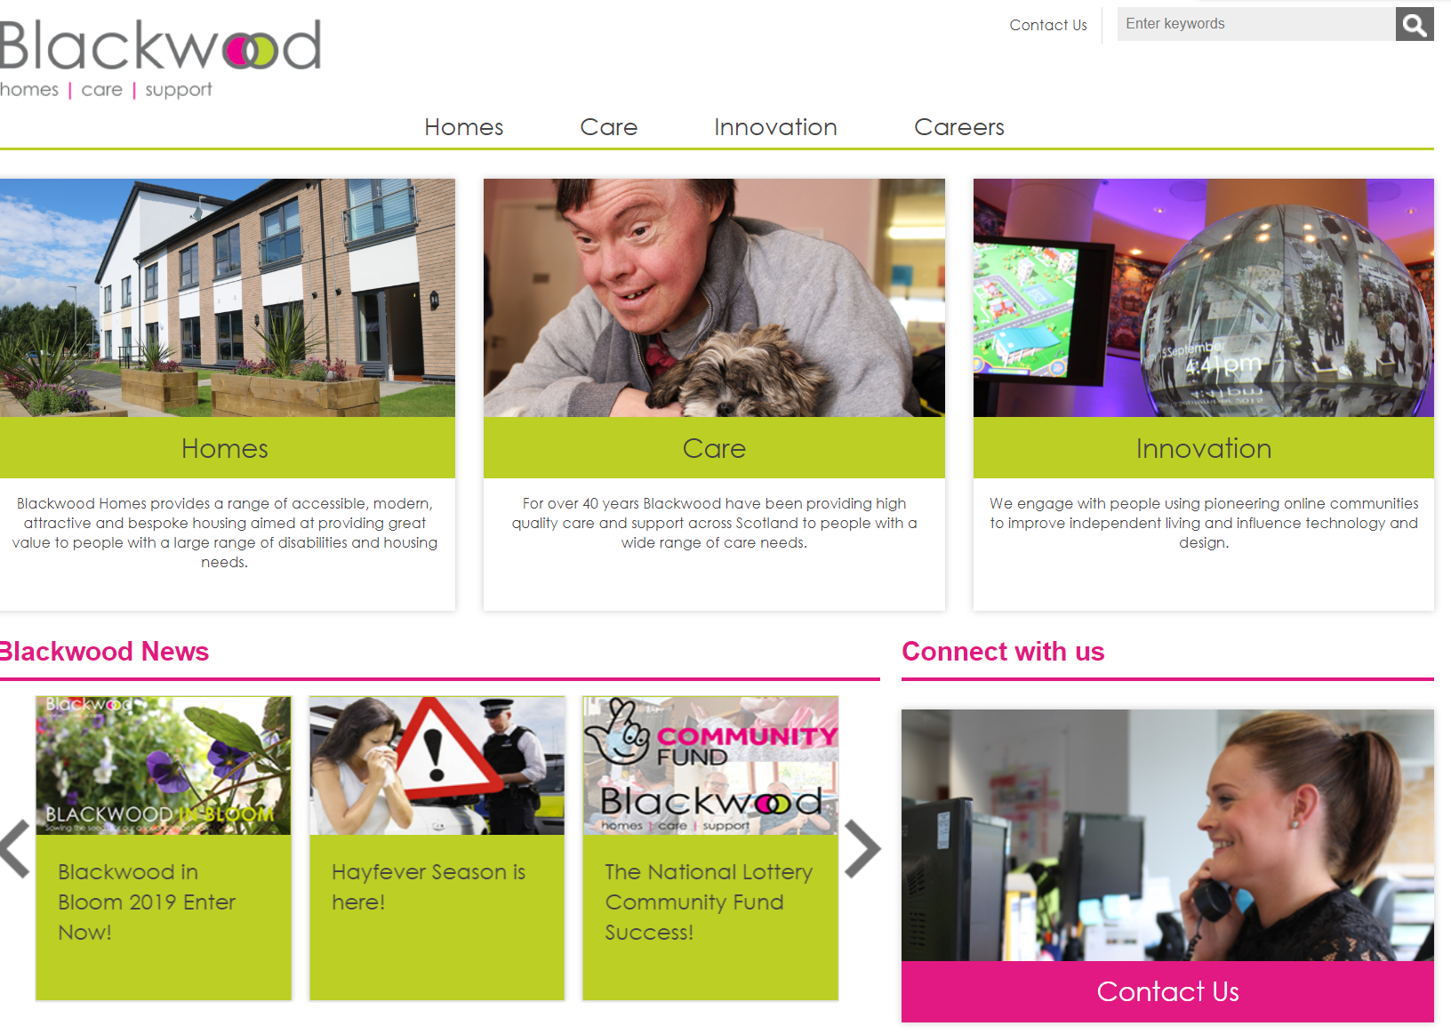
www.blackwoodgroup.org.uk
angelacurrie@blackwoodgroup.org.uk
Notes:
Contact Colin or Angela or our New Business Manager, Elaine Rose.
Our contact details are at the stand.

