Slide 1
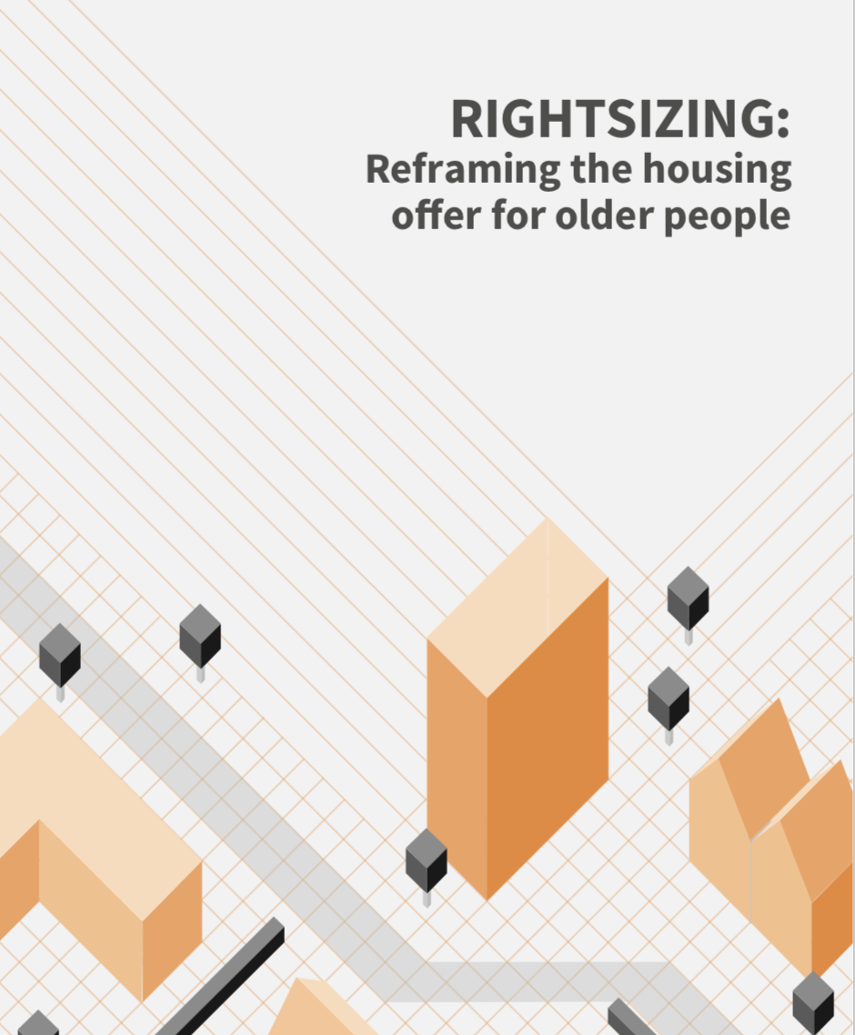

Dr Mark Hammond
Manchester School of Architecture
GMCA/GM Ageing Hub
Developed with:
Prof. Stefan White
Dr Stephen Walsh

Slide 2
Downsizing is a problematic term.
  People (still) talk about downsizing as a solution to a problem – under-occupancy / ‘family homes’
  This distracts from the lack of suitable alternatives; the financial inequality within the older population; and their agency in deciding which environment best serves their needs. Medicalisation of older people.
  Our working definition of rightsizing is that it is an older person’s active, positive choice to move home as a means of improving their quality of life.

Slide 3
Not many older people move home
  Just 3.4% of people aged 50 and over move home per year - under 50s are twice as likely to move.
  Research shows significant unmet demand – so why don’t more people move?
  Decision to move or not – ‘option recognition’
  Present and (perceived) future situation – personal and environmental.
  Not bricks and mortar comparison. Takes into account emotions, aspirations, social connections, the process of moving.

Slide 4
Person
  Age (young old/older old)
  Health factors
  Life-course transitions (divorce, retirement, marriage, loss of partner)
  Tenure: PRS 3 times more likely to move/ Effect of high mortgage debt
Environment
  Same as everyone else – quality, location, running cost, space.
  Quality of home and neighbourhood (HAPPI)
  Accessibility
  … but individual factors are not good predictors

Slide 5
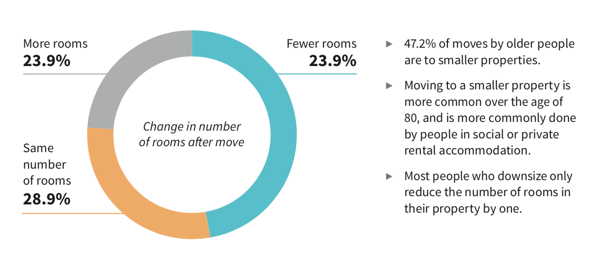
Data: The moves that people make
British Household Panel Survey/Understanding Society
People aged 50 and over who have moved home in the last year
N=3364
47.2%

Slide 6
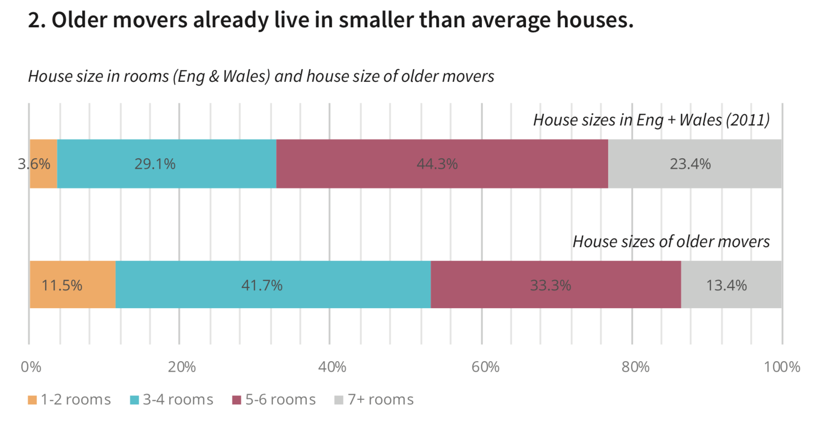

Slide 7
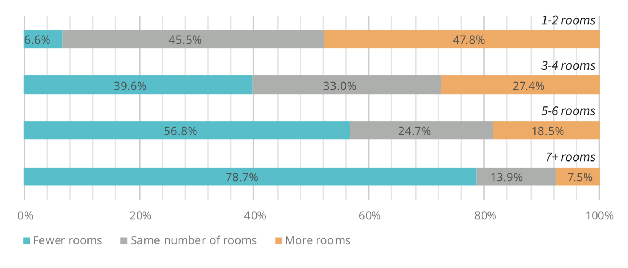

Slide 8
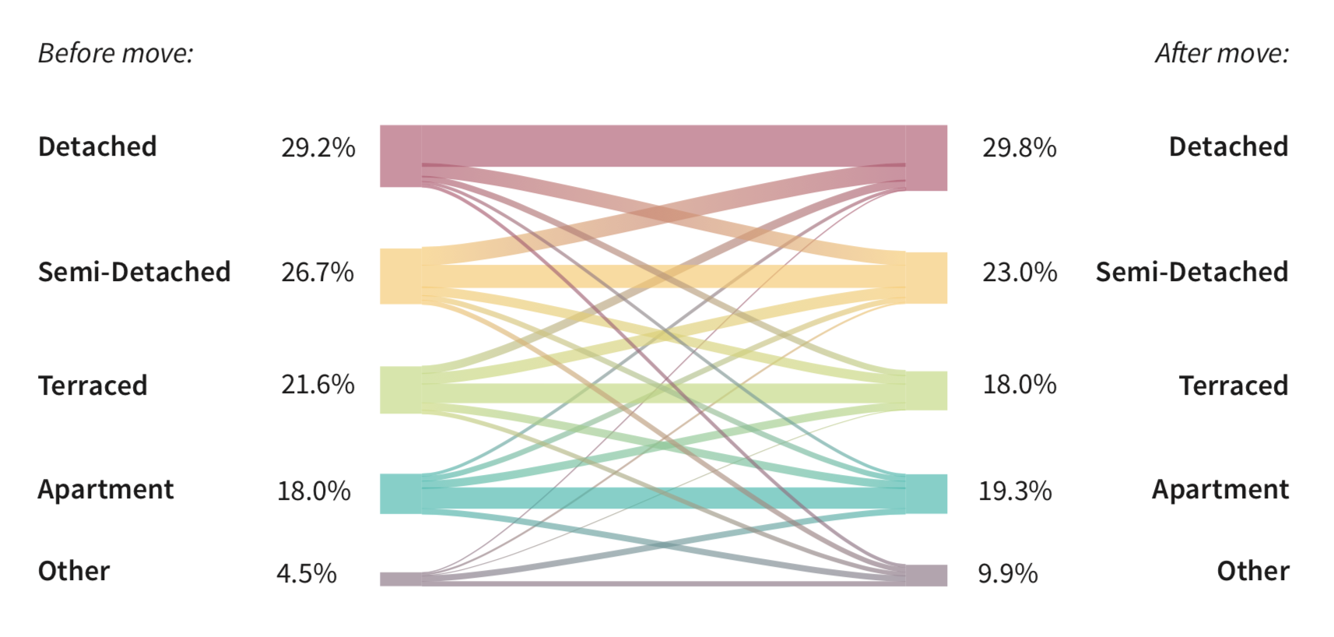

Slide 9
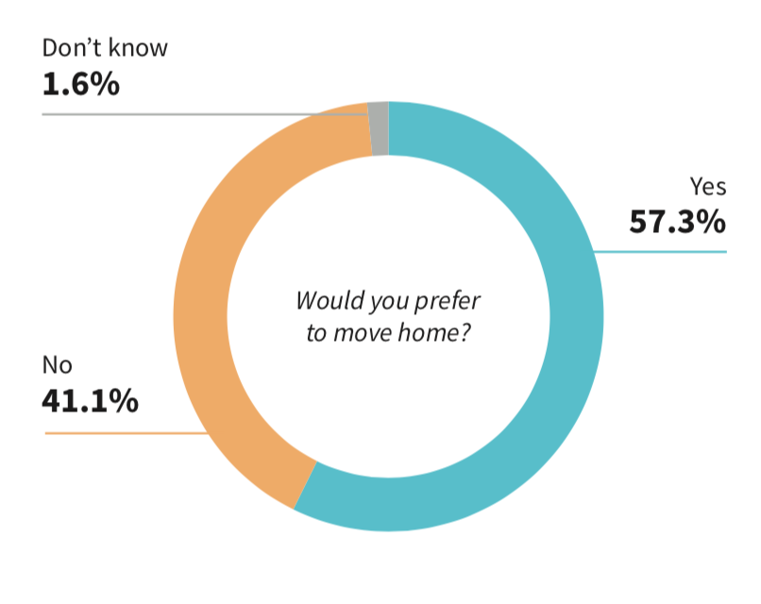
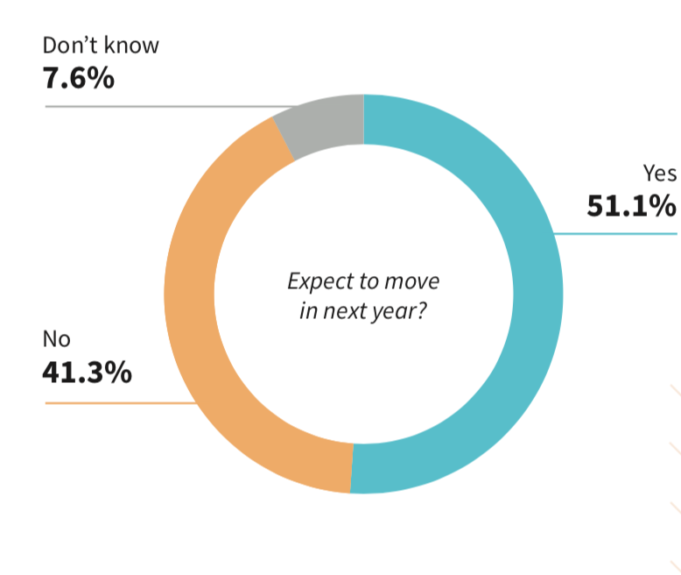

Slide 10
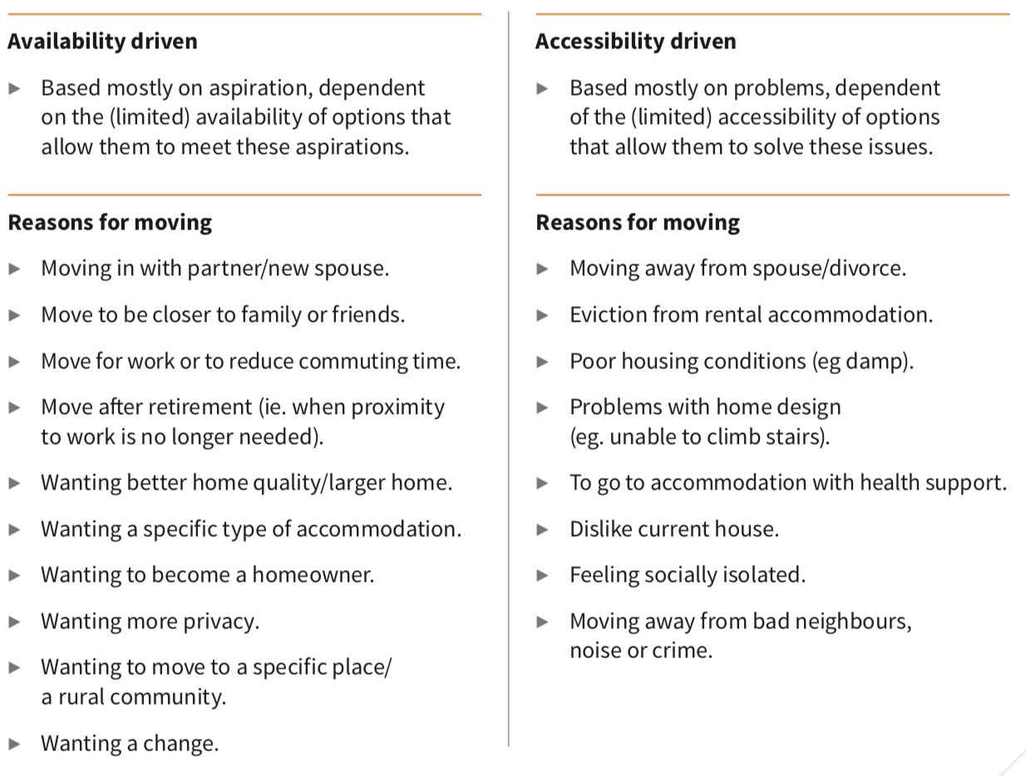

Slide 11
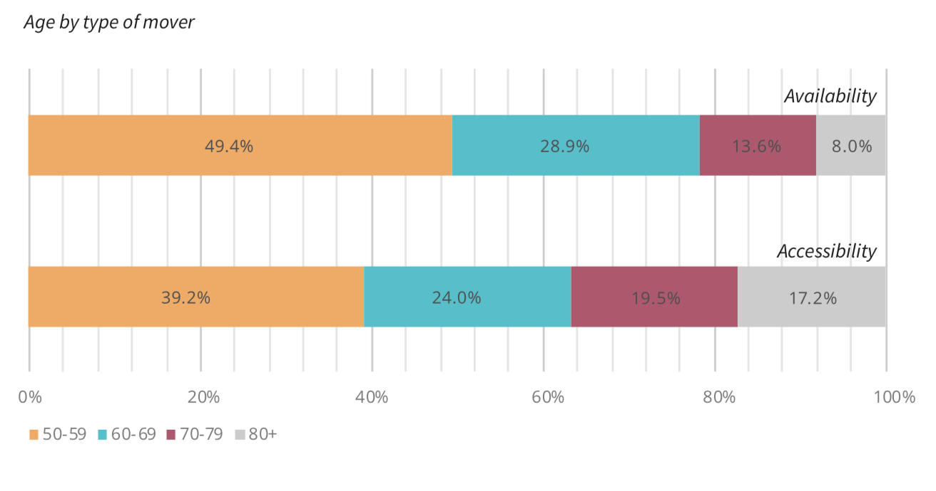

Slide 12
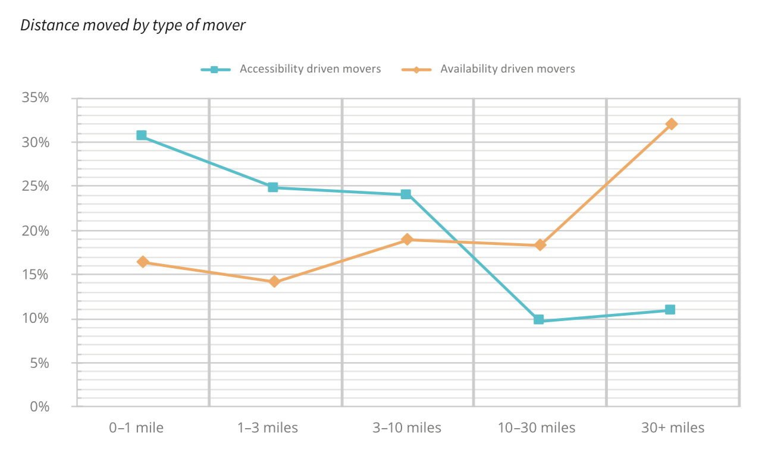

Slide 13
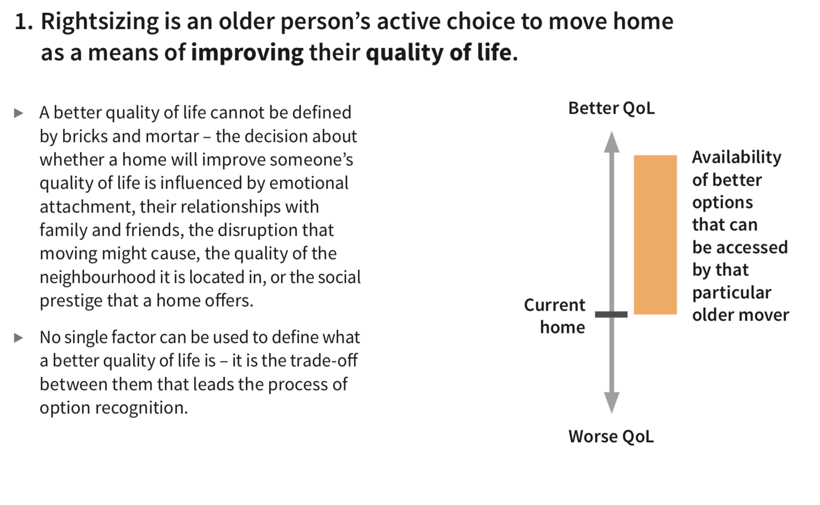
  Not which ‘building’ is better – social links, emotional connection, prestige, disruption.

Slide 14
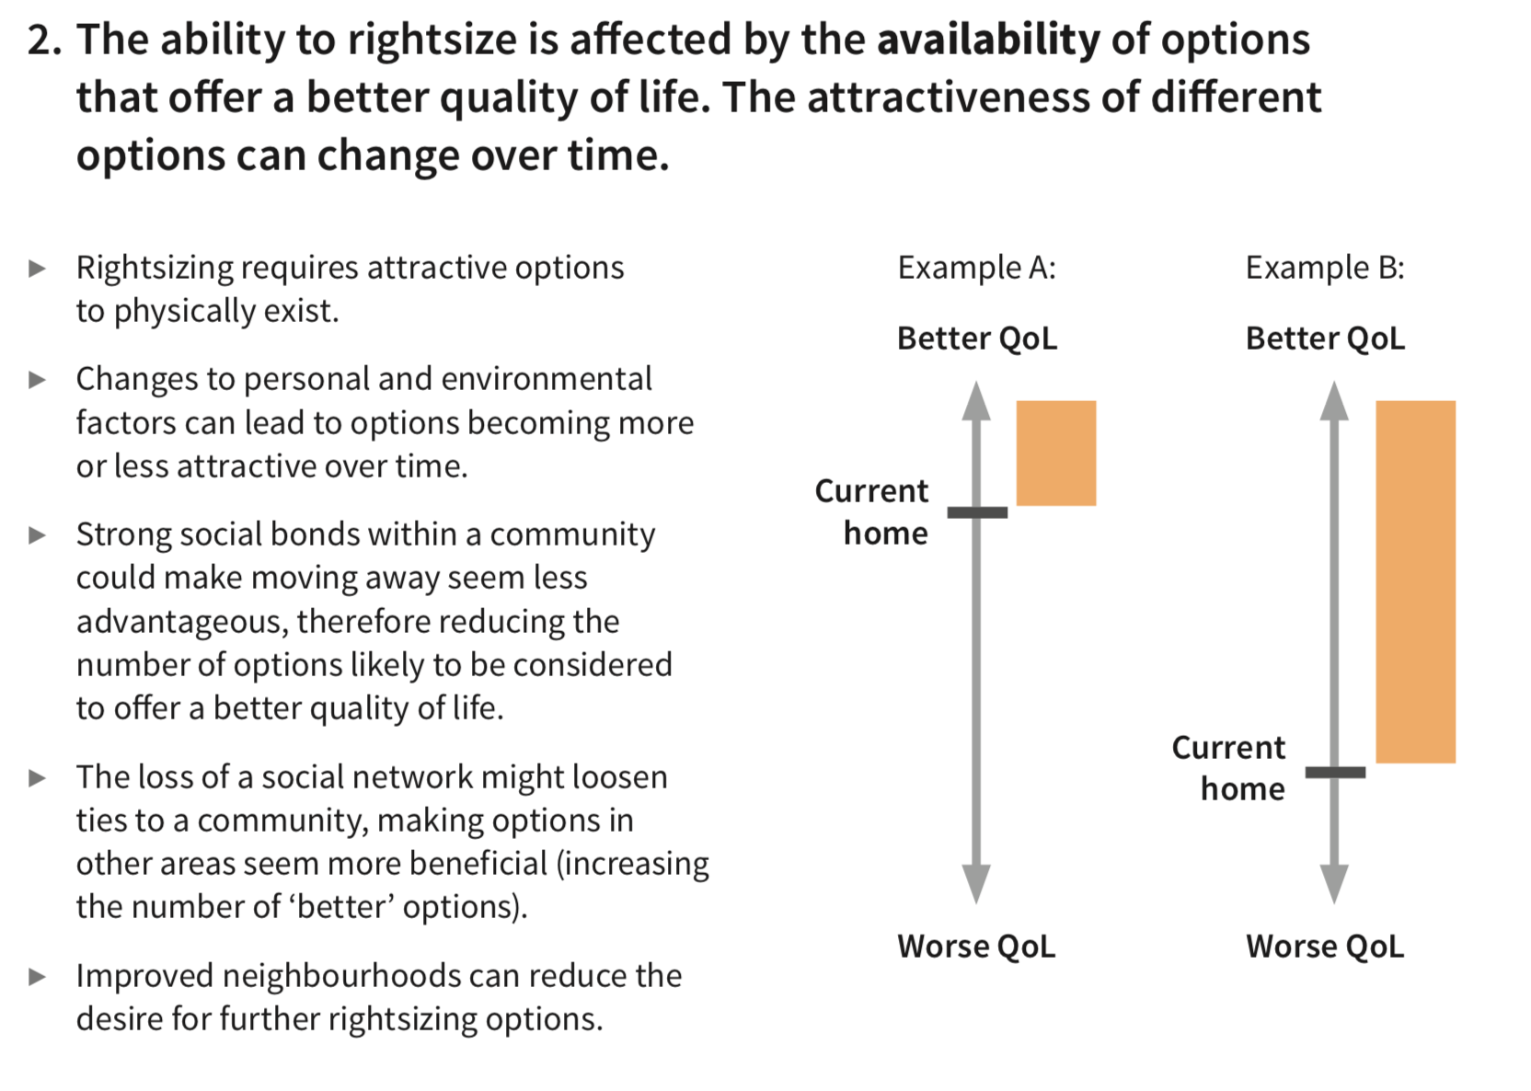
  Requires a better option to actually exist
  Life changes can mean that ‘better’ changes
  A: Family moves closer
  B: Family moves away

Slide 15
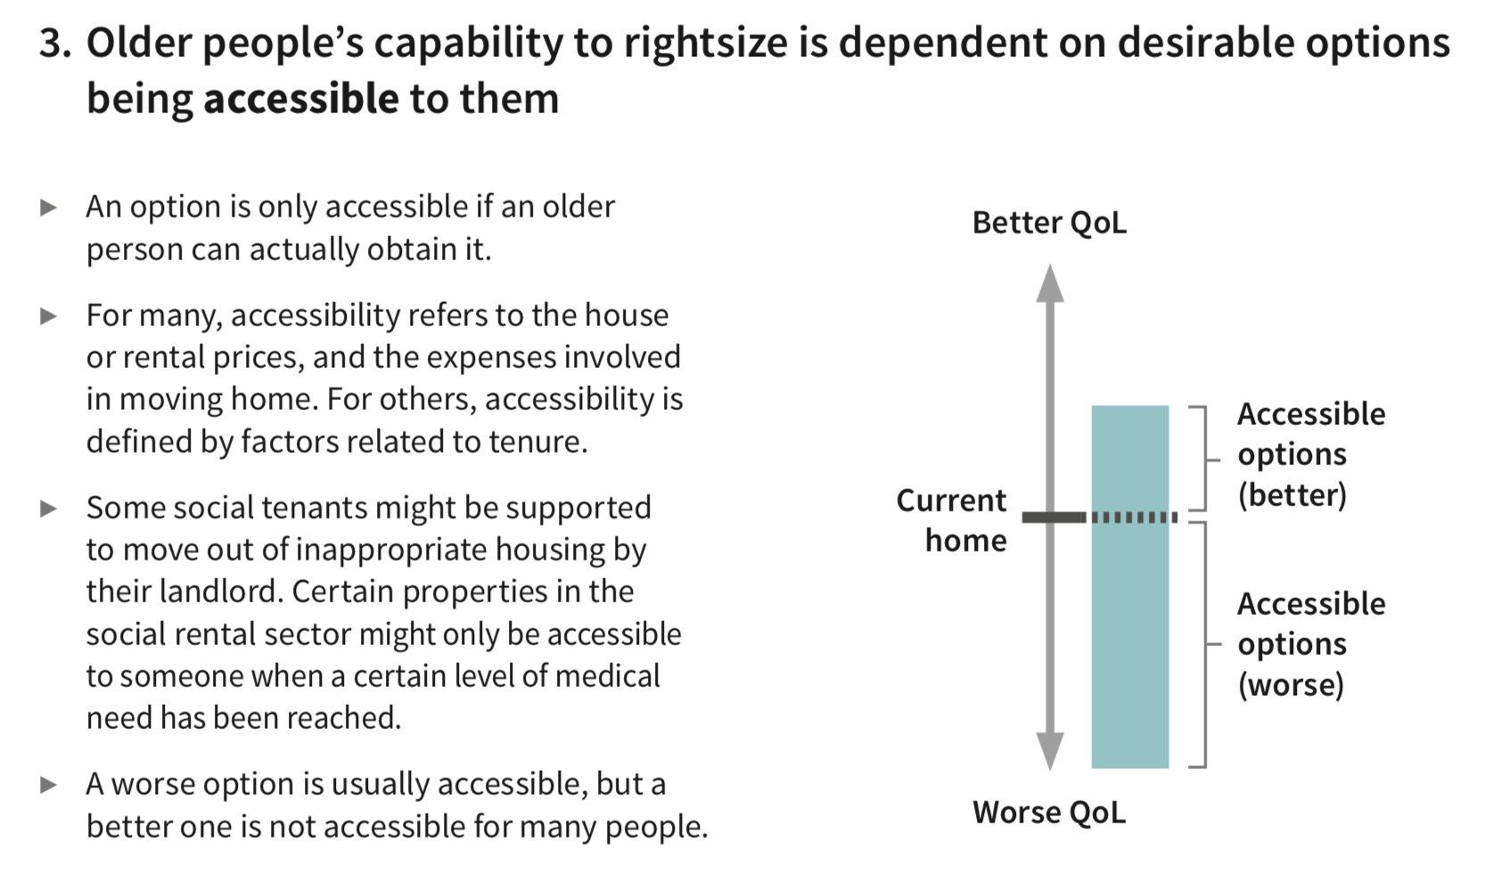
  Option is accessible when people can obtain it.
  House price, rental cost, tenure controlled, medically applicable, local covenants
  Worse options are usually accessible, better ones sometimes aren’t

Slide 16
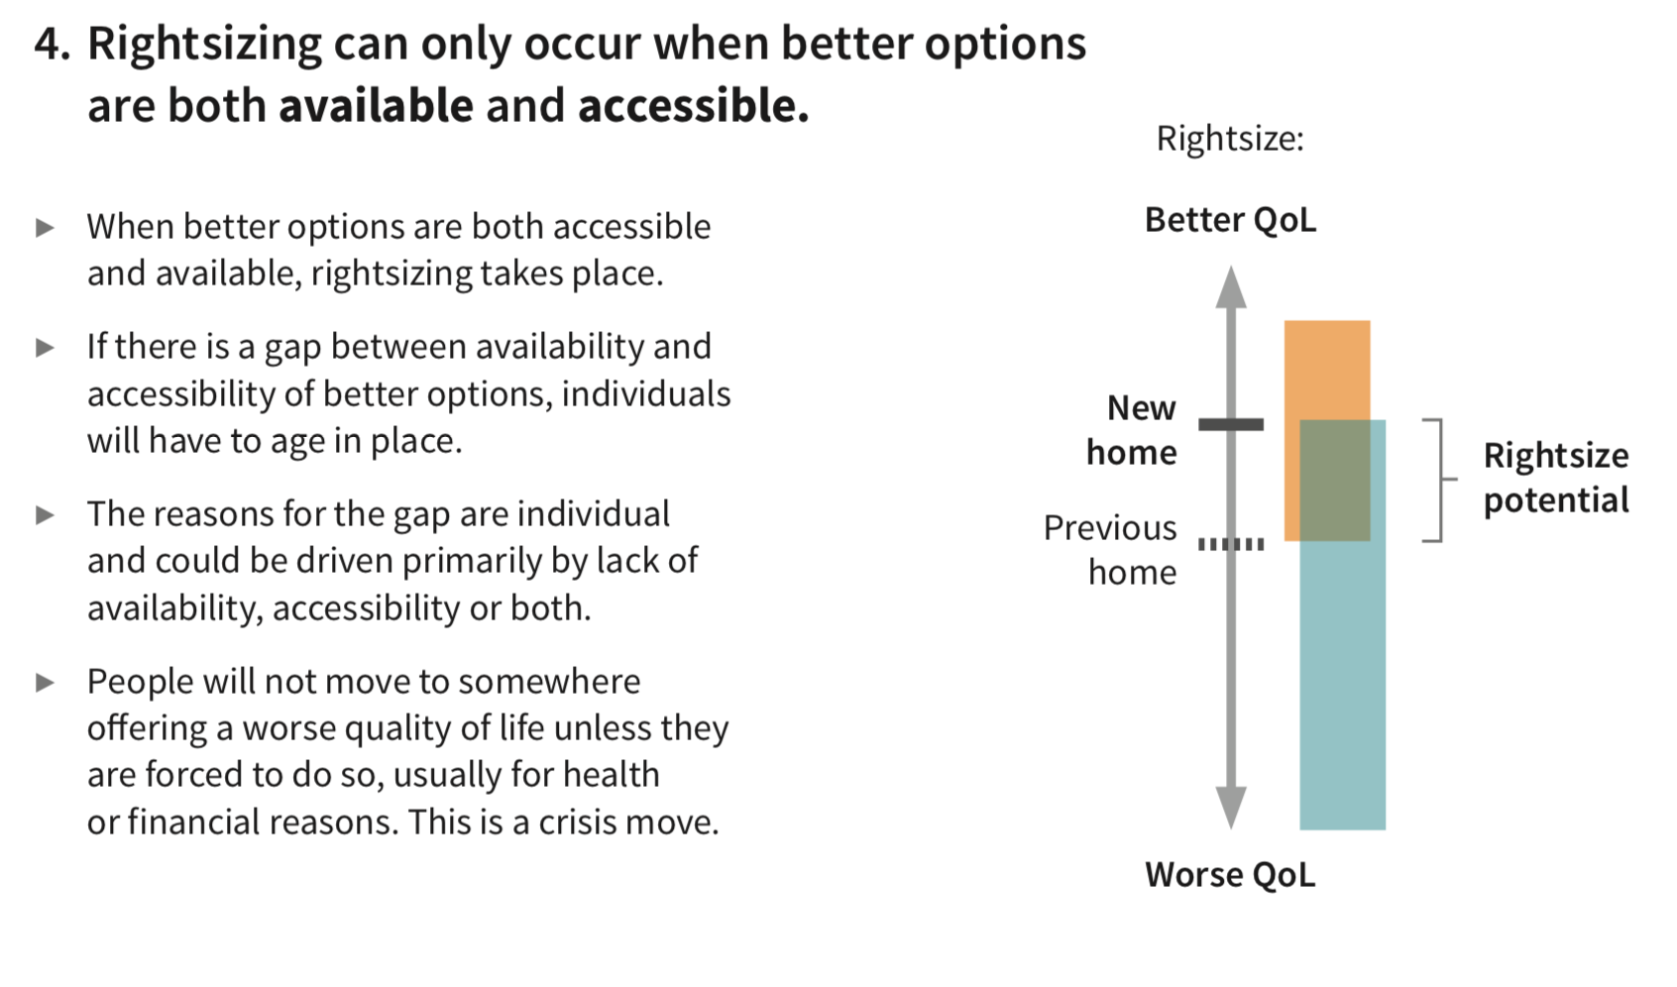
  When an option is available and accessible, there is potential to rightsize.
  The majority of people sit within the ‘rightsizing gap’

Slide 17
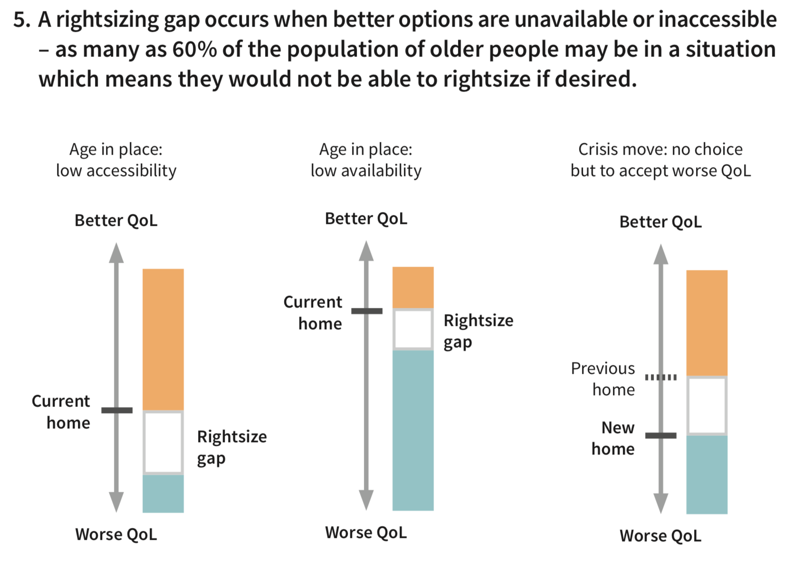
Notes:
Older parents who live with their adult children. There are 3.35m adults (aged 20-35) who currently live with their (older) parents (Bone, 2014, p. 3).
Those seeking to make proactive, midlife moves in social rental accommodation, due to high demand from people with higher needs for support.
Those seeking low levels of formal or informal social support, who o en end up in specialist housing with higher levels of care than desired. (Pennington 2013).
Older people with low levels of savings or income, who struggle to a ord removal services, stamp duty, survey, legal fees or rental deposits (Pannell et al., 2012, p. 44).
Increasing numbers of older private renters, for whom the loosely regulated private rental market provides few protections or support in changing circumstances.

Slide 18
Recommendations:
  Ensure housing strategies respond to the availability and accessibility of rightsizing locally.
  Develop and share rightsizing insights with older residents, housing providers and developers.
  Enable physical and financial accessibility for new and existing housing options.
  Develop cooperative neighbourhood and housing models across tenures.
  Follow-up study in 2019-2020 with GMCA, working with local authority planning teams to explore these issues.

Slide 19
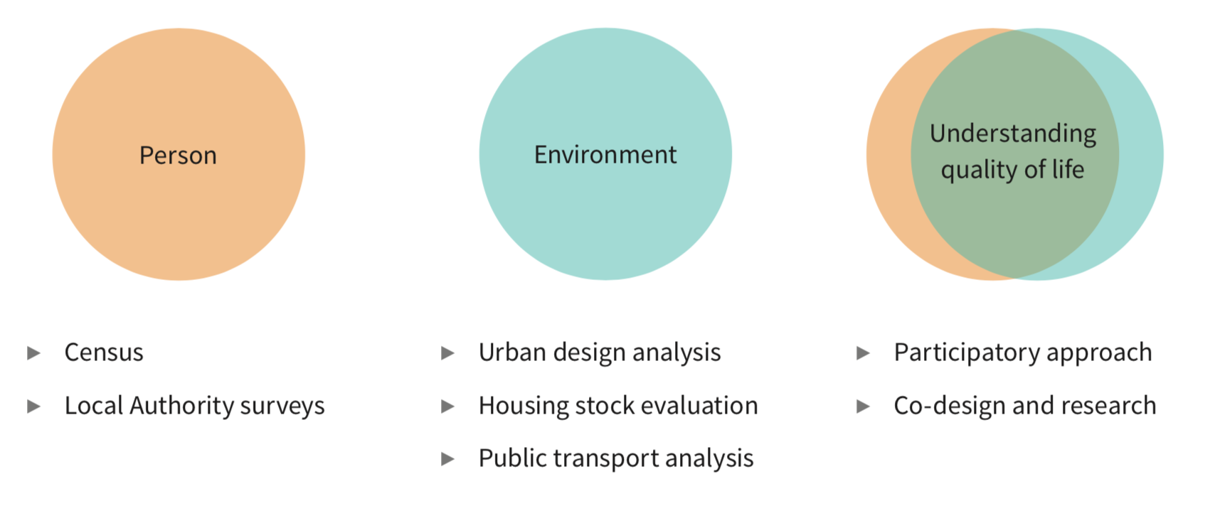

Slide 20
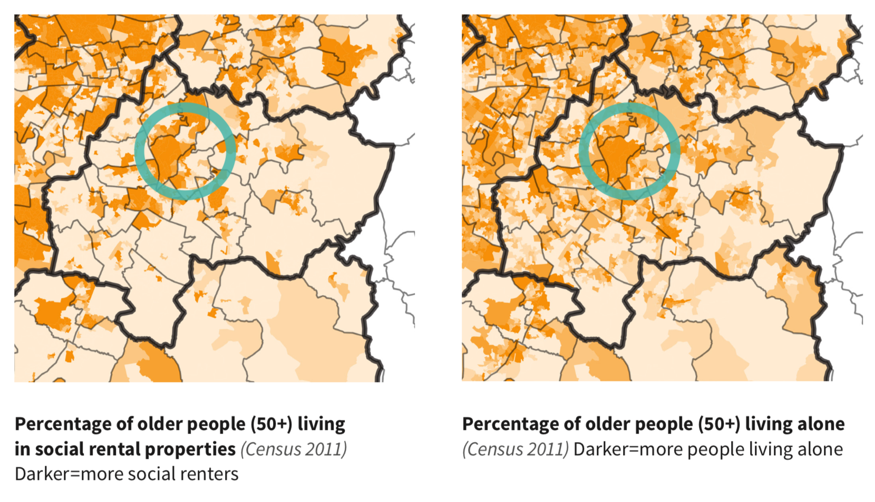

Slide 21
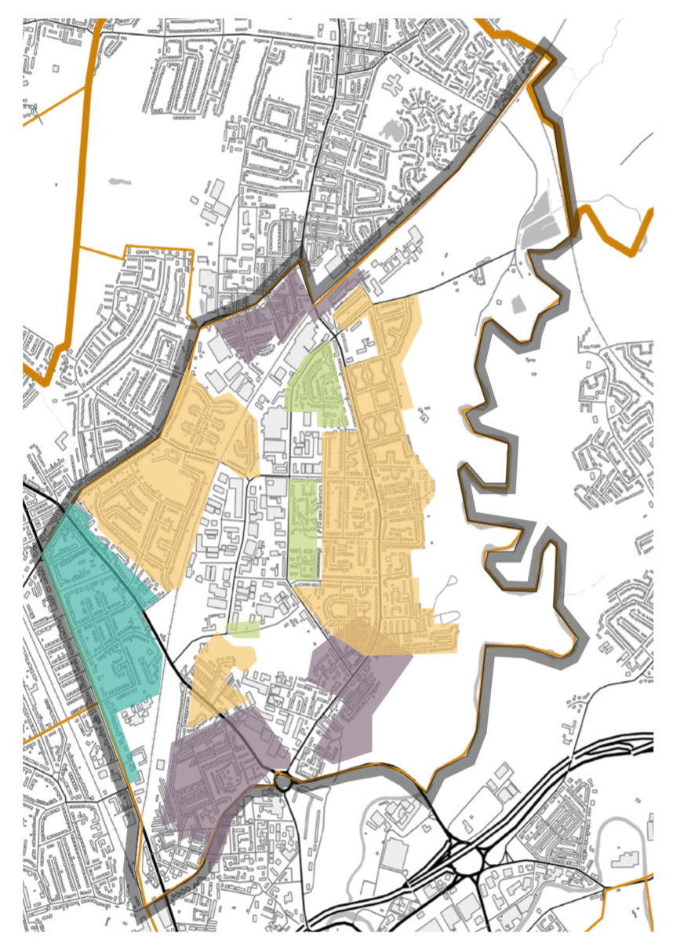

Slide 22
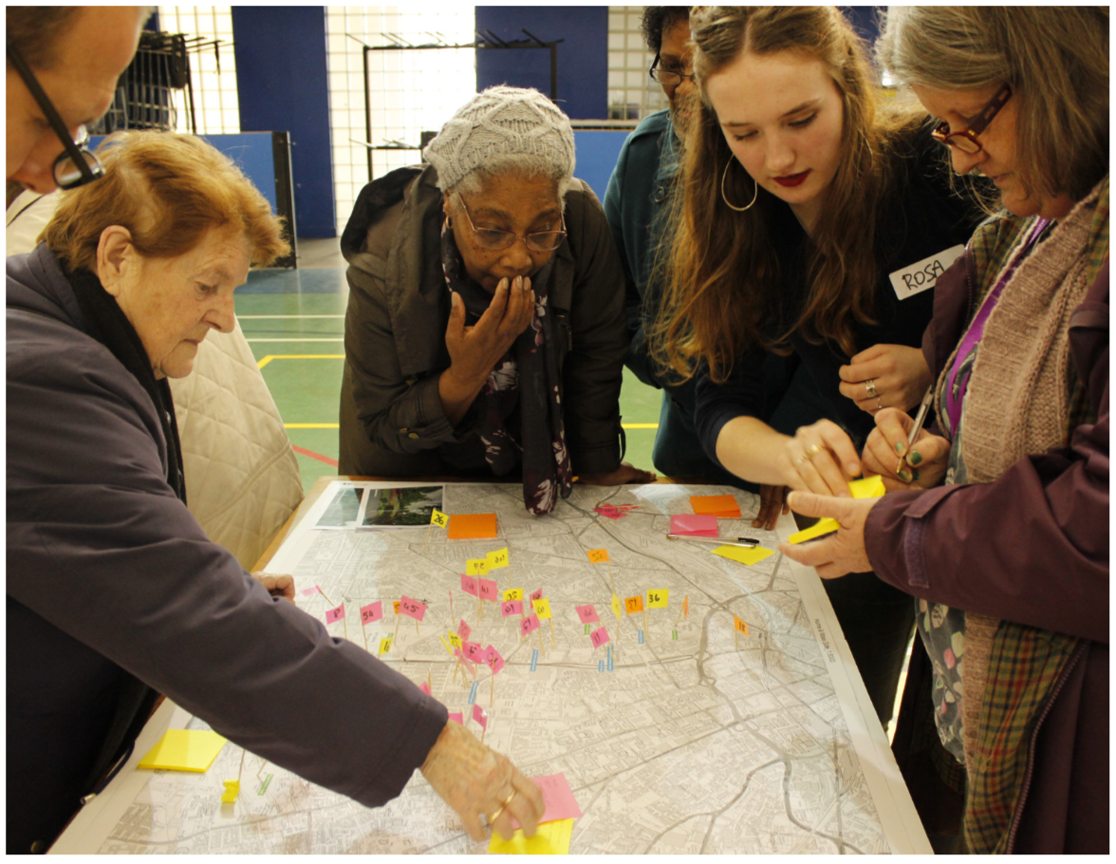

Slide 23
Thank you
Dr Mark Hammond
Manchester School of Architecture
GMCA/GM Ageing Hub
m.hammond@mmu.ac.uk

