Slide 2
POLICY
'The creation of high quality buildings and places is fundamental to what the planning and development process should achieve.'
Notes:
States in NPPF how important design is in the planning system
Creating high quality is fundamental
Fundamental – forming the necessary core
Not something we should strive for – it needs to be done
The majority of buildings last for a long time and therefore need to be high quality

Slide 3
POLICY
Form
Optimise use of land
Enhance local context
Encourage active travel
Be street based with clear definition between public and private
Facilitate efficient servicing and maintenance of buildings
Experience
Achieve safe and secure and inclusive environments
Provide active frontages – inside and outside
Deliver appropriate outlook, privacy and amenity
Provide conveniently located green spaces
Achieve environments that are comfortable and inviting for use
Quality and Character
Respond to existing character of the place
Be of high quality
Aim for high sustainability standards
Maximise opportunities for urban greening
London Plan
Design should address the following requirements:
Notes:
many of the above should be standard ‘good design’
Number of different requirements that design should address in the London Plan
Split into 3 sections
Quick run through of each point

Slide 4
DESIGN
Creative design can help to meet planning strategies
Holistic approach required
Collaboration is key
Flexibility
Future proof
FOUR SITUATIONS
Green belt
Intensification – urban centre
Intensification – suburbia
Urban Extensions/Masterplans
Notes:
Being creative can help to meet planning strategies
Need to be holistic – building itself, wider environment, climate change, users needs – striking a balance
Collaboration – work with neighbours at the planning stage, get people around the table, design team
Flexible – need to have a degree of flexibility – multi functional spaces, can building have double use?, seem to have twice the number of buildings we need
Future proof – future is hard to read – need to predict what is coming down the tracks
Look at four different contexts and how design can help with planning and wider requirements

Slide 5
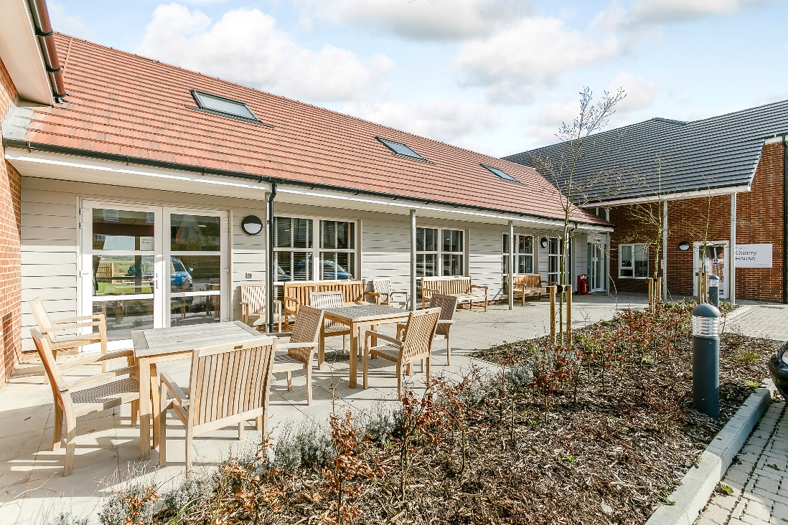
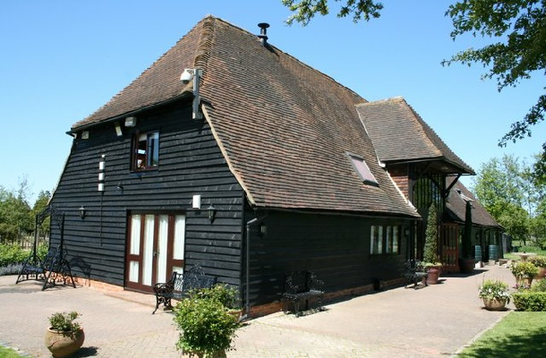
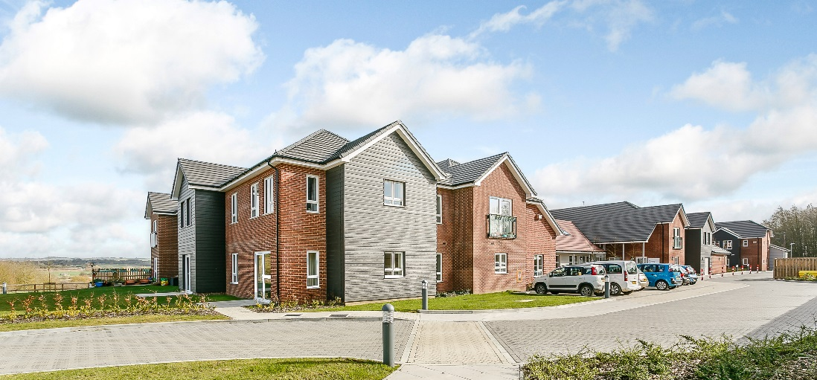
GREEN BELT
Use local vernacular
Notes:
Lack of older persons housing in rural areas – HAPPI 4 - scale can be an issue
Funding come from co-housing – strong communities in villages – crowd funding?
Public transport poor – driverless cars – what an enabler
Split building down - farmstead
Use local vernacular – don’t have to copy
Picking up on materials of local area
Responds to local feel – more likely that it will be accepted

Slide 6
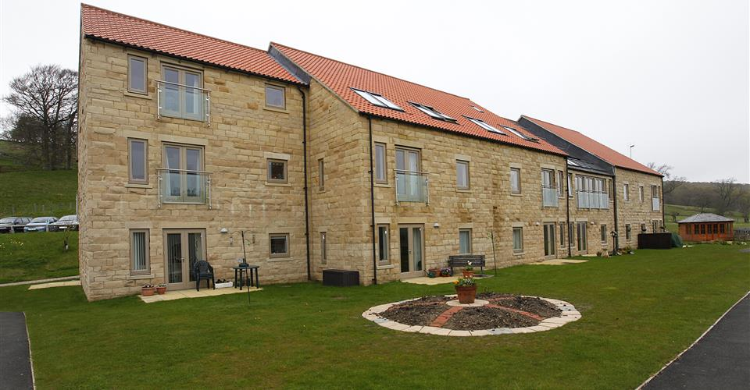
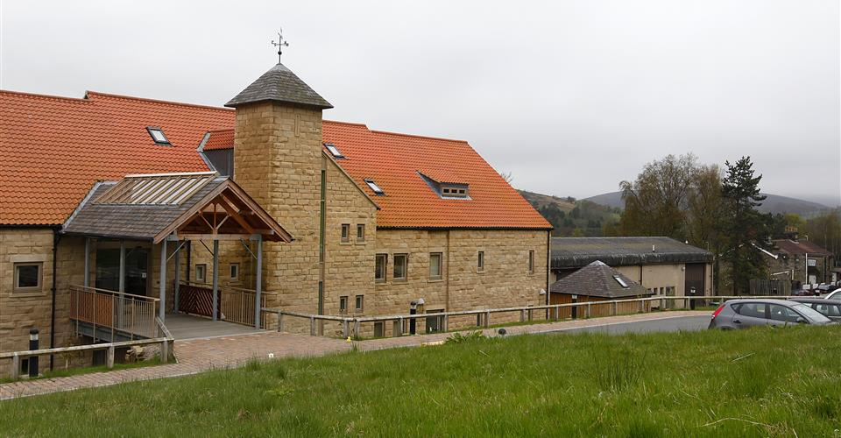
GREEN BELT
Become the community hub
Esk Moors Lodge and Bradbury Centre
‘We find that working closely with all of our neighbours makes Abbeyfield Esk Moors Lodge feel a very valued part of the community as well as helping us to help others’ – Abbeyfield/Golden Moments
Notes:
Rural areas – strong local community
Get them involved – scheme will thrive
Early engagement
Parish Council on board – will of the people will drive it through
many small post offices, pubs etc closing down
ABBEYFIELD SOCIETY’S ESK MOORS LODGE AND BRADBURY CENTRE, CASTLETON, NORTH YORKSHIRE
provide meals, activities, events and services for both residents and the wider community

Slide 7
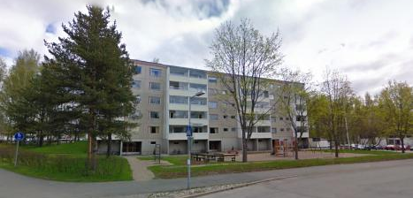
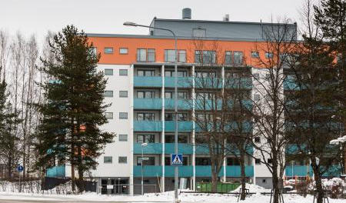
INTENSIFICATION – URBAN CENTRE
Existing stock – additional floor
Full renovation – facades, HVAC, bathrooms, surfaces
Construction of an additional wooden storey
Space was re-divided - one-half of the floor area now made up of small one and two-room flats
All new and nearly all renovated flats meet accessibility requirements
Hakapaavo, Tengbom Eriksson Architects Ltd
Notes:
Urban environments – look at existing stock
Can an additional storey be added
Intensification around transport hubs
Hakapaavo in Finland
Often high cost to renovation
This development they managed to increase the unit by optimising the floor areas

Slide 8
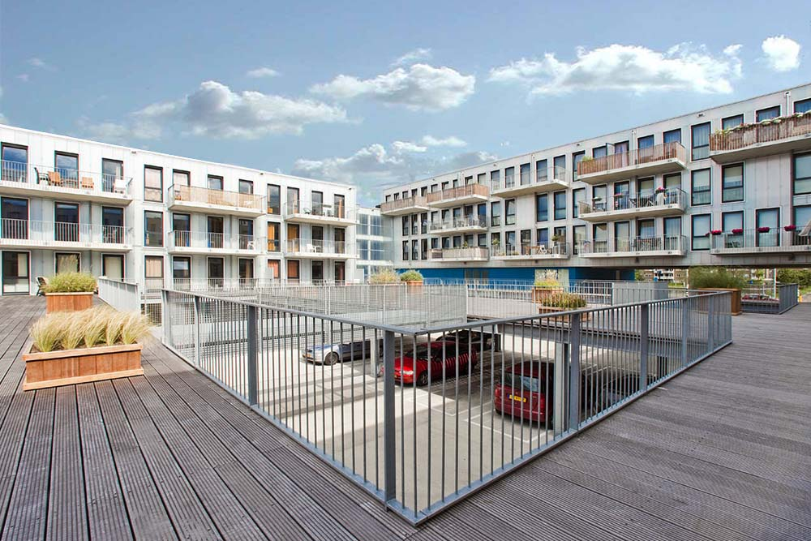
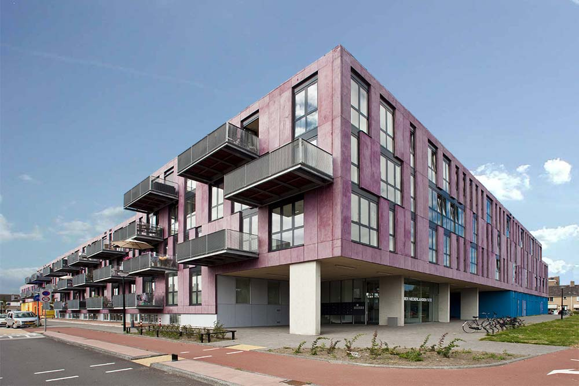
INTENSIFICATION – URBAN CENTRE
Mixed use – with shopping centre
Mixed use
Source; BNA.nl
Laan der Nederlanden, Studio Blanca
Notes:
Mixed use development in the Netherlands
Has a number of communal facilities at ground floor
Apartments above with a communal decking area – shared space

Slide 9
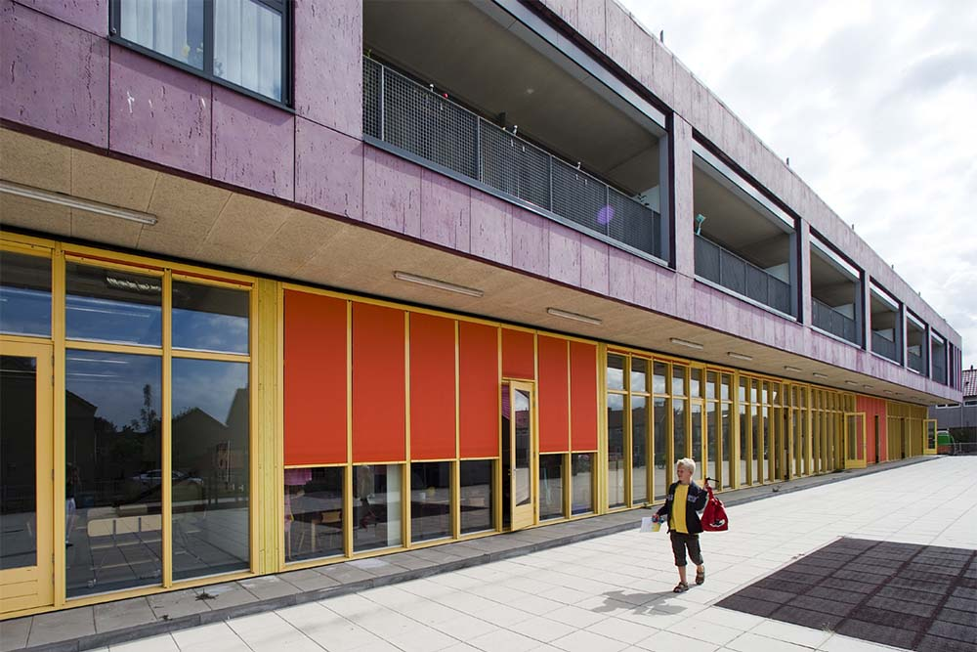
INTENSIFICATION – URBAN CENTRE
Mixed use – with shopping centre
Mixed use
83 multigenerational apartments
Sheltered scheme for 26 older residents
Primary school
Nursery
Offices
Located at the heart of a new district
Two bedroom apartments
Large penthouses
Maisonettes
Three bedroom apartments.
Notes:
Activity is great for older people
Some people retire to the countryside
Not everyone – see the benefits of being near activity, culture, want to be part of that
Variety of accommodation – not just one and two bedroom apartments

Slide 10
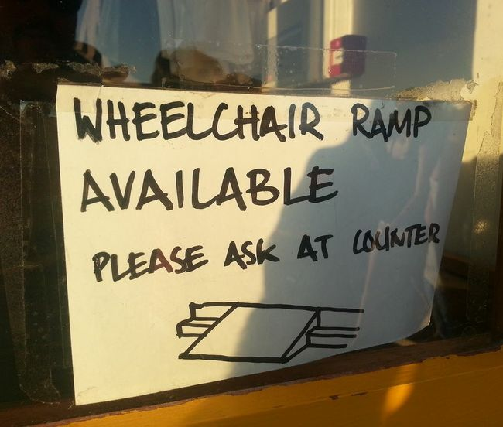
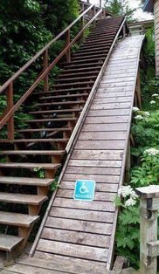
INTENSIFICATION – URBAN CENTRE
Not just about the building
Notes:
Need to think about wider urban environment
Extreme examples
Must think about urban realm
Not just physical – sight, hearing
Shops have quiet time so that people with autism can use shops – why can’t this be all the time?

Slide 11
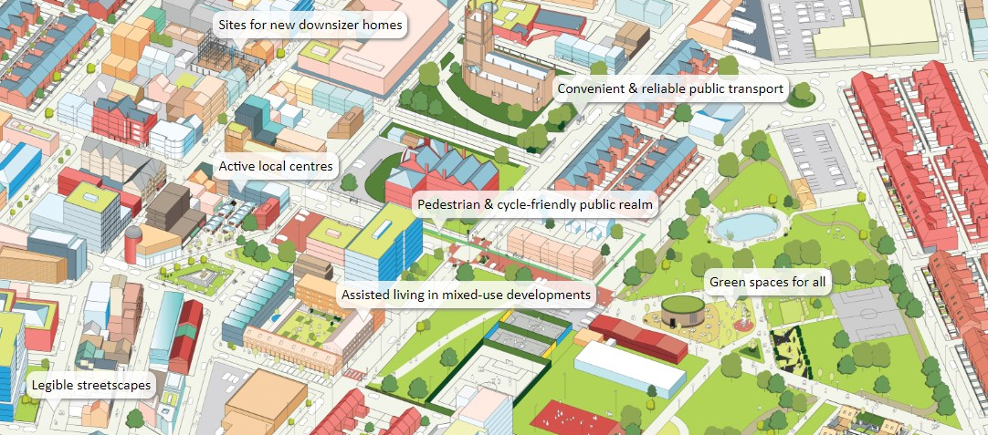
INTENSIFICATION – URBAN CENTRE
Source; Dwell Website
Notes:
Dwell – university of Sheffield
Mixture of developments
Allow older people not to feel isolated in their home
Easy for them to move around
Green spaces for everyone – older are active later in life

Slide 12
INTENSIFICATION – URBAN CENTRE
Saviour of the high street?
HOMES
+
COMMUNITY
FACILITY
Notes:
High street in poor condition
Often competing against developers for land – communal areas put price up
C3 use classification does not help this
possibly not suited to specialist dementia care
NPPF mentions about diversification of town centres – residential development should be encouraged in these areas on appropriate sites
Do extra care schemes need their own facilities? – can they be shared?
Saves costs of additional floor space – be more competitive on land
Housing associations put deals with well known chains
This is what people want

Slide 13
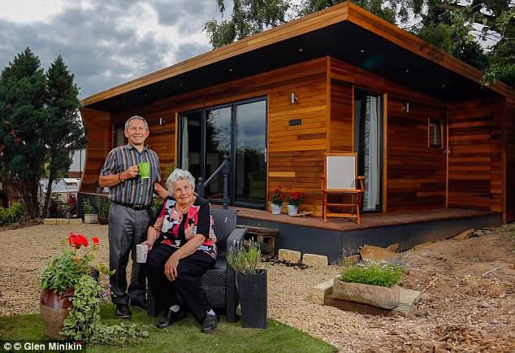
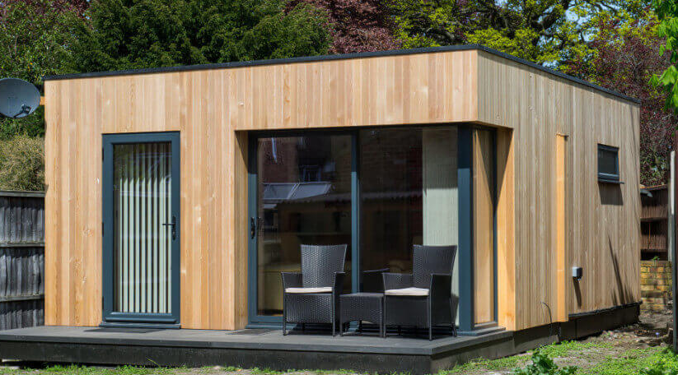
INTENSIFICATION – SUBURBIA
Garden dwellings
Green Studio
Notes:
Prefab granny annexes
One way to increase density
Grandparents are babysitters
Some want to release property value to children
Release property value to travel

Slide 14
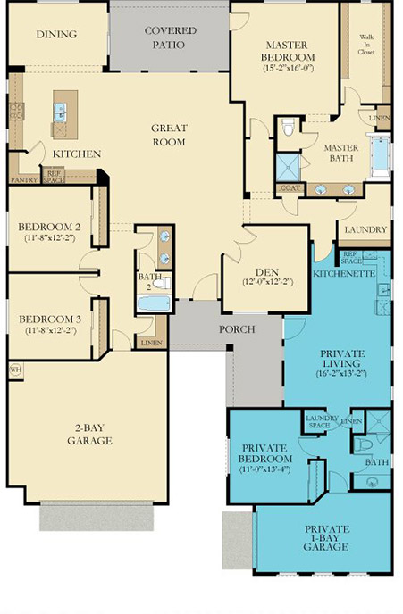
INTENSIFICATION – SUBURBIA
Integrated apartments
Not necessarily on one level
Grandparents help with childcare
Optimises use of land
Family can help with basic care
Maintain independence
Lennar NextGen
Notes:
American model
Could have flat at ground floor with house above
Mews development?

Slide 15
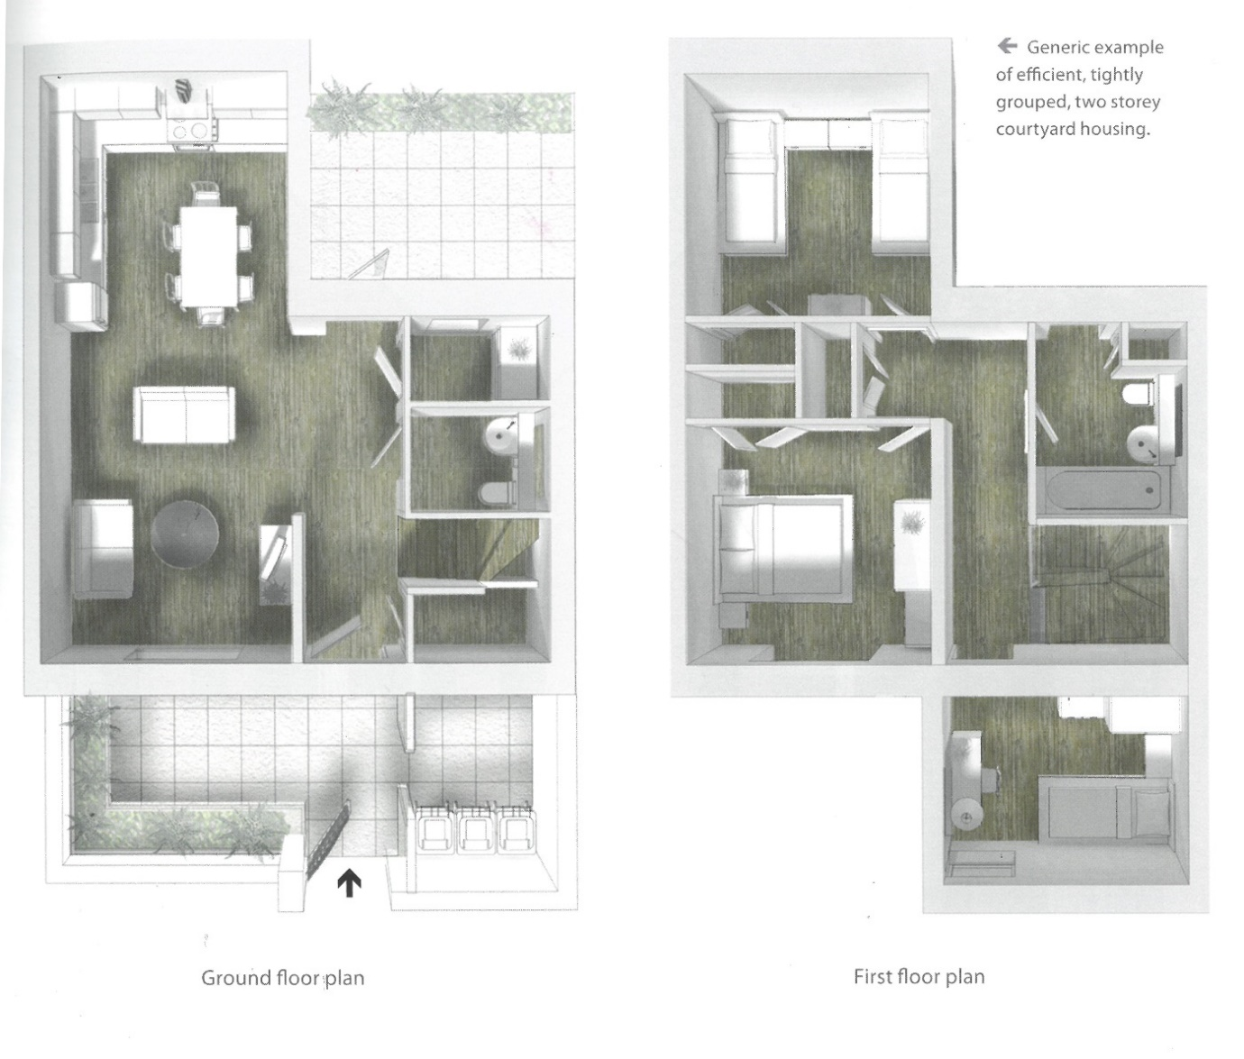
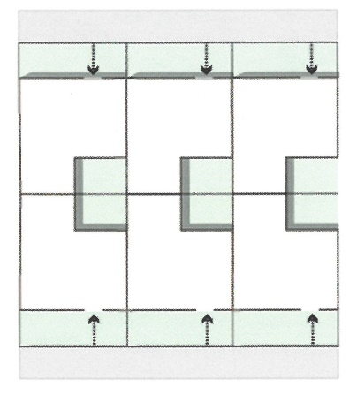
INTENSIFICATION – SUBURBIA
Tighter terraces
Small garden
Easier maintenance
Increase Density
RIBA – Age-Friendly Housing
Notes:
Downsizers don’t want to
Product isn’t good enough
Need to create product they buy into
Smaller than family house – but room for visitors
Condensed gardens

Slide 16
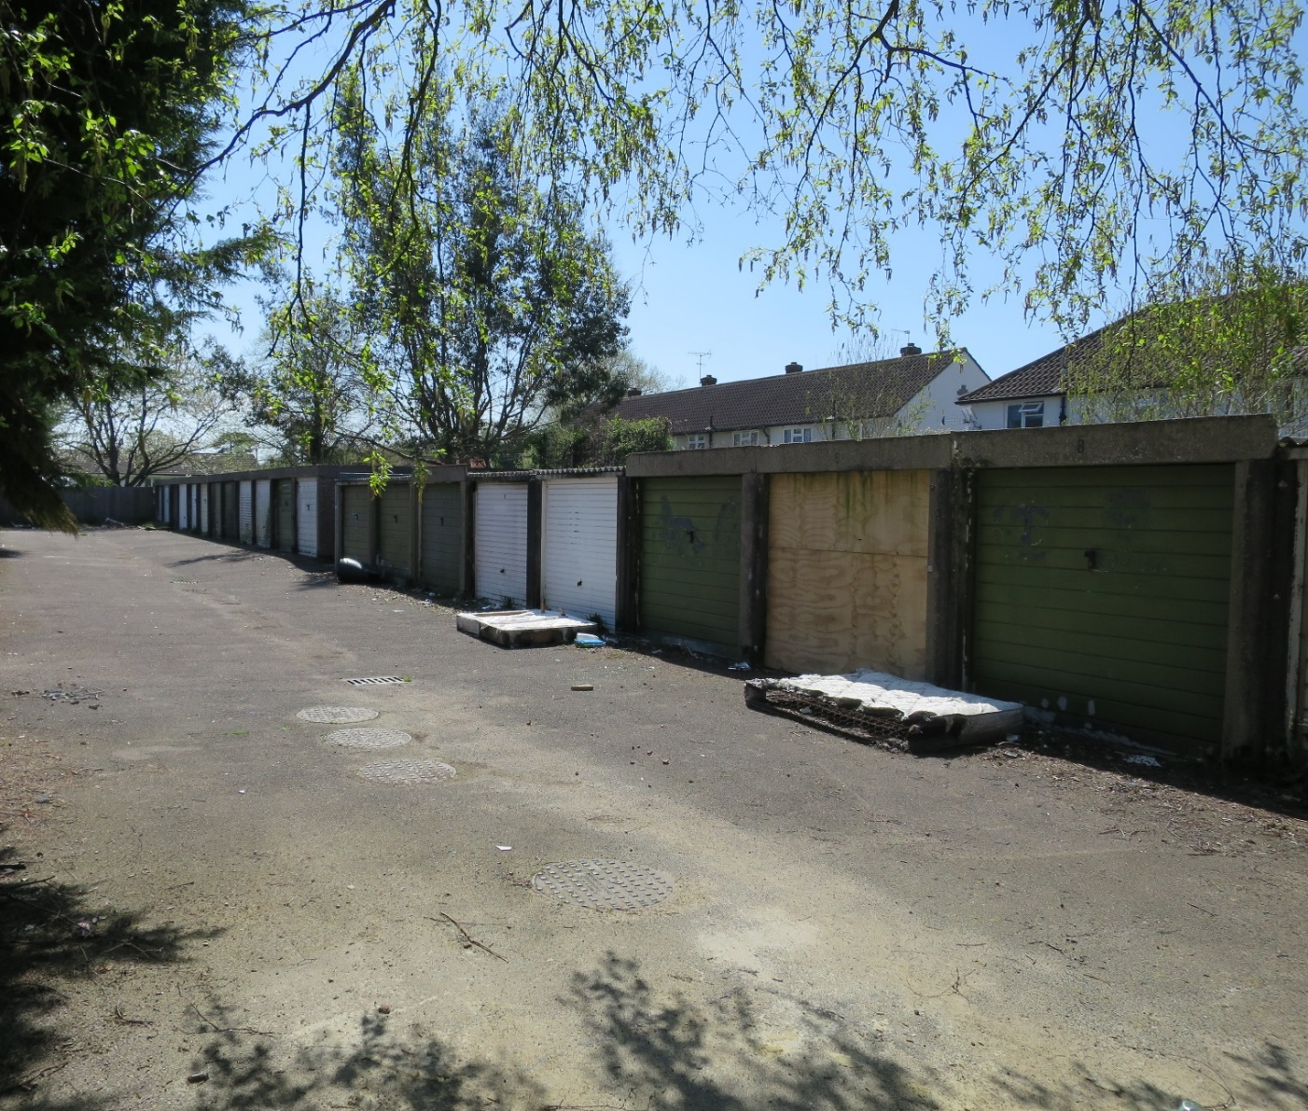
INTENSIFICATION – SUBURBIA
Garage sites
Maintenance cost
Underused land
In residential area
No land costs
Anti-social behaviour
Notes:
Some housing associations are sitting on unused sites
Problems
Councils not hitting affordable housing targets or older persons
Great opportunity

Slide 17
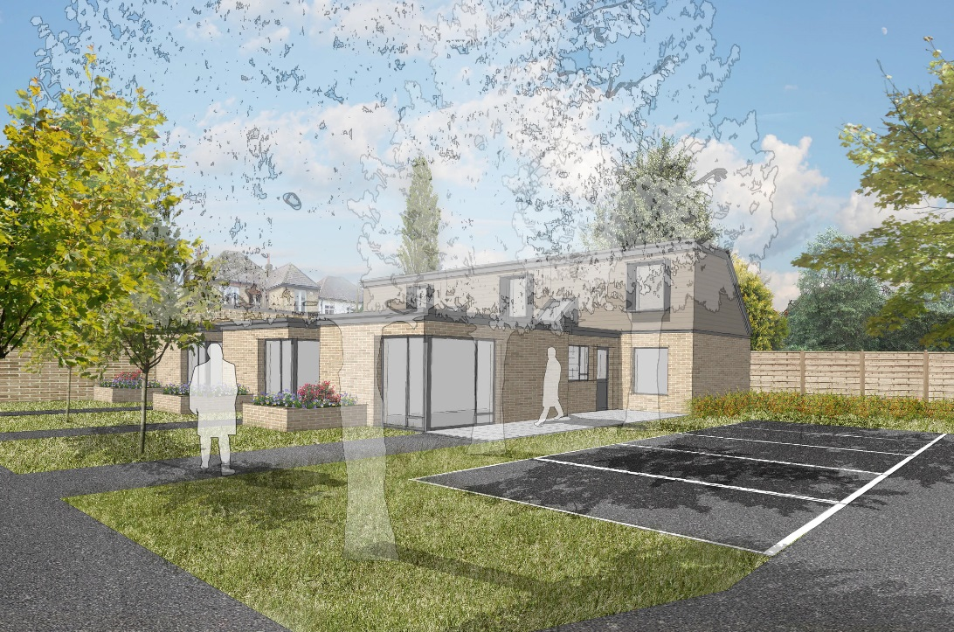
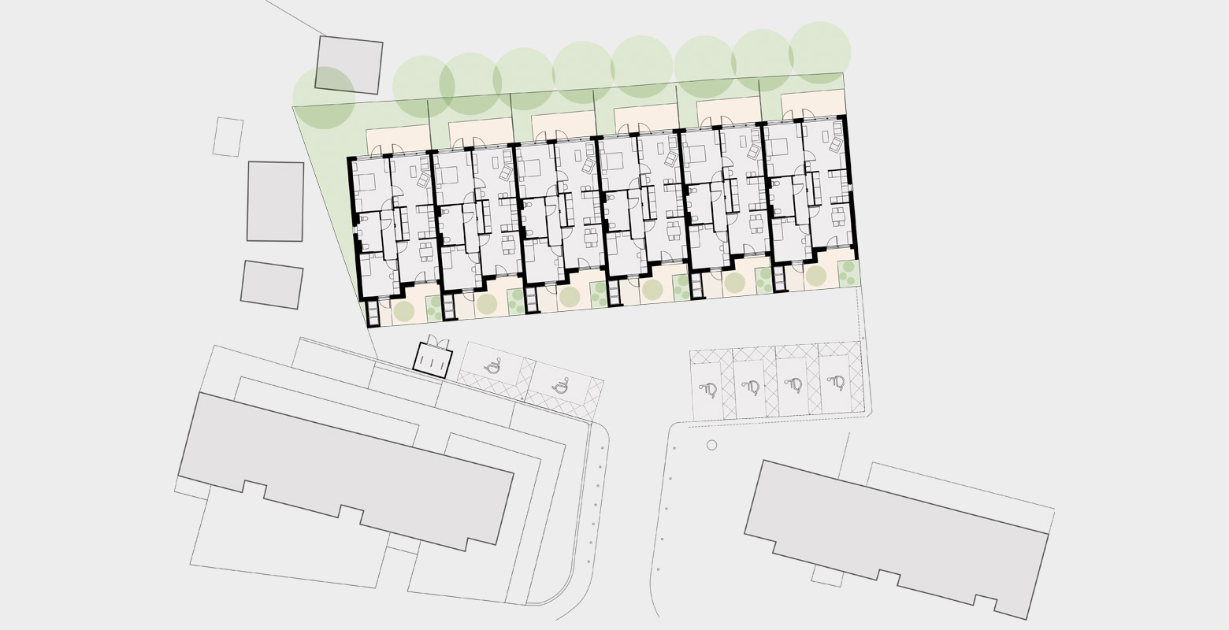
INTENSIFICATION – SUBURBIA
Garage sites
Greenwich Housing, Bell Philips Architects
Notes:
Small scale housing
Bungalows
Multiple sites with similar design to maximise efficiency
Modular construction

Slide 18
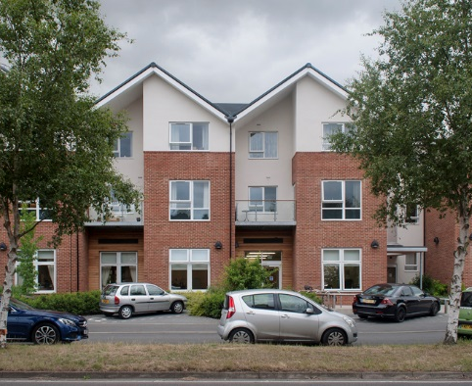
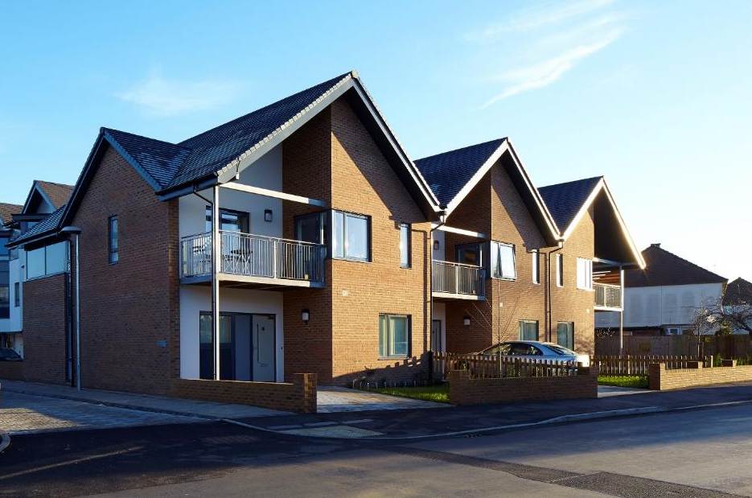
INTENSIFICATION – SUBURBIA
Match scale
Notes:
Problem is that generally older persons housing are large buildings
How do we squeeze them in?
Many homes have loft conversions – maximising use of roof space may help
Scale of surrounding properties
Castlemaine – houses from front, clever apartment arrangement
Lea Springs – took townhouse idea to split up facade

Slide 19
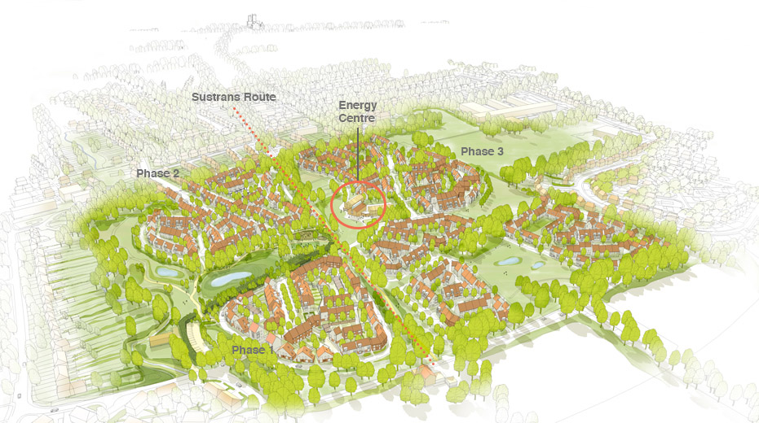
URBAN EXTENSIONS/MASTERPLANS
Neighbourhood centre
Energy centre = community centre
500 lifetime homes
Schools, nursery, doctors surgery
Designed around ecology of area
Landscaping important
Derwenthrope, Studio Partington
Notes:
One of the first large scale low-carbon communities in Northern England, Derwenthorpe seeks to create a mixed tenure, exemplar community of energy efficient homes on the periphery of York.
The masterplan makes use of the existing hedgerows which have been enhanced to structure the site and create ecological zones and amenity spaces threading through the development. Different sized houses are used appropriately to support the urban structure and provide enclosure and continuous frontages to the streets and spaces.
The Energy Centre at the heart of the scheme houses two wood-fired biomass boilers, and has a simultaneous use as a community centre.
Open design – lots of glazing
Green belt is to ideally be ‘enhanced’ – are we able to integrate housing in the landscape to achieve this

Slide 20
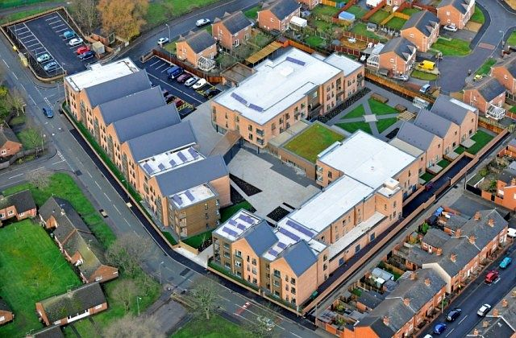
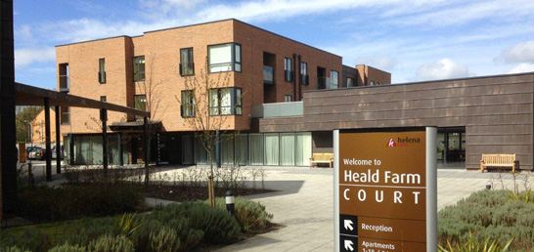
URBAN EXTENSIONS/MASTERPLANS
Become ‘public’ building
Heald Farm Court, DK Architects
NPPF - 'promote social interaction, including opportunities for meetings between people who might not otherwise come into contact with each other'
Notes:
NPPF - 'promote social interaction, including opportunities for meetings between people who might not otherwise come into contact with each other'
Helena Partnerships by DK-Architects
40 bed care home, 89 extra care apartments
Range of on site and outreach services for older people
Dining, healthcare and leisure facilities – aimed at people in retirement, but can be used by anyone
Different levels of privacy – 3 blocks linked around central hub
Areas liveliest venue – attracting younger people

Slide 21
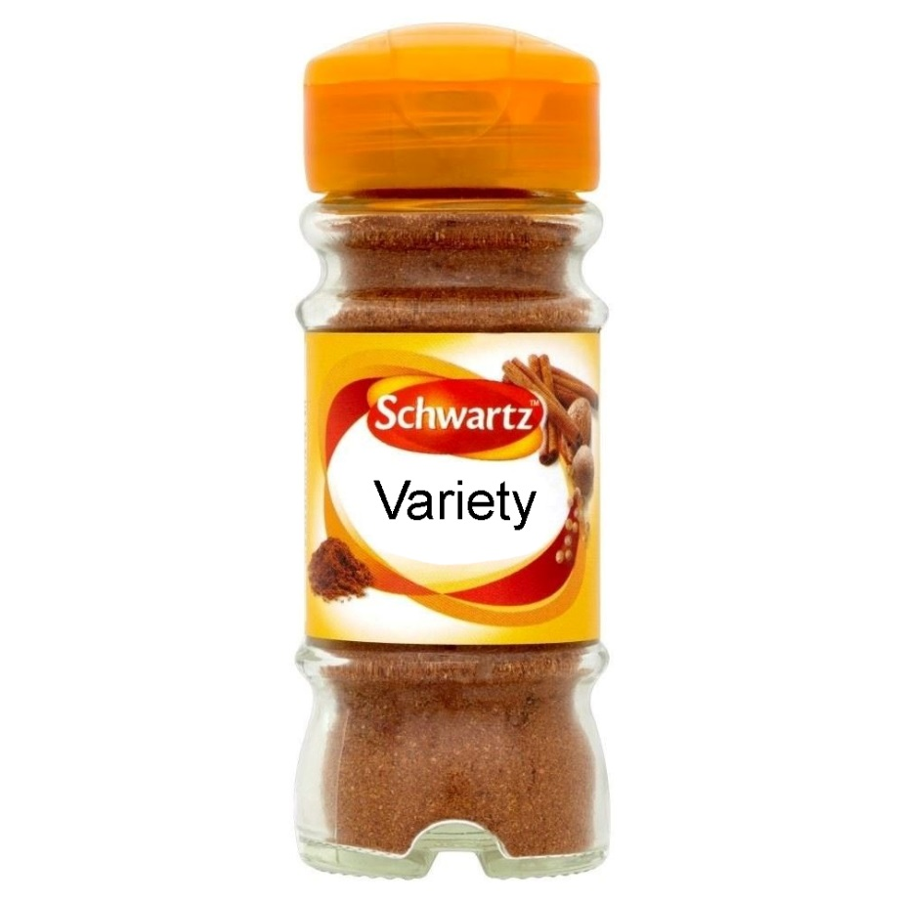
CONCLUSION
Not a single formula
Different areas require different treatment
Housing types need to vary
Collaborate to make best use of land
Variety of design styles
Notes:
Need variety of scales, styles and types
No one answer
Different types in different areas

Slide 22
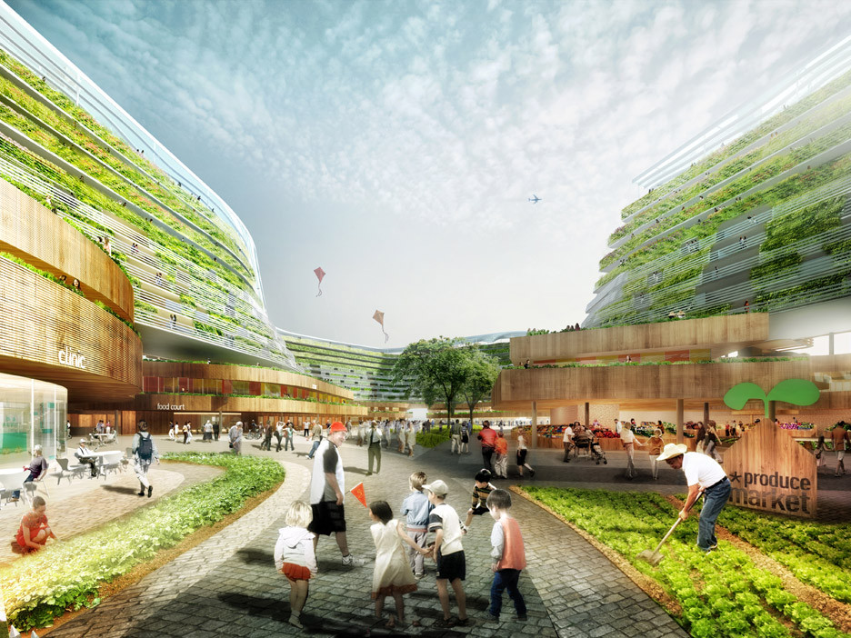
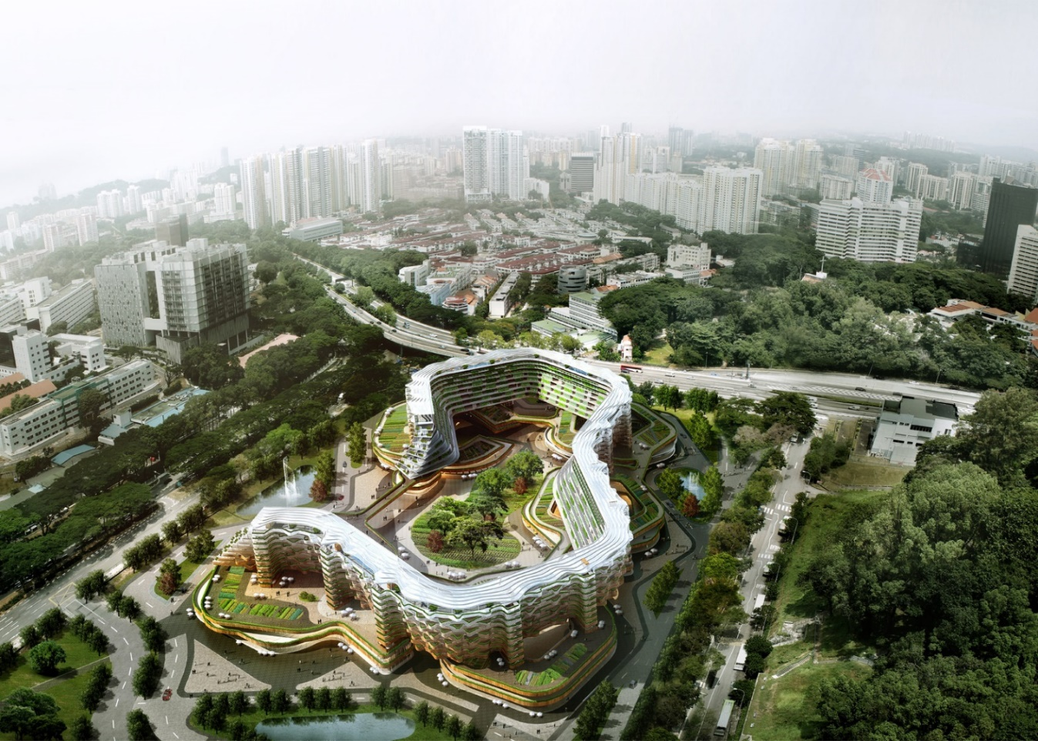
CONCLUSION
Home Farm, Spark
Time to get experimental
Notes:
South east asia – growing population and import all their food
Could lead to a crisis
Integrate an old persons scheme and farm

