Slide 1
Planning and Design Opportunities in 2019

Slide 2
The Planning System
National Planning Policy Framework (NPPF)
London Plan
Local authorities local plans

Slide 3
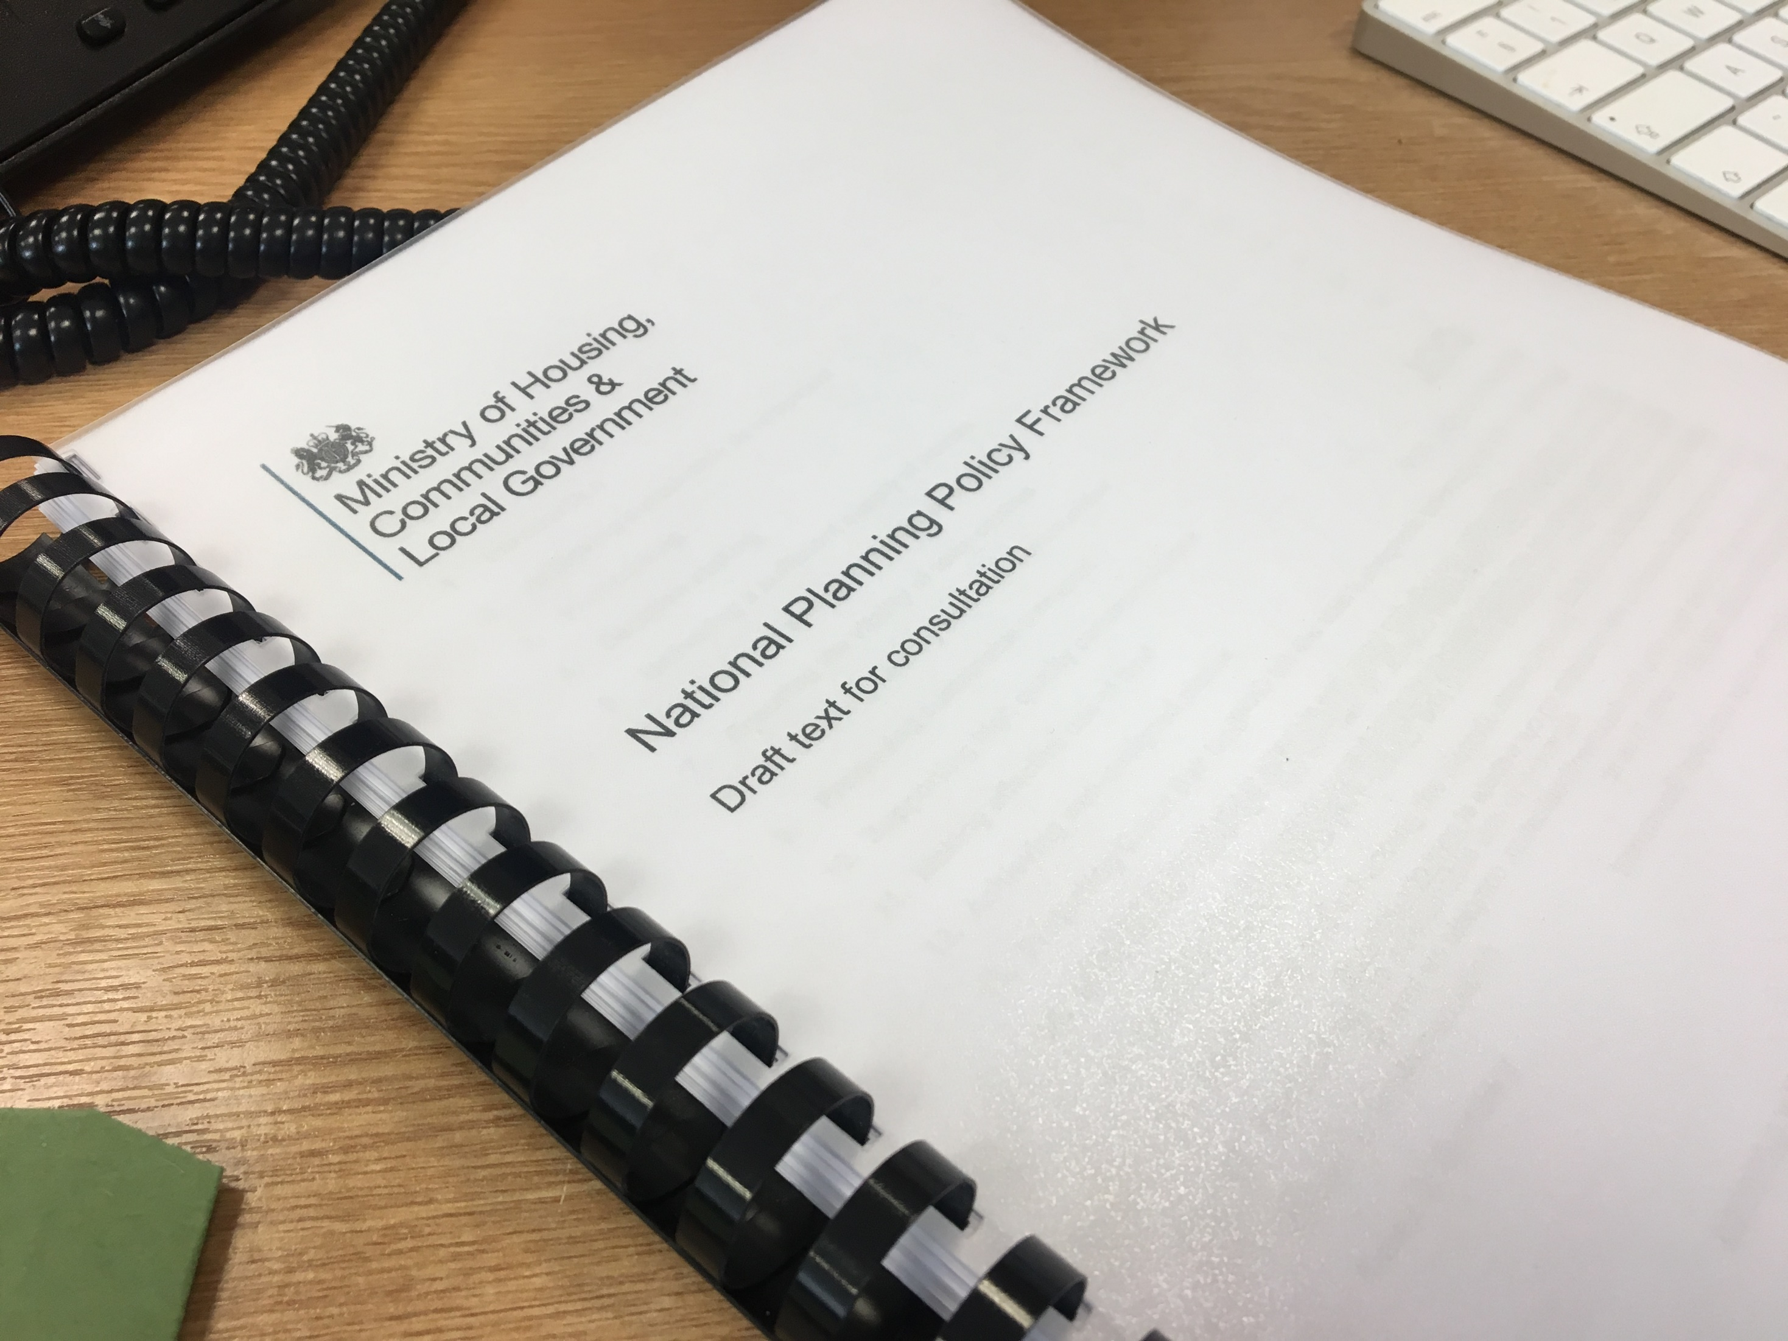
National Planning Policy Framework (NPPF)

Slide 4
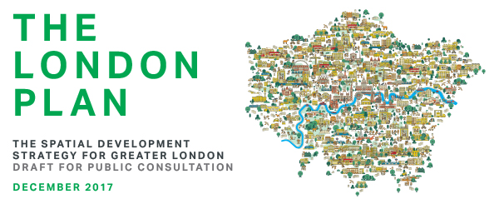

Slide 5
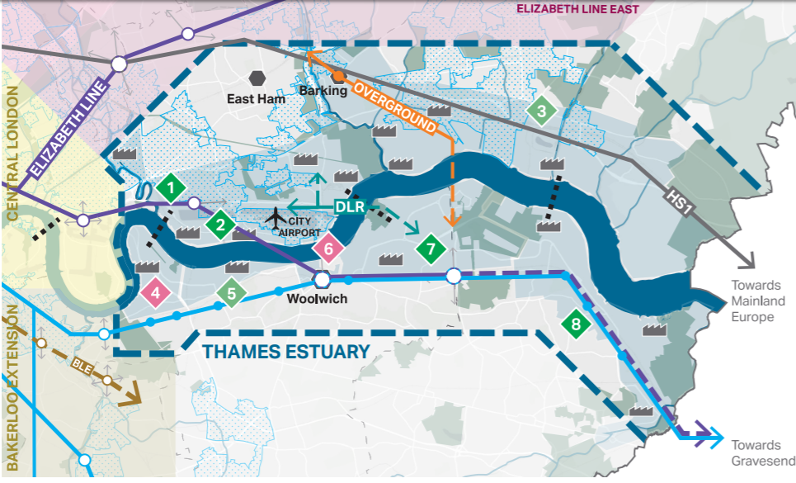
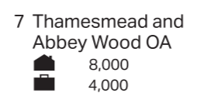
The New London Plan – Key Policies for Older People

Slide 6
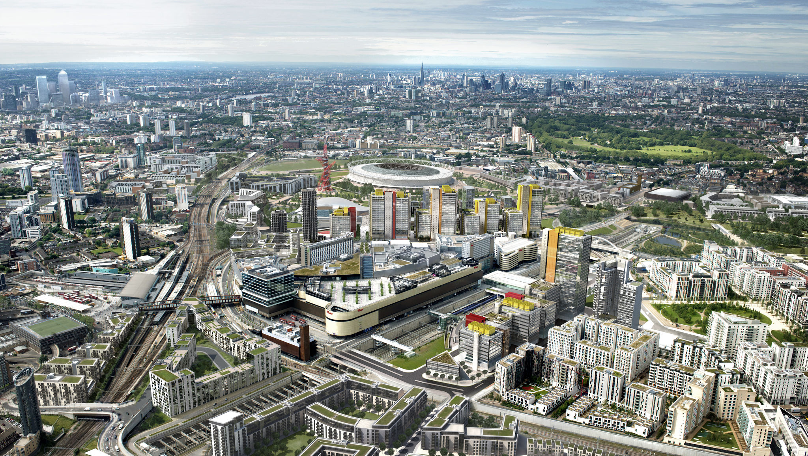
Masterplan Frameworks

Slide 7
The New London Plan – Benchmark Targets (units per annum)

Slide 8
Opportunities at local level

