Slide 1
Planning and Design Opportunities in 2019
Green Belt Policy and the West Malling Appeal

Slide 2
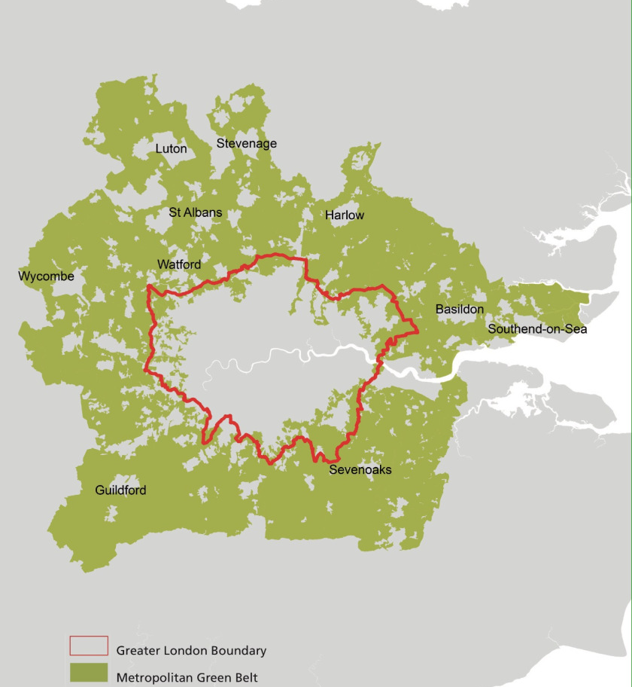
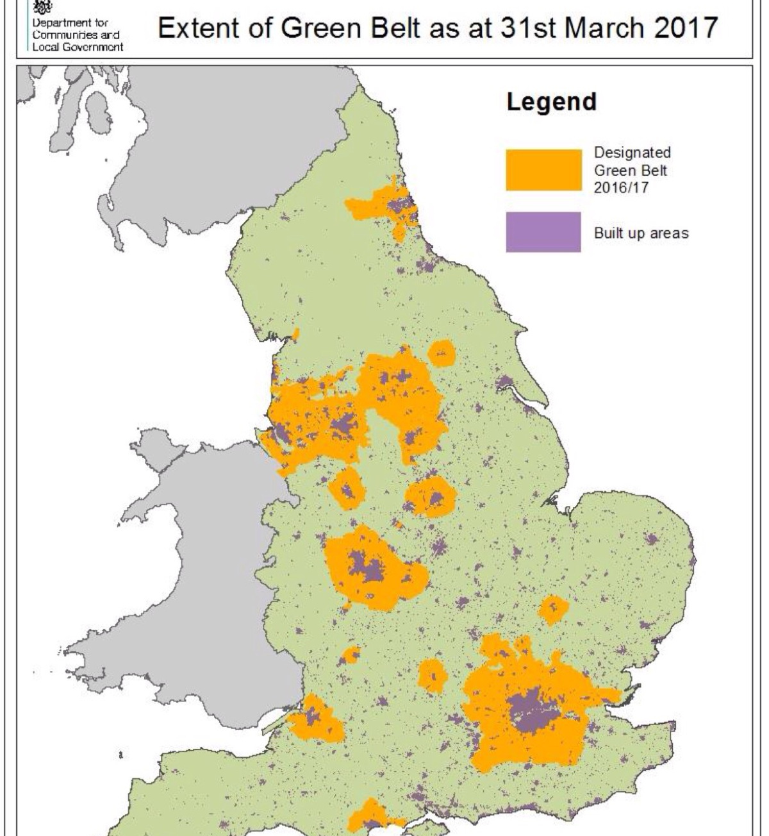

Slide 3
National Planning Policy Framework (“NPPF”)
133. The Government attaches great importance to Green Belts. The fundamental aim of Green Belt policy is to prevent urban sprawl by keeping land permanently open; the essential characteristics of Green Belts are their openness and their permanence.
134. Green Belt serves five purposes:
a) to check the unrestricted sprawl of large built-up areas;
b) to prevent neighbouring towns merging into one another;
c) to assist in safeguarding the countryside from encroachment;
d) to preserve the setting and special character of historic towns; and
e) to assist in urban regeneration, by encouraging the recycling of derelict and other urban land.

Slide 4
National Planning Policy Framework (“NPPF”)
143. Inappropriate development is, by definition, harmful to the Green Belt and should not be approved except in very special circumstances.
144. When considering any planning application, local planning authorities should ensure that substantial weight is given to any harm to the Green Belt. ‘Very special circumstances’ will not exist unless the potential harm to the Green Belt by reason of inappropriateness, and any other harm resulting from the proposal, is clearly outweighed by other considerations.

Slide 5
National Planning Policy Framework (“NPPF”)
145. A local planning authority should regard the construction of new buildings as inappropriate in the Green Belt. Exceptions to this are:
buildings for agriculture and forestry;
b) the provision of appropriate facilities (in connection with the existing use of land or a change of use) for outdoor sport, outdoor recreation, cemeteries and burial grounds and allotments; as long as the facilities preserve the openness of the Green Belt and do not conflict with the purposes of including land within it;
c) the extension or alteration of a building provided that it does not result in disproportionate additions over and above the size of the original building;
d) the replacement of a building, provided the new building is in the same use and not materially larger than the one it replaces;
e) limited infilling in villages;

Slide 6
National Planning Policy Framework (“NPPF”)
f) limited affordable housing for local community needs under policies set out in the development plan (including policies for rural exception sites); and
g) limited infilling or the partial or complete redevelopment of previously developed land, whether redundant or in continuing use (excluding temporary buildings), which would:
‒ not have a greater impact on the openness of the Green Belt than the existing development; or
‒ not cause substantial harm to the openness of the Green Belt, where the development would re-use previously developed land and contribute to meeting an identified affordable housing need within the area of the local planning authority.

Slide 7
National Planning Policy Framework (“NPPF”)
146. Certain other forms of development are also not inappropriate in the Green Belt provided they preserve its openness and do not conflict with the purposes of including land within it. These are:
a) mineral extraction;
b) engineering operations;
c) local transport infrastructure which can demonstrate a requirement for a Green Belt location;
d) the re-use of buildings provided that the buildings are of permanent and substantial construction;
e) material changes in the use of land (such as changes of use for outdoor sport or recreation, or for cemeteries and burial grounds); and
f) development brought forward under a Community Right to Build Order or Neighbourhood Development Order.

Slide 8
London Plan
Current
Policy 7.16 Green Belt
Strategic
A The Mayor strongly supports the current extent of London’s Green Belt, its extension in appropriate circumstances and its protection from inappropriate development.
Planning decisions
B The strongest protection should be given to London’s Green Belt, in accordance with national guidance. Inappropriate development should be refused, except in very special circumstances. Development will be supported if it is appropriate and helps secure the objectives of improving the Green Belt as set out in national guidance.
Proposed
Policy G2 London’s Green Belt
A
The Green Belt should be protected from inappropriate development:
1) development proposals that would harm the Green Belt should be refused
2) the enhancement of the Green Belt to provide appropriate multi-functional uses for Londoners should be supported.
B
The extension of the Green Belt will be supported, where appropriate. It’ s de-designation will not.

Slide 9
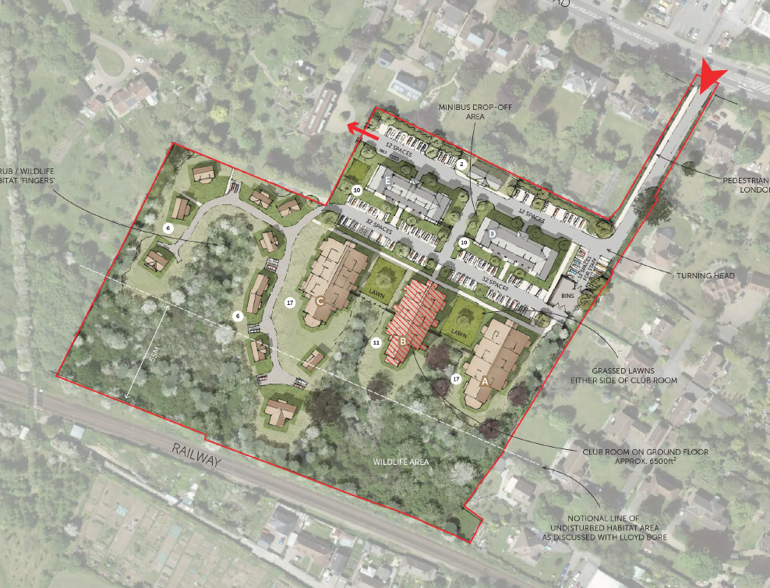

Slide 10
West Malling Appeal
Retirement Villages West Malling Limited (Ref: APP/H2265/W/18/3202040) relating to
land to the rear of 237-259 London Road, West Malling, Kent
Development inappropriate, therefore harmful to Green Belt.
Any other harm?
Development didn’t qualify as an exception.
Substantial weight accorded to the overall harm.
But………….

Slide 11
West Malling Appeal
……….there were ‘very special circumstances’
The ‘other considerations’ that tipped the balance were:
Shortfall in housing supply, including by freeing up general housing – significant weight
Unmet need for market extra care housing – substantial weight
Health and well-being benefits – significant weight
Site allocated for release from the Green Belt – limited weight
Overall, the ‘other considerations’ amounted to ‘very special circumstances’ as they cumulatively clearly outweighed the harm to the Green Belt.
What are the opportunities?

