Slide 1
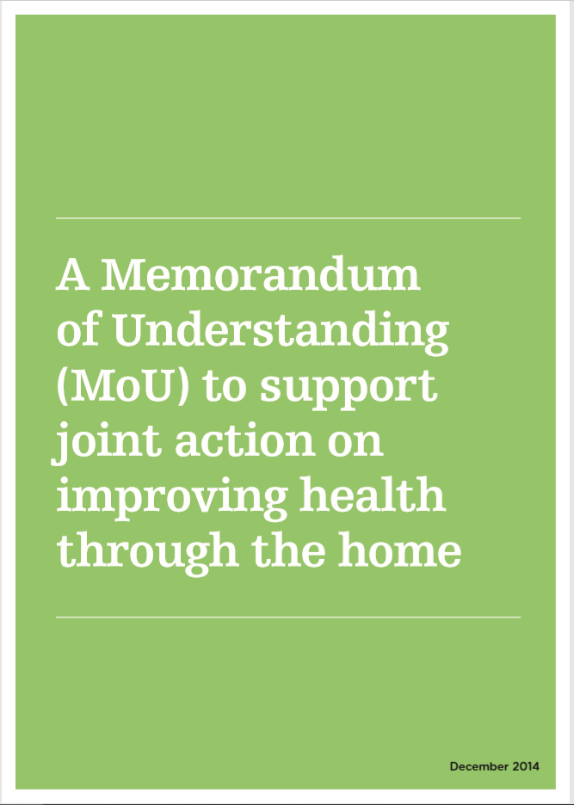
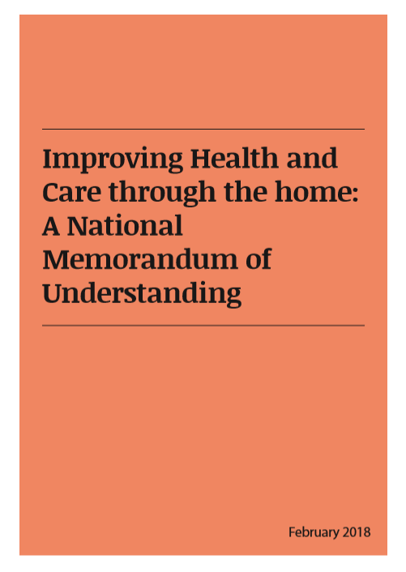

Lois Beech
Research & Stakeholder Engagement Officer
Housing LIN
l.beech@housinglin.org.uk
@HousingLIN
@HousingLINews
www.housinglin.org.uk
Notes:
We all know: The right home environment is essential to health and wellbeing, throughout life.

Slide 2
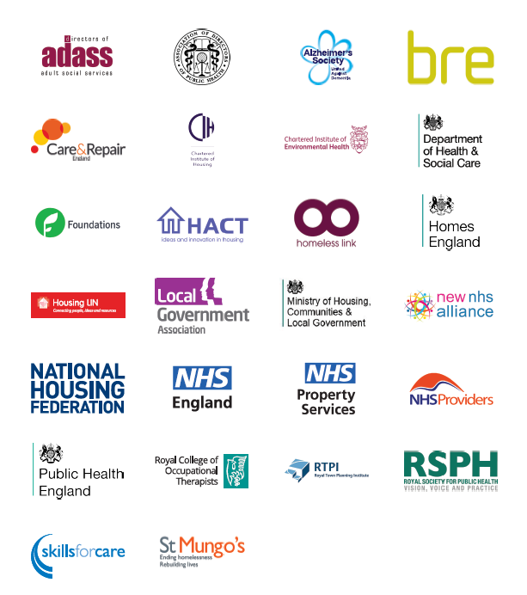
Improving Health and Care Through the Home - National MoU
NHS England initiated discussions with the Housing and Care sector
Published in 2014 and refreshed March 2018
ADASS hosted the process supported by DHSC
Public Health England taking a lead role
Notes:
MoU brings tog key orgs/decision makers to embed the role of housing in joined up action on improving health and better health and social care services.
Initiated by NHS England
2014 & 2018 refresh included social care
Rep’s meet 1/4ly through ADASS HPN. Annual review.
PHE lead role
An enabler rather than a ‘provider’. A national commitment to working together following a set of principles to ensure

Slide 3

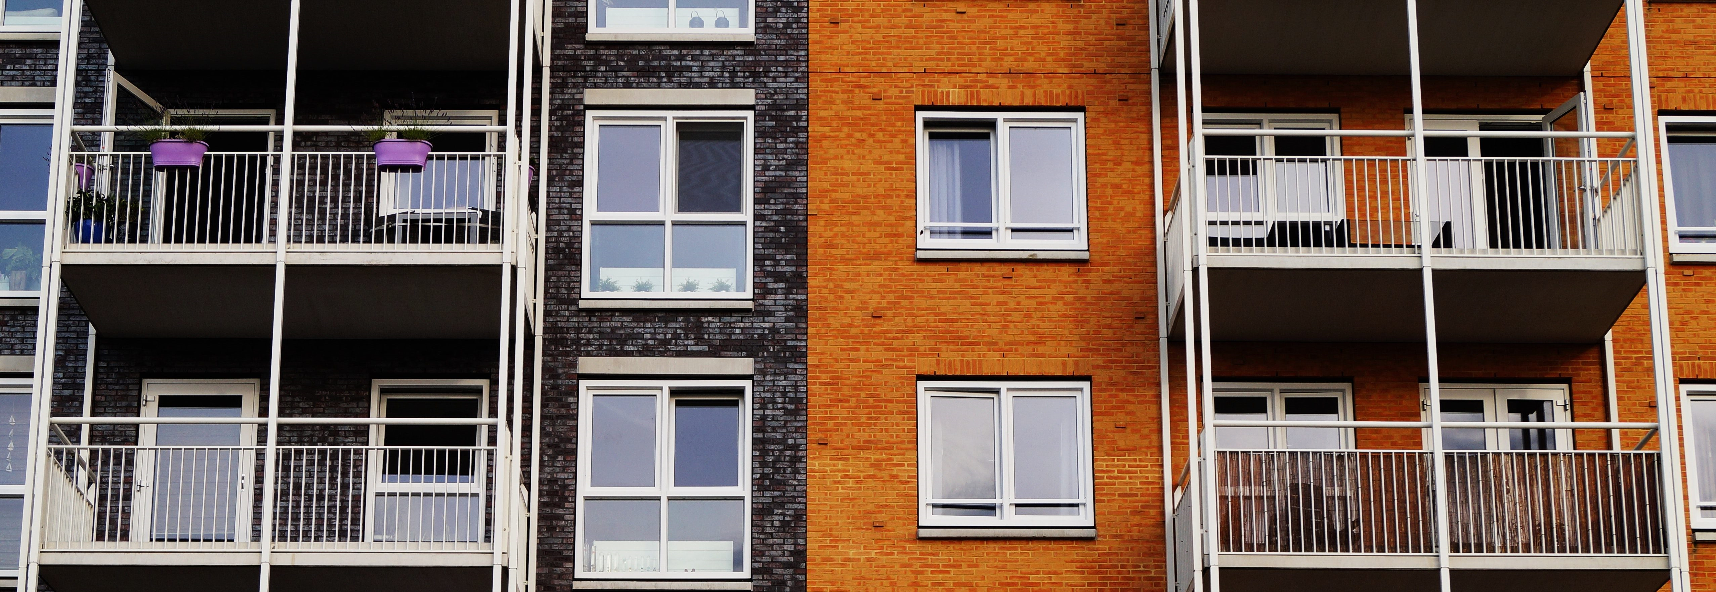
Wakefield Health and Wellbeing Board
Wakefield Health and Wellbeing Plan
Housing, Health and Social Care Partnership group (HHSCP)
Agreed that MoU checklist will be used across the Wakefield system
HHSCP identified number of patients who are delayed when leaving hospital due to a housing issue
Housing pathways and co-ordination is being reviewed with the Mid Yorkshire Hospitals NHS Trust (MYHT), with a view to making hospital discharge more efficient where housing issues are present
Other strategic examples:
Greater Manchester
Nottingham
Hounslow
Lincolnshire
Notes:
Strategic example of where MoU principles have been applied = Wakefield
W H&W Plan defines the need for W H & SC systems to understand role of housing on determining H&W
For which they have created the Housing, Health and Social Care Partnership sits under W H&W Board
PHE MoU checklist for local plans and policies acknowledge housing role in H&W. – used across Wakefield system
HHSCP highlighted number of patients who are delayed when leaving hospital due to a housing issue
Housing pathways and co-ordination is being reviewed with the Mid Yorkshire Hospitals NHS Trust (MYHT), with a view to making hospital discharge more efficient where housing issues are present
PROGRESS: Telecare is now offered as a standard part of the Reablement Service, WDH Care Link service, free of charge, to the patient for the duration of their reablement. Ambulance call-outs have been mitigated in up to 42% of fall incidents
OTHER
Nottingham MoU = agreement between local health, social care, housing and support colleagues who are committing to working in partnership to ensure that there is cross-sector identification and awareness of the needs of the local population.
Great Manchester = No MoU but H&H programme. Invested in 1. Primary (housing advisers and info service. HOOP) 2. Strategic (specialist housing provision needed). 3. Age Friendly City. Local hubs ‘Wellness Hub’ as a prevention method
Hounslow = useful accompanying Action Plan!
Lincolnshire = 11 December 2018 their H&WB Board agreed a memorandum of understanding to support joint action in Lincolnshire on improving health through housing

Slide 4
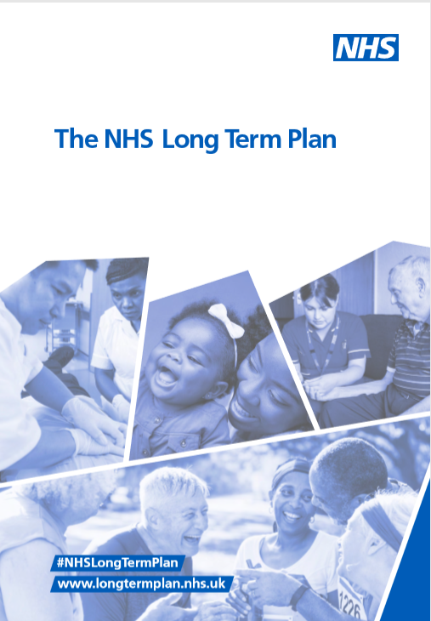
NHS Long Term Plan
Recognises there needs to be better support for people to maintain healthy lifestyles at home in a more personalised way
  Within five years over 2.5m more people will benefit from ‘social prescribing’ or a personal health budget
  Upgrade technology & digitally enabled care across the NHS
£30 million extra on meeting the needs of rough sleepers
  Access to specialist homelessness NHS mental health support, integrated with existing outreach services
  Hospital pathways
Through the Healthy New Towns programme, the NHS is playing a leading role in shaping the future of the built environment
Notes:
While NHS Plan doesn't reference housing as significantly as we might have liked, doesn’t appear to be a commitment to the MoU even though NHS are a critical partner (short sighted)
It offers some preventative (housing) measures that aim to reduce the demand on health service
What is clear is that it recognises there needs to be better support for people to maintain their lifestyles at home (personalised)
Personal health budgets and tech that enables people to self manage
Recognises the need to invest in homelessness services in order to prevent homelessness and cost to NHS.
Recognises the importance of the built environment as a determinant of health through the Healthy New Towns programme.
BUT there needs to be hooks to enable housing to have meaningful conversations with health and care to support better support at home, and also better care pathways out of hospital.
With forthcoming Social Care Green Paper, this should be a good time for us all to go up a gear in terms of health, housing and integration. Also because of more money for DFGs (see below).

Slide 5
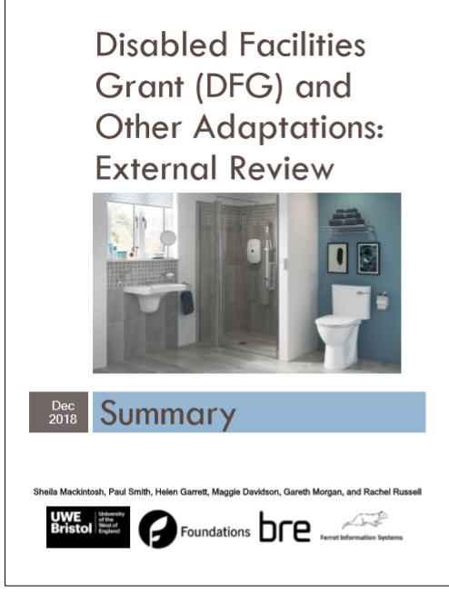
DFG Review
The ‘Goldilocks’ approach:
  Joint commitment at a senior and strategic level between housing and social care, e.g. Housing and Health Partnership Board
Integrated teams as essential to simplifying and speed up customer journeys
Use personal budgets to provide more tailored solutions
Notes:
Recent DFG review: Recommends housing as part of health, housing and care partnership board locally - i.e. as part of a formal structure
Growth towards personal budgets (and personal health budgets) for DFGs - more personalisation of how people use their money and purchase services and support (mirrors wider changes in social care in particular). Housing LIN completing RCOT Adaptations Without Delay

Slide 6
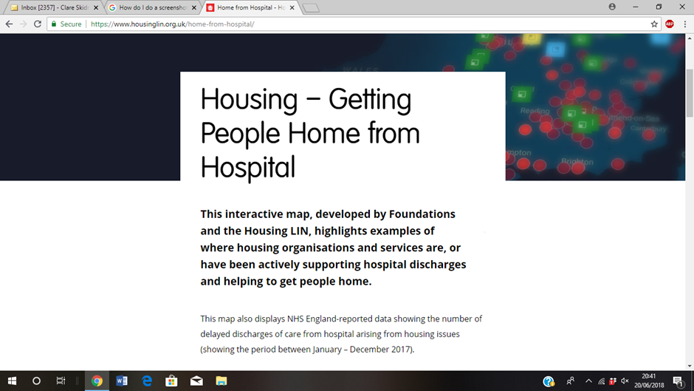
Home from Hospital – Interactive Map
Developed jointly by Foundations UK and Housing LIN
Highlights where housing organisations are supporting hospital pathways in range of practical ways
Projects from across England are profiled, set alongside ‘DToC’ (Delayed Transfer of Care) data
Aim: To inspire, support and inform conversations about what might be possible locally
Quarterly updates planned to capture new activity
Visit: https://www.housinglin.org.uk/home-from-hospital/
Notes:
Foundations & HLIN
Highlights where housing orgs are supporting hospital pathways
Projects profiled and set alongside DToC data
Inform conversations about what is happening locally
1/4ly updates. If your project is not listed on the map, please let us know and share your project details

Slide 7
Getting our homes and communities right
‘Residential Revolution’ (LGA, 2017) estimate shortfall of 400,000 units of housing for older people by 2030. Encourage councils:
Having a clear vision: promoting awareness and changing attitudes to later life
Planning for an ageing population
Delivering and enabling new housing for older people across the public and private sectors
Promoting an integrated approach to housing, care and health
Sustaining older people in mainstream housing
Notes:
Sets out what is needed to meet the housing needs and aspirations of an ageing pop
Underpinned by the idea that the suitability of housing stock is important to personal health and public spending (NHS & SC)
Recognises council role in place-making and shaping current and future housing supply. Council case studies including Derby City Council’s healthy housing hub (see next slide)

Slide 8
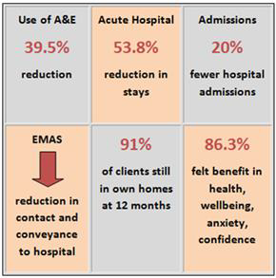
Impact of housing on NHS and social care costs and outcomes: the evidence
Derby City Council, Healthy Housing Hub
Housing related advice and support
Prescribed housing support
Healthy housing assistance
Partnership links across health, housing, social care and the voluntary sector
Evaluation - positive outcomes / efficiencies
Notes:
What can you do? Does anyone have anything they can share?

Slide 9
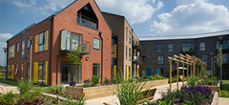
Local impact of housing on health and wellbeing, and NHS and social care costs: the evidence*
Specialist Housing:
Residents of retirement communities are more socially connected and therefore less prone to loneliness
Living in a care village increases life expectancy by up to 5 years
People living in extra care housing needed less formal care, as measured by the size of their ‘care packages’, compared to a control group in the community
Extra care housing residents’ unplanned hospital admissions reduce from 8-14 days to 1-2 days, compared to the community
Over a 12 month period, total NHS costs (including GP visits, practice and district nurse visits and hospital appointments and admissions) reduced by 38% for extra care residents
* Demonstrating the Health and Social Cost-Benefits of Lifestyle Housing for Older People, Housing LIN (report for Keepmoat Regeneration), October 2017
Notes:
Evidence of the impact of housing on H&W in specialist housing context
More socially connected so less lonely – the Housing LIN is part of a new 2 year Economic and Physical Research Council project led by Uni of Bristol into social inclusion in extra care housing. Details to be announced next month
Research by International Longevity Centre, ECH can increasing life expectancy by 9-15 years
ECH residents need less formal care as measured by the size of their care packages compared to control community group
ECH unplanned hosp admissions reduced from 8-14 days to 1-2 days compared to control
Over 12 month, total NHS costs (GP visits, practise, district Nurse) Reduced by 38% for ECH residents
New ExtraCare Charitable Trust research findings by Lancaster Uni coming out this month too. They update the Aston University project (same team have moved to Lancaster!)

Slide 10
Impact of housing on health and wellbeing, and NHS and social care costs: the evidence*
Housing staff based within hospital discharge teams:
Bournemouth Churches Housing Association provides advocacy and support to individuals who have come into hospital and are homeless or at risk of becoming homeless
Estimated cost benefit in terms of reduced excess bed days to the NHS for 2016-17 was £280,000 (for period April – December 2016)
* Home from Hospital: How housing services are relieving pressure on the NHS – written by Housing LIN for National Housing Federation, Sept 2017
Notes:
There are really good examples of local evidence of the impact of housing on H&W in hospital discharge services
HLIN Home from Hospital report for NHF on how housing services relieve pressure on NHS
A benefit to having housing staff in hospital discharge teams:
E.g. Bournemouth Churches HA advocacy and support to individuals in hosp at risk or are homeless
Estimated cost benefit in terms of reduced excess bed days to NHS 2016-17 £280,000
However, real difficulty is that these savings might not be cash releasing savings but more importantly when many NHS Hospital Trusts are in £20+million financial deficit, the £250,000-£500,000 savings don’t make substantial in-roads into the type of care efficiencies required to balance the books! Nevertheless, impressive patient experience and outcomes delivered

Slide 11
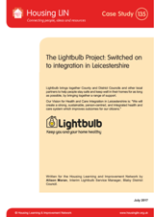
Impact of housing on health /care costs and outcomes: the evidence*
Lightbulb Project, Leicestershire: Community based housing support services - aids / adaptations, information / advice, warmth and energy, technology, equipment and housing options (planning ahead)
Integrated, proactive approach including GPs and other health professionals
Also includes housing enabler role based within hospital settings
Evidenced savings to the wider system include
  Reduction in service utilisation (health and social care)
  Reduction in A&E attendance, and reduced hospital admissions
  Reduction in Delayed Transfers of Care
  Falls prevention
  Lower DFG delivery costs through more efficient processes and staffing
* The Lightbulb Project: Switched on to integration in Leicestershire, Housing LIN Case Study, July 2017
Notes:
Evidence of impact of housing on health/care costs from Community based housing support services
Collab - county council, district councils and other partners –keep people in their own homes
Local Lightbulb Team offers a range of support such as aids and adaptations, energy advice, home safety and home maintenance to help people stay safe and independent.
Housing enabler in hospital settings
Evidence…

Slide 12
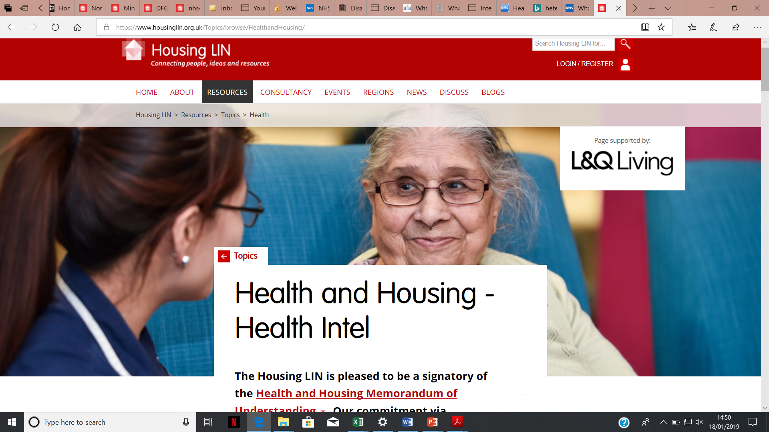
Housing LIN Health Intel
Pulls together selected documents that highlight the connectivity between health and housing at national policy and at an operational level.
Split into 11 categories including everything you need to know about hospital discharge integrated care, prevention, long term conditions management, NHS estate etc
https://www.housinglin.org.uk/Topics/browse/HealthandHousing/

Slide 13
Questions to consider
What partnerships exist already?
Is there an effective health and wellbeing board in your area?
What opportunities are there in your area to improve outcomes by working in a more integrated way?
Are there any really good examples from where you work of people doing this already - do share with us?
Are you in touch with you local Director of Public Health?
Notes:
What can you do? Does anyone have anything they can share?

Slide 14


Thank you!
Address:
The Ideas Store, 10 Lindsey Street
Smithfield, London EC1A 9HP
email: info@housinglin.org.uk
tel: 020 7820 8077
website: www.housinglin.org.uk
Twitter: @HousingLIN @HousingLINews
Notes:
What can you do? Does anyone have anything they can share?

