Slide 1
Thirteen Group and PIPS Partnership

Slide 2
Supporting People to Live Independently
About Thirteen
Housing Association based in Tees Valley
Health and Housing Strategy
Developed models of accommodation and support
£58m capital programme

Slide 3
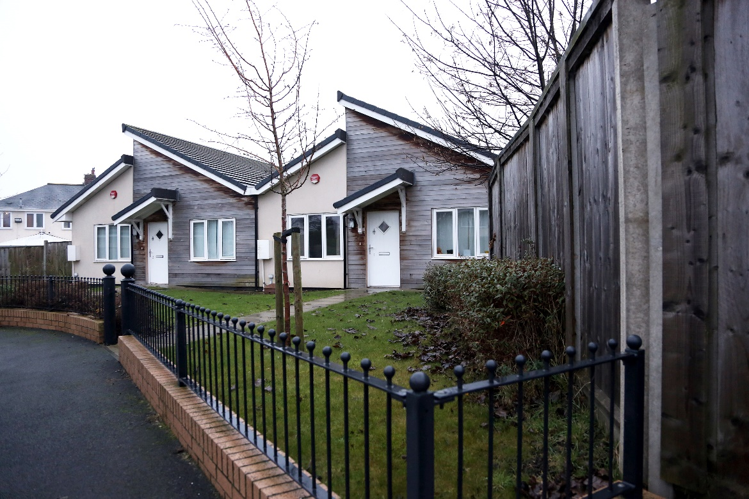
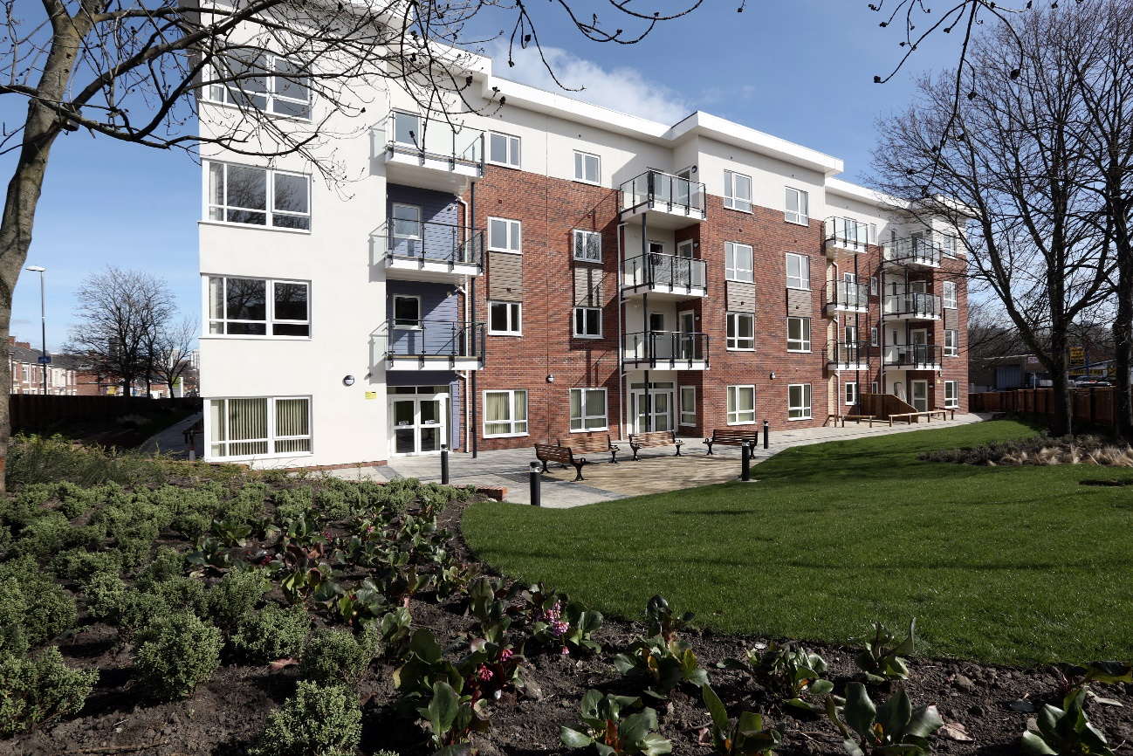
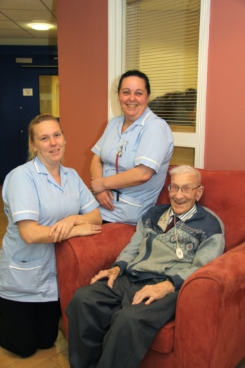
The Partnership

Slide 4
Supporting People to Live Independently
About PIPS
PIPs Social Care Limited Company owned by TEWV
PIPS was established to provide robust Social Care
PIPS provides Supported living to people with complex needs.
PIPS is registered with the CQC and OFSTED
PIPS has over 200 staff supporting 30+ individuals as tenants.
PIPS uses the model of PBS to support people effectively.

Slide 5
The Partnership
Joint Working Agreement established
Co-Operation Agreement per scheme (if required)
Accessed NHS capital grant
Agrees appropriate rent and services charges
Joint negotiations with commissioners and LA housing benefit teams
Six schemes delivered and operational

Slide 6
The Partnership
Thirteen:
buildings/capital for new build or refurbishment
fixtures and fittings to the scheme
bespoke landlord services from a specialist team
Repairs and maintenance
Individual tenancies
PIPS:
Primary relationship with commissioners
Assessment of potential clients for accommodation
Transitional support for the client
On-site staffing and intensive client support
A Joint Working Agreement is in place between Thirteen and PIPS to confirm partnership, property and care arrangements between the respective parties. Similarly, a Co-operation Agreement between the parties captures PIPS commitment to subsidise the annual lease premium of £100K. The agreement also contains a requirement for both parties to work together to mitigate any losses associated with rental differentials and the like between appraised values and those finally agreed with the Local Authority. This agreement will help to mitigate any future risks to the rental stream as a result of the changes to supported housing and the local housing allowance.

Slide 7
Fellows Hall
Formerly a general needs block of flats in East Cleveland owned by Thirteen
Refurbished in 2016/17 to provide seven self-contained furnished flats for people with high mental health support needs leaving long-stay hospital placements or residential care.
The service is commissioned by the CCG/LAs and delivered by PIPS.
Accessed £426,217 from the North Region Learning Disability Capital Grant pot for the refurbishment costs
Management agreement in place to mitigate contractual risks if support funding ceases.

Slide 10
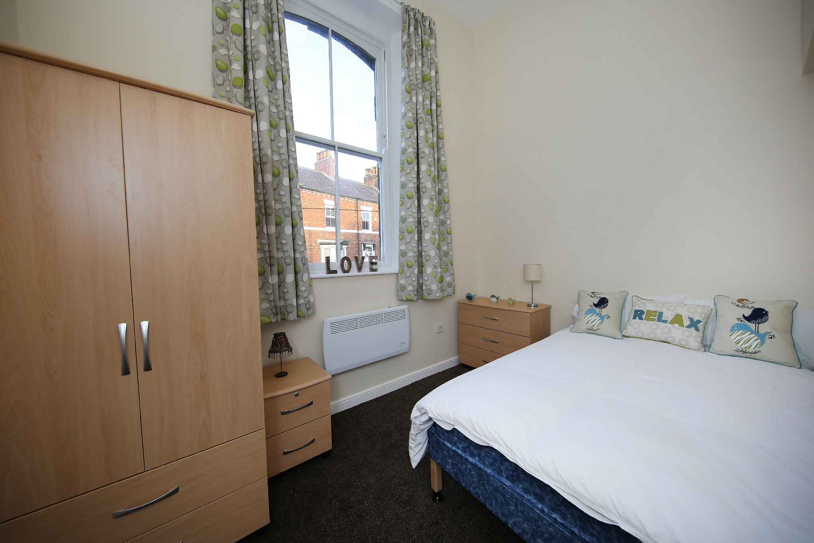
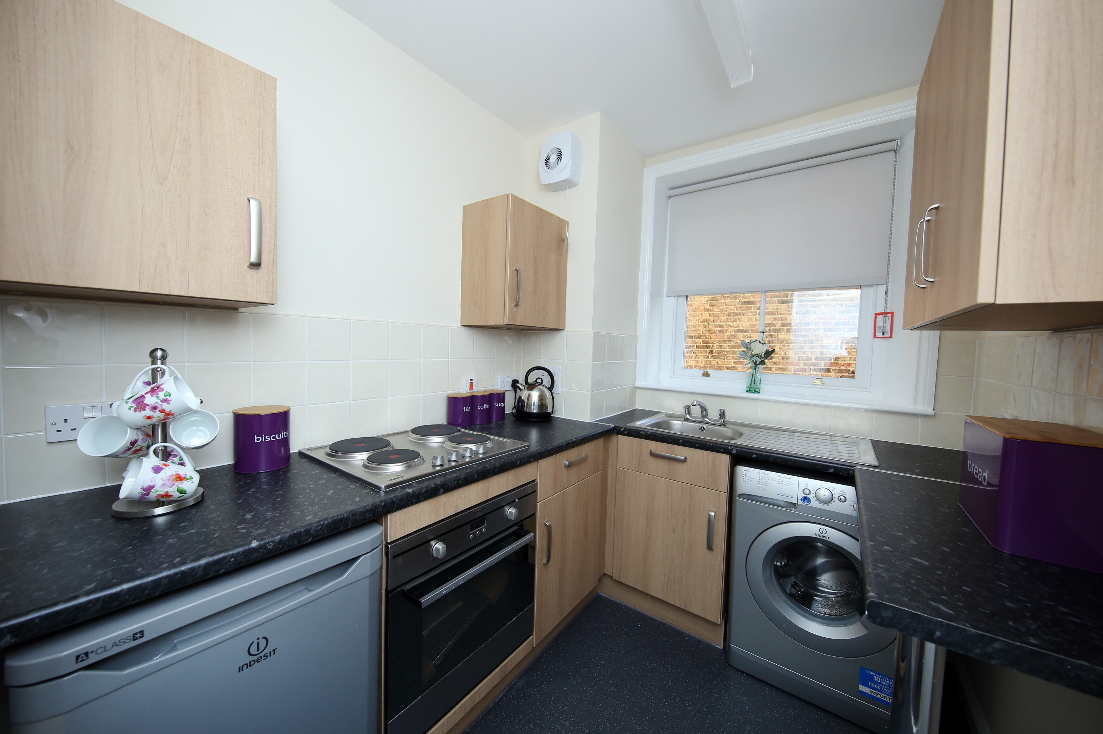
Fellows Hall

Slide 11
The Dales
Former assessment facility owned by TEWV
Refurbished by Thirteen for people with complex LD /Mental health/Autism.
£709k capital costs – jointly funded by Thirteen and TEWV
6 individual flats, staff care base, communal kitchen and communal lounges.
Rent and service charges £245 per week.

Slide 15
The Learning
It’s complex!
It’s still not joined up – despite the rhetoric
The delivery partners take the majority of the risk
But
We have developed a trusted and long standing relationship
Once occupied schemes are stable and tenants long term
Brilliant outcomes for residents

Slide 16
What’s Next?
NHS 10 year plan – priorities around mental health, LD, integrated care, STP’s
Local Authority strategic reviews – commissioning of support services, homelessness duties etc
Social Care Green Paper – forever delayed?

Slide 17
Amongst the Uncertainty
Still a demand for better quality accommodation
Schemes are deliverable – with the right partners
Local authorities have to be joined up – commissioning, HB, planning and development
NHS could do more!
It’s risky but worth it.

Slide 18
Case Study
50 year old man
Over 20 failed placements – many of these ended in difficult situations / each time reinforcing his low self-esteem and feeling of rejection. These included mainly residential homes.
Long periods in hospital including secure setting
Challenging behaviour – ability to burn out staff very quickly
Non-Compliant with his support plan
History of excessive drinking
History of threats and actual self injury
Long term history of making nuisance calls to emergency services – he was in the police force top 10 for making nuisance calls
Case made that a supported tenancy would be appropriate

Slide 19
Case Study
18 months on
He is proud of his flat, it is spacious, has good dimensions and light with access to an outside courtyard
Incidents have occurred where the property has been damaged, but repairs have been completed quickly and the tenant has paid for these.
Staff can give him the space when he requires. The communal area allows for people to socialise / meet.
Following a visit his care coordinator contacted reported:
For the first time ever he had a Christmas tree (his father died on Christmas day when he was a teenager).
He had food in his cupboards (he would usually spend money on alcohol).
He was clean and wore clean clothes.
A friend called during the visit and he was ‘nice person’.
In knowing the service user for 20 years, this was the best that she had seen him, ever.
Over the past 6 months the service user has been on holiday twice, he has developed friendships in the local area.
We do see challenging behaviours, these are however infrequent rather than on a regular basis.

Slide 20
Case Study
Costs - Fellows Hall
Weekly care £2600
Accommodation £153.24
Total £2753.24
Hospital proposal would have been £4000 a week.

