Slide 1

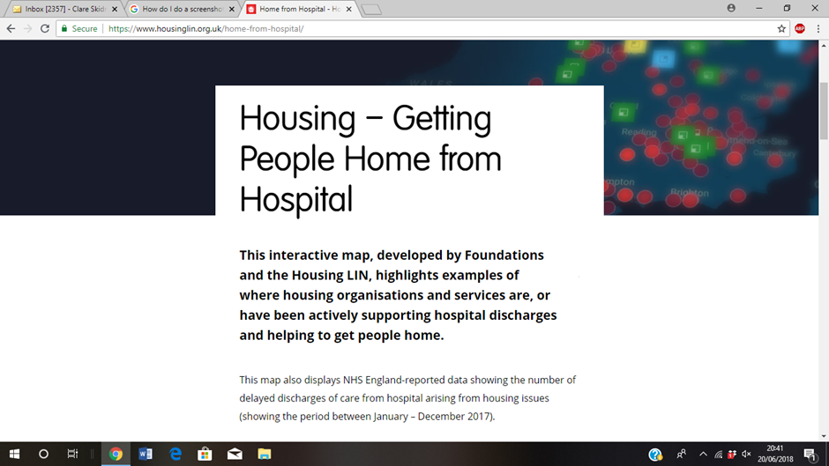
Home from Hospital – Interactive Map
Developed jointly by Foundations UK and Housing LIN
Highlights where housing organisations are supporting hospital pathways in range of practical ways
Projects from across England are
profiled, set alongside ‘DToC’ (Delayed Transfer of Care) data
Aim: To inspire, support and inform conversations about what might be possible locally
Quarterly updates planned to capture new activity
Visit https://www.housinglin.org.uk/home-from-hospital/

