Slide 1
Health and Housing
North East Region Housing LIN/ADASS
January 22nd 2019
Lorna Smith
Specialty Registrar in Public Health
Durham County Council

Slide 2
Public Health Principles
Aims
  Prevent illness
  Improve population health
  Reduce inequalities in health
  Improving health services
Approach
  Promotes a collective responsibility
  Based on social determinants of health and disease
  Focusses on population groups
  Delivers evidence-based interventions
  Efficient prioritisations of resources
  Embeds and advocating for equity

Slide 3
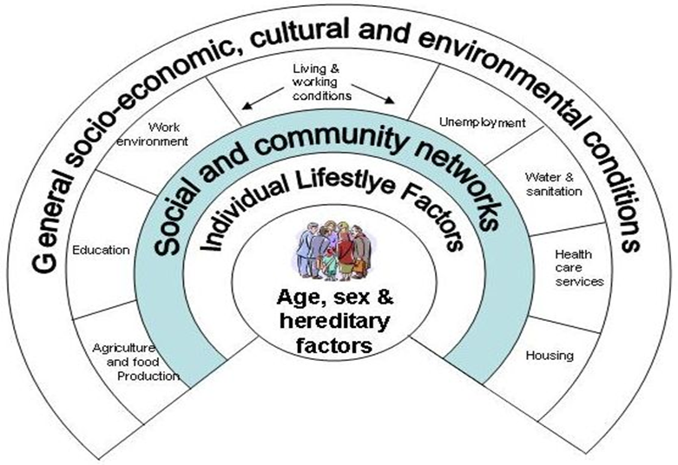
Where does housing fit?

Slide 4

Pollution
Noise
Community
Neighbours
Public Transport
Amenities
Warm
Space
Affordable
Accessible
Safe
Secure
Basic needs
Adaptable

Slide 5
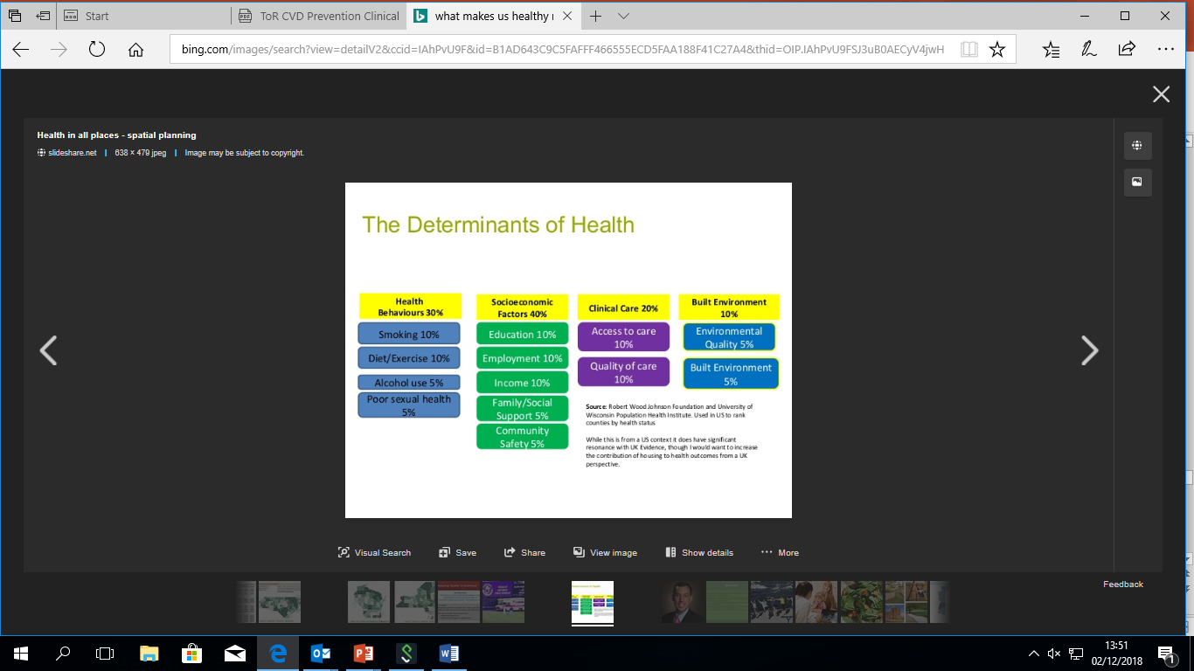
What makes and keeps us healthy?
Notes:
The home is a driver of health inequalities, and those living in poverty are more likely to live in poorer housing, precarious housing circumstances or lack accommodation altogether.
including our mental health, everyday health choices, and our surroundings – not just health care services. While pressures on front line services dominate the news, the actual impact of those services to our health overall is actually relatively small. Access to healthcare is of course important but more healthcare does not necessarily mean better population health. Public health is concerned with the building blocks which need to be in place for good health such as good housing, employment , education, reducing the numbers of children in poverty……..

Slide 6
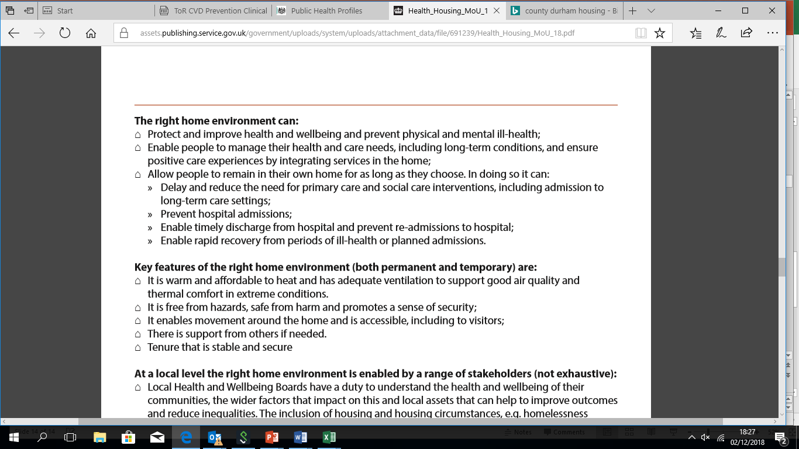
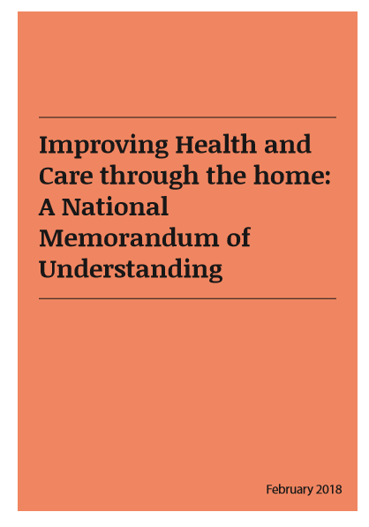

PHE Housing and health: MOU
Notes:
Better strategic planning:
Better understanding of the preventative role of housing:
Greater collaborative care: including prevention and transfer of care or discharge planning.
4. Better use of resources:
5. Improved signposting:
6. More shared learning:
7. Wider sector engagement:
Evidence suggests it can:
Improve health & wellbeing & prevent ill-health
Enable people to manage their health and care needs
Allow people to remain in their own home for as long as they choose
Ensure positive care experiences
And it can contribute to:
Delayed & reduced need for primary care & social care interventions, including admission to long-term care
Timely discharge & reduced hospital re-admissions
Rapid recovery from periods of ill-health or planned admissions
In PHE
‘Triple F’ programme (falls and fragility fractures)
Cold weather and heat plans
Priorities: dementia; TB; alcohol; obesity
DH & DCLG
Home adaptations, specialist housing, planning
NHS England
Contribution to £22bn efficiencies: falls prevention
Out of hospital urgent care: better use of care at home
Healthy New Towns: learning from new/regeneration
House of Lords select committee on built environment
Future of ageing population policy
and social care sectors to enable this. This MoU brings together key organisations, decision-makers and implementers from across the public and voluntary sector, to maximise opportunities to embed the role of housing in joined up action on improving health and better health and social care services.

Slide 8
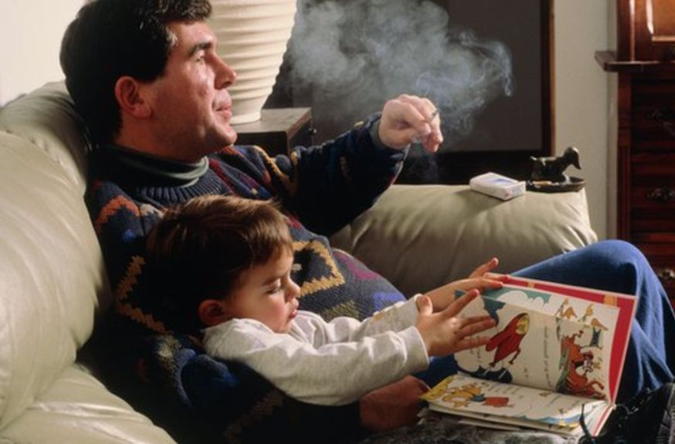
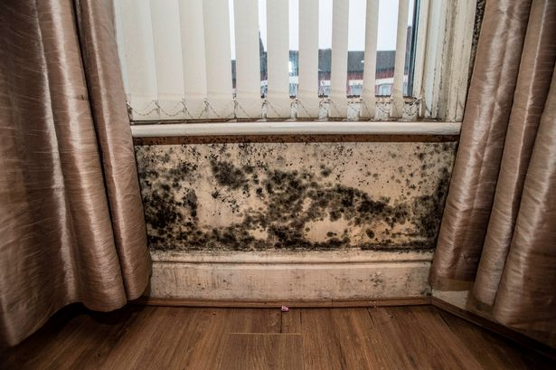
An unhealthy home: creates morbidity
Cold, damp or otherwise hazardous
Respiratory illness
Cardiovascular problems
Mental health problems
Injuries, particularly in children and older people
Poor diet in children, poor infant weight gain
Domestic fires
Excess winter deaths
Notes:
Our health is determined by our genetics, our lifestyle, the health care we receive and the impact of wider determinants. Such as our physical, social and economic environment including, for example, education and employment, as identified by Dahlgren and Whitehead(5) in their seminal diagram.
individual
layers of influences on health (‘determinants’), such as lifestyle, community networks, living and working conditions - including access to services - and socio-economic conditions.
Reference:
Dahlgren, G. & Whitehead, M. (1991) Policies and strategies to promote social equity in health. Stockholm: Institute for future studies
Source: NHS Education for Scotland (2011) Bridging the Gap: Introducing the Wider Determinants of Health - http://www.bridgingthegap.scot.nhs.uk/understanding-health-inequalities/introducing-the-wider-determinants-of-health.aspx

Slide 9
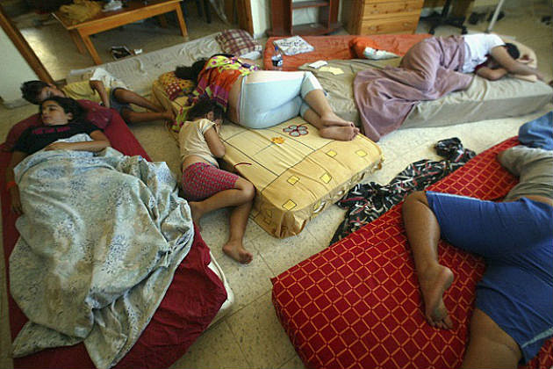
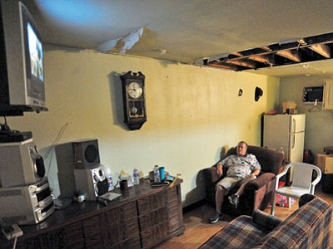
An unsuitable home: increases vulnerabilities
Overcrowded or not meeting residents’ needs
Communicable disease
Mental health problems
Limited to one room
Negative impacts on children’s development
Physical injury
Social problems e.g. interpersonal conflicts, isolation
Prevents independence, hospital discharge
Notes:
Our health is determined by our genetics, our lifestyle, the health care we receive and the impact of wider determinants. Such as our physical, social and economic environment including, for example, education and employment, as identified by Dahlgren and Whitehead(5) in their seminal diagram.
individual
layers of influences on health (‘determinants’), such as lifestyle, community networks, living and working conditions - including access to services - and socio-economic conditions.
Reference:
Dahlgren, G. & Whitehead, M. (1991) Policies and strategies to promote social equity in health. Stockholm: Institute for future studies
Source: NHS Education for Scotland (2011) Bridging the Gap: Introducing the Wider Determinants of Health - http://www.bridgingthegap.scot.nhs.uk/understanding-health-inequalities/introducing-the-wider-determinants-of-health.aspx

Slide 10
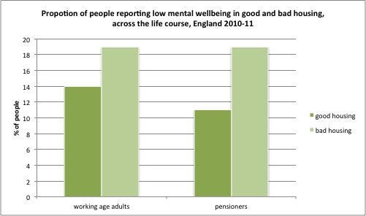
Housing and mental health

Slide 11
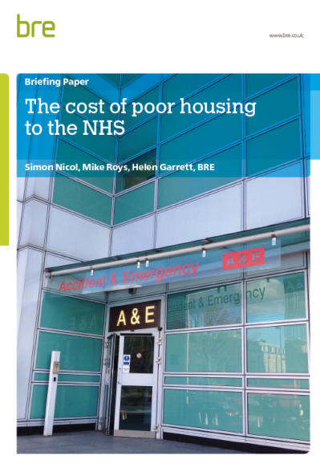
The cost of poor housing
Annual cost of poor housing to society estimated at £18.6bn:
  1.4bn in NHS treatment costs
  £6bn investment to reduce cold homes in 15% poorest quality housing stock would save the NHS £848 million per year
Higher costs of poor housing to the wider public sector and to individuals:
  £1.8bn in crime and offending costs,
  £14.8bn in lost earnings for one generation as a result of educational under-attainment.

Slide 12
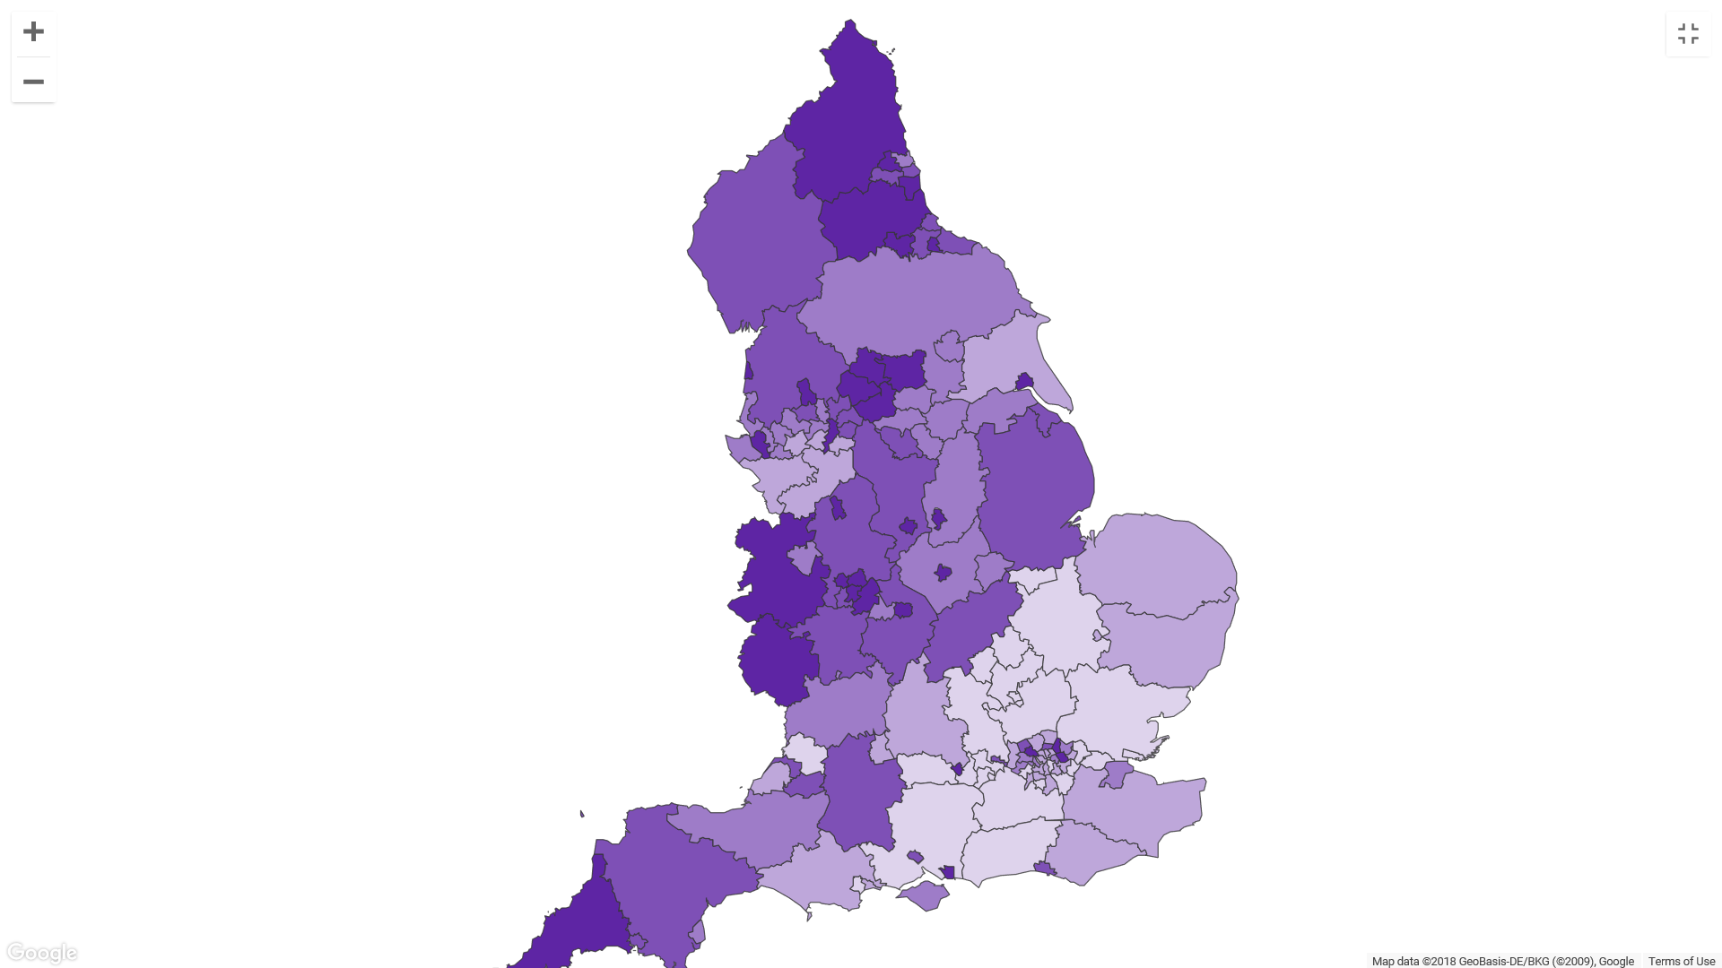
Fuel Poverty by quintiles – England 2015
PHE monitors it through QOF
Concentrations of fuel poverty
Urban problems in some of our more deprived urban areas
Contribution to the inequalities experienced in rural areas
Exacerbates risks in most vulnerable groups

Slide 13
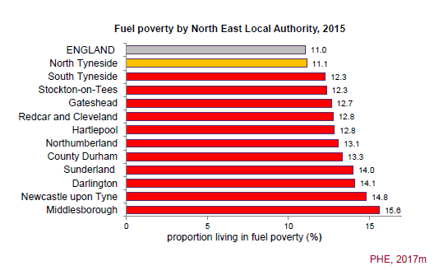
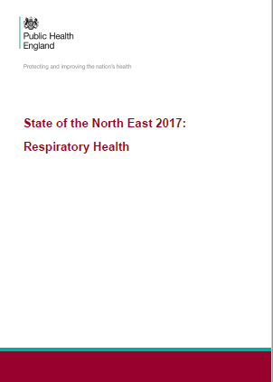
North East Fuel Poverty
People have a low income and experience high energy costs in order to adequately heat their home
Due to poor energy efficiency in their property or high energy prices.

Slide 14
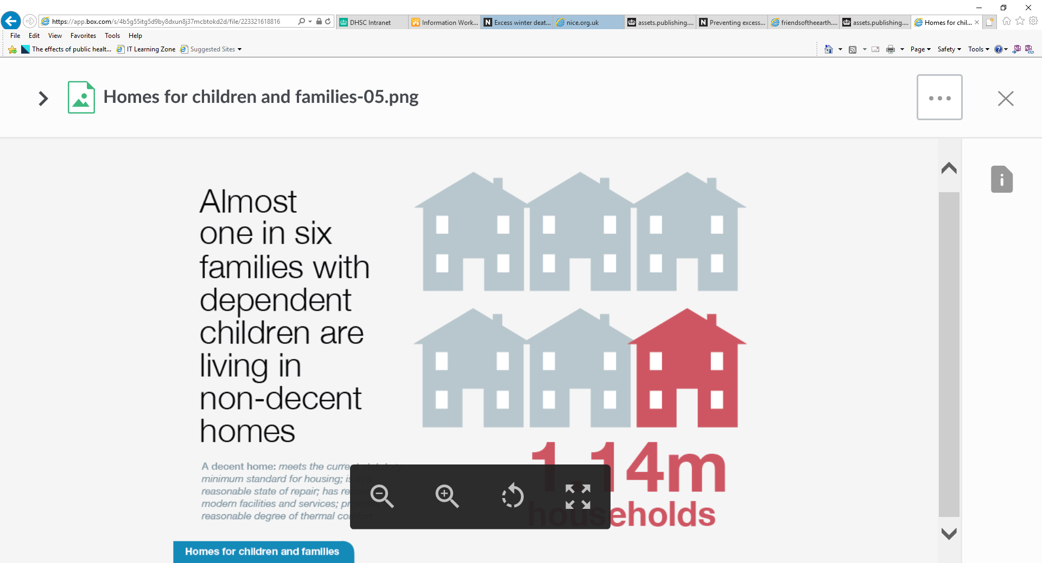
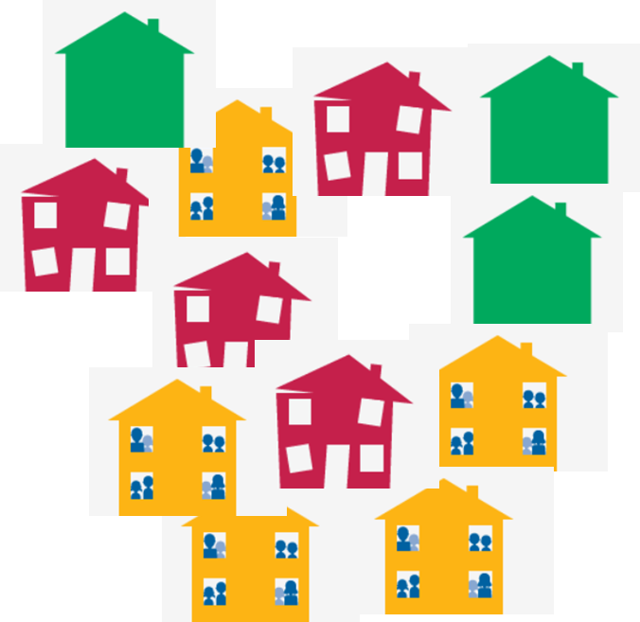
Cold Homes: Impact on Health
Respiratory health
e.g. resistance to respiratory infection, trigger bronchoconstriction and asthma
Circulatory problems
e.g. increased BP and stroke, coronary events more fatal in cold period
Long term conditions
e.g. exacerbate diabetes, MSK, slow recovery following hospital
Mental health
e.g. Multiple mental health problems in cold homes, isolation
Notes:
Respiratory
Links between cold temperatures and respiratory problems:.
Resistance to respiratory infections is lowered by cool temperatures and can increase the risk of respiratory illness.7
Cold temperatures have been found to impair the functioning of the lungs and may trigger broncho-constriction in asthma and chronic obstructive pulmonary disease.
A case-control study also found that people with asthma were two to three times more likely to live in cold and damp household conditions than non-asthmatics
Circulatory
Research suggests that deaths from cardiovascular disease in England were 22.9% higher in winter months than the average for other times for the year.
cold affects circulatory health where temperatures fall below 12°C, which results in raised blood pressure, caused by the narrowing of the blood vessels, which can lead to increases in blood thickness as fluid is lost from circulation. Increased blood pressure, and increased blood viscosity, can increase the risk of strokes and heart attacks.20
research analysing coronary events in people aged 35-64 across 21 countries found coronary events to be more fatal during colder periods than in warmer periods
Mental Health
increases in room temperature were associated with reduced likelihood of experiencing depression and anxiety.
Young people living in cold homes were more likely to be at risk of multiple mental health symptoms, experiencing four or more negative mental health symptoms.23
28% of young people lacking affordable warmth were at risk of multiple mental health symptoms, compared with just 4% of young people living in sufficiently warm homes.
Children and young people
Children growing up in poor housing conditions (including cold living conditions) were more likely than others to experience mental health problems, such as depression and anxiety; more likely to experience slower physical growth and cognitive development; and had higher risks of respiratory problems, long term ill-health and disability.
children living in cold, damp and mouldy homes have been found to be between 1.5 and 3 times more likely to develop symptoms of asthma than children living in warm and dry homes. Children living in inadequately heated accommodation were twice as likely to suffer from chest and breathing problems as children living in warm homes.
LTCs
Studies indicate that cold conditions can exacerbate existing medical conditions including diabetes, certain types of ulcers and musculoskeletal pains.
increased likelihood of developing symptoms of asthma and bronchitis which can develop into long-term conditions.
cold homes may slow down recovery following discharge from hospital
Older people
cold temperatures can cause blood pressure to rise in older people, increasing the risk of strokes and other circulatory problems.
One study examined residents aged over 65 across the London Borough of Newham and hospital admissions for respiratory diagnosis, ranking these against the Fuel Poverty Index (FPI). The FPI included factors of housing energy efficiency, low income, householder age and under-occupation. The study found the FPI to be a predictor of hospital admittance,
,cold homes have been associated with lower strength and dexterity and exacerbated symptoms of arthritis, which can increase the risk of falls and unintentional injury.

Slide 15
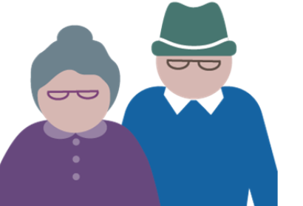
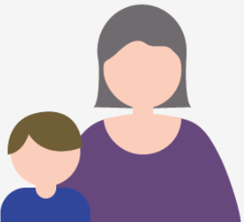
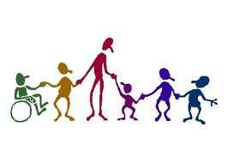
Impact on vulnerable people
Older people, unemployed, single parent families, young people (<35) in private rentals, working poor and multiple person households
Older people
e.g. Strokes, flu, risk of hospital admission, lowered strength and dexterity
Children and young people
e.g. slow physical growth, cognitive delay, respiratory and MH problems
People with disabilities
e.g. mobility too limited to be able to keep warm
(Fuel Poverty Statistics Report, 2018)
Notes:
Unemployed 4 times more likely
Private rentals twice as likely

Slide 16
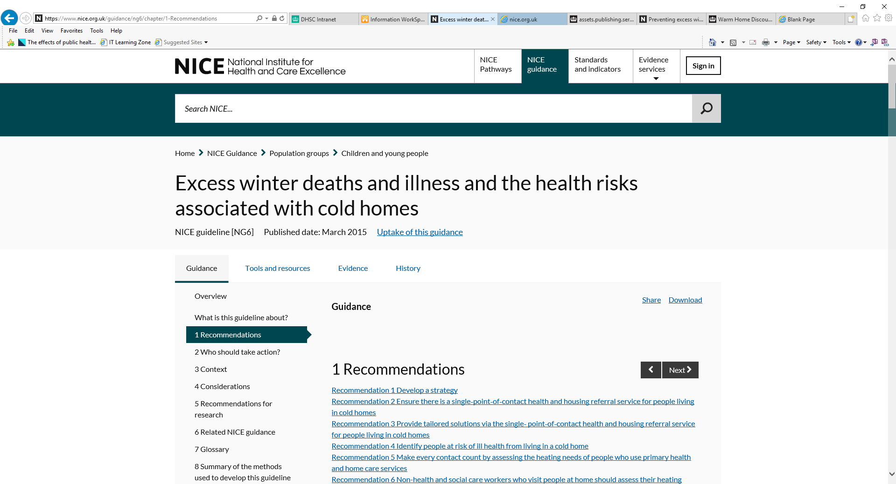
Call to action: NICE guidance
A strategy from Health and wellbeing boards
Single point of contact service
Identifying people at risk
Referral pathways to enable access
Tailored solutions
Roles of Health & Care services and non Health workers in assessing need
Using existing infrastructure

Slide 17
Durham PH Housing Commitments
Good housing for all
Housing Strategy Health Impact Assessment
Fuel Poverty
Partnership group
Review MECC and implement NICE
Social Housing
Falls prevention
Accident prevention
Dementia-friendly homes
Private Sector Landlords
Proposed licensing scheme
Preventing Homelessness
Needs assessment and pathway reviews
Preventing and managing domestic abuse
Supporting ex-offenders
Not in education, employment or training
In work poverty
Poor mental health
Drug misuse
Alcohol misuse
Loneliness
Falls
Carers

Slide 18
Health and housing shared priorities
Addressing poverty
Awareness of support for warm homes / fuel poverty
Identification of at-risk groups (health status; income; age)
Early Years
Preventing accidents in the home
Increasing the Home Environment Assessment Tool (HEAT)
Family approaches to earlier identification of neglect and safeguarding
Older people
Falls prevention, re-ablement / adaptations
Ageing friendly towns

Slide 19
Targeting action with vulnerable group
Develop approach to homelessness in regard to offenders
Private landlords license scheme implications
Input to the Rough Sleepers Strategy group from substance misuse perspective with Drug and Alcohol services engagement Referrals into Wellbeing for life
Workforce development for housing and support staff – Making every contact count (MECC) and Mental Health@scale training
Referrals and processes for domestic abuse support

Slide 20
Conclusion
Good quality homes create positive health and wellbeing
Poor housing can put health at risk and exacerbate existing health conditions
The health and housing agenda requires broad thinking across disciplines
Strategic action is required at each local area
Planning and delivery can build on the existing infrastructure and measures
We need to exchange intelligence of needs / demands of communities
The health and social care sector has a role to play in enabling access to available schemes and support for clients with direct benefit to outcomes
Homes should be designed to maximise opportunities not just minimise harms

Slide 21
Thank you
Lorna Smith
Specialty Registrar in Public Health
Durham County Council
Lorna.smith@durham.gov.uk /
lornasmith1@nhs.net

