Slide 1
Welcome
Our rented ShireLiving apartments offer peace of mind and security for those looking to enjoy a hassle free retirement.
Notes:
Welcome & Good Morning / afternoon
My name is Karen Bate, I am an Area Manager for ShireLiving
Thank you for coming along to our ShireLiving Open Day, the aim of today is for us to provide you with information about ShireLiving and our new developments both here in Oswestry and in Shrewsbury.
ShireLiving is our Brand name for Extra Care Housing / or Housing with Support. ShireLiving is not a care home. It is independent living where people have their own front door (read of the slide – our rented ……)
Next slide

Slide 2
Live the life you choose
Notes:
As you will see we have a number of stands for you to visit and ask the staff questions and course help yourself to some of the freebies.
Each of the stands are either a partner or product under the umbrella of the Wrekin Housing Trust Group
On the stands we have:-
ShireLiving - information on the new development, and how to register (Denise & myself)
ShireLiving Money Matters / Welfare Advice – (Carol) unfortunately she is unable to give in-depth advice today, but she can make individual appointments
Choices – information on their Domiciliary service
Reviive – Up recycling furniture & recently start their removals service
ShireLiving Catering – display of fresh produce, meal packages
WATCH – Home pendant alarm service
MONKs – Local estate agent who is working with ShireLiving and for those of you who may have a house to sell and would like some advice
All of them are either a product or partner

Slide 3
Live the life you choose
Notes:
ShireLiving is our brand name for housing with support or otherwise know as Extra Care Housing
ShireLiving is a partnership between WHT – who own &maintain the buildings and tenants have a WHT tenancies
Choices have a management agreement with the WHT to provide the 24/7 onsite service within the development.
By the end of the year we will have 8 ShireLiving developments, out latest developments are

Slide 4
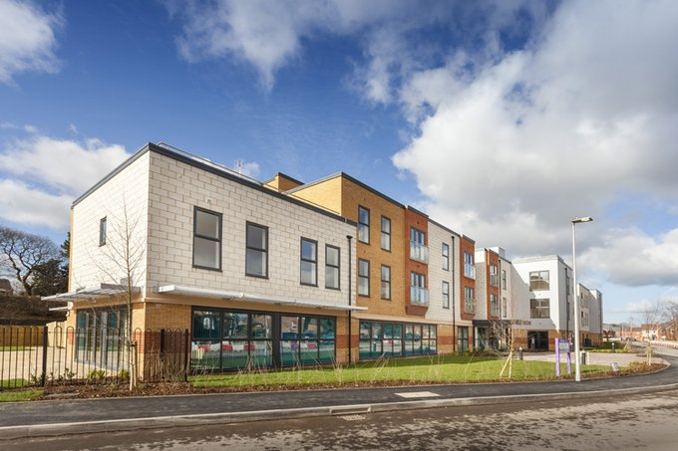
Withywood – Shrewsbury
Live the life you choose
Notes:
Withywood on the Ellsmere Road Shrewsbury, has been open since January 69 apartments mix of one & two bedroom

Slide 5
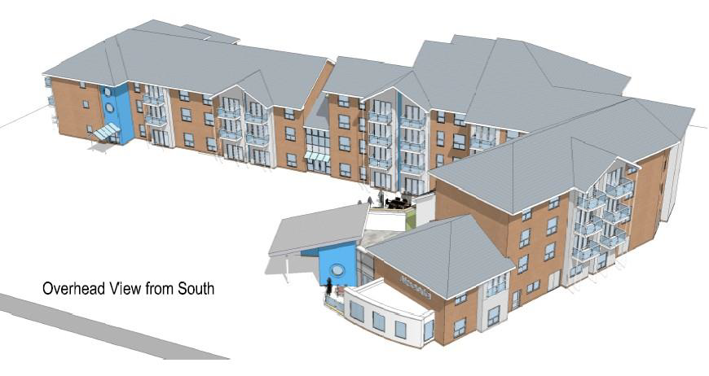
Ashwood – Oswestry
Live the life you choose
Notes:
Ashwood – Off Alexandra Road – Oswestry, due to be completed and handed over to the WHT early July
53 apartment mix of one & two bedroom Plus 8 bungalow 6 two bedroom / 2 one bedroom

Slide 6
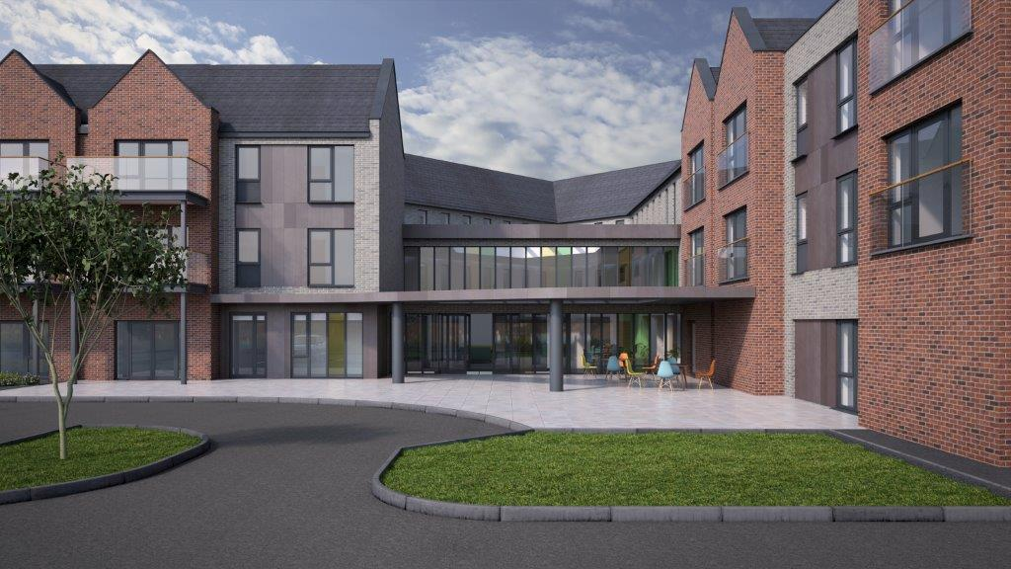
The Coppice – Bicton
Live the life you choose
Notes:
The Coppice at Bicton, Shrewsbury the current expected date we have for completion and handed over to the WHT is Mid to end of October (20th ) with occupancy January 2018 - 85 apartments mix of one & two bedroom

Slide 7
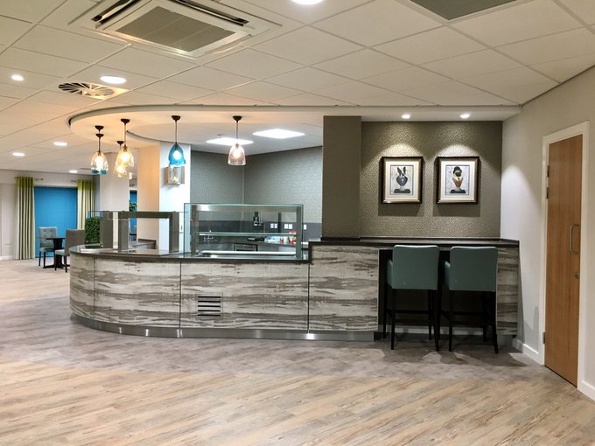
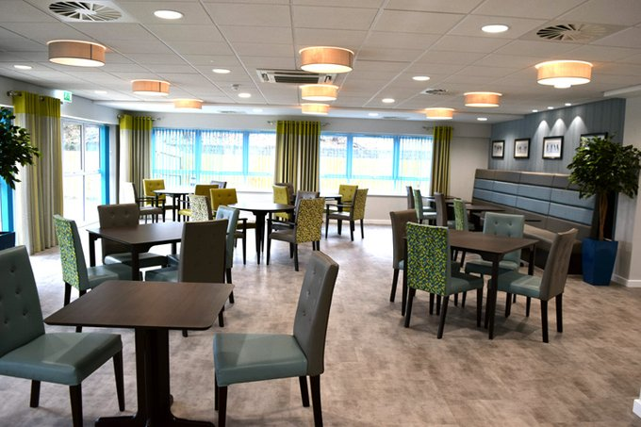
Onsite restaurant
Live the life you choose
Notes:
We aim to given all of our developments the Five Star Hotel feel – and for those of you who have been to see Withywood I’m sure you will agree,
All developments have an onsite restaurant which are open to the general public as well as the residents

Slide 8
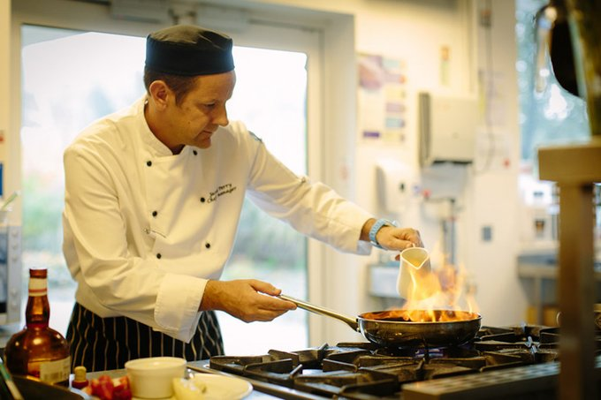
homemade fresh food
Live the life you choose
Notes:
Our restaurants offer locally sourced produce, which is freshly cook on site.
Claire will be happy to give more information regarding menus and meal packages

Slide 9
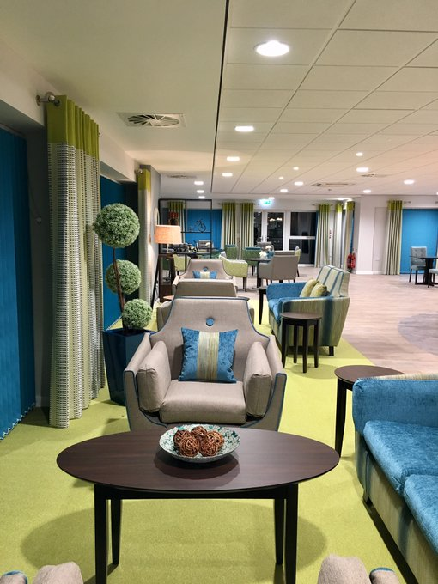
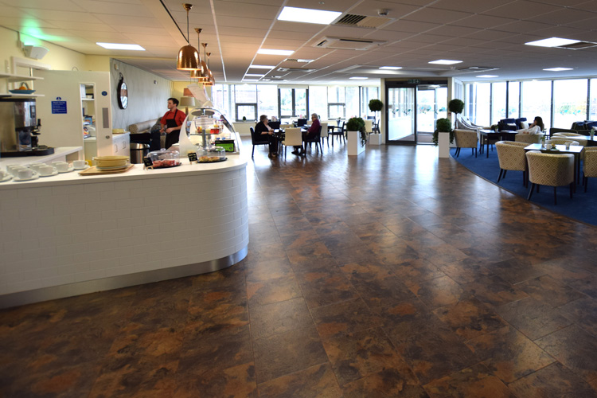
Communal facilities
Live the life you choose
Notes:
Communal facilities some of the communal facilities are for general public to use and some are for residents and their visitors only
We always encourage the local community into our ShireLiving schemes because the people living in our scheme are still part of the community and we want the community to be part of the scheme

Slide 10
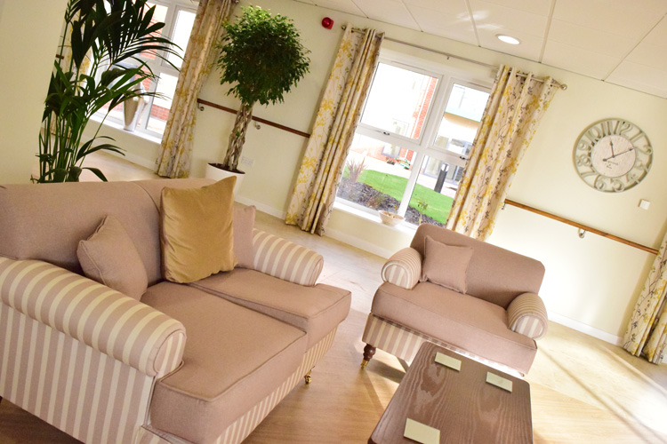
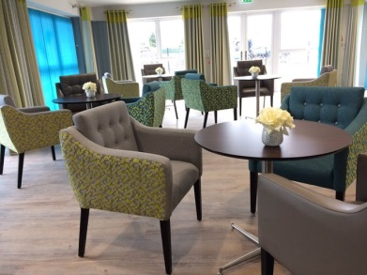
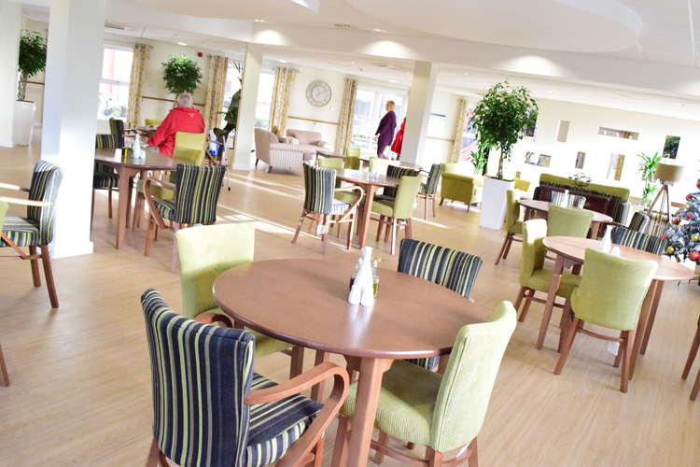
Communal facilities
Live the life you choose

Slide 11
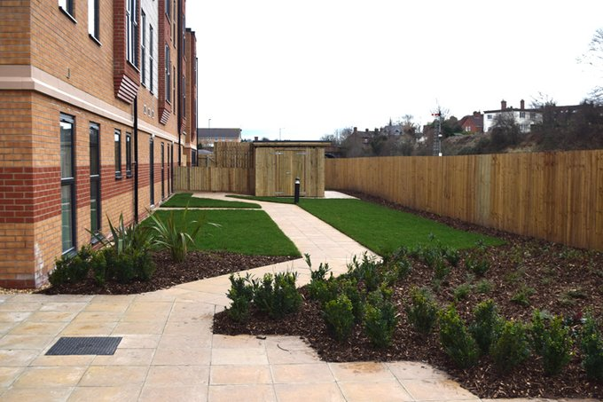
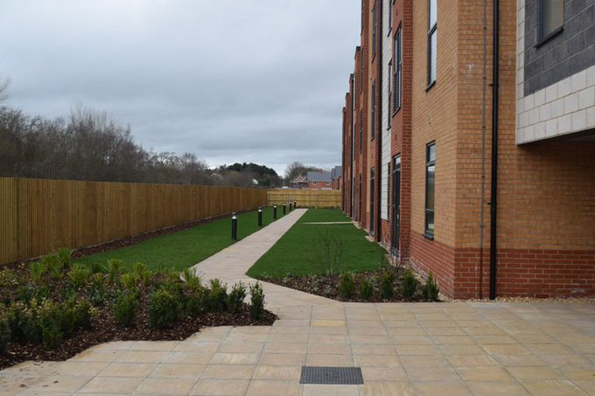
Well maintained gardens
Live the life you choose
Notes:
All developments have well maintained secure gardens, the Coppice will have an impressive garden with a central feature

Slide 12
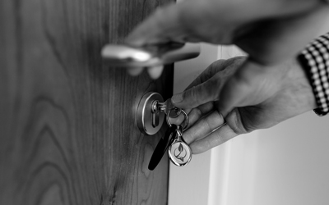
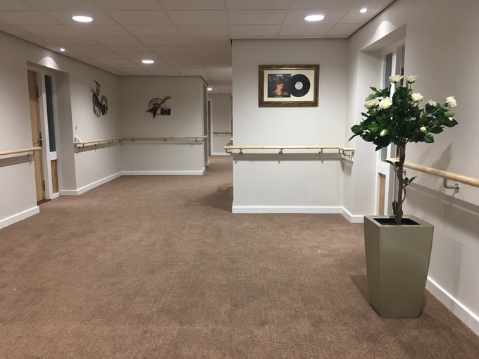
Own front door
Live the life you choose
Notes:
All residents have their own front door, their own tenancy – enabling them to decide if they want to join in social events or not.
Even their post is delivered to their front door

Slide 13
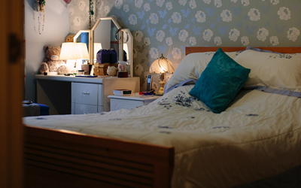
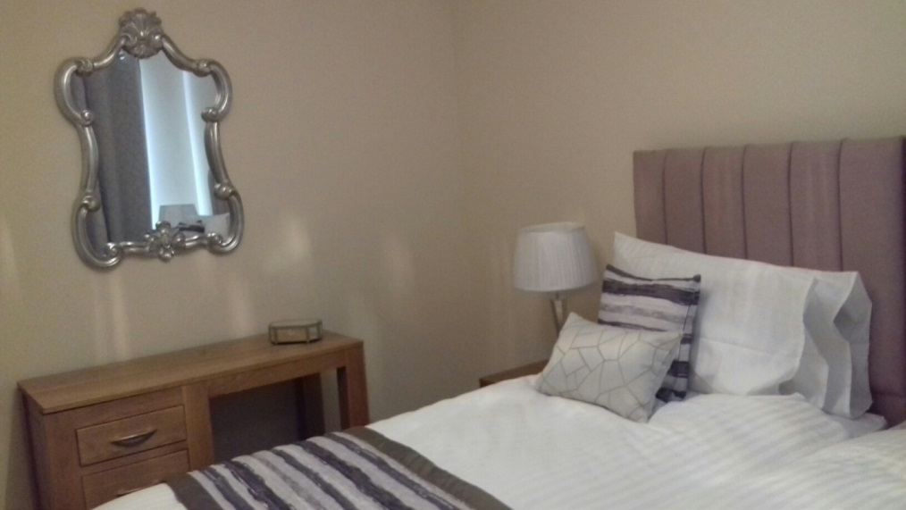
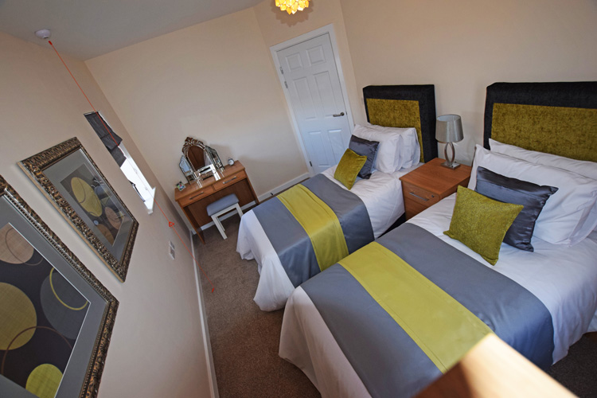
One & two bedroom apartments
Live the life you choose
Notes:
The Coppice has a mix of one & two bedroom apartments. Over three floors (ground, first & second floor)
The majority of the ground floor apartments have patio door and their own terrace
The majority of the upper floors have walk out balconies

Slide 14
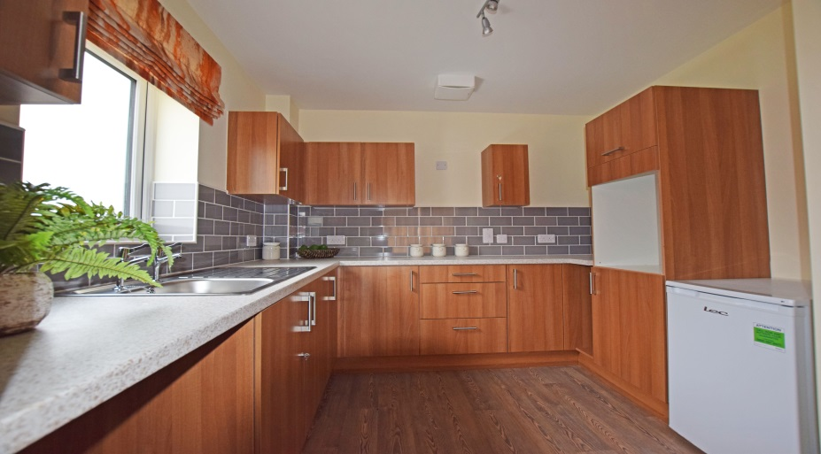
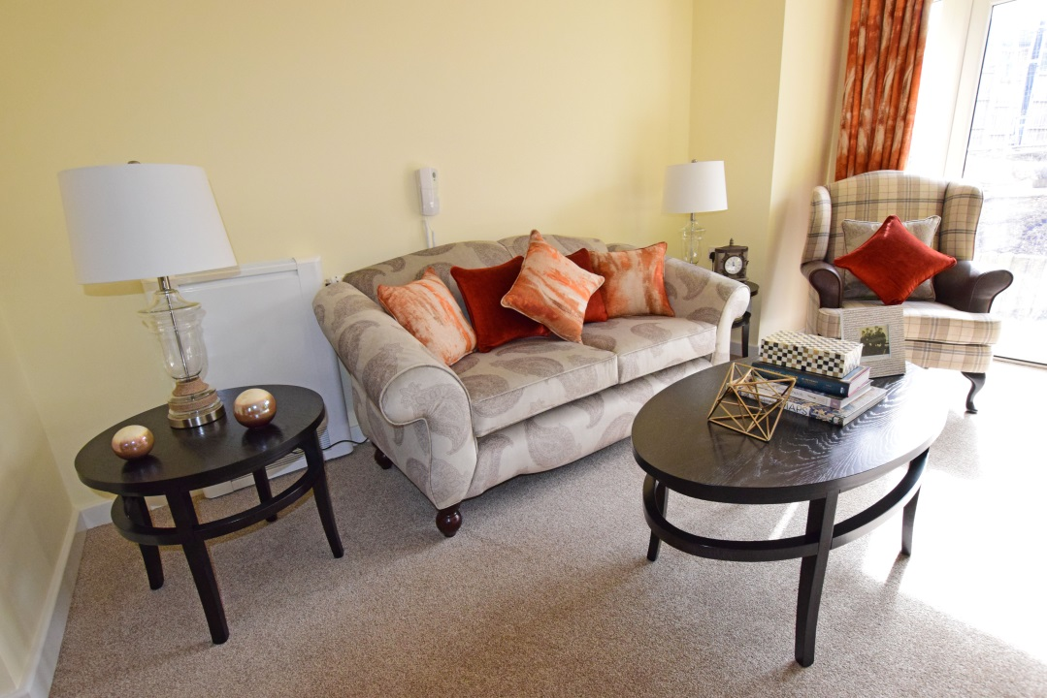
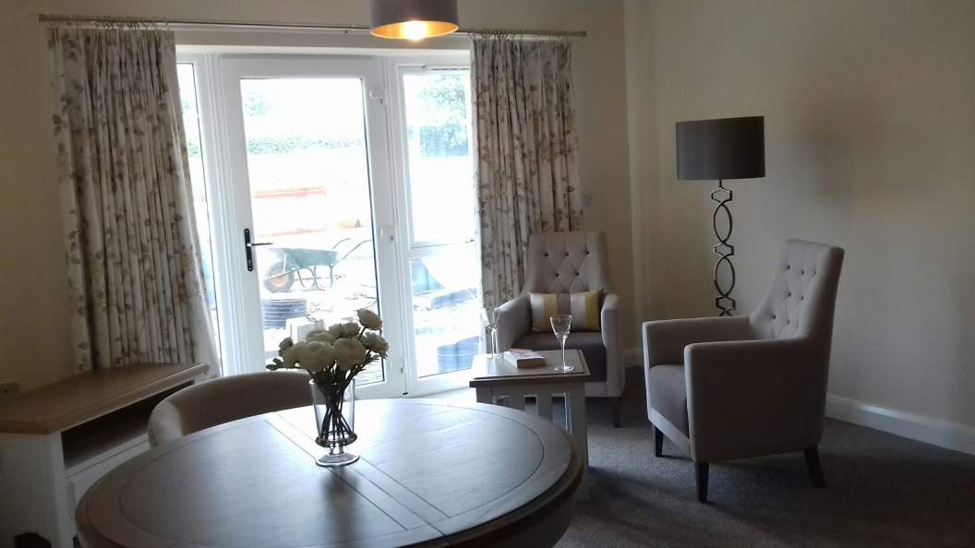
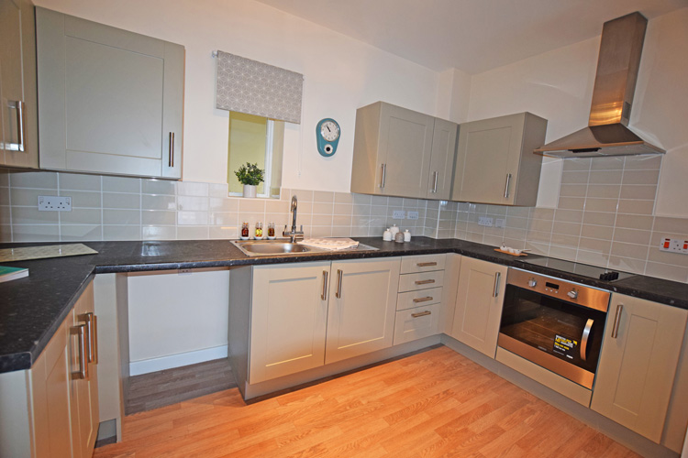
Open plan kitchen / lounge
Live the life you choose
Notes:
All apartments are an open plan design – kitchen / lounge

Slide 15
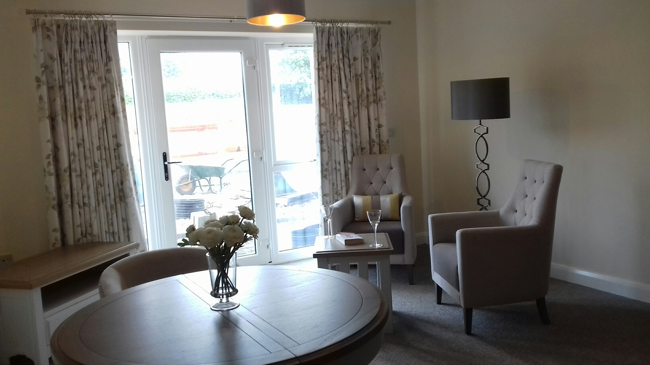
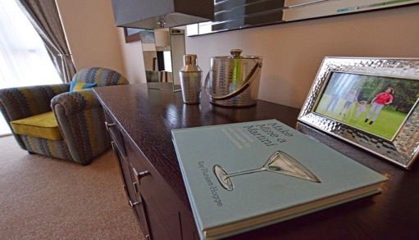
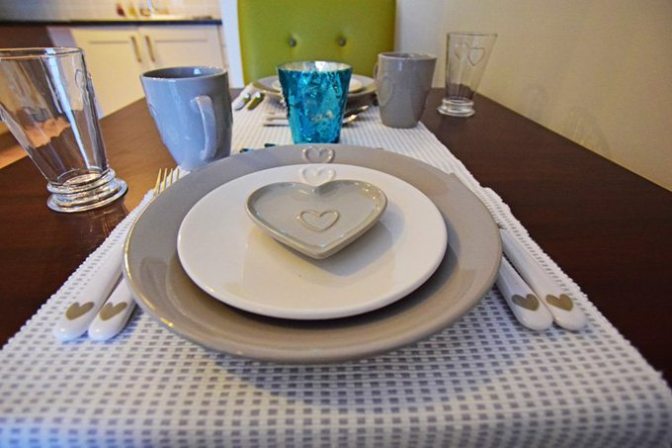
Lounge / Dining
Live the life you choose
Notes:
Lounge dining

Slide 16
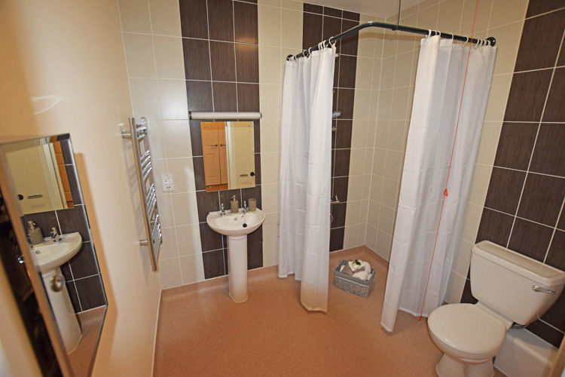
Accessible shower room
Live the life you choose
Notes:
All apartments have accessible shower room,
however within the building there is a pamper bathroom, for those residents who would like a both and is able to use a normal bath
But for those residents who needs assistance with bathing there is an assisted bathroom

Slide 17
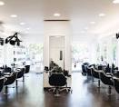
Hairdressers, Nail Bar & Therapy Room
Live the life you choose

Slide 18
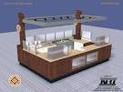
Kiosk
Live the life you choose
Notes:
The will be a small kiosk, selling some essential items

Slide 19
Pervious Question Asked
Questions:-
Can I have my Grandchildren or visitors stay over night? YES. Providing they don’t cause nuisance, annoyance or stay for prolong periods of time.
Can I have a visiting pet? YES however we ask that the
dogs are taken to the apartment via the shortest route,
not to stay overnight, and not to be taken into the
communal garden.
What is the heating system? The heating is provided
from the central plan room, however each of the
apartments have their own programmer, room & radiator
thermostats.
Are the apartment carpeted? YES and we gift them over
to the tenant when they sign their tenancy
Live the life you choose

Slide 20
Previous Question Asked
Questions:-
What white good are provided within the apartment? Oven, Hob & extractor hood and as the landlord we maintain these, – there is also a space for a washing machine & fridge/freezer
Can we decorate the apartments? YES however not within the first 12 months. Pictures / mirrors etc. are fine
Pamper bathroom, do I need to book? No first come , first served basis
Is there a communal laundry? YES all machines are commercial so take less time then a domestic machine, they are part of the service charge, first come, first served
Are there lifts ? YES there are two.
Live the life you choose

Slide 21
Previous Question Asked
Questions:-
Do I have to pay a deposit? NO however at the point of signing the tenancy we do require two weeks rent in advance .
If I sign a tenancy , am I locked in for the full period of the tenancy? NO if you want to end your tenancy we require 4 weeks notice .
Is there WIFI? Yes in the communal area, however if someone whets WIFI in their apartment they would need to make there own arrangements though a provider
If I have Sky do I need my own satellite dish? NO each apartment has a connection to the communal digital ariel .
Were do I take my rubbish? There Is a communal bin store which will enable you to dispose of your household & recyclable items. Alternative arrangements for bulky items
Live the life you choose

Slide 22
For more information
call us on
0800 023 22 44
Live the life you choose

