Slide 1
Creating partnerships to fund homes for the most vulnerable in our society
Henley Social Investments [HSI]
2018
The content of this document has not been approved by an authorised person within the meaning of the Financial Services and Markets Act 2000. Reliance on this document for the purpose of engaging in any investment activity may expose an individual to a significant risk of losing all of the assets invested. There is no right to compensation in respect of poor performance

Slide 2
“The projected national demand for Specialist Supported Housing is 3x higher than previously anticipated and expected to increase by roughly 7,000 units (to 29-37,000 units) by 2027/28”*
Specialist Supported Housing
“Demand for SSH is increasing because it is becoming more difficult to provide housing with public subsidy”*
“.......SSH is found to be a cost-effective way of providing housing for those with the most complex needs”*
*Mencap and Housing Learning and Improvement Network [LIN], ‘Funding supported housing for all: Specialised Supported Housing for people with a learning disability’, April 2018
Notes:
Summary of the situation:
What is SSH?
‘Homes for Life’ in the community for vulnerable adults, who will otherwise have to live in residential care to meet their needs. The majority of whom have 24/7 on-site care.
Assess the current situation in their areas to understand opportunity – how many per year, how they currently manage and partner with, aware of Henley model and align need for it
What are the Drivers of Demand?
Higher survival rates at birth & increasing life expectancy
National and local policy that promotes people moving out of, or avoiding, registered care to live in community-based housing
The often-lower overall cost for LAs of housing based alternatives to residential care
Discuss the high demand for SSH but low supply of housing
Assess the current situation in their areas to understand opportunity – how many per year, how they currently manage and partner with, aware of Henley model and align need for it

Slide 3
Who are HSI?
What do we do?
HSI is a social investment fund established in 2012
We are committed to being the partner of choice providing high quality homes for vulnerable adults enabling them to live independently in the community
Since 2012 we have delivered more than £250m of supported housing to the sector
Partner with Commissioners, Care Operators and Housing Associations
Provide 100% grant-free capital funding & create new supported housing stock
Manage everything in-house from sourcing, purchasing, through design and refurbishment to rent testing.
Remain focused that we are creating homes and not just houses
Notes:
STATE THE IDEA:
I am going to show you how we can partner together with a Housing Association and Care Provider to create new SSH stock bespoke to the individuals needs, funded by 100% grant-free capital funding, and most importantly improve lives through supplying high quality homes for life?
Establised in 2012 as HHI, we are committed to being the partner of choice for specialist adapted homes for vulnerable adults wanting to live independently within the community.
What we do?
We want to build long term partnerships with Care Providers, Local Authorities and Housing Associations in areas where we can most make a difference
Provide 100% grant-free capital and funding to create new supported housing stock
Whilst we will lead the sourcing of property, this is a partnership and we will have dedicated specialists to help all parties along the journey
Keep front of mind we are building a home for someone, not just a house
What?
We partner with ASC commissioners & framework Care Providers to understand established demand.
We work together to identify appropriate properties or sites for these individuals.
We provide the capital funding to bring a range of new SSH accommodation to market
We then lease these properties over the long term to Registered Providers, who provide the required intensive housing management for those who live there

Slide 4
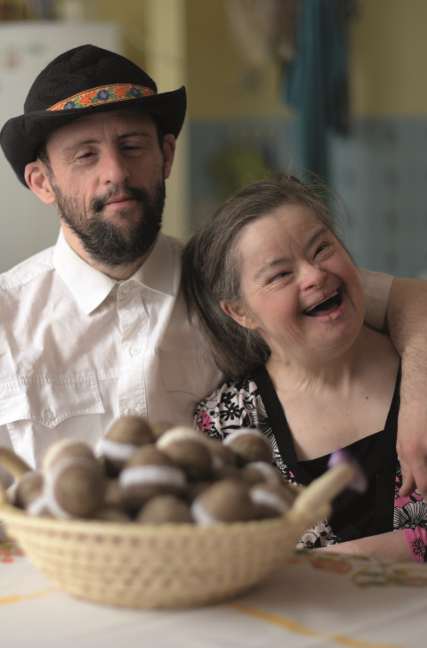
Service Users
Living independently with support in the community can have a positive impact on people’s wellbeing
Living in homes that are thoughtfully designed, each one is uniquely tailored in order to meet individual tenants’ needs, offering safe, comfortable & enjoyable living environments
Service Users feel connected with others, and are able to live fulfilling lives
People age well and remain living at home for longer; reducing the need for hospitalisation or residential care
Patients
Notes:
Partners
ASC Commissioners are therefore able to commission framework CPs to provide the care for these vulnerable adults in an environment that meets their needs whilst giving them the opportunity to live as independently in the community as possible.
This allows RPs to support vulnerable tenants in long-term, settled accommodation and provide intensive housing management services to allow those tenants to live independently in their own homes.
Service Users
There is strong evidence that SSH delivers both good social outcomes for the individual and is a cost-effective way of providing housing and care for those with highly complex needs, with lower overall costs to local authorities compared to residential or institutional care.

Slide 5
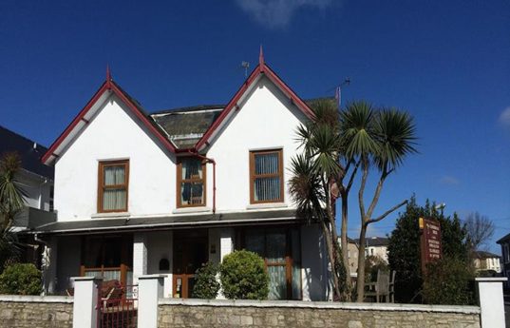
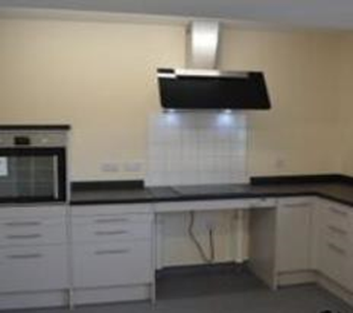
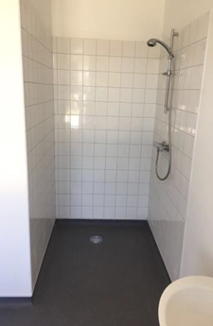
HSI Model – Access to Care with Zero Capital
Property
Purchase
Housing Association Lease
Adaptions & Refurbishment
Move In
Agreed timescale and planned handover date
We purchase, adapt and refurbish the property to your required specification
We partner your preferred Care Provider with a quality Housing Association to manage the property - leaving you free to focus on wellbeing of each individual in your care
We agree the specification with all parties upfront to minimise late adaptations and costs
You will have in-house experts at all stages of the process to ensure the needs of the individuals are met
Notes:
We purchase, adapt and refurbish the property to your required specification
- Identify demand for housing with Commissioner support, and we will source the property to your requirements
- The option to commission New Build programmes is also available
We partner you with a quality housing association to manage the property - leaving you free to focus on wellbeing
- Selection of quality Registered Providers which have competitive charges to contain gross rents
Focussed property briefing meeting once RP views and accepts the property with HSI, RP,CO, LA OT (or CO OT staff)
Upon all parties signing relevant documentation, HSI will commission the refurbishment plan
You will have in-house experts at all stages of the process to ensure the needs of the individuals are met
Property, Development & Housing Benefit Team
All partners involved in key sign offs to minimise late adaptations

Slide 6
What’s the cost?
What’s the cost?
Rents and service charges are higher than other forms of high needs housing, or general needs rent, but lower than residential or institutional care
Key factors:
The absence of public subsidy
The need for very specific locations
Greater degree of adaptations
A higher ratio of rooms to residents
The need to replace furniture/fittings more frequently
Notes:
Housing costs are funded through exempt Housing Benefit, incl lease rent and eligible service & management charge.
Care is funded through ASC via the LA or NHS’ TCP
New supply of SSH must be developed without public capital subsidy, as there is limited SSH specific central government grant funding currently available. The funding for the acquisition & development of this new supply therefore comes from two sources; an RP’s or Local Authority’s own funds or private investment, such as HSI.
Most, if not all, individuals living within SSH claim exempt HB. As such these individuals are those that require “a high level of support, which approximates to the services or support which would be provided in a care home, for residents for whom the only acceptable alternative would be a care home”.

Slide 7
Why HSI?
Potential Concern | How HSI help | Benefit to You
Lack of strategic partnership | Fully understanding the Commissioning needs with the aim of developing long-term strategic LA partnerships | Confidence that we will work within your strategy and guidelines to assist those that need it most
Care Providers | We will work with CPs on the LA framework, or where there is no framework with a preferred partner with a strong local presence | Confidence that the CP for each scheme is of a high quality, with a local presence and who has passed Due Diligence checks for viability and governance.
Stablility of Regulated Social Landlords (Housing Associations) | Due Diligence & RSH requirements must be passed. Capability for local intensive housing management must be proved. Each scheme will be viable for an RP in isolation to ensure long-term support. | Confidence you are working with a Housing Association you can trust, which has stability, quality and long term viability at the heart of governance decisions
Rent Levels | In-house teams & Housing Benefit expert working directly with LA’s Housing Benefit team for each application | Greater control & reduced cost of projects Credible relationships with HB authorities & rent-tests which allow for confidence and indicative approval in the viability of each scheme’s rents
Quality of housing design & finish and completing on time | Clear specifications agreed upfront. In-house design & construction teams keeping you involved, with a clear handover process and sign off | Confidence the project will be delivered as agreed to appropriate specification of the individuals moving in. Schemes will be delivered on time, allowing for robust planning for each individual.
Notes:
Features to Benefits:
Identify main concerns – relate to the feature we have – be clear on the benefit to the CO linking to a concern

Slide 8
Working together, we have the opportunity to meet the huge unfulfilled demand in SSH and change the lives of the most vulnerable in our society
CHARLOTTE NUNN - LA Client Relationship Manager
ddi: +44 1483 617 059
m: +44 7590 123 876
e: charlottenunn@henleyhi.com
w: www.henleyhi.com

Slide 9
Case Study
Southern unitary authority
Type of Accommodation | Shared & Self-Contained Units
Number & Profile of Cohort | 1 PD, 3 LD & 4 independent living tenants
Lease Rent PPPW | £121.97
Service Charges PPPW | £102.04
Total Eligible Rent for HB PPPW | £233.01
Commissioner Grant for Works | £300,000.00
Rent Approval Status | Approved
Nominations Rights | Care Provider - 5yrs, incl subsequent voids. Conditions in Council care framework terms for length of lease

Slide 10
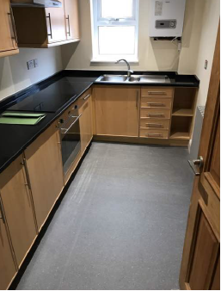
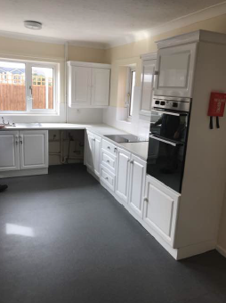
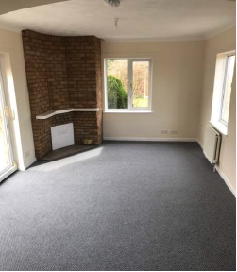
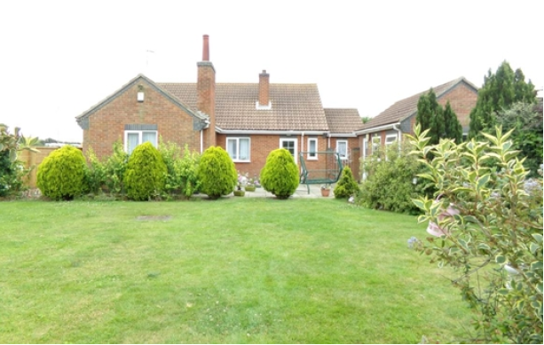
Private & Confidential
Case Study
South East Unitary Council Portfolio of 5 schemes
 | Type of Accommodation | Number & Profile of Cohort | Lease Rent PPPW | Eligible Mtg & Service Charges PPPW | Total Eligible HB Rent PPPW | Rent Approval Status | Nomination Rights
1 | Shared | 3 extra care | £230.00 | £116.39 | £364.39 | Approved | Council -10yr, incl subsequent voids
2 | Shared *1 user, 2 bedrooms | 1 LD | £375.07 | £195.27 | £570.34 | Approved | Council -10yr, incl subsequent voids
3 | Shared *1 user, 2 bedrooms | 1MD | £375.07 | £195.27 | £570.34 | Approved | Council -10yr, incl subsequent voids
4 | Shared *1 user, 3 bedrooms | 1LD | £475.07 | £195.27 | £670.34 | Approved | Council -5yr, incl subsequent voids
5 | Self-contained | 4LD | £220.00 | £108.19 | £328.19 | Approved | Care Provider -5yr, incl subsequent voids

Slide 11
Service Design
(Provider Led)
Quality
Contracting (provider) and monitoring (commissioning) for assurance
Impact and Outcomes
For people receiving support
(Commissioner Led)
Services are designed based on individuals
People live with support in the community with a good user experience
Quality is defined by best practice
Homes are safe
People age well and remain living at home for longer
People accessing support are involved in the design
Aspirations are raised for service users, to live independently
The service is designed to deliver care and maximise independence
Service users feel connected with others and are able to live fulfilling lives

