Slide 1
Ann Sutcliffe, Director Independence Trust (a subsidiary of the Connexus Housing Group)
Connexus: recently formed from merger of Shropshire & Herefordshire Housing Groups
Two very rural counties on border with Wales Dispersed, sparsely populated:
Shropshire: 0.96 people per hectare
Herefordshire: 0.86 people per hectare
England: 4.09 people per hectare
To support our tenants landlords need to be interested in broader solutions for PLACE – we need to be more than a landlord – care, employment, wealth, transport, inward investment & job creation
https://factsandfigures.herefordshire.gov.uk
https://shropshire.gov.uk/information-intelligence-and-insight

Slide 2
SUSTAIN consortium
Represent the 4 largest landlords in Shropshire/Telford
Connexus: South West & North East (& Herefordshire)
STAR: South East & North West
Housing Plus: Shrewsbury, Staffordshire
Shropshire Housing Alliance (Wrekin Housing): Telford
Also – specialist providers – Trident, ETHOS, Shropshire Rural, Mayfair, Age UK.
Vision: Collaborate, not compete – join up the offer – shared brand – add value to each other & to statutory services. Protect diversity.

Slide 3
Usual rural challenges
Beautiful countryside, inward migration of older retirees, often affluent – raises house prices. Often have money but can’t buy desired services because not viable to provide.
Loss of younger people (family & carers) can’t afford to live locally.
Low unemployment yes but mainly low wage, low skill employment: multiple part-time “portfolio” jobs – fit round family commitment – carefully appraised – working hours, security, transport costs
Poor transport infrastructure + broadband – need a car
Struggle to attract doctors, nurses, care workers to work in local GP practices and hospitals
Push to centralise to rationalise costs

Slide 4
Solutions: How social landlords can help
Housing offers - affordable rents, shared ownership, keyworker accommodation, develop for sale, retirement homes, supported housing – Foyers, Refuges, Care-leavers, brain injury, ALD, Mental illness, young families, step-down beds
What we need – partnering – information about need + demand, collaboration not competition – higher land price means state (+ people) lose out
Service offers – alarms, Telecare, Falls Responder, Falls Care Navigator … domiciliary care, HomeLife, procure, (enforce or reward) collaboration around service offers to PLACE – to build viable economies of scale & coherent service packages
Local hubs, co-location, shared data + referral pathways – frailty registers, ECINS, Local teams – multi-disciplinary – share a caseload, Strengthening Families pilot … Schools. Need sensible joined up unity on public estate – siting of hubs – competition – libraries, children’s centres, GP surgeries (same problem with “community connector services!)
Local investment – Mayfair, Disco Centre, CDFs, build our tenants social capital not “beneficiaries”

Slide 5
What barriers if older people want to move home?
Choice, ways to enable fluidity across tenures, information
Fear of leasehold & service charges – good models exist (e.g. Commonhold or fully mutuals – but not understood or promoted).
Ways to mix & match tenure – step down/step up beds which enable discharge (& prevent admission) COULD flow into a purchase or a rental move … need courage re procurement, underwrite risks, skill social workers to maximise occupancy
Rent family home out (protect inheritance) & rent my retirement home with the proceeds
A range of Products & Services to promote independence
Issues about viability & scale in small market towns

Slide 6
What wider policy developments might impact rural communities?
Move to centralise services to rationalise costs - e.g. Shrewsbury & Telford Hospitals … community hospitals become failing backwaters, harder still to attract staff – vicious circle of failing confidence. Clarity on service model.
Need to travel for appointments – but limited public transport - ambulance response times – 2nd rate services
Economic decline – loss of skilled work, lower wages, precarious employment contracts – leave for the city
Other cost saving measures – public transport, libraries, leisure centres
Lack of investment in basic infrastructure – mobile phone network, broadband
All undermines the appeal and sustainability of the PLACE

Slide 7
Solutions we are working on
Menus of Services
Come to sheltered hub for company – build trust over time
Quality assured/DBS checked adaptations & repairs service
Homelife, Domiciliary Care – clustering packages around schemes – make viable (appealing) work-streams for staff
Issues: Individualised brokerage, prevents coherent offer, joining up, economies that make sense
Falls Responder Service – (Herefordshire) CCG commissioned – then add a Mobile Responder service (subscription - £2.50 per week) to address other issues Issues: Ambulance call centre triaging; Need unified alarm monitoring service across county (procurement and “unfair competition” rules)

Slide 8
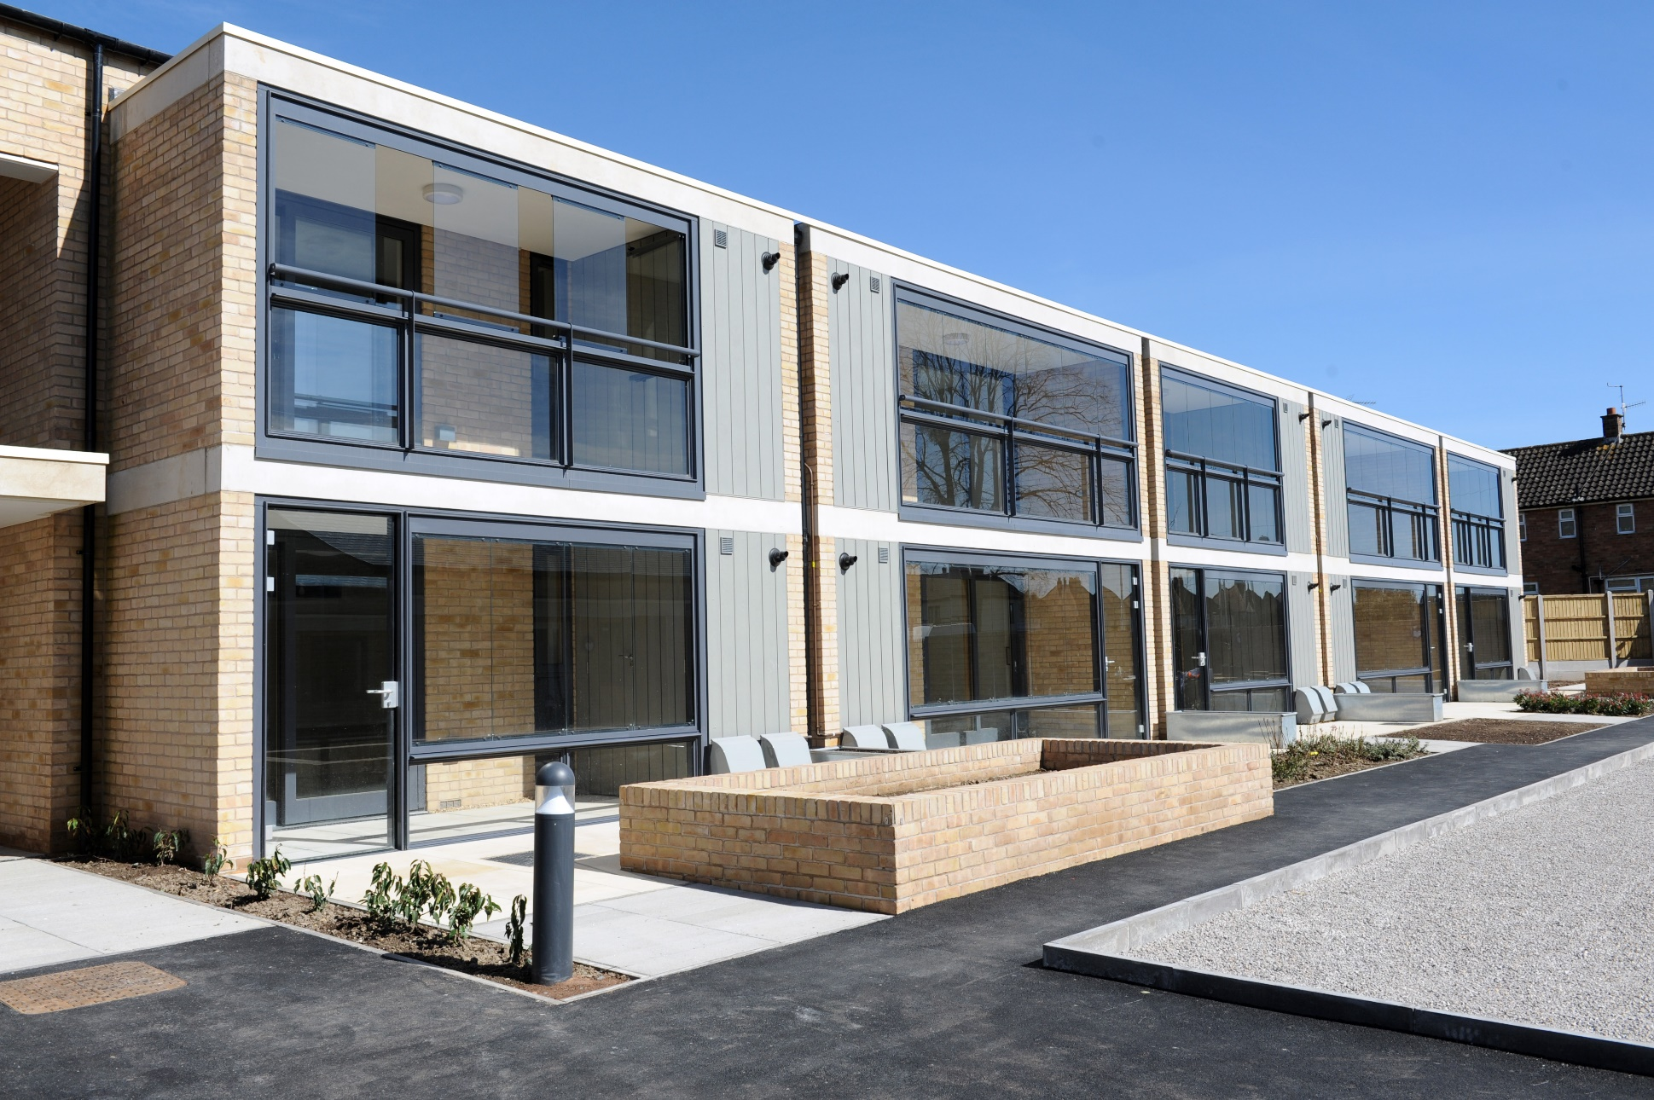
Beech Gardens Ludlow

Slide 9
The Support
Dedicated full time support officer on site 5 days a week
Community alarm (Telecare ready) for out of hours support and emergencies
1 hour of HomeLife per tenant pw: help with daily tasks e.g. shopping, heavy housework, accompanying to appointments, socialising, money management, getting out & about)
A regular program of activities, events, outings
Support on achieving an independent lifestyle
Helping people to help themselves & enjoy a happy social life.
Support and preserve the person’s wellbeing – quickly identify “upstream” health issues and solutions – to prevent longer term, high cost interventions “downstream”* - domiciliary care packages, mobility scooters, falls responder services, Telecare
* DEMOS report “The Social Value of Sheltered Housing” Mar-17 * Housing Lin “Home from Hospital” Aug-17

Slide 10
Housing can offer many services to help people who would otherwise be stuck in hospital to recover more quickly & stay well longer:
A temporary home for people leaving hospital who cannot return to their own home immediately, where they access the support they need to prepare for independent living again, often called ‘step down’.
Timely and appropriate transfers out of hospital and back to the patient’s own home or to other suitable accommodation.
A new home for people whose existing home or lack of housing mean that they have nowhere suitable to be discharged to.
Keep people well at home who would otherwise be at risk of being admitted or readmitted to hospital.
A myriad of other services: Adaptations, accredited DBS checked repairs service, Alarms and Telecare, accessible homes, Falls Responder and so on

Slide 11
A hub-based approach
Beech Gardens
Community centre as base for healthy living concept (social prescribing, postural stability & Extend, lifelong learning)
Locally commissioned care contract for the hub and immediate area
Joined up telecare offer – aligning to better offer or shared care packages
Support provided on scheme
ALSO personal subscription services such as HomeLife or Mobile Responder service
Also relationships with local VCSE e.g. Hands Together, Getting Older Adults On-Line, Age UK

Slide 12
How can we make this happen?
Rethinking of commissioning to serve PLACE
Care packages delivered on average hours (via personal budgets of people on site) – locally commissioned, tenants involved
Support and care aligned to work together to provide joined up support
Supervised on site – high quality, reliable, trusted, monitored, known – embedded in the community
On site relationship between functional teams and providers multi-disciplinary, co-located, complementary

