Slide 1
CASSH fund update and specialist housing in the region
Karen Anderson – Specialist, Home Ownership & Supply, North East, Yorkshire and the Humber

Slide 2
A new agency

Slide 3
Who we are
We’re the government’s housing accelerator. We have the appetite, influence, expertise and resources to drive positive market change. By releasing more land to developers who want to make a difference, we’re making possible the new homes England needs, helping to improve neighbourhoods and grow communities. So we welcome partners who share our ambition to challenge traditional norms and build better homes faster. Join us in breaking new ground to make this happen.

Slide 4
Our Strategic Plan
We were launched in January 2018 to play a major role in fixing the housing market.
At Budget 2018, we published our five-year Strategic Plan explaining the steps we’ll take, in partnership with the sector, to do this.

Slide 5
“The new Homes England is all about making homes happen – and our new
five-year plan sets out our ambitious new approach. We are committing to boosting housing supply, productivity, innovation, quality, skills and modern methods of construction to help make a more diverse and resilient market.”
Nick Walkley
Chief Executive, Homes England

Slide 6
Our mission and objectives

Slide 7
Why we are needed
England does not have enough homes in the right places. This means housing is unaffordable in some places and unsuitable in others. The reasons for this include a shortage of land available for development, a lack of finance available for major infrastructure, low productivity growth in the construction sector and insufficient market diversity.
We’re committed to tackling the underlying causes of England’s housing crisis, ensuring that more people have access to a home they can afford.

Slide 8
Our mission & objectives
Our mission is to intervene in the market to ensure more homes are built in areas of greatest need, to improve affordability.
We will make this sustainable by creating a more resilient and diverse housing market.

Slide 9
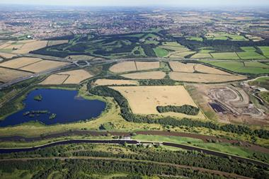
Unlocking investment
We will ensure a range of investment products are available to support housebuilding and infrastructure, including more affordable housing and homes for rent, where the market is not acting.
Investment is needed to support:
Housing associations, who need funding stability to leverage private finance
The Private Rented Sector, where confidence is still low
Smaller business and other parts of the sector considered higher risk or less commercially viable
Infrastructure, where there can be a lack of commercial coordination and appetite

Slide 10
Improving productivity
We’ll improve construction productivity.
MMC has the potential to significantly increase the pace of delivery, improve the quality of construction, address labour and materials shortages and deliver a number of additional benefits such as improved energy efficiency.
We ‘re supporting its uptake through a range of interventions in our land and investment programmes, including pilot projects and our building leases
We’re also engaging with the government to develop modern construction skills by increasing the number of skilled apprenticeships

Slide 11
“We’re all incredibly excited about the Gateshead Innovation Village as it will see a wide range of homes and construction methods being tried and tested together on one site. Support from Homes England is pivotal in helping us make this vision a reality, building real homes for real people using the latest technology.”
Brian Ham
Executive Director of Development at Home Group

Slide 12
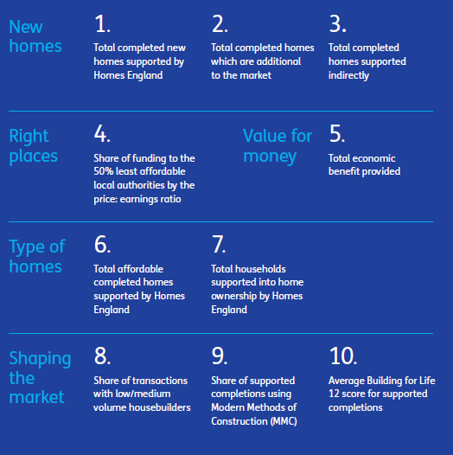
Our impact will be measured using these key performance indicators, with relevant targets set against these on
an annual basis.

Slide 13
Specialist Housing and CASSH

Slide 14
Older People’s Housing Programmes
Providers have access to two main routes of grant funding to support the delivery of specialist housing for older people:
2016-21 Shared Ownership and Affordable Homes Programme
Care and Support Specialised Housing Fund

Slide 15
2016-21 Shared Ownership and Affordable Homes Programme
Specialist housing for older people is supported in the SOAHP through Continuous Market Engagement
£400m of the original budget was set aside to provide 8,000 specialist homes (including other forms of supported housing),
Total budget for AHP is just under £5 billion
Includes £1.67 billion additional budget (June 2018)
Funding is available for Affordable Rent, Social Rent, or Home Ownership tenures
Schemes can include supported housing and designated housing covering a broad range of housing types and needs (including hostels, foyers, sheltered housing)

Slide 16
Care and Support Specialised Housing Fund (CASSH)
Delivered on behalf of the Department of Health and Social Care
The fund is intended to:
Improve housing options for older people and adults with disabilities and mental health problems to help them to live more independently
Accelerate the development of the specialised housing market
Supporting development of new affordable housing schemes
Originally launched in 2013 c£143m allocations to date for almost 4,100 homes
CME bidding re-opened with up to £125m capital available to 2021

Slide 17
Types of Schemes
Schemes can include, but are not limited to:
Sheltered housing
Extra care housing
Retirement villages
Accommodation should be self-contained and incorporate a full range of facilities to enable residents to live independently
Flexible levels of care can be provided through schemes
Aim is to develop a wide range of innovative options so that people can exercise real choice about their accommodation options according to their individual needs, circumstances and preferences.

Slide 18
Older Persons Shared Ownership
Older Persons Shared Ownership operates on shared ownership principles
It is only available for people aged 55 or over
The maximum level of equity that can be purchased is 75%
When the maximum level of equity has been purchased the leaseholder does not have to pay rent on the remaining 25% share of the property

Slide 19
Bidding Requirements and Applying for Funding
The landlord of all rented homes must be a Registered Providers of social housing
Lead organisations must be qualified Homes England Investment Partners.
Bids must be for affordable housing only
Detailed guidance including specialist design features are contained in the Capital Funding Guide
Bids from eligible applicants (as identified in SOAHP Prospectus)
Bidding for all programmes is through the Investment Management System (IMS)
IMS is now capable of holding supplementary information & paying acquisition tranche for CASSH as well as SOAHP
Prospectus and IMS guidance can be found at gov.uk/housing/funding-programmes

Slide 20
Move On Fund
Launched as part of the Government’s new Rough Sleeping Strategy in August 2018
Supports provision of move-on accommodation for: people currently living hostels or domestic abuse refuges, and rough sleepers, with low and medium level needs
£50m funding available outside London up to 2021, including:
Capital grants to cover the costs of acquisition and development of properties; and,
Revenue funding for on-going tenancy support costs
Homes to be let at either Affordable or Social Rent tenures
CME bidding now open via IMS

Slide 21
Key considerations What we can and can’t support
Not one size fits all – we need different choices of accommodation & support
Homes that meet aspirations – not just need
Location – Sustainability – Scale of need v viable scheme size
Space – personal, communal & storage!
Is the revenue in place to support peoples’ independence?
We can’t grant fund step-up/step down accommodation.
We can’t grant fund shared ownership homes with a local connection criteria attached to them except on rural exception sites.
Maximum staircasing to 80% okay for DPAs & rural exception sites.
We can’t fund S106 homes unless exceptional case.

Slide 22
Further info
Full details of all programmes available on GOV.uk:
https://www.gov.uk/topic/housing/funding-programmes
Enquiries:
Care and Support Fund - Enquiries.CSDH@homesengland.gov.uk
Move On Fund - MoveOnFund@homesengland.gov.uk
Community Housing Fund - communityhousingfund@homesengland.gov.uk

Slide 23
Strategic Partnership Deals Wave 1 & Wave 1a

Slide 24
Wave 1 and Wave 1a
 | Wave 1 | Wave 1a | Total
Number of proposals | 8 | 7 | 15
Grant | £590m | £653m | £1,243m
Affordable housing starts | 14,280 | 13,475 | 27,755

Slide 25
Wave 1 and Wave 1a
Wave 1 | Wave 1a
Sovereign & LiveWest | Platform (Fortis & Waterloo)
Accord | Guinness & Stonewater
EMH | Southern
Places for People | Optivo
Hyde | Orbit
Great Places | Thirteen
L&Q | Vivid
Home

Slide 26
Wave 2
12 Proposals received
Due diligence to ensure entry criteria met
Announcement anticipated before Christmas

Slide 27
HA Strategic Partnership Deals
“We have been working with Nick Walkley and the Homes England team to explore how we can collaborate to drive both scale and pace of housing delivery. We are delighted to have been selected as one of Homes England’s strategic partners as it is a key element of our work. The combination of certainty and flexibility that the new approach offers gives us the confidence to accelerate our programme and deliver an additional 2,603 new affordable homes across the country and provides the cornerstone for our wider partnership working.”
David Cowans,
Group Chief Executive of Places for People

Slide 28
A couple of local examples

Slide 29
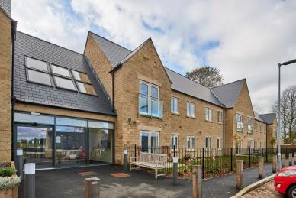
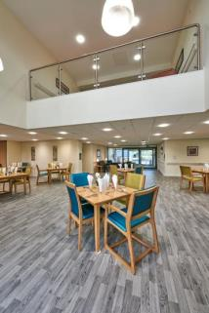
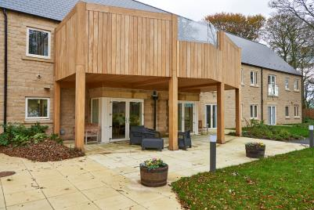
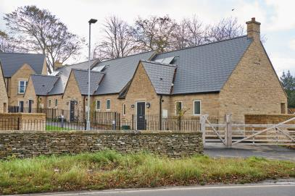
Kirkwood House, Leyburn, Richmondshire

Slide 30
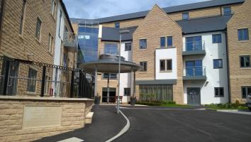
Fern House, Bingley, Bradford

Slide 31
What more can we all do to deliver more homes that meet need and aspirations?
How can we get closer to ‘Health’ – & which parts of ‘Health’?
How do we make joint meetings and scheme planning with housing & adult social services the norm?
How can we pull our funding together to provide more developments that cater for relatively independent people through to those needing temporary accommodation ?
Let’s collaborate, learn, be ambitious, creative and commercial to achieve more!

Slide 32
And if you want to get in touch
Karen Anderson
0191 497 7642 or 0779 53 53 555
karen.anderson@homesengland.gov.uk
@HomesKarenJA

