Slide 1
National Outlook on Health and Housing
How housing and the NHS can work together
Tom Luckraft – Assistant Head of Planning Delivery
NHS England Hospital to Home Team

Slide 2

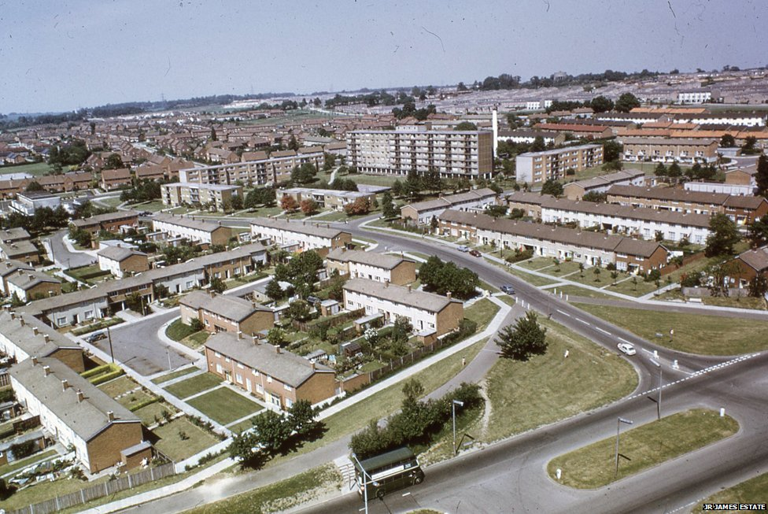
Notes:
Policy has been developed to get people home
Within the clinical setting Its about the front line staff being able to inform policy

Slide 3
Health and Housing
Link between unsuitable housing conditions and wide range of common chronic health conditions including respiratory illnesses, stroke, heart disease, arthritis and rheumatism and depression.
Substandard housing increases the risk of physical injuries as well as general health deterioration and social isolation.
Unsafe housing is associated with increased falls, leading to otherwise avoidable hospital admissions.
Individuals discharged to unsafe, cold, unsuitable homes are more likely to return to hospital.
Housing issues can have a negative impact on a persons mental health.
There are only 500,000 homes designed specifically for older people e.g. sheltered, extra care or retirement housing.
96% of older people live in mainstream housing
790,000 households in a non-decent home include someone of working age with long-term sick or disabled people
Estimated cost of poor housing to the NHS is £1.4 billion per annum

Slide 4
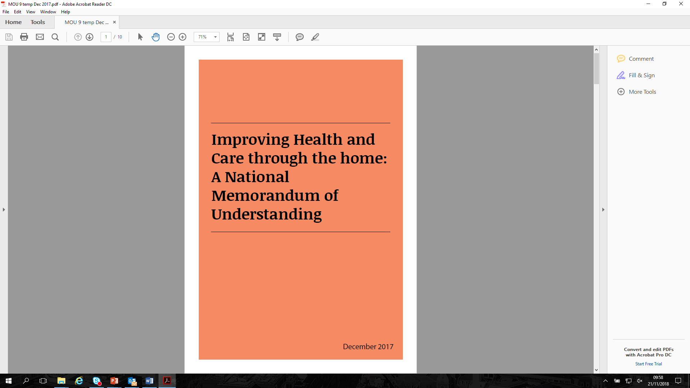

Memorandum of Understanding
Improving Health and Care through the home: A National Memorandum of Understanding
Co-signed by 26 signatories inc. health bodies, housing organisations and government departments

Slide 5
Memorandum of Understanding
The MOU sets out:
Our shared commitment to joint action across government, health, social care and housing sectors, in England;
Principles for joint-working to deliver better health and wellbeing outcomes, more effective
healthcare and social care and to reduce health inequalities;
The context and framework for cross-sector partnerships, nationally and locally, to design and deliver:
  healthy homes, communities and neighbourhoods;
  integrated and effective services that meet the needs of individuals, their carer’s/carers and their families;
  Shared success criteria to deliver and measure impact.

Slide 6
National DToC Figures (17/18)

Slide 7
Housing Issues on Discharge
Access to equipment
Home adaptations
Financial Insecurity
Repairs to home
Need for bespoke housing advice on options while in hospital
Practical housing support to get home safely
Need for appropriate housing post discharge
Homelessness

Slide 8
What have we delivered?
Phase One (2016-17)
Health and Housing Quick Guide
Successful CCG Engagement Programme
Series of Webinars focussing on
  Learning Disabilities
  Homelessness
  Long Term Conditions
  Older People
  Estates Strategies

Slide 9
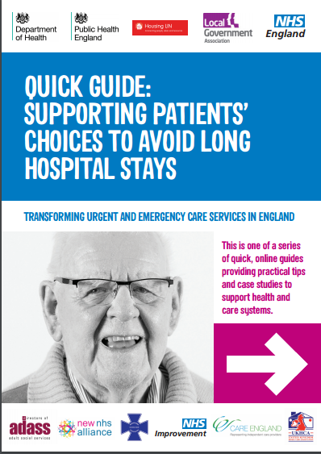
The Quick Guides
A suite of published Quick Guides can be found at www.nhs.uk/quickguides
Quick Guide: Improving hospital discharge to the care sector (October 2015)
Quick Guide: Better use of care at home (October 2015)
Quick Guide: Clinical input into care homes (October 2015)
Quick Guide: Sharing patient information (October 2015)
Quick Guide: Technology in care homes (October 2015)
Quick Guide: Identifying local care home placements (October 2015)
Quick Guide: Supporting patients’ choices to avoid long hospital stays (March 2016)
Managing care home closures (July 2016)
Quick Guide: Discharging to Assess (September 2016)
Quick Guide: Health and Housing (October 2016)
Quick Guide: Hospital Transfer Pathway ‘Red Bag’ (June 2018)
Notes:
The ICS Programme has published 10 Quick Guides to date which:
Bring clarity on how best to work with the care sector
Help you to find out how people across the country are working across the country with the care sector to reduced unnecessary hospital admissions and delayed transfers of care
Break down commonly held myths for example, sharing patient information across integrated care teams and continuing healthcare assessments
Allow you to use other people’s ideas and resources

Slide 10
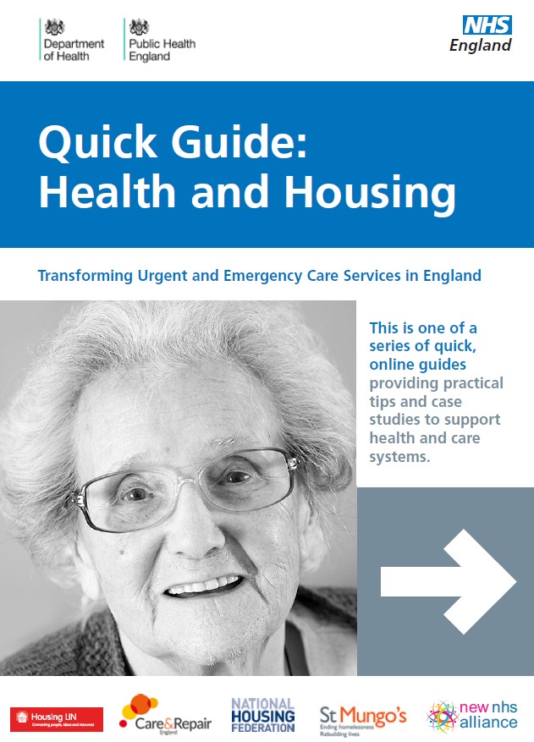
Health and Housing Quick Guide
This quick guide provides practical resources and information for Clinical Commissioning Groups (CCGs) from a range of national and local organisations on how housing and health can work together to prevent and reduce hospital admissions, length of stay, delayed discharge, readmission rates and ultimately improve outcomes

Slide 11
Health and Housing Quick Guide
The guide highlights 3 key ways in which housing can assist health and social care organisations:
1. Help prevent people from being admitted to hospital;
2. Help people be discharged from hospital; and
3. Support people to remain independent in the community.
The document also summarises how housing organisations can:
Provide health and wellbeing services.
Improve people’s home environments.
Improve safety, sustainability and suitability of people’s homes.
Provide step up/ step down services.
Offer advice on housing options

Slide 12
What have we delivered?
Phase Two (2017-18)
NHS provider engagement with housing sector pilot workshops (SW London / Cheshire & Merseyside):
  Introduced system level engagement
  Created greater bonds between health and housing
  Developed system wide change including all NHS providers

Slide 13























































The Organisations Represented

Slide 14
We asked for your comments…
Here are some comments made by delegates…
I am going to seek out handyperson services for my hospital and community beds
Very useful and informative day with a good mix of people around the table gave interesting discussions.
The subject of the day was interesting
I made some good contacts with Trusts and plan to engage with them to see how we can work together
I am going to look at existing protocols and improve consistent approach
Good opportunity to collaborate – the challenge is to ensure it continues with day to day workloads

Slide 15
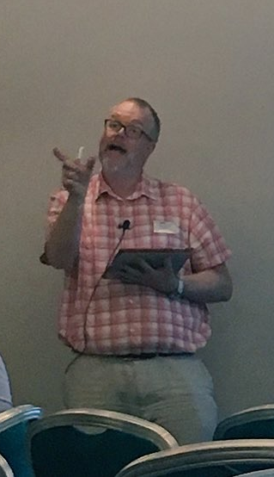
The next steps…
A number of key topics that come out of the discussions were:-
Mapping of the STP footprint and the different systems within it.
Engagement by executive level at both system level and local organisation level
Housing expertise to be utilised to benefit the patient pathway by being part of discharge teams.
The next steps to continue these discussions and work towards improving discharge are:-
NHS England and partners involved will take these key themes to the STP leadership.
Individuals to take the learning from the workshop back to their organisations and look to improve patient discharge through implementation or providing support.
NHS England to follow up on the workshop in the coming months to investigate and measure impact of workshop.
This is just the start of the conversations and through collaborative working, we can provide a positive impact on the patient experience.

Slide 16
This is just the start…
We will continue to build on the outputs from the workshops.
By working collaboratively health and housing can improve discharge, prevent readmission and improve the patient journey
The Hospital to Home team are available on england.OHUC@nhs.net for further information.
You can follow us on Twitter @NHSHosp_to_Home
Keep the conversation going using #HealthandHousing
Thank you

