Slide 1
Developing a Strategic Approach to Housing for Older People
Tim Hoyle, Assistant Director – Strategic Commissioning Central Bedfordshire Council

Slide 2
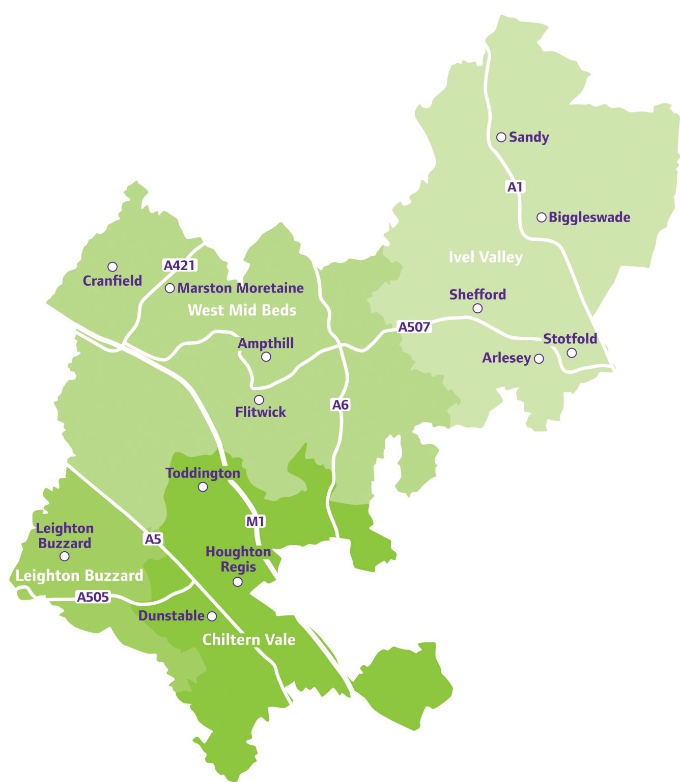
About Central Bedfordshire Population: 280,000 (2017) Households: 104,400 (2011) 73% owner occupied Over half the population is rural
Generally fairly affluent Major centres of population: Leighton Linslade:40,070 Dunstable: 37,880 Houghton Regis: 18,110 Flitwick: 13,180 Sandy: 12,210 Local Plan 2015-2035 identifies growth of 39,350 dwellings – an increase of over one third in the next 16 years.

Slide 3
Central Bedfordshire Council’s approach to housing and social care
Understands the critical contribution that housing makes to health and wellbeing
Considers the whole market – not just those needing public support.
Addressing the entire continuum from general needs housing to care and nursing homes.
Keen to use Council land and other assets where appropriate and to maximum effect.
Keen to engage with the market and to develop partnerships.
Use most appropriate delivery model for circumstances.

Slide 4
Central Bedfordshire Council’s housing challenges – older people
Ongoing need to support older people to remain at home
Immediate need to replace existing care homes that were no longer fit for purpose
Medium term need to deliver housing-with-care solutions as an alternative to residential care
Longer term need to respond to demographic pressures of an older population with a range of housing solutions tied in with the growth agenda
Potential benefits throughout the system: more appropriately housed people have a better quality of life and make less call on public services

Slide 5
Delivering Change with Housing-based Interventions – concepts and timescales
 | Short-Term | Medium-Term | Long Term
Concept | Enhance & Reuse | Develop | Plan & Develop
Time to deliver | 1-2 years | 3-5 years | 6 years +
Building-based initiatives | Repurpose Repair Adapt Refurbish | New build schemes Simple regeneration schemes | Complex regeneration schemes New villages, neighbourhoods and towns
People-based initiatives | Prevention schemes Homelessness interventions | Integration of housing, social care and health
Examples | IBCF-funded Housing Team | New housing-with-care schemes | Healthy Neighbourhoods

Slide 6
Initiatives in Central Bedfordshire (1)
Tenancy Support and Housing Assistance
What it does:
Supports tenants to avoid debt
Supports tenants to access appropriate health and social care
Outcomes:
Prevents breakdown of tenancies and avoids people becoming homeless.
Short-term / ongoing: part of prevention strategy

Slide 7
Initiatives in Central Bedfordshire (2)
Housing Support for Hospital Discharge
What it does:
Provides dedicated housing service for people coming out of hospital
Provides fast access to accommodation-based reablement, adaptations, assistive technology and specialist housing
Outcomes:
Facilitates hospital discharge
Avoids admissions to residential care
Short-term / ongoing: part of prevention strategy

Slide 8
Initiatives in Central Bedfordshire (3)
Development of new Housing-with-Care and Housing-with-Support schemes for older people
What it does:
Provides new affordable specialist housing
Outcomes
Diversion of people from residential care
Better health outcomes for residents of schemes
Reduced use of health facilities
Lower care costs
Frees up larger homes
Medium term: delivery is 3-5 years for each new scheme

Slide 9
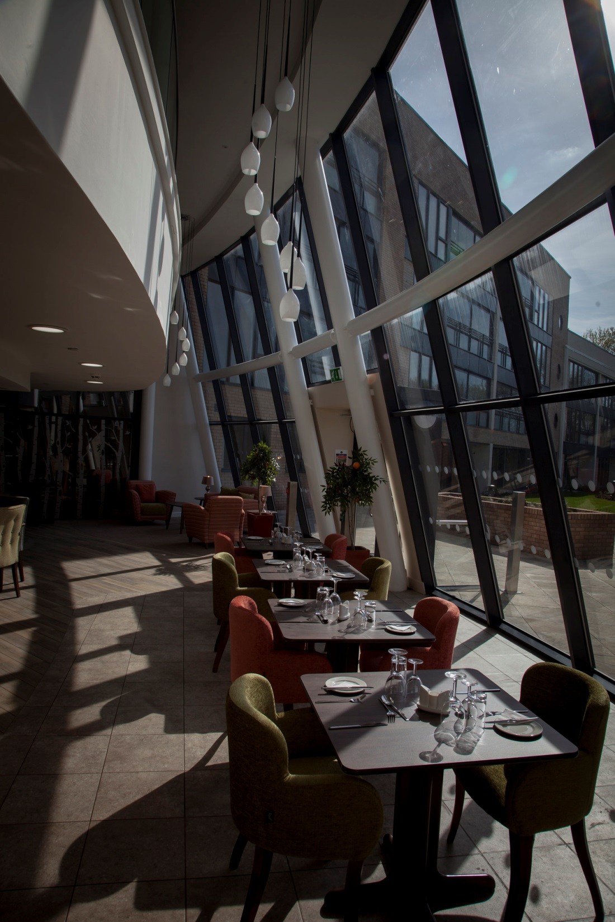
Extra Care example – Priory View
Developed and operated by Central Bedfordshire Council
83 one and two-bedroomed apartments
Combination of affordable rental and shared ownership
Onsite care and support available 24/7
Associated communal facilities open to the public
Opened April 2016

Slide 10
Initiatives in Central Bedfordshire (4)
Development of Investment Prospectus for Accommodation for Older People
What it does:
Sets out Central Bedfordshire’s aspirations in terms of accommodation for older people
Outcomes
Seeks to attract investment into the council area…
…focussed on the types of accommodation that are most needed
Document available at: goo.gl/GJLnpC
Medium term

Slide 13
Initiatives in Central Bedfordshire (5)
Research into Housing Needs of Older People
What it does:
Provides an evidence-base to determine the shape of new housing.
Influences Local Plan policies to enable delivery of homes suitable for older people
Outcomes:
Creates healthier, more inclusive, multigenerational communities
Long term: helps shape future communities

Slide 14
Research into the Housing Needs of Older People: Compiling an Evidence Base
Used national research:
Future of an Ageing Population
HAPPI 1, HAPPI 2, HAPPI 3, HAPPI4
Designing with Downsizers
Commissioned our own independent research in Central Bedfordshire with a representative sample of older people
600 short interviews
80 in-depth interviews
Stakeholder focus groups

Slide 15
Key Research Areas
Propensity to move
Drivers for those considering a move
Preferred tenure type
Preferred housing types
Downsizing
Full report published online at: goo.gl/P37QJ8

Slide 16
Propensity to Move
Source: Assessment of the Housing Needs of Older People in Central Bedfordshire – ORS / Central Bedfordshire Council March 2017

Slide 17
Drivers for those planning or prepared to move
Source: Assessment of the Housing Needs of Older People in Central Bedfordshire – ORS / Central Bedfordshire Council March 2017

Slide 18
Type of property preferred by those planning or prepared to move
Source: Assessment of the Housing Needs of Older People in Central Bedfordshire – ORS / Central Bedfordshire Council March 2017

Slide 19
Summary from the research
Around half of the over-65 population is ‘Planning to Move’ or ‘Prepared to Move’
Location the most important factor
Current location
Access to facilities
Access to social networks
General preference for bungalows or houses over apartments

Slide 20
Implications
Many older people have a desire to downsize…
…but is has to be the right product:
Location
Design
Price
Tenure
If this is not available people will stay where they are
But if we can meet demand with the right range of products then we can release at least 5,400 houses with 3 or more bedrooms

Slide 21
Influencing Planning Policy
As a result of this research we have proposed clear policies that:
Define housing suitable for older people
Require a percentage (23%) of any new development to be suitable for older people
This increases to 100% for developments within existing settlements (with some caveats)
Require larger developments to have suitable housing-with-care and/or housing-with-support schemes

Slide 22
Going Further - Promoting Innovation
Acquire sites and or allocate existing sites in the Council’s ownership
Deliver exemplar housing designs and schemes:
Low cost / high quality / high density
Unit-based designs – scalable solutions
Investigate benefits of using smarter construction methods
Explore options for subsequent delivery at scale
Continuing research and engagement with older people

