Slide 1
From Understanding to Partnership
Integrating health, housing and adult services
22nd November 2018
Neil Revely
ADASS Housing Policy Network Co-Chair and LGA Care & Health Improvement Adviser

Slide 2
National Policy Context
Marmot Review - need to improve the social determinants of health
Health and Social Care Act - creating Health & Well Being Boards
Care Act - an emphasis on housing/home based solutions
Better Care Fund – promoting integration including Housing
Five Year Forward View – Healthy New Towns
Building our Homes , Communities and Futures – Dec 16 LGA Housing Commission
Housing White Paper – “Fixing our broken housing market” Feb 17
Neighbourhood Planning Act – April 2017
MHCLG /DWP Supported Housing Consultation – 2017/18
Social Housing Green Paper – Summer/Autumn 2018
NHS Plan - in development
Adult Social Care Green Paper - soon?

Slide 3

Improving Health and Care Through the Home - National MoU
NHS England initiated discussions with the Housing and Care sector
Published in 2014 and refreshed March 2018
ADASS hosted the process supported by DHSC
Public Health England taking a lead role

Slide 4
Using & Extending the MoU
Nottingham
Cambridgeshire and Peterborough
Hertfordshire
Northamptonshire
Gloucestershire
Worcestershire
Bristol
Greater Manchester
North East

Slide 5
The Cost of Poor Housing
The cost of poor housing is estimated to be at least £1.4bn p.a. (first year treatment costs only)
1.3m homes with Category 1 hazard
£442m p.a. excess cold
£131m falls
>£26m delayed transfer of care – lack of housing
Only between 4 – 7% of homes are accessible
Poor housing affects 3.6m children, 9.2m working age adults, 2m pensioners
19% of adults in poor housing have poor mental health

Slide 6
Building the Strategic Case
Joint Strategic Needs Assessment
Health and Wellbeing Board and Strategy
Client Group Strategies (Older People/Learning Disabilities)
BCF Plan
Housing Needs Analysis
Local Plan and Housing Strategy
Sustainable Transformation Plans (STP)
Neighbourhood Planning Act
Developing age-friendly Communities
Underpinned by research to understand the aspirations
of current and future generations of people

Slide 7
Good Practice Examples - Strategic Approaches
Central Bedfordshire – from a detailed evidence base the Council has developed an Investment Prospectus
North Yorkshire – 15 year strategy has delivered 23 Extra Care schemes with a further 40 planned
Sunderland – Over 800 units of Extra Care and Supported Living with more in development delivered since 2008 as a result of a long term strategic approach
Greater Manchester – Health & Social Care Partnership

Slide 8
Creating the stock we need – Supported Housing Strategy
  Utilising the opportunities presented through devolution, empower residents to live healthy, independent lives in a suitable home within their own communities and draw on their skills and strengths to contribute to health, wellbeing and economic growth within Greater Manchester.
Our objectives:
Support a social care system that is less reliant upon nursing and residential care
Develop ‘asks’ of the system to assist in innovative delivery arrangements
Oversee and advocate up-scaled provision of extra care
Create confidence in the market for providers and developers
Stimulate economic growth through development of new housing
8
Notes:
Focus has been on developing a evidence base to inform strategic direction - what we have and what future provision should look like;
Supported Housing Census
Housing LIN Predictive Model (SHOP@) – older people’s accommodation
NW Market Sustainability Research
Cost Benefit Analysis and financial models
This data and our vision have been shared with localities (social care, housing and planning) as we work with them to facilitate delivery.

Slide 9
Good Practice Example – Learning Disabilities & Transforming Care
Nimrod House, Newham (Look Ahead)
Developed in 2016 to support the Transforming Care Programme
Co-designed with customers, carers, families, clinicians and CQC
Designed for people with complex needs
Delivering impressive outcomes for individuals with complex, profound, and multiple needs
Delivering significant efficiencies
Winner - CIH UK Housing Awards 2017 (Outstanding approach to meeting specialist housing needs)
Winner - National Learning Disabilities & Autism Awards 2017 (Supported Housing Award)

Slide 10
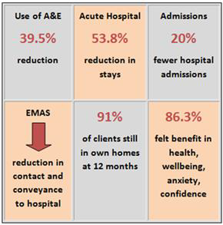
Good Practice Example – Derby City Council
Healthy Housing Hub
Advice and Support
Prescribed Support
Healthy Housing Assistance
Partnership Links
Evaluation demonstrates positive
outcomes and efficiencies
Highly Commended at The MJ Awards 2013

Slide 11
Good Practice Example – One Housing Group
Step Down Scheme
Working with London Borough of Camden
10 Step down beds in an Extra Care Scheme
Short Term reablement
Facilitates early discharge
Savings of between £400 & £700 per person per week
30% reduction in care package
National Housing Federation – Home from hospital 2017

Slide 12
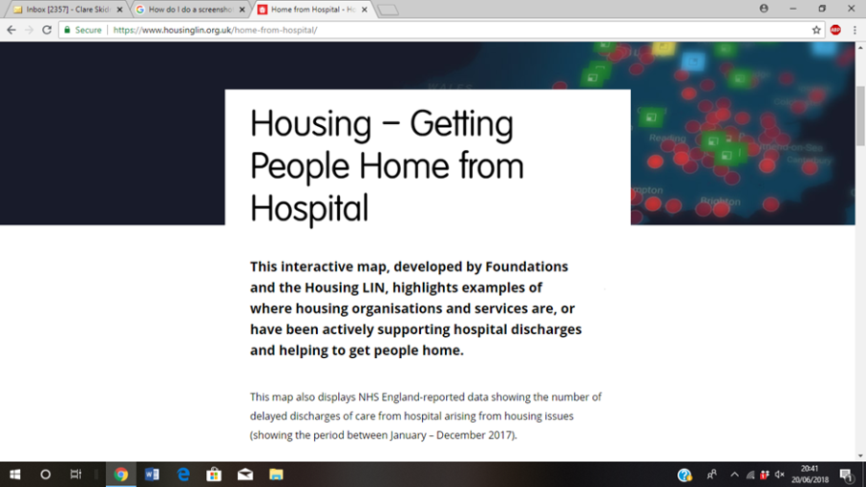
Home from Hospital – Interactive Map
Developed jointly by Foundations UK and Housing LIN
Highlights where housing organisations are supporting hospital pathways in range of practical ways
Projects from across England are
profiled, set alongside ‘DToC’ (Delayed Transfer of Care) data
Aim: To inspire, support and inform conversations about what might be possible locally
Quarterly updates planned to capture new activity
Visit https://www.housinglin.org.uk/home-from-hospital/

Slide 13
Summary - working in partnership with housing is good for you
Policy Framework is strong and getting stronger
Poor and inappropriate housing is expensive
Better housing is an investment in better health and reduced need for care
Strategic approaches are important
Delivers efficiencies
Evidence of much better outcomes for people!
There are great examples to draw upon

