Slide 1
Suffolk Mental Health Supported Housing Pathway Adult Acute Services
Wendy Scott, Ipswich & East and West Suffolk Clinical Commissioning Group
Jo Bailey, Suffolk County Council
Ipswich & East Suffolk CCG
West Suffolk CCG
Suffolk County Council

Slide 2
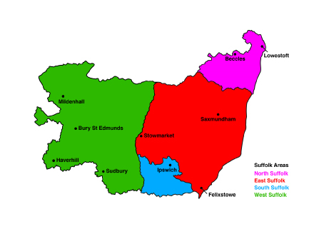
Geographical area

Slide 3
Where are we now?

Slide 4
Current provision
250 beds of various support levels across all areas.
Some with 24 hour support
Some with waking nights.
Others with floating support and/or personal care package
4 different providers MIND, Julian Support, Richmond Fellowship and Home Group.
Assessment beds x 2 for up to 3 months.
3 x respite beds
3 x admission prevention (gate kept by home treatment team)
1 x homelessness bed.

Slide 5
24 hour Support Providers in Suffolk
Ipswich Mid Suffolk & Babergh Suffolk Coastal
Waverney West Suffolk
Bramford Place
The Cornerhouse
(waking night)
Gippeswyk
Felixstowe Road
Riverside Road
Kirkley Cliff, Lowestoft
Cricket Meadow, Stowmarket
Queens Road, Sudbury
Rye Hill, Sudbury
Hospital Road, Bury St Edmunds
Spinney Close, Kelsale
Eastwood Terrace, Woodbridge

Slide 6
Financial Breakdown
Pooled Fund
Total Supported Housing £2,436,706
Suffolk County Council £1,515,389
West Suffolk CCG £307,998
Ipswich & East Suffolk CCG £459,562
Waveney CCG £153,756

Slide 7
Processes
Aims
Review
Moving On

Slide 8
Aim of Mental Health Supported Housing
The aim of these services is
To enable people to recover,
Sustain that recovery,
Be socially included
Develop/ maintain independent living skills.
These services are firmly embedded within recovery principles and cannot be viewed as long term solutions.

Slide 9
Process
Prior to completing application form the Care Co-ordinator contacts the support providers to discuss the referral and arrange project visits.
Once the providers have received all the necessary information and the service user has visited potential projects an assessment will be arranged.
Following assessment, the Providers will take their recommendations to the Supported Housing Panel which meets on a monthly basis.
The role of the Panel is to offer advice and guidance to Care Co-ordinators regarding housing and support solutions that will best meet the need of the individual and agree the allocation of supported housing when appropriate.

Slide 10
Review
Once the service user has been allocated a supported accommodation placement they will be subject to a review every 12 months.
The Panel will also review all service users whose length of stay has exceeded 18 months with the Care Co-ordinator.
This process will be repeated every six months and the service user’s needs will be thoroughly evaluated and move on options and related issues explored.

Slide 11
Extra Contractual Resources

Slide 12
MH EAT Panel
Membership includes Suffolk County Council and CCG
The purpose of the MH EAT panel is:
to MAKE funding decisions for individual patients, where funding is not already agreed through standard contracting and commissioning
to review funding decisions on all new packages after 3 months and established packages 6 monthly.
Criteria is S117 aftercare or clinical exceptionality
Clinical Exceptionality definition:
How is this patient significantly different from the population of patients with similar clinical circumstances who would not normally be offered this treatment?
Is this patient likely to gain significantly more benefit from this treatment than would be expected from other patients with the same condition who are not currently offered it?
Funding 50/50 split

Slide 13
Limitations
Supported housing does not administer medication provide personal care.
Admission prevention patient/customer needs to be open to the home treatment team to access the admission prevention beds.
Requiring only prompting for support needs

Slide 15
Flexible Short Stay Pilots
Corner House x 2 beds Hospital Road x 1 bed | The Coach House x 2 beds
Can provide prompting with medication Can provide prompting with personal care and Activities and Daily Living (ADL). Service user needs to be able to provide and prepare own food with support. | Can Administer medication Can provide/assist with personal care and ADL’s Meals can be provided, and support can be given to eat also Physical observations can be carried out and completed if required.
Service Users are monitored by MH hospital social worker and/or Home Treatment Team (HTT). It is no longer a requirement to be open to HTT, although support workers from HTT will provide support Access up until 10.30pm

Slide 16
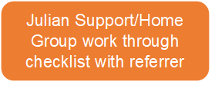
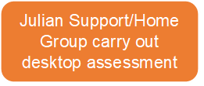
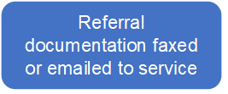
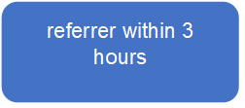
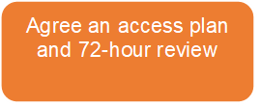
Referral process and form

Slide 17
Aspirations
If pilot successful to become part of pooled fund offer
Explore PHB & DP’s for aftercare

Slide 18
Any Questions ????

