Slide 1
Homes England
Making homes happen

Slide 2
A new agency

Slide 3
Who we are
We’re the government’s housing accelerator. We have the appetite, influence, expertise and resources to drive positive market change. By releasing more land to developers who want to make a difference, we’re making possible the new homes England needs, helping to improve neighbourhoods and grow communities. So we welcome partners who share our ambition to challenge traditional norms and build better homes faster. Join us in breaking new ground to make this happen.

Slide 4
Our Strategic Plan
We were launched in January 2018 to play a major role in fixing the housing market.
At Budget 2018, we published our five-year Strategic Plan explaining the steps we’ll take, in partnership with the sector, to do this.

Slide 5
“The new Homes England is all about making homes happen – and our new
five-year plan sets out our ambitious new approach. We are committing to boosting housing supply, productivity, innovation, quality, skills and modern methods of construction to help make a more diverse and resilient market.”
Nick Walkley
Chief Executive, Homes England

Slide 6
Making waves

Slide 7
Our mission and objectives

Slide 8
Why we are needed
England does not have enough homes in the right places. This means housing is unaffordable in some places and unsuitable in others. The reasons for this include a shortage of land available for development, a lack of finance available for major infrastructure, low productivity growth in the construction sector and insufficient market diversity.
We’re committed to tackling the underlying causes of England’s housing crisis, ensuring that more people have access to a home they can afford.

Slide 9
Our mission is to intervene in the market to ensure more homes are built in areas of greatest need, to improve affordability.
We will make this sustainable by creating a more resilient and diverse housing market.

Slide 10
Our objectives
We’ll unlock public and private land where the market will not, to get more homes built where they are needed.
We’ll ensure a range of investment products are available to support housebuilding and infrastructure, including more affordable housing and homes for rent, where the market is not acting.
We’ll improve construction productivity.
We’ll create a more resilient and competitive market by supporting smaller builders and new entrants, and promoting better design and higher quality homes.
We’ll offer expert support for priority locations, helping to create and deliver more ambitious plans to get more homes built.
We’ll effectively deliver home ownership products, providing an industry standard service to consumers.

Slide 11
Our ethos

Slide 12
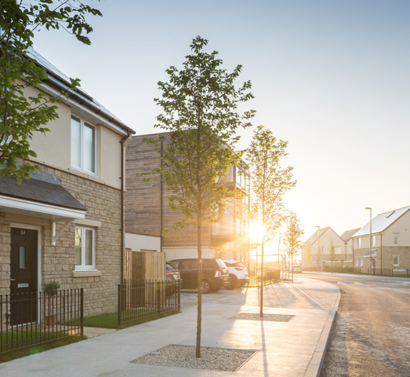
Our commitment
We cannot deliver the homes England needs alone. That’s why it’s our job to work with partners across the sector.
We will:
Aim investments at smaller builders – helping them to scale up so they can access funding, grow and expand
Work with local authorities and housing associations to help them make their vision a reality
Help housing associations through strategic partnership deals – in return for being more ambitious with their delivery
Work closely with housebuilders to promote better design and higher quality homes through Build for Life
Work collaboratively with local areas to help them grow by identifying and overcoming barriers to growth

Slide 13
“We plan to be bold, creative and think big. We hope the whole of the housing sector – big and small, up and down the country – will join us for the next five years and beyond.”
Sir Edward Lister
Chairman, Homes England

Slide 14
Affordable Housing Funds

Slide 15
Grant Funding Programmes
Affordable Homes
Main 16-21 AHP Programme: open for bidding via CME.
Social Rent
Social Rent Programme: open for bidding via CME.
Community Led
Community Led Affordable Housing: open for bidding via CME.
CaSSH
Care and Support Specialised Housing Fund: open for bidding via CME.
Move on Fund
Move on Fund – The Government is making available £50million across England (outside London) up to 2020/21 . The fund is part of a package of measures that have been announced through the Government’s new Rough Sleeping Strategy: open for bidding via CME.

Slide 16
Strategic Partnerships
Housing Associations currently deliver around 65,000 homes pa – we need this to increase to around 100,000 homes p.a. to meet demand.
This project (joint with the NHF and MHCLG) was established to remove barriers and co-design a new relationship – and design a new supply deal – to deliver affordable housing at scale
For Homes England, this provides a more mature, strategic partnership approach with trusted delivery partners, and better assurance on delivery and spend than management on a scheme by scheme basis

Slide 17
Recent Announcements
In September, the Prime Minister announced a £2bn long-term fund to boost social housing and help build the homes the country needs, including at least 40,000 more affordable homes. This funding will be distributed through strategic partnerships from 2022-23 to 2028-29.
In October, the Prime Minister announced that the HRA Borrowing cap would be lifted

Slide 18
Case Studies

Slide 19
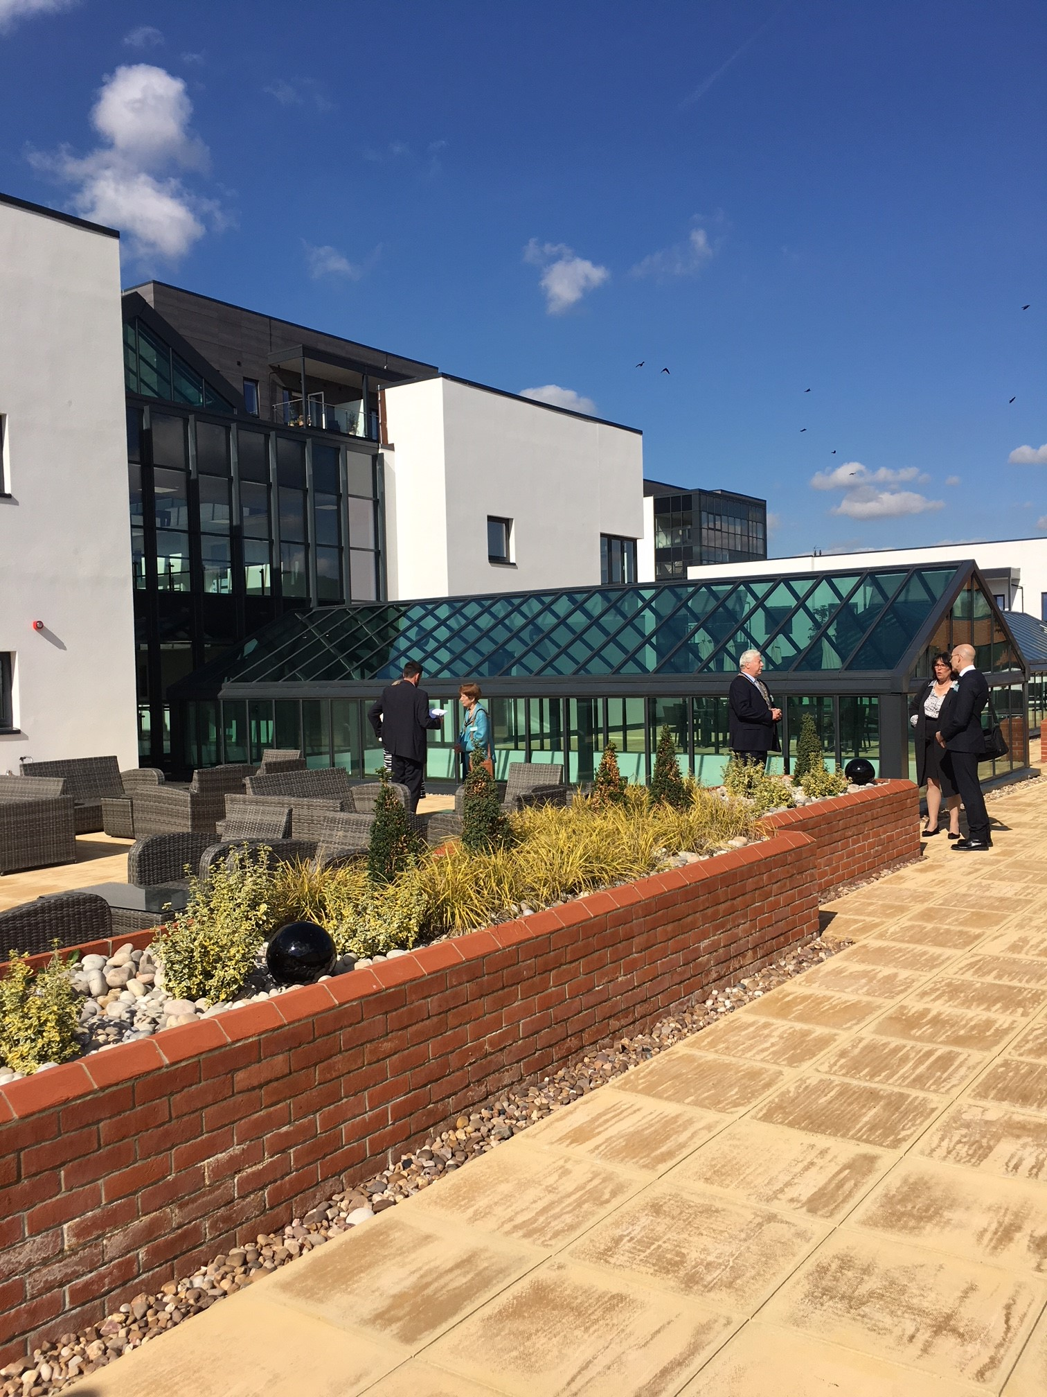
Hughendon Gardens Village, High Wycombe The ExtraCare Charitable Trust
260 self-contained, fully accessible apartments
129 market sale, 56 shared ownership, 75 rent (capacity for 350 residents)
Extensive facilities; links to local community
Care and wellbeing support, fitness and other activities
200 construction jobs, locally recruited village staff
Build cost £54.5m; Homes England Grant £1.4m

Slide 20
Rosewell House, Tonbridge, Kent Rapport Housing and Care
Over 55’s assisted living scheme; 59 one and two bed apartments, 35 rent, 24 shared ownership
Design promotes integration, companionship and wellbeing
Use of MMC reduced build time by 3 months
Attention to safety, security and accessibility
Pet friendly policy
£1.8m Homes England Grant

Slide 21
“We’re using our finance, land and expertise to get new homes built in ambitious places, demonstrating how government is prepared to intervene to unblock development and help people and businesses thrive”.
Carol Cairns, Head of Home Ownership and Supply, South East

Slide 22
Contact details Carol Cairns Head of Home Ownership and Supply, South East carol.cairns@homesengland.gov.uk 01234 242517

