Slide 1
Designing a healthy neighbourhood and integrating health services
Harriet Bosnell

Slide 2
Curo – supporting health through housing
Curo is a housing association, house builder and support provider with 13,000 homes in South West England housing 25,000 people
Support services include supported accommodation & independent living services to over 3,000 each week
Step Down from hospital, Wellbeing House, Independent Living Service all part of health offer & open to all residents of Local Authority area

Slide 3
Housing and health in the UK
Recent data - significant increase in the number of disabled people rising from 11.9m (19%) in 2013/14 to 13.9m (22%) in 2016/17. The change comes from increases in working-age adults and state pension age adults reporting a disability.
A quarter of the UK population is disabled, yet just 7% of homes meet access standards
In 2015 some 1.2m hospital bed days were lost costing £820m, due to patients not having a suitable home to go to
Not investing in housing will result in an additional 55,000 residential care housing placements by 2030

Slide 4
Ageing UK Population
Today there are about 12m people over 65. In 2046, there will be c.19m
Office for National Statistics - 2017

Slide 5
A Cooperative Approach
Support national and local dialogue and information exchange to inform better strategic decision-making across government, health, social care and housing sectors
Coordinate health, social care, and housing policy to offer a more integrated approach to national policy development and advise on local implementation
Enable local partnerships to collaborate more effectively across health, care and housing when planning, commissioning and delivering homes and services
Ensure the public and service users are heard and involved in collaborative work across health, care and housing
Promote the housing sector contribution to: addressing the wider determinants of health; health equity; improving people's experience and outcomes; preventing ill health and safeguarding

Slide 6
Memorandum of Understanding
Promote the adaptation of existing homes and the building of new accessible housing with support which is environmentally sustainable and resilient to future climate change and changing needs and aspirations
Develop the workforce across sectors so that they are confident and skilled in understanding the relationship between where people live and their health and wellbeing, and are able to identify suitable solutions to improve outcomes
Signed up to by a wide number of key partners

Slide 7
Impact to date
Housing equal partners at National Policy and governance level; Better Care Fund Framework
Increased recognition in the role housing plays in integrated health & social care
Influencing regional housing market as shown by investments
Regional Leadership sets (Housing LIN)
50+ Clinical Commissioning Groups engaged in MOU
Consultative NHS commissioning practices with the social housing sector i.e. stepdown

Slide 8
Outcomes
Development of a new evidence base via collaboration (HACT social value and Social Return on Investment measures)
Shared learning & accelerated improvements
Home adaptations Consortium on MOU steering group
Provides permission and scope for integration pioneers to take local action
Promotion of working examples of best practice – like stepdown from hospital & Asset Based Community Development with Public Health
Public health commissioning of ABCD model for challenging housing estates

Slide 9
Delayed Transfer of Care
Chart shows number of delayed days for patients receiving acute and non-acute care in NHS organisations in England
‘Awaiting residential’ or ‘nursing home placement’ and ‘awaiting care package’ in own home were key reasons for delays

Slide 10
Getting People Home from Hospital
Step Down Housing Provision
Community based practical Housing support
Co-located / Embedded Caseworkers + Community Based practical
Co-located / Embedded Housing Support within Discharge team
Curo Step Down

Slide 11
Step Down - an alternative to hospital
Adults discharge-ready who can’t immediately return home OR who would otherwise be in hospital bed
Accessible apartment with own kitchen and bathroom to hotel standard
Care and Support reablement package tailored to each person + telecare
In direct partnership with health professionals involved in the discharging process
Curo’s Step Down services saved the NHS 2917 hospital bed days in 2017/18

Slide 12
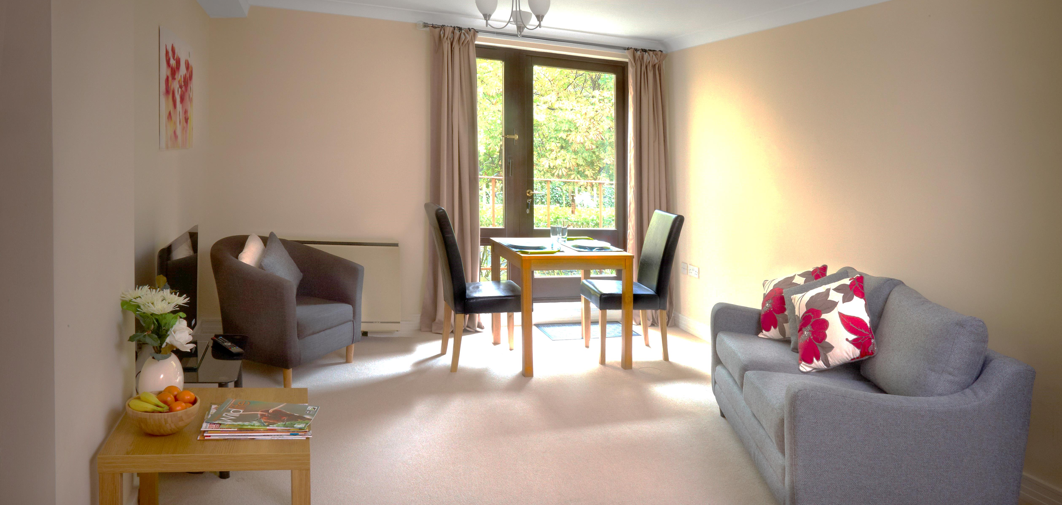
High quality product
Notes:
These are photos of St John’s at Bathwick.

Slide 13
The Wellbeing House
An estimated 1 in 20 bed days are used by people experiencing a delayed discharge in a mental health setting^{HealthWatch}
Provides a retreat for those experiencing mental health distress where they can receive support to stabilise themselves and prevent escalation to secondary care
Delivered a Social Return on Investment value of £377,763 in 2017/18

Slide 14
Asset Based Community Development
Build independence and resilience rather than creating dependency; helping people to develop solutions
Prevent, reduce or delay the need for public sector interventions; encouraging personal responsibility, supporting personal ownership of issues and responses
Supporting reciprocity – people helping each other; passing it on; paying it back
Building long-term sustainability into community responses, identifying existing assets and building on them where they exist, supporting the creation of new approaches only where it doesn’t exist.
Curo’s ABCD interventions saved over 350 GP appointments, 140 referrals to residential care and 85 visits to A&E in 2017/18
Examples; Community Connect, North Somerset Estate, Connectors

Slide 15
Independent Living Service – A person centred service supporting independence
Our Independent Living Service helps the people we care about to stay independent, in the comfort of their own home
Fully funded Supporting People or privately funded services available
24 Hr alarm service available to all customers
Flexible and bespoke approach to individual needs

Slide 16
Measuring Social Return
SROI outcome | Source | Date | Value
Homelessness | National Audit Office - Cost of homelessness | 2017 | £14,888
Hospital spell | Department of Health NHS Reference costs | 2016/17 | £1,590
A&E attendance | Department of Health NHS Reference costs | 2016/17 | £148
Admission to residential care (12 weeks) | Local residential rate | 2016/17 | £5,925
GP Appointment | Personal Social Services Research Unit | 2017 | £37
Standard hospital bed day | Department of Health NHS Reference costs | 2016/17 | £313
Mental health bed day | Personal Social Services Research Unit | 2017 | £404

Slide 17
Housing Associations’ Charitable Trust – Social Value
Outcome | Source | Date | Value
Temporary accommodation to secure housing | Housing Associations' Charitable Trust (HACT) | 2016 | £8,019
Unemployment to full time employment | Housing Associations' Charitable Trust (HACT) | 2016 | £14,433
Unemployment to part time employment | Housing Associations' Charitable Trust (HACT) | 2016 | £1,229
Regular volunteering | Housing Associations' Charitable Trust (HACT) | 2016 | £2,357

Slide 18
Contact details
Harriet.Bosnell@curo-group.co.uk
Twitter @hbosnellcuro
Tel; 01225 366135
Mobile; 07553 435556

