Slide 1
Peterborough City Council Home Service Delivery Team
Belinda Child - Head of Housing, Prevention and Wellbeing
Sharon Malia - Housing Programmes Manager
Notes:
1

Slide 2
Peterborough City Council Home Service Delivery Team
The Service brings together teams across Adult Social Care and Housing
Focuses on keeping people living in their homes independently and safely for as long as possible
‘One stop shop’ approach for clients which looks at both their ability to carry out activities of daily living and their physical home environment

Slide 3
Home Service Delivery Team
The service brings together
Reablement
Therapy Services (including sensory impairment and assistive technology)
Care and Repair Home Improvement Agency
Housing Programmes

Slide 4
Reablement
Therapy led
Short-term support service
Designed to help maintain independence at home or increase independence following a period of ill health and/or planned or unplanned hospital admission
The main focus is on improving people’s health and well-being, autonomy and confidence through providing support and encouragement to meet identified goals thereby reducing the need for ongoing care and support
Ensure all clients have the most appropriate Technology Enabled Care in place

Slide 5
Therapy Services
Provides assessment of daily function with people with sensory, physical and/or learning disability and their carers
Assists with continuing rehabilitation /reablement of a person who has for example been newly registered with a sensory impairment, recovering from a period of ill health or injury or who has had a deterioration from an existing long term condition
They will agree a programme of activities to improve function with the person, teach adaptive techniques and identify and order equipment as part of the overall enablement of people they are working with, including assessing for disabled facilities grants/minor aids and adaptations

Slide 6
Care and Repair Home Improvement Agency
Care and Repair is Peterborough City Council’s in-house Home Improvement Agency. Its purpose is to provide assistance and support to disabled adults and children, elderly, frail and vulnerable residents to adapt, repair and maintain their homes to enable them to live safely and independently
Disabled Facility Grants
Repair Assistance Grants
Relocation Grants
Minor Aids and Adaptations
Advice and practical support such as fund-raising, state benefit entitlement checks

Slide 7
Care and Repair Home Improvement Agency
Referrals to heating and insulation schemes
Handyperson Service
Self funded adaptations & repairs
Work with the Fire Service to ensure all homes have smoke detectors
Refer to voluntary organisations

Slide 8
Housing Programmes
Are responsible for the monitoring of the capital programmes and the decision making process on the most suitable course of action for both grant funded adaptations and remedial repairs to address high risk poor property condition, including the feasibility of large scale, complex adaptations or alternative housing solutions to meet residents long term housing needs.
Deliver energy efficiency and fuel poverty projects both directly and with external partners, in particular Peterborough’s award winning LEAP scheme
Attends all 4 of Peterborough’s Health Multi-Disciplinary Team meetings (MDTs)

Slide 9
Local Energy Action Partnership (LEAP)
PCC piloted LEAP from January 2017 and it now covers 125 local authorities across the UK.
Run in partnership with AgilityEco and funded through the Warm Homes Discount Industry Initiative. It is completely FREE to the council and its residents.
ALEO East Region Award 2018
Peterborough have embedded the project across frontline services and the Home Services Delivery Team within Adult Social Care are the coordination point for referrals, liaison with AgilityEco’s Contact Centre, for publicity and awareness of the project.
1,400 referral target between June 2018 - March 2019

Slide 10
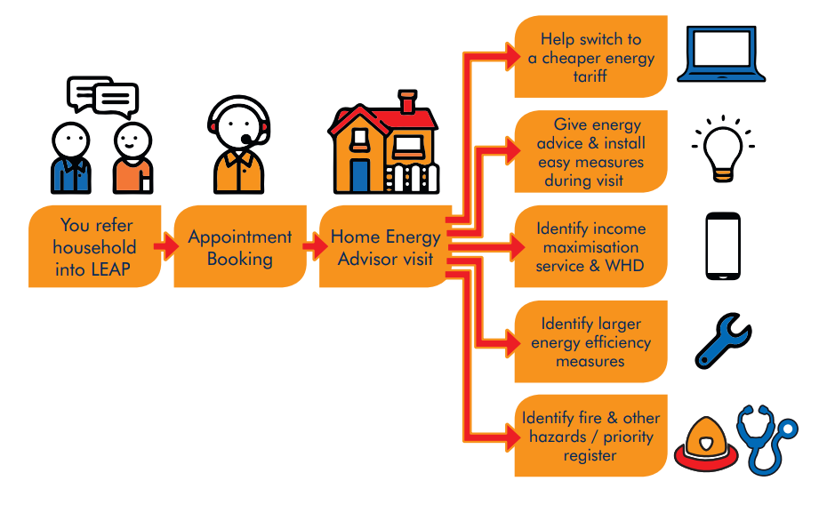
Tackling Fuel Poverty
LEAP JOURNEY

Slide 11
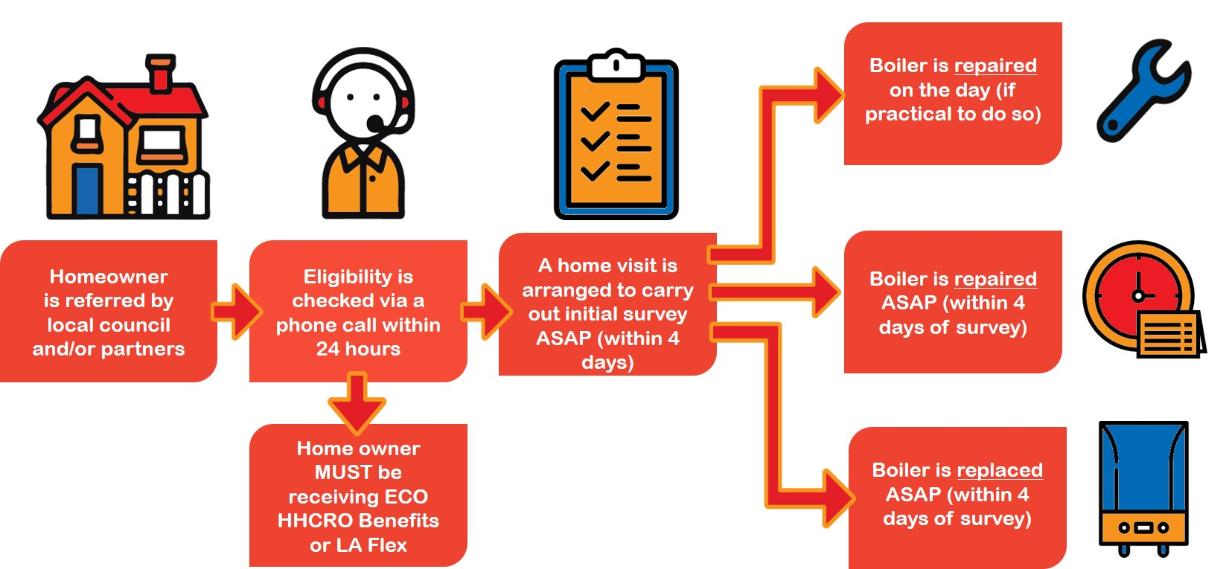
Tackling Fuel Poverty
Emergency Central Heating Offer (ECHO)

Slide 12
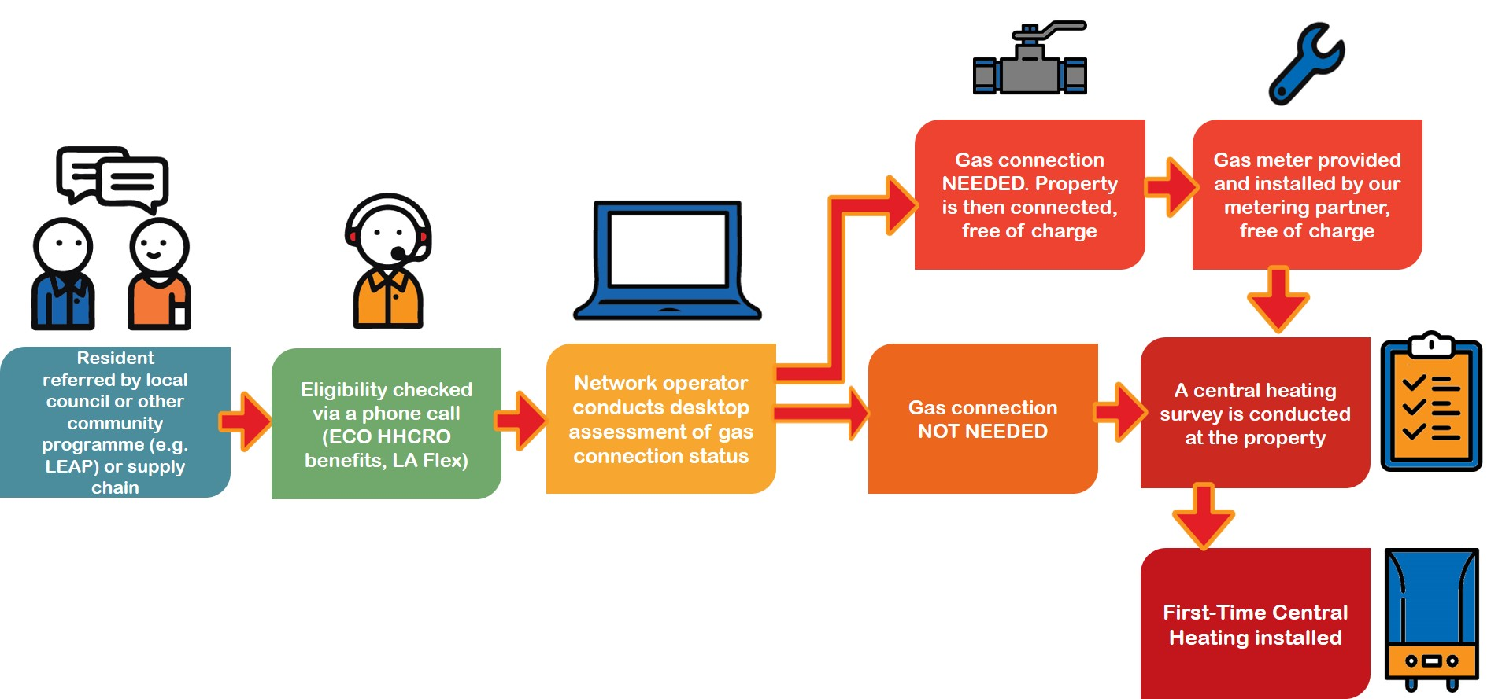
Tackling Fuel Poverty
Warm Homes Funded First Time Central Heating Offer

Slide 13
Benefit to clients of the service
Care and support is personalised, joined up and coordinated
Focus is on client’s independence and wellbeing
Holistic of clients needs and their environment
No being transferred from team to team for different parts of the service
No waiting on different teams waiting lists - e.g. wait on a list for Occupational Therapist then move to a waiting list for a disabled facility grant
Client’s case is managed by a Caseworker so that have one person to tell their story to rather than several

Slide 14
Benefit to clients of the service
Caseworkers are ‘cross trained’ so they can assess clients needs for adaptations like level access showers and stairlifts as well as completing grant applications and means testing
Housing needs and home environment assessed at the earliest point to ensure home is safe, warm, suitably adapted and secure
Improvements in perceived health-related quality of life. This would include reducing problems associated with mobility, self-care, pain/discomfort, and anxiety/depression.
Maintaining independence and therefore a reduction in dependency on long term health and social care support services
More personalised service, relating more closely to individual’s needs (delivering services that better meet the needs of the customer)

Slide 15
Case Study 1
Mrs D had a stroke and had been admitted to hospital.
The hospital needed to discharge the lady but her housing arrangements were not suitable. The hospital OT had identified that the elderly couple needed ground floor living and using their dining room as a bedroom was the best option to get her home. However the carpet was in poor condition and was an unsuitable surface to use a mo-lift (hoist).
The Caseworker visited the client and assisted them to obtain a Discretionary Disabled Facility Grant to fund a vinyl floor installation. Other issues were identified by the Caseworker. The husband was unable to manage and as he didn’t drive he was relying on the hospital volunteer transport service so he could only visit his wife once a week for a few hours. The caseworker liaised with the social worker and voluntary sector to provide the relevant support services for him
The Caseworker also arranged for the faulty shower to be replaced, as it was identified that the clients had been at risk of scalding. The Caseworker also discussed the property security with the landlord who undertook repairs and additional security measures immediately.
The client was discharged from hospital into a safe property with access to washing, sleeping and toilet facilities. She was home with her husband with a low level care package and did not need to go into full time residential care or stay in hospital.

Slide 16
Case Study 2
Mrs P was admitted to hospital due to an infarct and atrial fibrillation. She also had a past medical history of stroke and right sided weakness due to this.
She was discharged into a reablement flat and OT assessed and set goals with her to support to improve independence and confidence.
On arrival to the flat Mr P had very poor mobility and was assessed as requiring the supervision of x1 staff member for all mobility and transfers. She also had reduced manual dexterity which was impacting on her ability to carry out activities of daily living. An easy press pendant was requested by OT to allow Mrs P to call for support as required.
In house Physiotherapy input started an initial x3 times weekly regime of visits to practice exercises to improve dexterity.
Mrs P was provided with a static commode and a calendar clock due to disorientation to time/date.
During her stay in the flat Mrs P`s mobility improved greatly and she was able to mobilise around the flat independently.
Mrs P`s family were anxious regarding her returning home but the service worked with Mrs P and the family to reassure them that this was Mr`s P`s preferred location and that the situation is being assessed to ensure safety.
Mrs P`s home environment was assessed and the provision of a half step with key clamp rail, the bathroom door to be rehung to open outwards and a grab rail in the bathroom were all implemented.

Slide 17
Case Study 2
An extension to reablement was agreed for 2 weeks to enable Mrs P to continue to build on independence while these works were being carried out.
In the days prior to Mrs P`s discharge home she was managing more tasks independently and was reporting to be feeling much better in herself and confident regarding going home.
Mrs P returned home and both her and her family all commented on how much progress she had made through the support of the team.

Slide 18
Client’s Comments
“Work fantastic - you've given me back my dignity feel human again.”
“you have made such a difference to my mental and physical well being. I was very happy with the standard of work from contractors and the respect they showed me.”
“Thank you for the work, it has made such a difference to my life already, being able to have a shower rather than a bath makes it much more safe and stable, thank you for the repairs and redoing so much for me”

Slide 19
Next Steps
Q. How can the service be more proactive and identify clients at an earlier stage?
A. Closer working with the 29 GP surgeries in Peterborough

Slide 20
Next steps
We have developed in conjunction with the Greater Peterborough Network a referral form for GPs
The referral form sits within the GPs IT system which means they can bring the form up, complete it and send it to us without leaving their system
The referral form has basic client information on it and is a list of services which the GP can select, it includes:
Reablement
Home environment assessments
Handyperson service
Minor aids and adaptations
Strength and balance classes
Equipment and TEC
OT assessments
Fuel Poverty/LEAP

Slide 21
Barriers
GPs do not know what services are available
Needs to be a straightforward and secure process
GPs need to see that it is not additional work and that it can reduce their workload in the longer term
GPs will need to be assured that action has been taken and there is feedback
Need to identify GPs who are proactive and see the value of the preventative approach this offers to encourage their colleagues to use the service
Having a two way dialogue regarding ongoing cases
Can’t over promise

Slide 22
Any Questions?
Contact:
Belinda Child belinda.child@peterborough.gov.uk
Sharon Malia sharon.malia@peterborough.gov.uk

