Slide 1
Digital Health, Housing and
Social Care – the Tipping Point?
Clare Skidmore
Strategic Lead – Influencing and Networks, Housing LIN
@SkidmoreClare

Slide 2
Health, supported housing and care - lagging behind in digital revolution?
World / daily life changed beyond all recognition in last 30 years
However, in many respects, worlds of health, care and support in the home have not changed to the same extent
We still, mostly, interact with our health professionals in dedicated premises, e.g. GP surgeries, clinics, hospitals
Many supported and sheltered housing schemes do not even have full wi-fi into residents’ apartments
Many telecare / assistive technology devices in the home have not changed significantly in decades, and often have an ‘institutional’ appearance
In the supported housing sector, in one recent survey, 9% of housing providers had no digital plan in place; 7% were not aware of digital solutions; and 7% did not see digital as part of their current strategy -
WHY?

Slide 3
Barriers – Skills and knowledge deficits
Skills and knowledge deficit in care and social housing workforce:
While digital skills are recognised as a core functional skill in the learning and skills sector, the current social care workforce training and qualifications frameworks do not address digital capabilities in any significant way.’ (Skills for Care, 2016)
https://www.skillsforcare.org.uk/Document-library/NMDS-SC,-workforce-intelligence-and-innovation/Research/Digital-literacy/Digital-Capabilities-Survey-Report-300314-FINAL.pdf
‘…[Housing] boards rarely have a board member or members recruited on the basis of tech-literacy or recent experience of technology in a business context… there is an over-reliance on external consultant-led change… [representing] a major barrier to the adoption of effective approaches to digital transformation.’ (HACT, 2016)
https://www.hact.org.uk/sites/default/files/uploads/Archives/2016/12/HACT%20-%20Is%20Housing%20Really%20Ready%20To%20Go%20Digital.pdf

Slide 4
Barriers – Getting to know each other
Technology developers slow to see people with care and support needs as providing a real market opportunity
‘Aside from a few niche applications e.g. for disabled or elderly users… marketing materials tend to target a general purpose audience and do not differentiate to any great degree between potentially different categories of user’.
https://www.eceee.org/library/conference_proceedings/eceee_Summer_Studies/2013/6-appliances-product-policy-and-ict/who-uses-smart-home-technologies-representations-of-users-by-the-smart-home-industry/
The people who know about housing, care and support, and the people who know about technology, are not generally very familiar with one another or with each others concerns / priorities
Older and disabled people are a diverse group whose personal objectives are not the same; housing / care / health systems within which people are supported are also complex and variable

Slide 5
Barriers – who are the ‘users’, anyway?
Technology companies already embedded in housing, care and support sectors often seem to view commissioners and providers, rather than end users, as their key target consumers
With the increasing importance of self-funders in adult social care, this reluctance to engage directly with end-users seems puzzling
You have to understand what are [users] are worried about, what are their fears, what are they trying to do? If we don’t engage with them that way, it doesn’t matter what technology we use. - Roy Rosin, Chief Innovation Officer, Penn Medicine
Not always easy to define who ‘users’ are – ‘the term “user” hides the diversity of the older population’; even beyond this group, family / paid carers / responders could also be defined as ‘users’ of the technology
https://link.springer.com/article/10.1007/s10209-016-0499-3

Slide 6
Starting with the right questions
Perhaps as a result of these disconnects, there has – arguably – sometimes been an attitude of ‘here is a really clever device or system, how might it help?’ rather than ‘what problems do you face in your daily life, or in your customers / patients’ daily lives’? – and starting from there
"… [many pure technology software solutions] are created in a vacuum or rejiggered from something a health plan needs, or something someone else had laying around. They don’t really understand the needs of [GP] practices..." - Dr. Farzad Mostashari, CEO, Aledade

Slide 7
Design Quality
Perhaps because of historic focus on commissioners / providers, rather than people with care needs, as the primary ‘customers’, there has arguably been insufficient focus on design quality; few assistive and telecare devices have an aspirational, attractive appearance

Slide 8
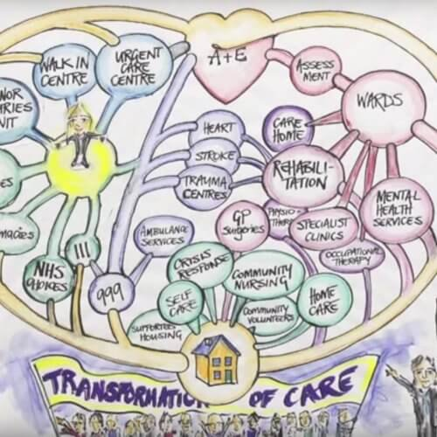
Beyond the technology
One cannot separate the technology from the wider system: e.g for Telecare,
Who physically responds to emergency calls?
How to manage the potential high number of false alarms?
How to effectively signpost telecare users, without access to health and care records?
How to make best use of all the data which can be – or indeed is – collected, to inform better designed or more personalised housing and care services?
Housing LIN (unpublished) research suggests that for systems without embedded newer digital technologies across other functions (i.e. beyond health / care), major transformation in this area becomes a challenge

Slide 9
Paralysing impact of austerity?
The whole public sector, and providers who rely on public sector funding, have experienced prolonged period of severe financial challenge with, as yet, little relief in sight
Within this climate, it is challenging to pursue long term innovation / strategic transformation
Nevertheless, such are the efficiencies, as well as improved outcomes, which have been seen across the rest of the economy through full adoption of digital technologies, it could be argued that it will cost the housing and care sectors dear in the long term if we do not follow suit; and older and disabled people will miss out on many positive outcomes

Slide 10
Key Policy Developments
Adult social care green paper expected to have strong focus on role of technology in transformation of social care, and embedding of personalised care for people, whatever type of housing they live in.
Equally, the NHS 10 Year Plan is expected to incorporate a strong emphasis on the role of technology and digital in NHS transformation.
Government’s ‘Ageing Grand Challenge’ as part of their Industrial Strategy aims to ‘harness the power of innovation to help meet the needs of an ageing society’, and to ‘build markets for consumer products and services that better meet the needs of older people’.
In August 2018, the government confirmed that funding arrangements for supported housing tenants would remain ‘in the welfare system’, providing revenue funding security for providers of supported housing.

Slide 11
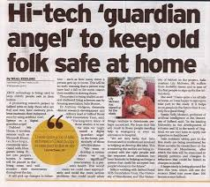
Salix MiiHomes
Salix Homes are trialling smart home technology to help older people to continue living safely in their own homes, with Salford Royal NHS Foundation Trust, and Universities of Manchester and Salford.
Project uses sensors, such as Microsoft Kinect technology, commonly associated with the Xbox, in sheltered housing.
Co-created with residents, it is hoped that the system will be more likely to be welcomed into people’s homes in future.
The aim is to help people with mobility and memory impairments to maintain independence by monitoring their well-being, using AI.
https://www.salixhomes.org/news/pioneering-smart-home-technology-keep-older-people-safe-their-homes-piloted-salford

Slide 12
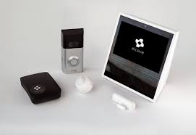
L&Q Alcove
L&Q has partnered with Alcove to embed telecare across four supported living schemes, supporting people with a range of needs, including learning disabilities, and complex needs.
One scheme is fitted with over 50 devices, including movement, heat, light, eating sensors, Alexa, and Alcove’s video calling carephone devices.
The technology has enabled more personalised care for the people living in the schemes, and also provided a waking night shift care saving to the local authority.

Slide 13
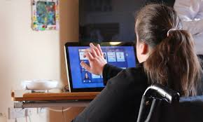
Blackwood Group ‘Cleverclogs’
Blackwood Group, a housing and care provider in Scotland, are investing in new technology, alongside high quality services and aspirational design. Through co-designing with their customers, they aim to develop and deliver a truly personalised housing and care service.
A key innovation is ‘Cleverclogs’, their digitally enhanced care system, which aims to keep people independent, in control and in their own home.
Centred around a touch screen home hub, the system enables people to stay in touch with friends and family, access information, pursue interests, and receive convenient reminders of any appointments or medication.
The system enables bespoke care and response services, personalised around all aspects of the person’s care, housing and support needs.

Slide 14
Health, Social Care and Housing –
Key System Objectives
Reduce negative outcomes caused by ‘loneliness and social isolation’ – including reduced impact on GP and other health and care services
Cut A&E admissions from ‘underlying long-term conditions’
Enable people living with long-term conditions to self-manage their care, with the intervention of professionals triggered by automatic alerts
Find technology to support older and disabled people (including those in mainstream, and in specialist housing) to live independently for longer
To support more personalised care and housing services, bespoke to the needs and aspirations of each individual person
But… older / disabled people’s personal objectives may look quite different…

Slide 15
Looking to the Future
The ‘Future of House and Home’ report, published by Shelter in 2016:
People who will be in their 80s in 2030 are in their 60s, or younger, today; will be more familiar with digital than many older people now
Greater rise of home monitoring technology, ‘wearables’, and telehealth in everyday life
Digital technology: even more ubiquitous by 2030 than now. Personal devices will routinely engage with sensors / embedded digital tech. Tech will be more lightweight, based on phones and tablet-like devices rather than laptops and computers.
https://england.shelter.org.uk/professional_resources/policy_and_research/policy_library/policy_library_folder/report_the_future_of_housing_and_home_scenarios_for_2030

Slide 16
Looking to the Future
‘Ubercare’ / ‘CareBnB’ – and other potential off-shoots, both of the tech start-up revolution, and of the ‘gig economy’
Many risks in such developments, particularly re potential security / job satisfaction of future care and support roles, and also around ensuring the safeguarding of people using such services
However, with growth of timebanking, social enterprise, housing and community-led, and social prescribing, new personalised models of care are emerging based on individual, negotiated relationships.
Evolving models may be strengthened through the availability of new, mobile applications providing people direct and straightforward access to request and purchase tailored services and support requirements.

Slide 17
Back to the tipping point:
Perhaps the real ‘tipping point’ will finally come when:
Technology developers start to really listen to what matters to older and disabled people (in all their diversity), as well as to health / care systems, and design solutions to address these core concerns and priorities;
Developers begin to market directly to end users, including people with disabilities and care needs – perhaps offering bolt on care-focused offers, added to existing smart home systems, which also deliver entertainment, communications, environmental controls, etc.
This may also help to reduce the stigma associated with assistive technology, particularly with the extra benefits that non-specialist developers could offer in terms of aspirational, marketable design being part of the package.

Slide 18
New from Silicon Valley: Ask older people!
With a rapidly ageing population, older people are becoming an increasingly numerous consumer group, and many have money to spend.
Recognising this, interesting to note the recent Silicon Valley tech conference, sponsored by ‘Aging 2.0’, ‘an organisation that ‘supports innovators taking on the biggest challenges and opportunities in aging [sic]’
This conference was ‘different, by design’ – starting with its title, ‘Seniors Shaping Technology: Your Opinion Matters’.
Next to each vendor booth was a voting station where older attendees could show interest or approval of a particular product / service, in four quadrants: ‘Cool, Will Buy, Not Sure and More Info Needed.’
In other words, asking older people what they really prefer and value.
https://www.nextavenue.org/cool-technology-trends-older-adults/

Slide 19
Looking for inspiration?
Visit the Housing LIN ‘Going Digital’ webpages, https://www.housinglin.org.uk/going-digital/
Contact me, Clare Skidmore, Strategic Lead, Influencing and Networks – c.skidmore@housinglin.org.uk
@SkidmoreClare on Twitter

