Slide 1
Community Hubs
Esk Moors Lodge & Bradbury Centre

Slide 2
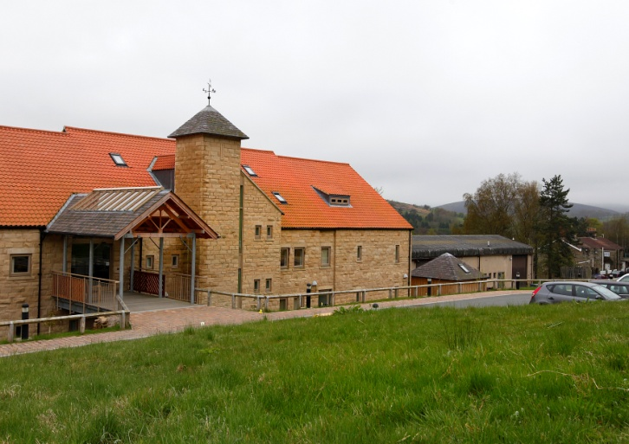
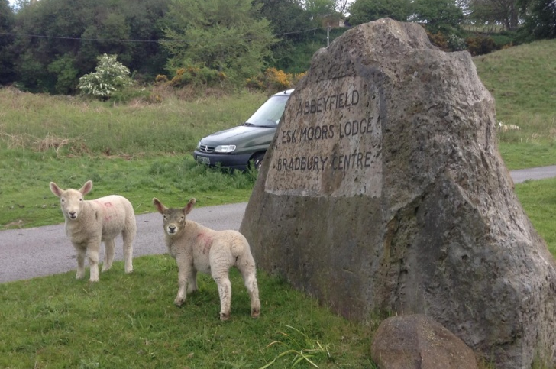
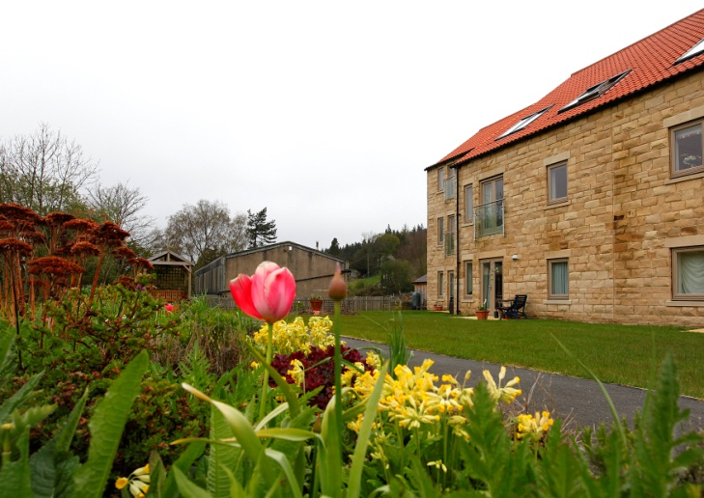
The ‘Esk Moors Story’
Key learning from our experience

Slide 3
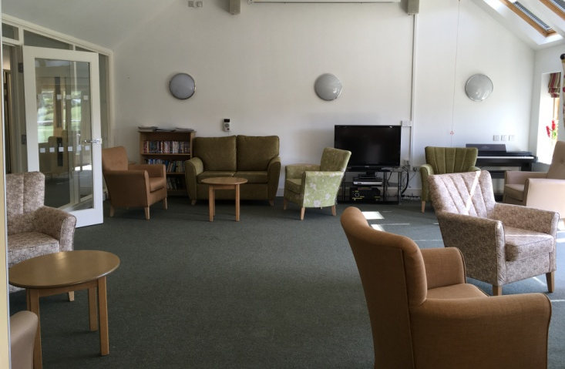
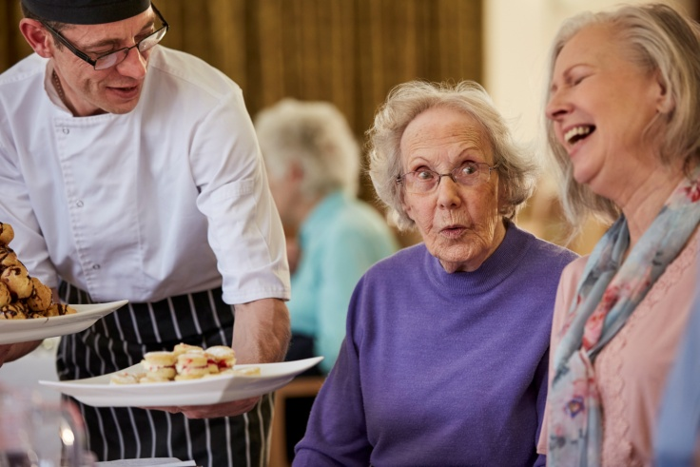
Combating Loneliness
Bradbury Centre – this is a “community hub” which has proved to be a great success. We provide meals, activities, events and services for both residents and the wider community e.g. chiropodist, hairdresser
The centre comprises of two communal areas; a dining area with tea bar and large lounge, and the Mary Thompson room which is a general purpose treatment/meeting space
Residents are served a two course dinner followed by tea or coffee everyday in the communal dining area. This gives everyone the opportunity to come together which helps to foster community and prevent loneliness
Sharing Sundays – friends, family and visitors from the local community can also book in and enjoy a lunch (and not just on a Sunday!)

Slide 4
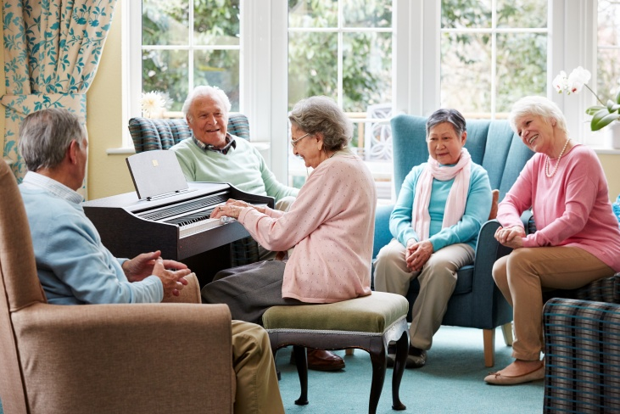
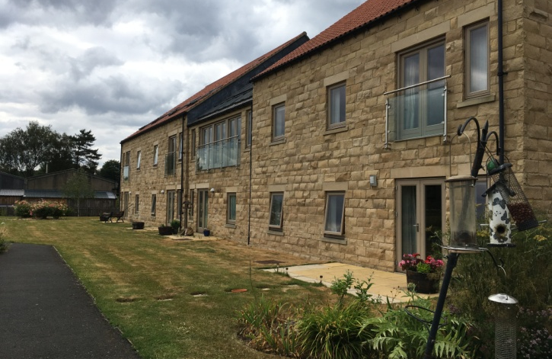
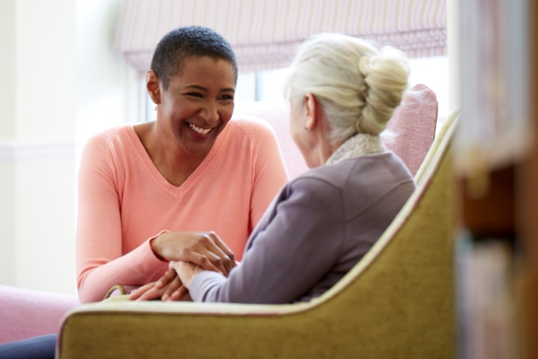
Combatting Loneliness
Daily check calls by members of staff – can be calls or visits where there is a daily opportunity for residents to talk to staff personally
Volunteers – excellent volunteers who really care and are happy to give their time to improve the quality of life for everyone in the scheme. Assisting with games afternoon and providing cakes and making lots of tea and helping at all planned activities, e.g. Afternoon teas, special occasions and lunches
Esk Moors Carers on site care team - providing background support and all out of hours support in the scheme. This gives the security and peace of mind that everybody wants. In rural areas, this kind of care delivery has always been very difficult to provide but there is now a team of local carers who deliver care daily, not just to Esk Moors lodge but all the surrounding villages

Slide 5
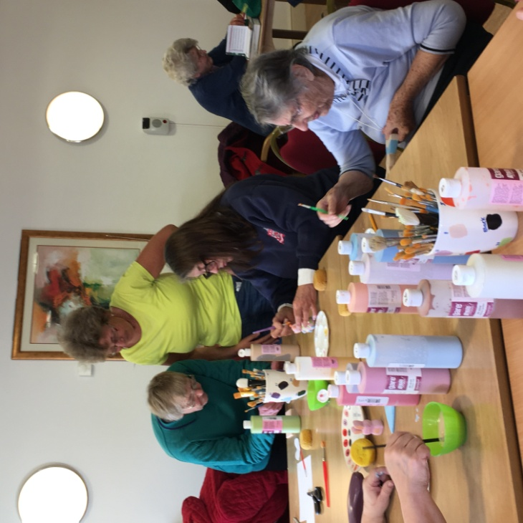
Combatting Loneliness
To help alleviate loneliness, we always have many opportunities for everyone to come together and enjoy the activities and events that we have in the scheme and everyone is always welcome.
The scheme has such a lovely warm friendly atmosphere with brilliant caring staff who are always eager to listen and help.
We feel that we alleviate loneliness very well especially in the wider community too, where everyone has a chance to come in and join in and enjoy themselves. There is always something to look forward to here and it allows older people to remain active and fulfilled in later life.

Slide 6
Promoting Neighbourliness
Joint working with Esk Moors Caring – encouraging them to continue to bring activities to the scheme for everyone to enjoy. Promoting a community car to assist people to get to hospital visits or shopping trips.
Working very closely with The Heather Hopper Community Bus – this is a bus run by volunteers and is based here at Esk Moors Lodge. It has a very varied programme of activities which the community can book into and get out and about on a regular basis e.g. Lunches, swimming, shopping trips, theatre trips and small holidays.
It can also be privately hired out by the residents of Esk Moors lunch to go to the seaside and for lunches

Slide 7
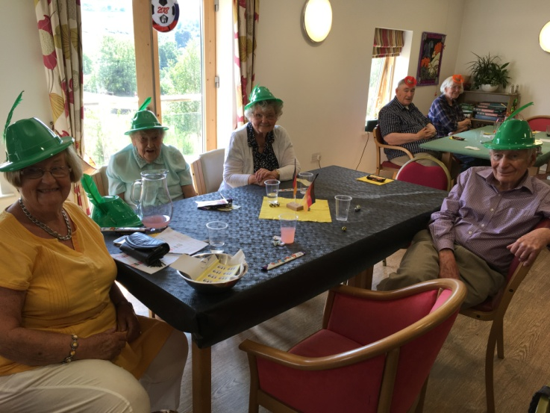
Promoting Neighbourliness
Heather Hopper lunches – bringing the community in once a month for a themed lunch, where the bus goes out and picks up lots of people from villages and they all come for lunch.
This has been fantastic as it brings together residents and the community on a regular basis; meeting up with their old friends and neighbours for a fun lunch, e.g. seaside lunch, harvest lunch, Mad Hatters tea party lunch. Also, flower arranging and pottery painting the activities go down very well!
Church services – the local vicar provides a service every month for both the residents and the community to join together

Slide 8
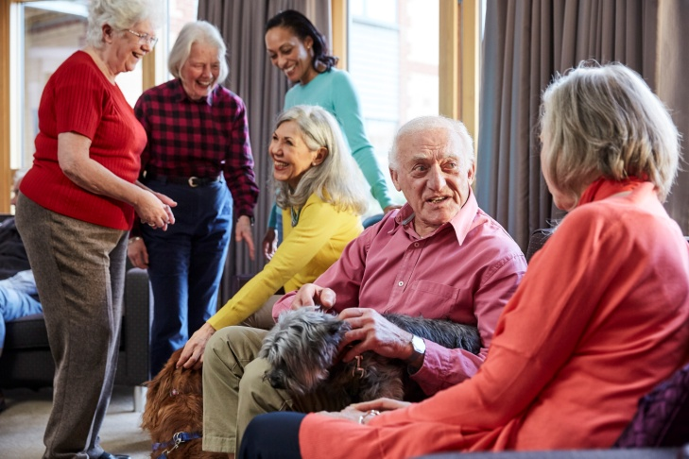
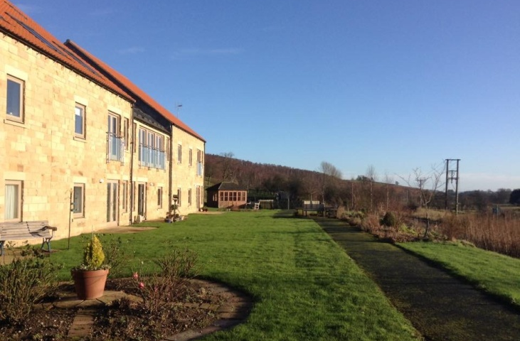
Promoting Neighbourliness
We find that working closely with all of our neighbours makes Abbeyfield Esk Moors Lodge feel a very valued part of the community as well as helping us to help others

