Slide 1
Live Smart Live Well; Innovations in Later Life Living
Living Life
Julia Ashley, Chief Executive, C&C
E: Julia.Ashley@ccht.org.uk
M: 07842 179726
T: 020 79225315

Slide 2
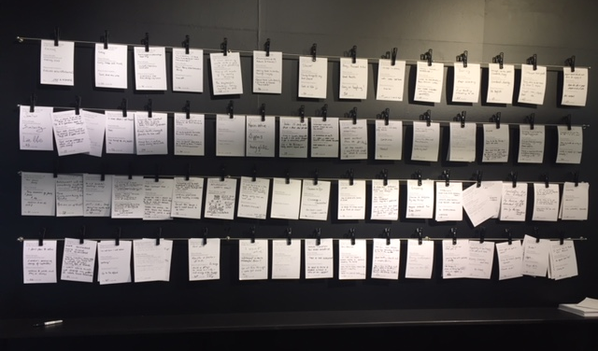
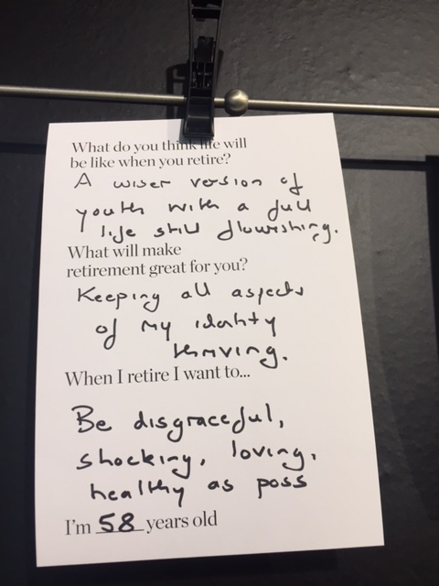
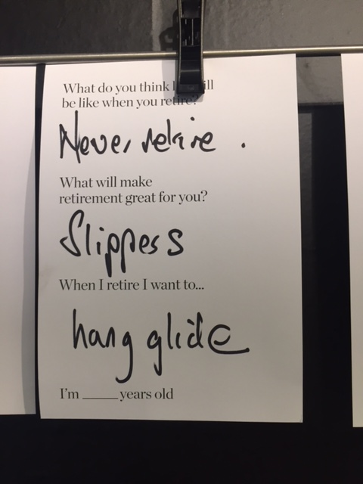
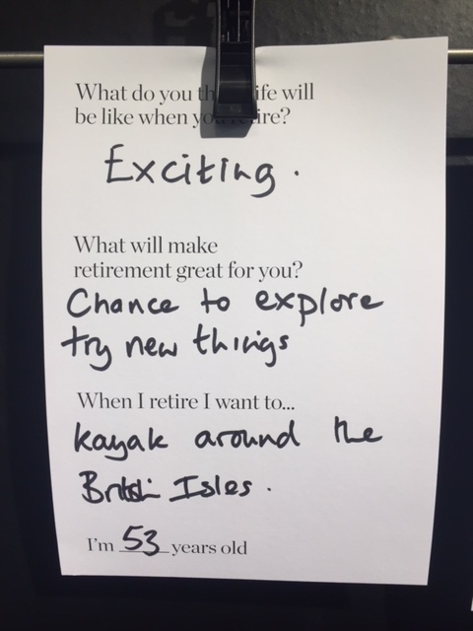
The biggest and most needed revolution is to rethink ‘age’
At no age do we suddenly revert from wanting fun in our lives.”
We want to travel, go out with mates, keep fit, read, sing, learn, walk, engage with nature, and so on
Live Life

Slide 3
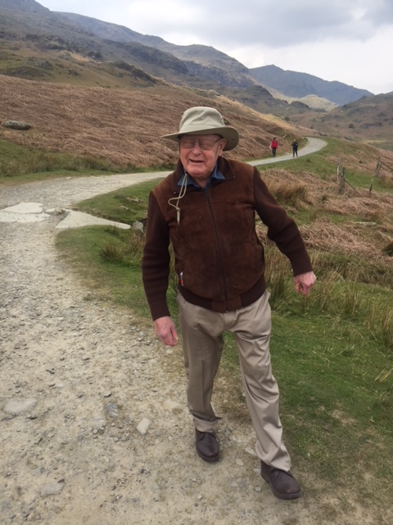
The biggest and most needed revolution is to rethink ‘age’
Old?
Technically yes – 83
Multi-morbidity? Definitely – too many to mention
Mobility?
Very hard to walk far
Barriers?
Little short term memory
Using services? Healthcare, repairs, cleaning, meals, laundry, managing post
Experienced?
Yes – National Service, Engineering, early mobile telephony, women in engineering, hiking, cycling, badminton
Healthy?
Walks as much as possible. Is sociable and enjoys company – has lots of friends, loves family
Mobile?
Still driving. Walks with stick, pushing for a hip replacement & considering an electric bike or mobility scooter to aid being outdoors
Self sufficient?
System to compensate for poor memory, engaged with friends & family, eating out, on-site services – meals, laundry and repairs, network at new home
Giving?
Provided decades of unpaid childcare and years of unpaid personal care for wife. Still helping anyone he can

Slide 4
A new vision for our ‘GAP’ years
Generation: Achievement & Purpose
Living Life

Slide 5
GAP Housing
Generation: Achievement & Purpose
Future Expectations
Less money
Fewer services
Restricted healthcare
Faster life
‘Free’ economy
Subscriptions economy
Gig economy
Robotics / AI
Connected lives
Social Media
Providing childcare
Extended family
Global connections
Hopes
Travel
Be by the sea
Be active
Healthy mind and body
Intellectual stimulation
Fitness / exercise
Reading, Gardening, hobbies
Learn new things
Arts, culture & nature
Volunteer / give
Desires
Love
Happiness
Freedom
Fun
Friends
Be connected
Part of the community
Social life
Positive attitude
Control at the end
Enablers
Voice assisted technology
Social media
Money
Access to free stuff
Transport
Feel safe & secure
Right size home
Right located home
Adapted home
Smart home
Outdoor space
Living Life

Slide 6
GAP Housing
Generation: Achievement & Purpose
TODAY
Co-Housing
Co-designed living
Adaptable apartments and spaces
Home Share
Intergenerational Living
Shared Living
Smart homes
Student Helpers
Care Villages
Living Life

Slide 7
GAP Housing
Generation: Achievement & Purpose
TOMORROW
Can we start a revolution?
Ageing is a positive GAP with lots to look forward to
Capitalise on the GAP years of experience, available time and need to be useful
looking forward to GAP so we design a better life
Living Life

Slide 8
GAP Housing
Generation: Achievement & Purpose
A New Blueprint?
Global homes – travel / mobility / connected world
Fit Communities – Focus on health, fitness & belonging
Technology – doing the things I cant or don’t want to & supporting my desires
Connectivity– to family friends, community, information
Living Life

Slide 9
Global Homes

Slide 10
Global Homes
Virtual travel
https://www.telegraph.co.uk/travel/destinations/asia/japan/tokyo/articles/worlds-first-virtual-reality-airline-vr-technology/
Mobile Retirement Community (travel / Air BnB / subscription retirement)
http://perpetualtravel.org/?page_id=106
Retirement (time) Share / ‘Air C&C’
Virtual Communities
http://retirementandgoodliving.com/a-virtual-retirement-community/
Global-local – connect adjacent town and villages
Living Life

Slide 11
Fitness Communities

Slide 12
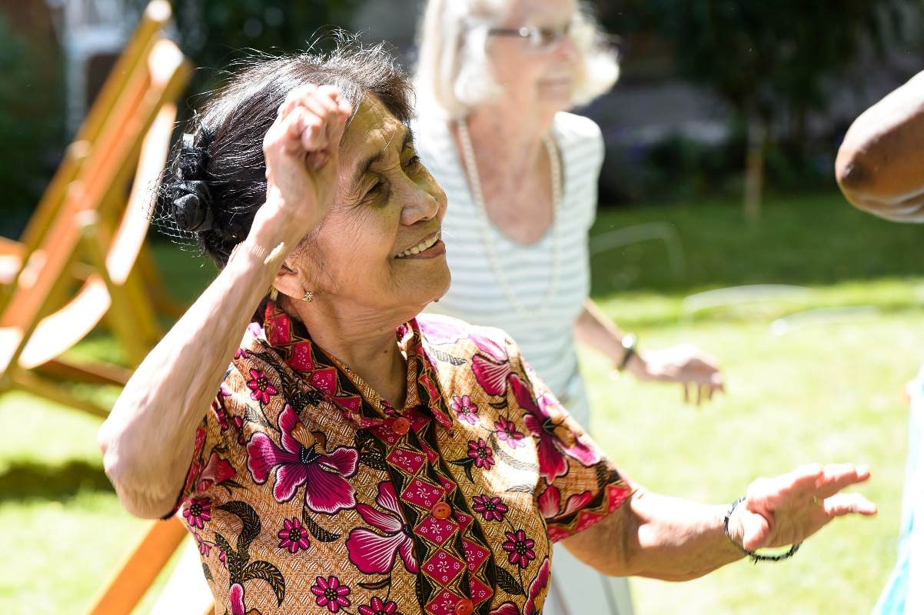
Fitness Communities
Walking, Cycling, Swimming
https://wheelsforwellbeing.org.uk/cycling-sessions/
GAP Tri?
http://seniortriathletes.com/gotta-tri-triathlon-in-the-villages-florida/
Sports – tennis, badminton, table tennis
https://www.bouncepingpong.com/bat-foundation
Wellbeing – yoga, pilates, Zumba, golf
https://oomph-wellness.org/about
Eating – 5-a day challenge, healthy food, cooking
Living Life

Slide 13
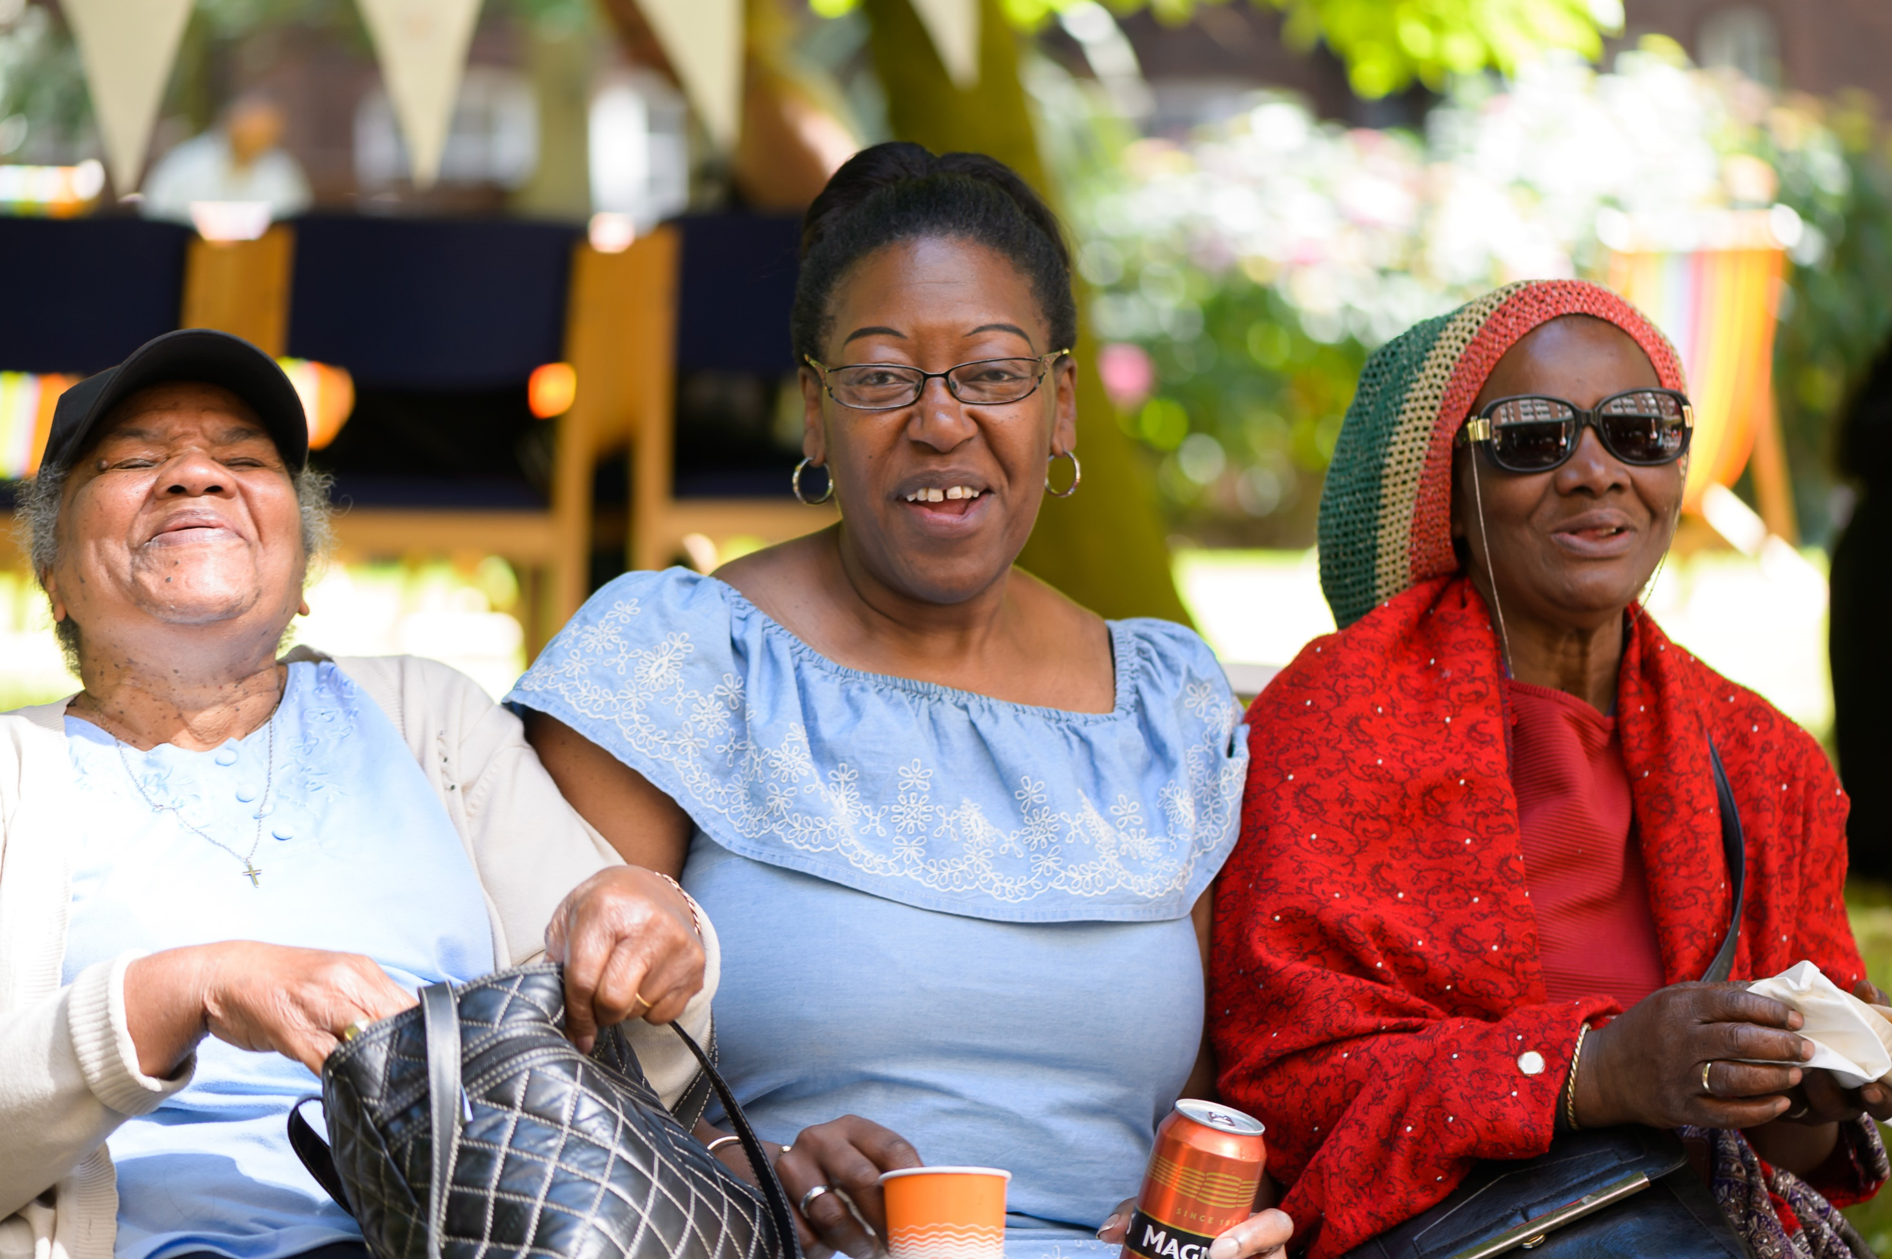
Connectivity

Slide 14
Technology
5G
Health tech – wearable devices / unconscious interventions
Help tech – smart homes / robotics
Transport tech – driverless / drone
http://www.dailymail.co.uk/sciencetech/article-4857352/Driverless-taxis-hit-streets-London-2019.html
Asset tech – repair fix before symptoms
Care tech – learning & responding / dementia support
Biometrics
Living Life

Slide 15
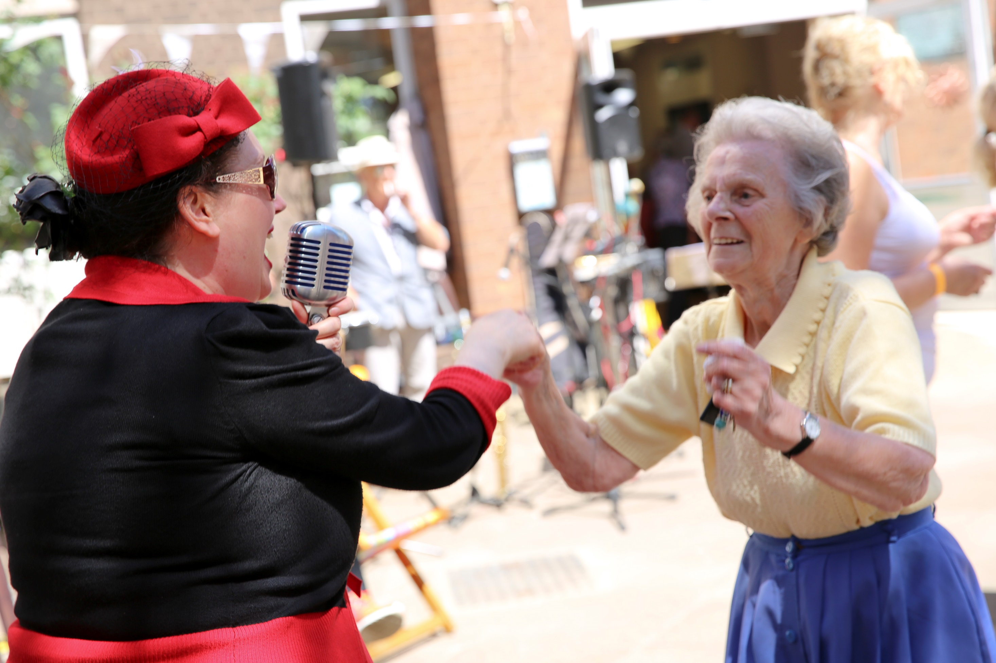
Connectivity

Slide 16
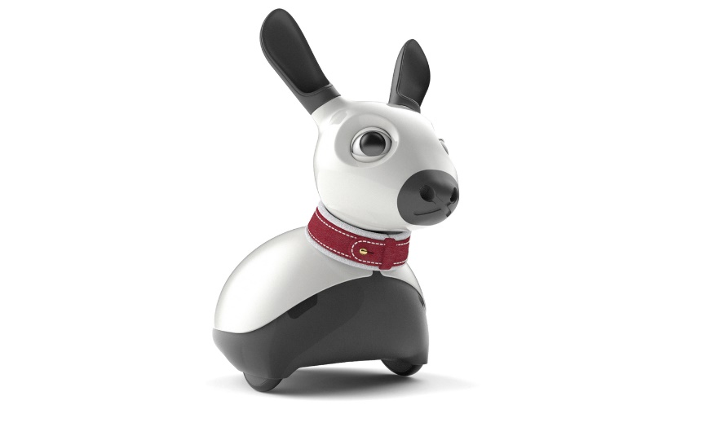
Connectivity
Virtual Communities
Digital Concierge Services
Remote Participation
Complex communications https://tovertafel.com/research/
Voice control
Social tech – social media / virtual concierge / companion robotics http://consequentialrobotics.com/
Info tech / Alexa / Siri – 2-way?
VR – visit the globe / immersive experiences / connection
https://www.youtube.com/watch?v=LXyX-OvZlUg
Living Life

Slide 17
Thoughts on Direction of Travel
Virtual communities are a real opportunity – the tech just needs pulling together
Live & play inter-generationally and in own community with friends and family
Base services on self-preservation and mutual support
Access to the Gig service revolution – change of risk acceptance / protection
Repairs, Meals, Care / Cleaning, Transport, healthcare??
Virtual & real social gatherings & fitness groups
Subscription Retirement
Robotic support – low level dementia / memory / mobility
Health monitoring / data / LT trends / events
Living Life

Slide 18
Conclusions for our GAP years
We are in a technological revolution – its changing the shape of everything we know. We need to jump in, invest & develop a funded new-age retirement community
Motivation, purpose, happiness and fulfilment = better health = ⬇ public £
Health, fitness, connectivity and access to friends, family & self-directed services are most important – this should be our main focus
Living Life

