Slide 1
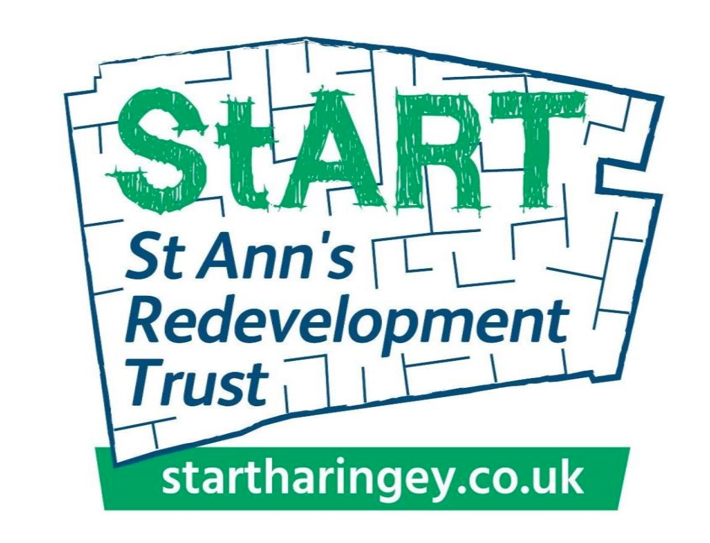

Slide 3
The site has high potential for archaeological remains of medieval date, relating to a farmstead held by the Order of the Knights of St John.
Archaeology South East
Archaeological Desk Based Assessment
September 2017

Slide 6
Haringey demographics
267540 resident population, will increase to 286900 by 2020
100+ languages spoken
Almost 2/3 of the population are from ethnic minority backgrounds
5th most ethnically diverse borough in the country
Ranks as the 29th out of the 32 London boroughs for poverty after housing costs
High level of long term conditions such as diabetes
The 10th highest diagnosed prevalence of SMI in London
High level of childhood obesity
Significant health inequalities across the borough

Slide 7
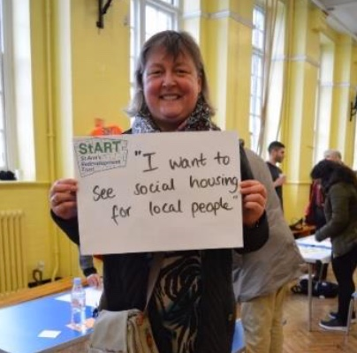
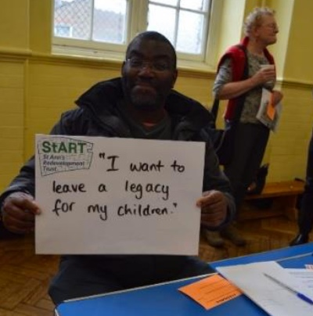

Slide 8
Affordable community led housing
Health
Environment

Slide 11
Our vision for the ‘health’ legacy:
Public health, environment and sustainability standards
Specialist/supported housing
‘New’ health services on site
An allocation of 15% of the homes for health and social care workers

