Slide 1
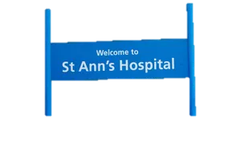


THE OPPORTUNITY FOR A GENERATION
What does an inclusive community look like, and how do you make one happen?
Chestnut Community Centre September 19th 2018
Stephen Hill MRICS Churchill Fellow
RIBA Ethics & Sustainable Development Commissions
National CLT & UK Cohousing Networks
@stephenhillFP @ukcohousing @community_land @RIBA

Slide 2
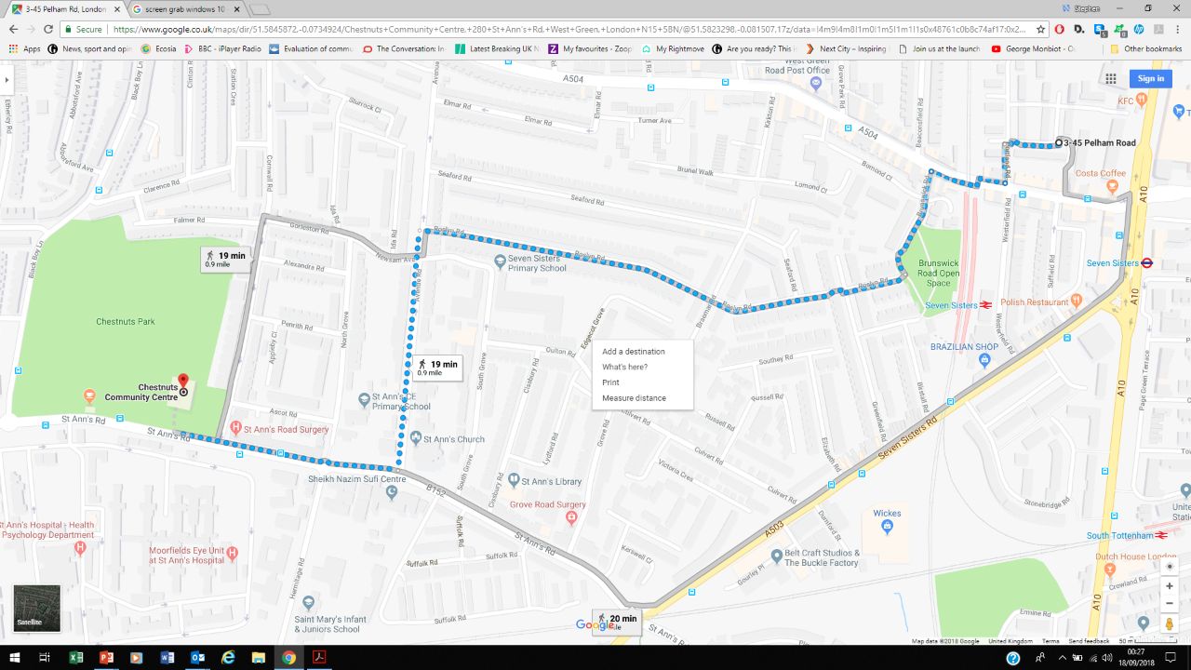
YESTERDAY
TODAY

Slide 3
Discover the meaning of a line…
Creating sociable and
healthy places by design and co-production

Slide 4
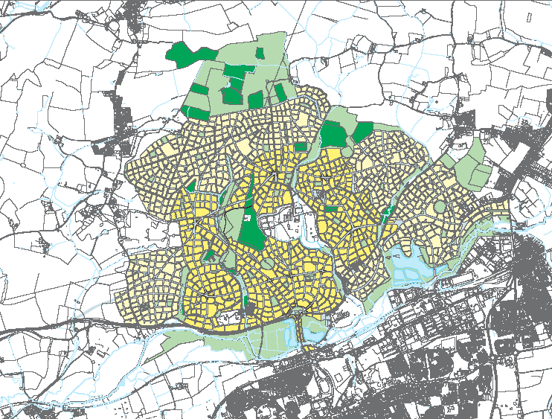
BIG Placemaking…
Lines for Living

Slide 5

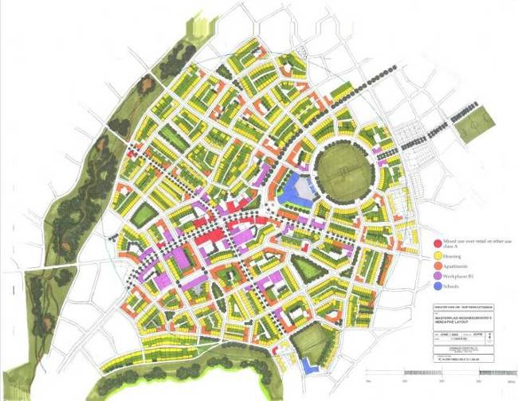
Nice design… but how do you actually make the place?

Slide 6
Phase 1

Slide 7
Phase 2

Slide 8
Phase 3

Slide 9
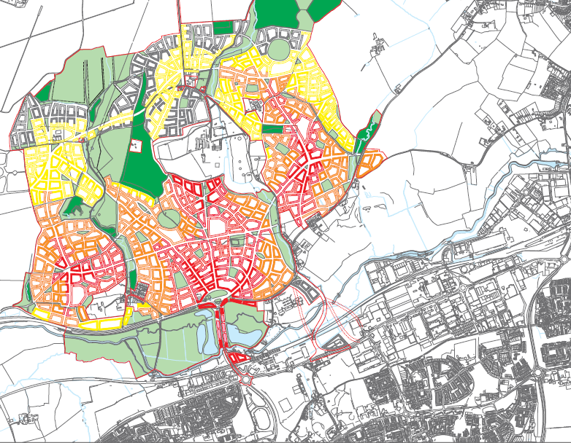
Phase 31

Slide 10
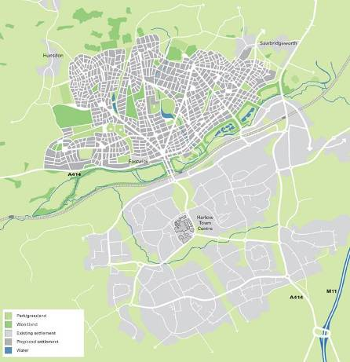
Completing the vision…
Building centres and along connections
Diversity of housing provider
Early adopter movement patterns
Interim Uses & Services
Backfill spaces in between
Roles of new residents
Spaces left over for possibilities
Design Leadership does not equal control

Slide 11
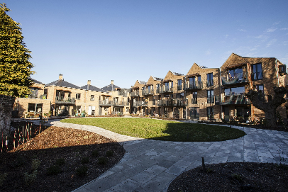
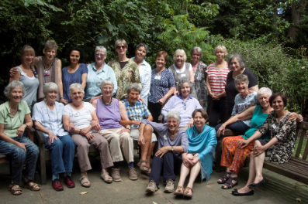
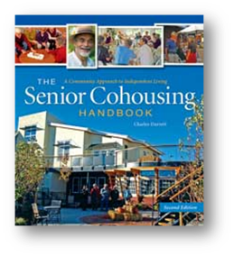
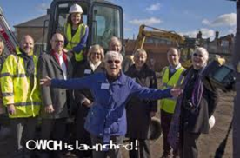
Small Placemaking
2017 OWCH, New Ground, High Barnet
Mixed tenure
social rent &
leasehold flats
Mutual self care
for over-55s

Slide 12
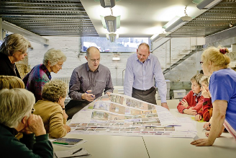
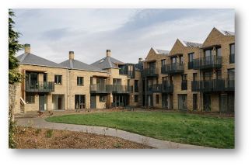

Part Self-funded and developed
with Hanover & Homes for Women
Tudor Trust investment
in social rent
Housing Design Awards 2017
Custom Build Award
Overall Winner
4.5m hits on
BBC News
Facebook

Slide 13
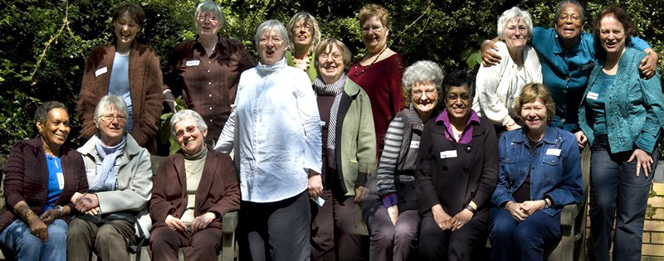
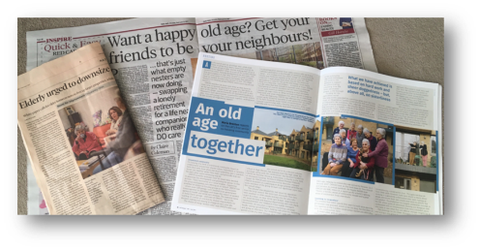
Social organisation doesn’t happen by accident
“When I came back with the news (breast cancer diagnosis),
within 2 minutes 6 women were in my sitting room opening
the brandy. There were offers from people to stay the night, a rota to take me to chemotherapy, a rota for bringing me soup – it was amazing!”

Slide 14
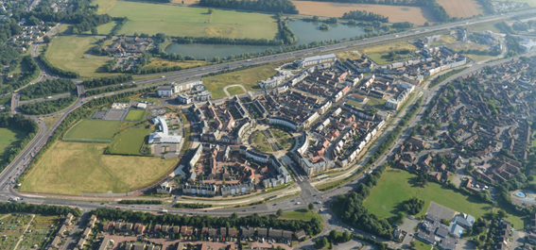
Cambridge - Orchard Park Masterplan
Masterplan and Design Guide
…faithfully realised on the ground
Q. Which bit of Orchard Park do you like the most?
A. The commercial centre…there’s some street life there.

Slide 15
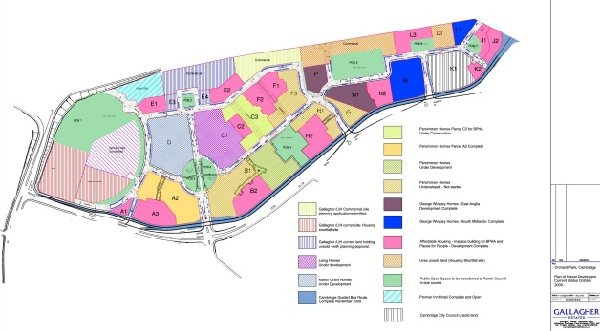
Orchard Park Plot Disposal Plan
These streets were not made for transit,
not for living
No
double sided
street
plots for effective placemaking

Slide 16

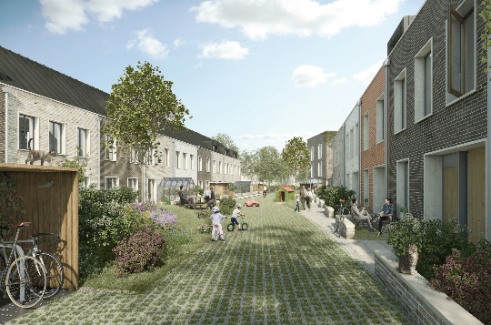
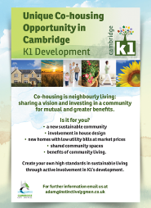


Creating the kind of street that people really want to live on…
42 houses and flats
Co-financed with enabling developer
and investor on Council land

Slide 17
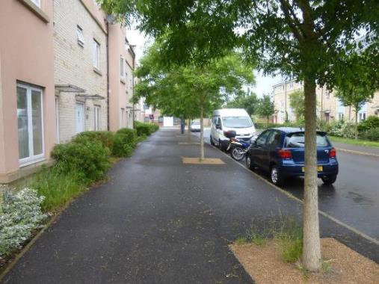
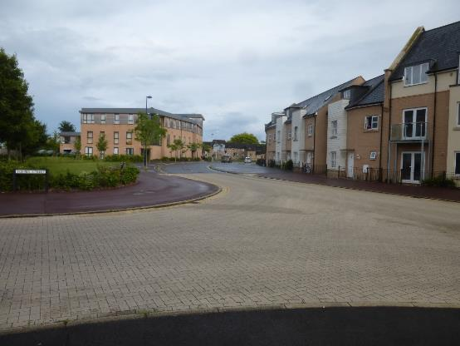
…unlike these streets
…the product of most
‘normal’ masterplans

Slide 18
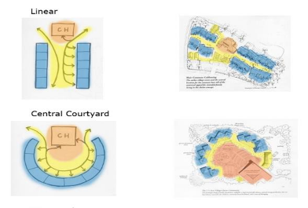
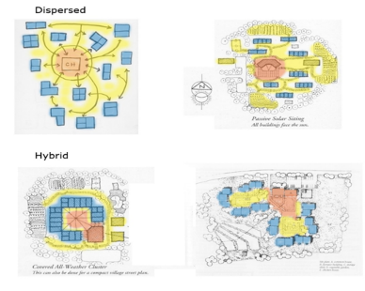
The Cohousing Principles
…or just common sense?
Community life – Supports community dynamics for easy informal contact with neighbours
Inclusivity and healthy living - Promotes the wellbeing of cohousing community members, is inclusive and forms part of the wider community
Co-production – Starts with the process of co-design through to management by intentional communities of place or interest
Sharing and privacy – Includes private and shared facilities to achieve a balance between privacy and communality
Control and responsibility - Embeds collective resident ownership, control and place stewardship into its legal form and decision making
‘Community’ layouts

Slide 19
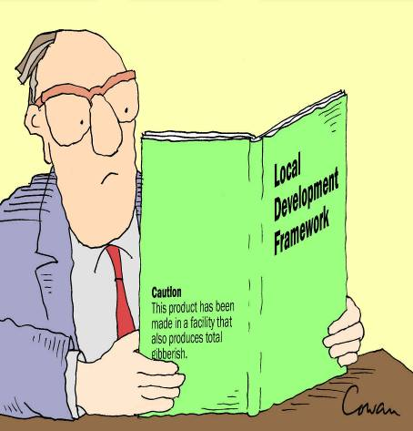
Planning and Design Conundrum:
Do it like I say…
“Specifying in a plan that
development must be sustainable
is no more useful as
guidance to a developer than
describing a piece of music as
beautiful tells us anything about
what it sounds like”
Rob Cowan - The Dictionary of Urbanism

Slide 20
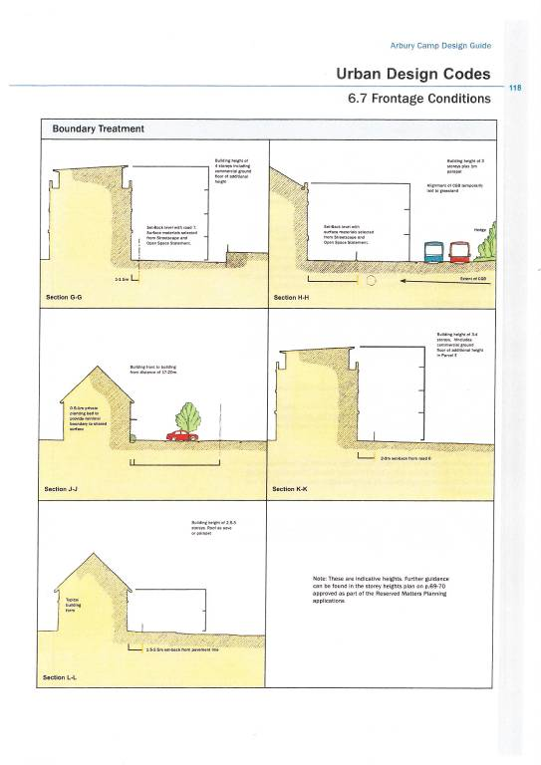
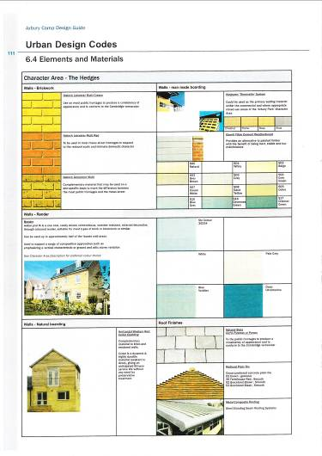
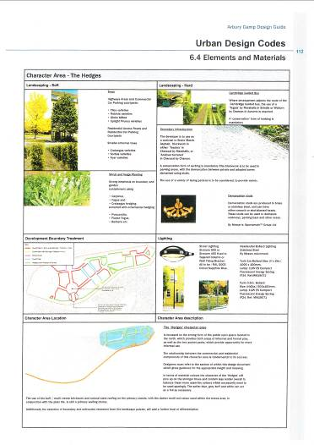
Design Code 352 pages

Slide 21
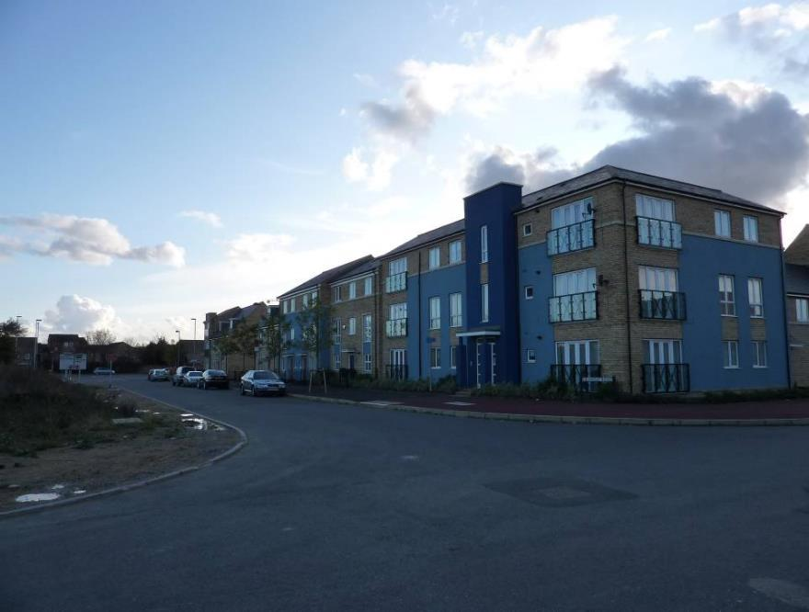
“…uniformly depressing”
Another developer
“It’s like Beirut…”
Germaine Greer in the Guardian, September 2009

Slide 22
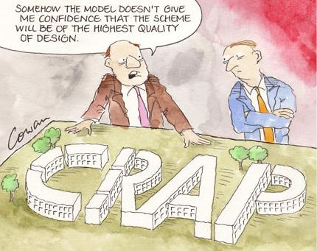

Slide 23
Planning and Design Solution:
Do it like we do…
“We must learn to see that every
problem that concerns us…always
leads to the question of how we
live”
Wendell Berry
“Sex, Economy, Freedom and Community” (1992)
Notes:
The interaction between habitat and population is key
This is all about sustainable lifestyles – how to make them easy, accessible and – crucially - attractive

Slide 24
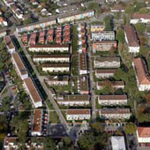
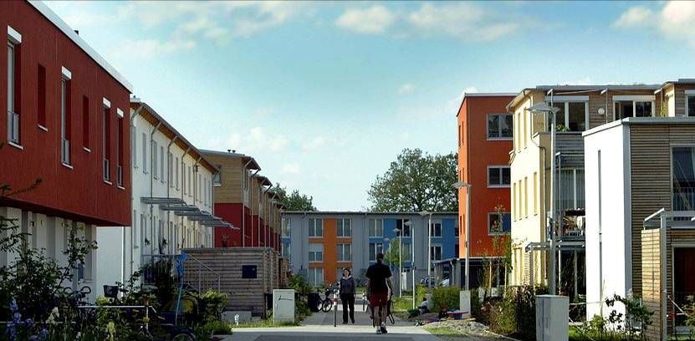
Karlsrühe Nordstadt ‘Smiley West’
Co-producing Design and values
Construction management
7.5 acre
3 hectare site
190 homes –
65+ dwellings/ha
Local Authority arms length enabling company…Recruit and support 10 ‘building groups’…Masterplan and design code

Slide 25
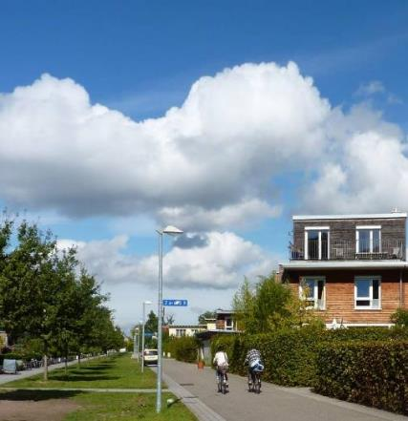
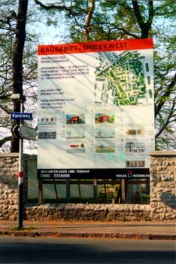
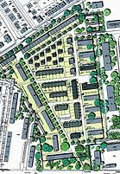
Managed co-production by municipality and community groups

Slide 26
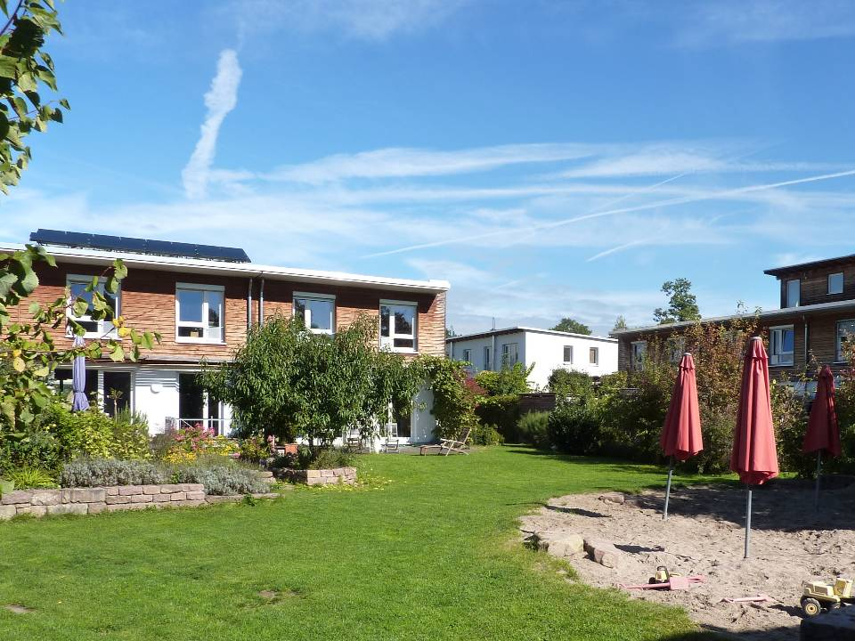
‘Secure by Design’…or by…Living Together?
Family Cohousing
Passivhaus group

Slide 27
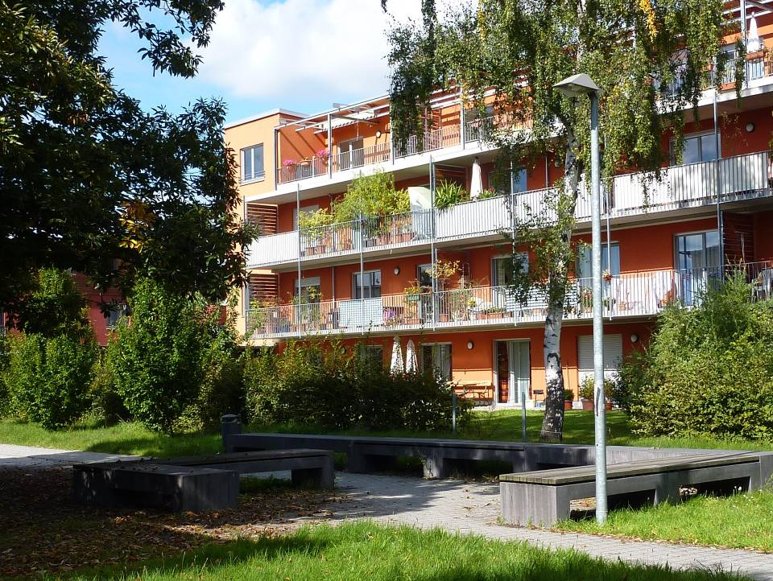
Barrier free living group

Slide 28
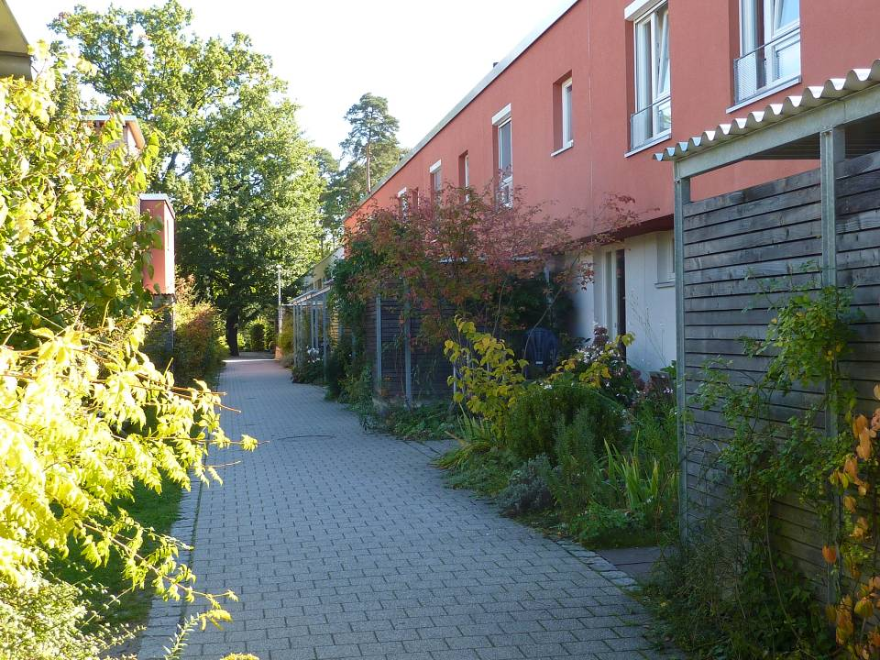
Lower income family group

Slide 29
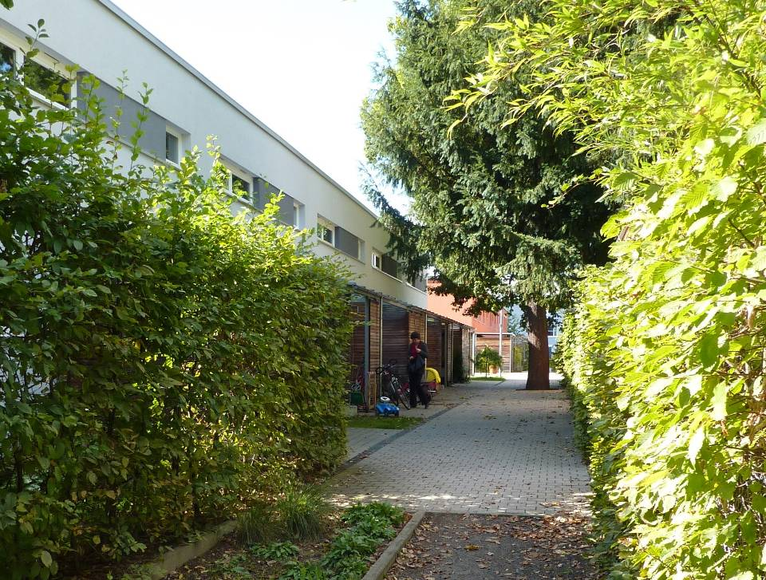

Slide 30
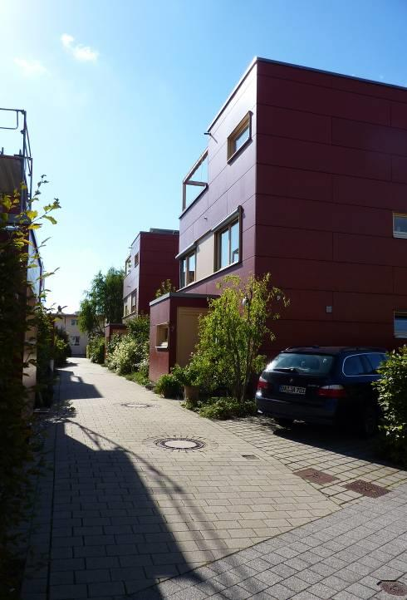
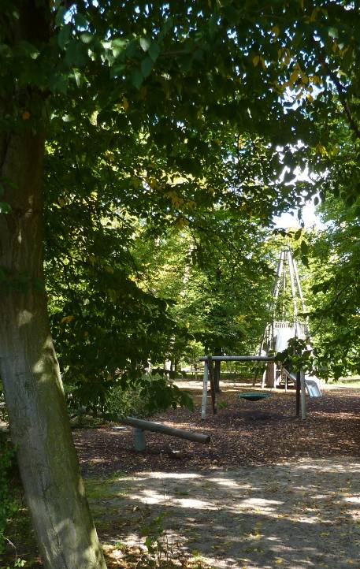
High quality public spaces
High value detached
and semi-detached
villas

Slide 31
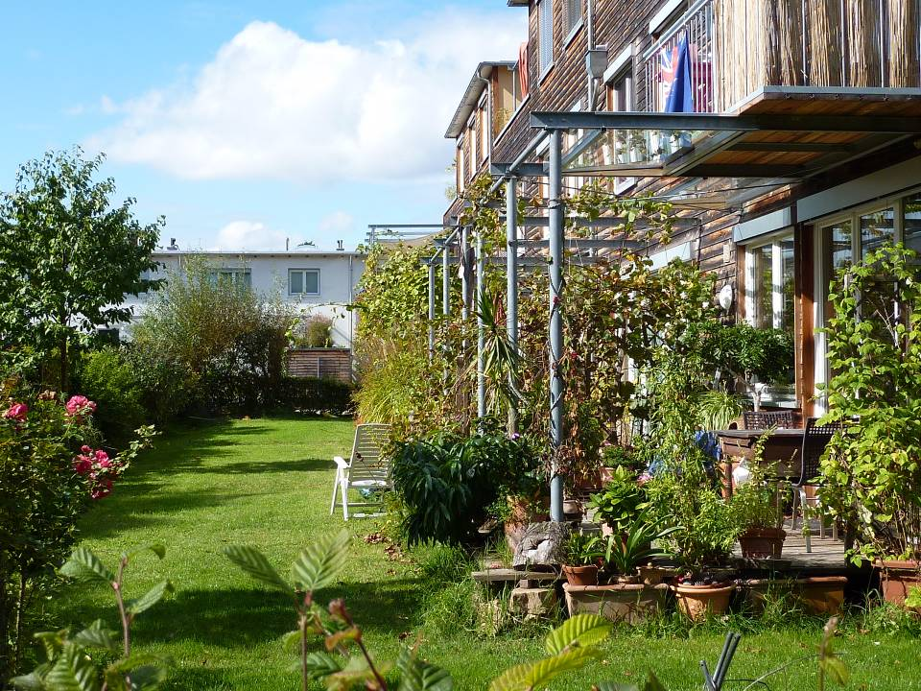
“Managing our co-existence in shared space”
Prof. Patsy Healey – Definition of Spatial Planning
Mid-market family group

Slide 32
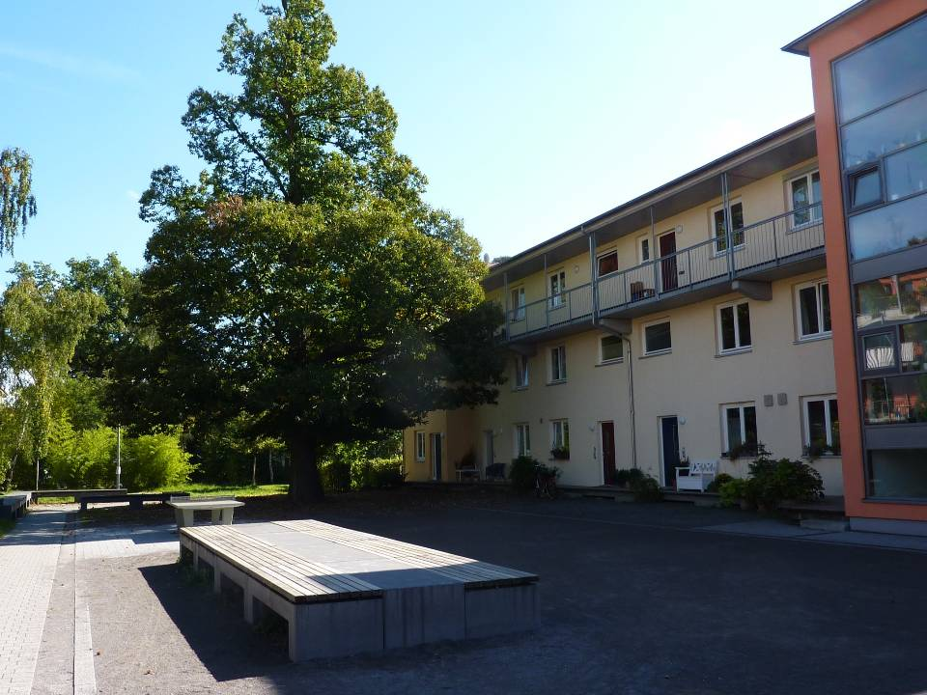
Older people’s group

Slide 33
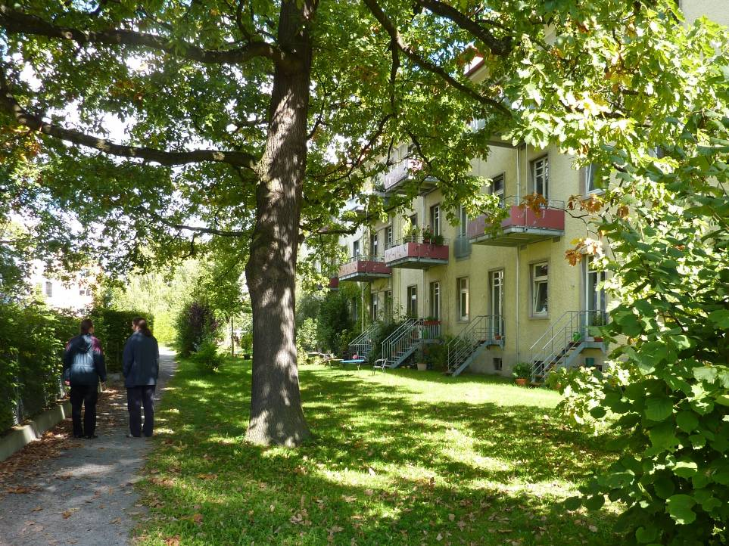
Coop Mika

Slide 34
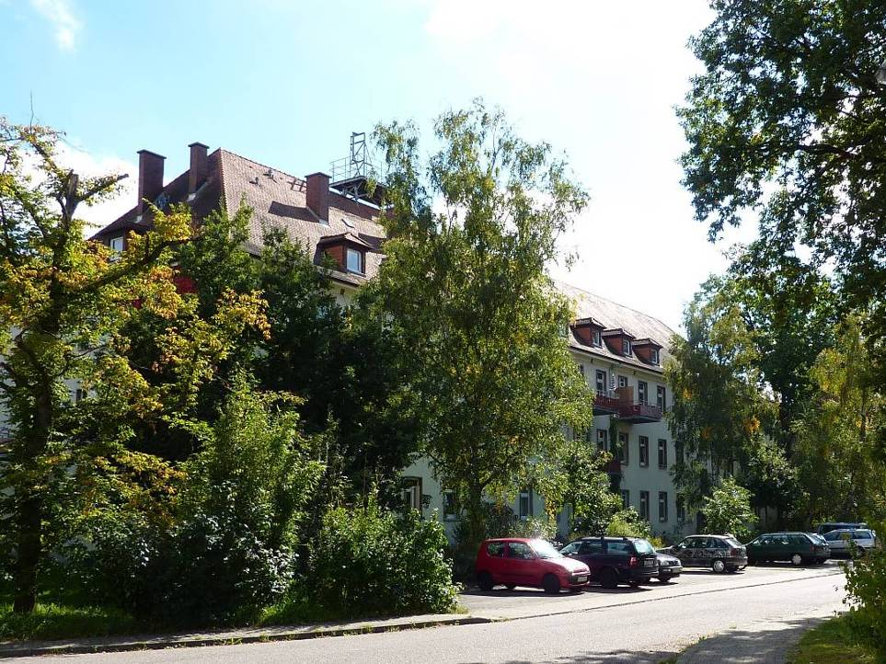
Self-refurbishment:
Flats for families
and single people
Notes:
34
34
What I like…secondly…also about 60 DPH

Slide 35
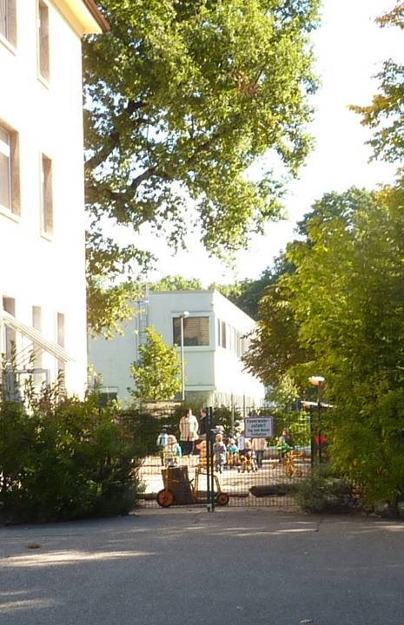
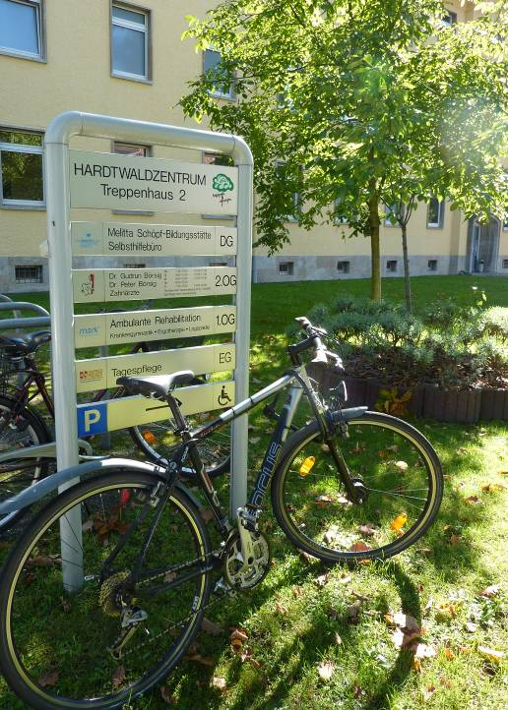
Workspace
and local
services
Community
facilities

Slide 36
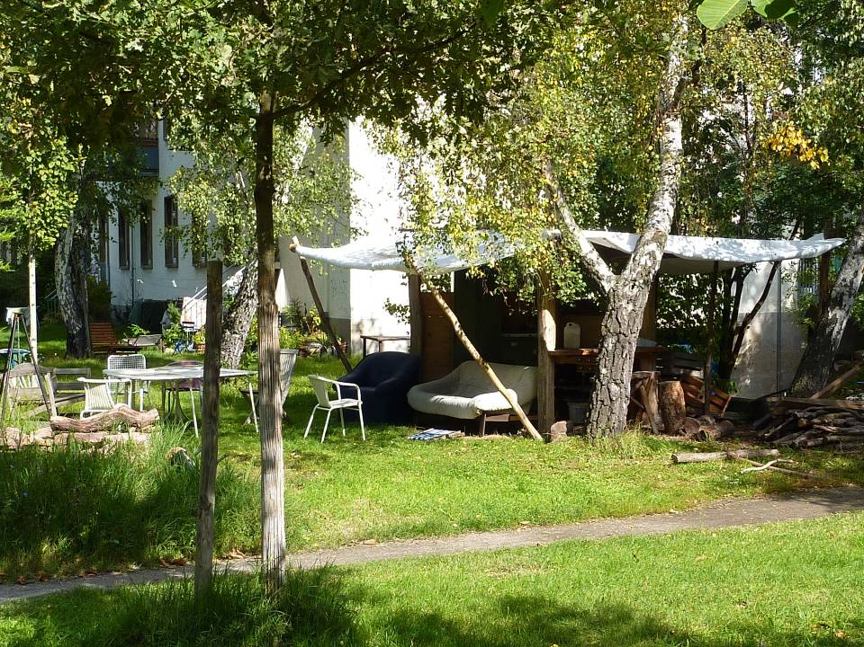
Messy living…

Slide 37
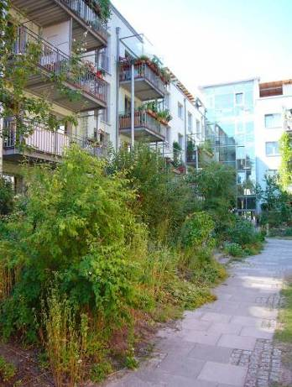
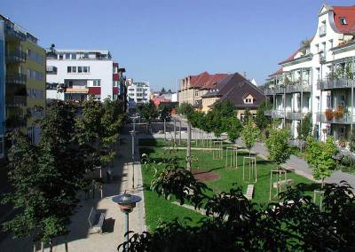
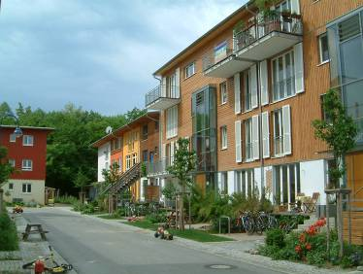
Diversity and maturity in mainstream politics and housing markets - Germany
Tübingen Südstadt
Project Vauban, Freiburg
Karlsruhe, Hamburg, Leipzig….

Slide 38
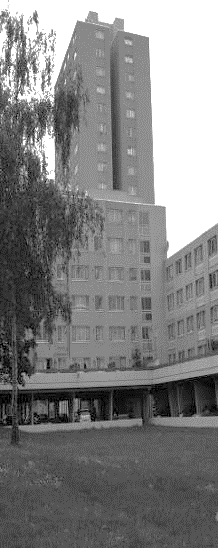




1976 Pelham Court Coop N.17
Managed co-production – Haringey Council and their tenant co-operators
Inspired by the work of Ralph Erskine at the Byker Wall redevelopment
1976 The Game (later Planning for Real)
Brief: ‘Not look like a council house’

Slide 39


Slide 40


Slide 41


‘Why don’t these look like council houses?’
What was
the real
question?

Slide 42

How shall we live?
80/20 Principle of ‘Community’ Housing…
80% Same
20% Unique
Neighbourliness
& Sociability
Affordability
& Freedom
from Debt
80%
Sustainable &
Cooperative
Living
AUTONOMY
& DEMOCRATIC
LEGITIMACY
Land Reform
for the
Common Good
Placemaking
& Community
Building

Slide 43



What is ‘Co-Pro’ all about?

Slide 44

…is not to design a finite scheme based on assumptions about future behaviour
…but to provide a foundation from which residents carry on designing through living in the place as an intentional community.
The challenge for designers…

Slide 45

The Malings, Ouseburn

Slide 46


Slide 47


Slide 48



Overall Winner Housing Design Awards 2016

Slide 49



Leadership for Placemaking, Planning & Design?
Formal process of “design” ends
Design as “living” begins
Scale and Identity
Intimacy of place and people
Loud and quiet architecture
Unlocking creativity of people
Long term responsibility
for place and its people
More than what it looks like on Day 1

Slide 50

“Weirdy…
they are
not normal.”
Ward Councillor (from the then Big Society Party)
at Stroud District Council
Planning Committee

Slide 51

What is the added value of working with ‘the community’?
Localism shifts some of the power
to communities, but growth and
renewal can be compatible,
provided schemes are thought
through in terms of community
need and input..
It will demand better tailored
proposals and interventions.’
David Lunts
GLA Director of Housing & Land
Alan Cherry Memorial Lecture May 2011

Slide 52



My sister can’t believe I’ve got this place
2018 Marklake Court, Kipling Estate, Bermondsey
Leathermarket (JMB) Community Benefit Society with LB Southwark
27 – homes for social rent – not subject to Right to Buy
125 – year lease on the site
302 – units per hectare
£9.7m – total funding from Southwark
£0.3m – predevelopment costs from GLA
14 two-bed flats for downsizers needing a bed for a guest or family carer.
Knowing who the residents were beforehand was a critical part of the project’s success.
Bell Phillips Architects

Slide 53

Everybody who has been involved in this collaborative approach
has benefitted from it.
I’d like to see more examples of this across
the capital.
James Murray, Deputy Mayor
for Housing and Residential Development.

Slide 54

Main barriers: Hard work to get and
co-ordinate land, project finance, mortgages, professionals and construction, culture…
All development is
95% PERSEVERANCE!
Whether you are the council, a developer,
housing association or community group

Slide 55

Site reserved for a community centre
….since 1976!

Slide 56


Coming soon…oh, this is sooo tiring

Slide 57

Citizen inspired housing ‘Policymaking by doing’
Building new markets
Growing the Voice of the Demand Side
Read more ‘Property, Justice and Reason’
http://stephenhillfutureplanning.blogspot.co.uk

