Slide 1
Housing, Health, and Care

Slide 2
Why is Housing Important to the Health and Care System?
It makes sense
The evidence is strong
It’s nothing new
There’s never been a better time to act

Slide 3
The home is at the heart of everything
The link between housing and health/care is stronger than ever
Everyone should be able to live in a home that is suitable for them, their needs, and their life
A suitable home can help people stay independent for longer, and reduce and delay care costs
We want to ensure more people live in ‘suitable’ homes

Slide 4
The home environment impacts people’s health and independence and, therefore, both the health and care systems
Health care
Health and wellbeing
Prevention
Avoid hospital admission
Fast track discharge
Social care
Independent living
Prevention
Recovery
Care arrangements
Inclusion
‘Suitable’
homes

Slide 5
We want everyone to be able to live in a suitable home; but what do we mean by a ‘suitable home’?
Accommodates care / medical needs
Personal preference
Accessibility and independence
Suitable Homes
Location
Social inclusion/ community engagement
Affordability

Slide 6
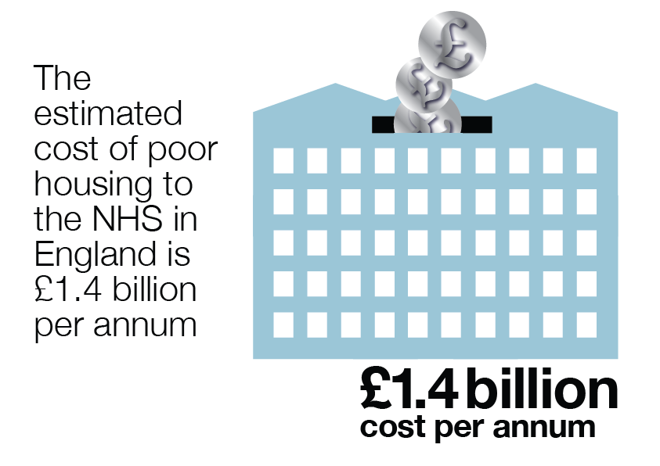
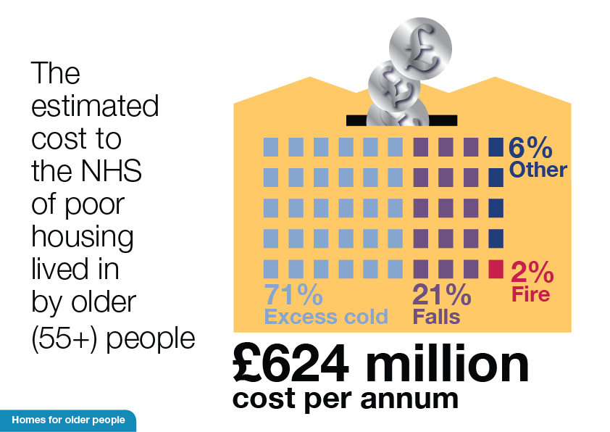
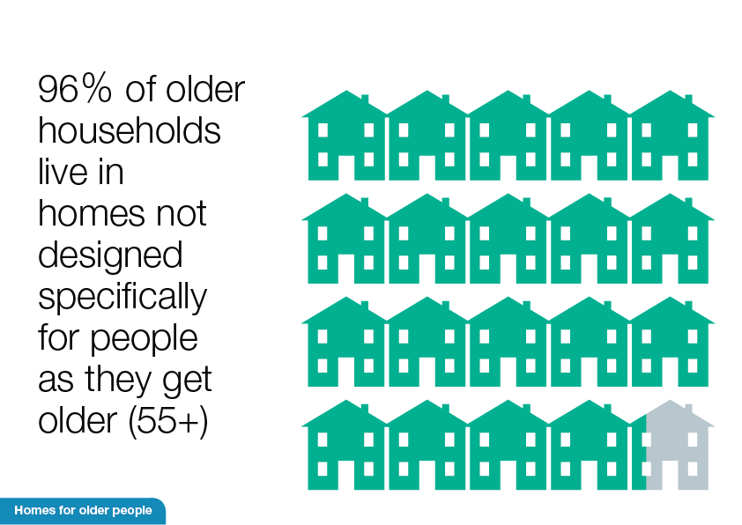
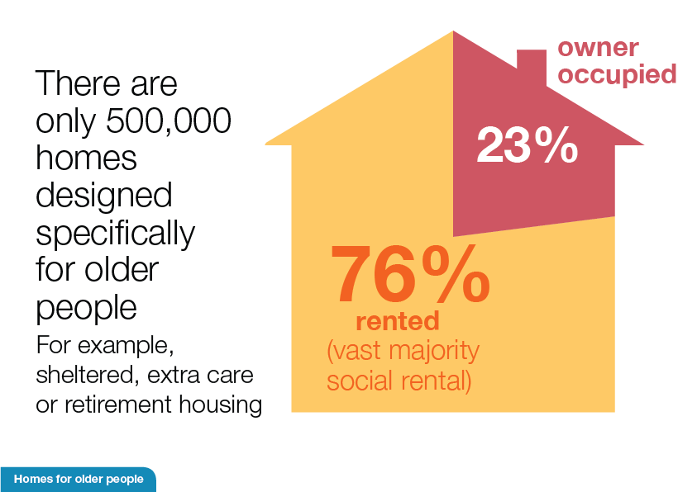
There is a large and strong evidence base underpinning the role of housing for the individual and the system
Supported Housing Options can lead to net benefits of £938 per person
At least 475,000 older people lack adaptations that would help them with the disability or long term condition

Slide 7
What’s our approach? What are we already doing; and planning to do?
Existing stock
Adaptations
Disabled Facilities Grant
Technology
Funding
Local integration
‘Right sizing’
New stock
Mainstream
Regulations
Design & Supply
New models
AGC
Specialised Housing
CASSH Fund
Supply and demand
Information and advice
DFG Review
Social Care Green Paper
AGC and Industrial Strategy
Supported Housing Consultation
Social Housing Green Paper
NPPF and guidance

Slide 8
What’s our approach? What are we already doing, and planning to do?
Existing stock
Adaptations
Disabled Facilities Grant
Technology
Funding
Local integration
‘Right sizing’
New stock
Mainstream
Regulations
Design & Supply
New models
AGC
Specialised Housing
CASSH Fund
Supply and demand
Information and advice
DFG Review
Social Care Green Paper
AGC and Industrial Strategy
Supported Housing Consultation
Social Housing Green Paper
NPPF and guidance

