Slide 1
Rural housing in an ageing population
Louise Reynolds, Senior Support Services Manager
Connexus Housing Group

Slide 2
Connexus: recently formed from merger of Shropshire & Herefordshire Housing Groups
Two very rural counties on border with Wales Dispersed, sparsely populated:
Shropshire: 0.96 people per hectare
Herefordshire: 0.86 people per hectare
England: 4.09 people per hectare
To support our tenants we need to be interested in broader solutions for PLACE – we need to be more than a landlord –care, employment, wealth, transport, inward investment & job creation
https://factsandfigures.herefordshire.gov.uk
https://shropshire.gov.uk/information-intelligence-and-insight

Slide 3
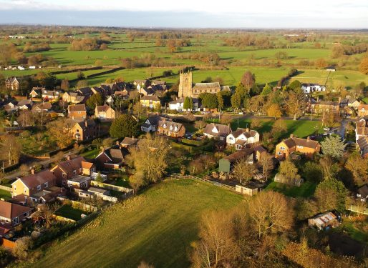
Usual rural challenges

Slide 4

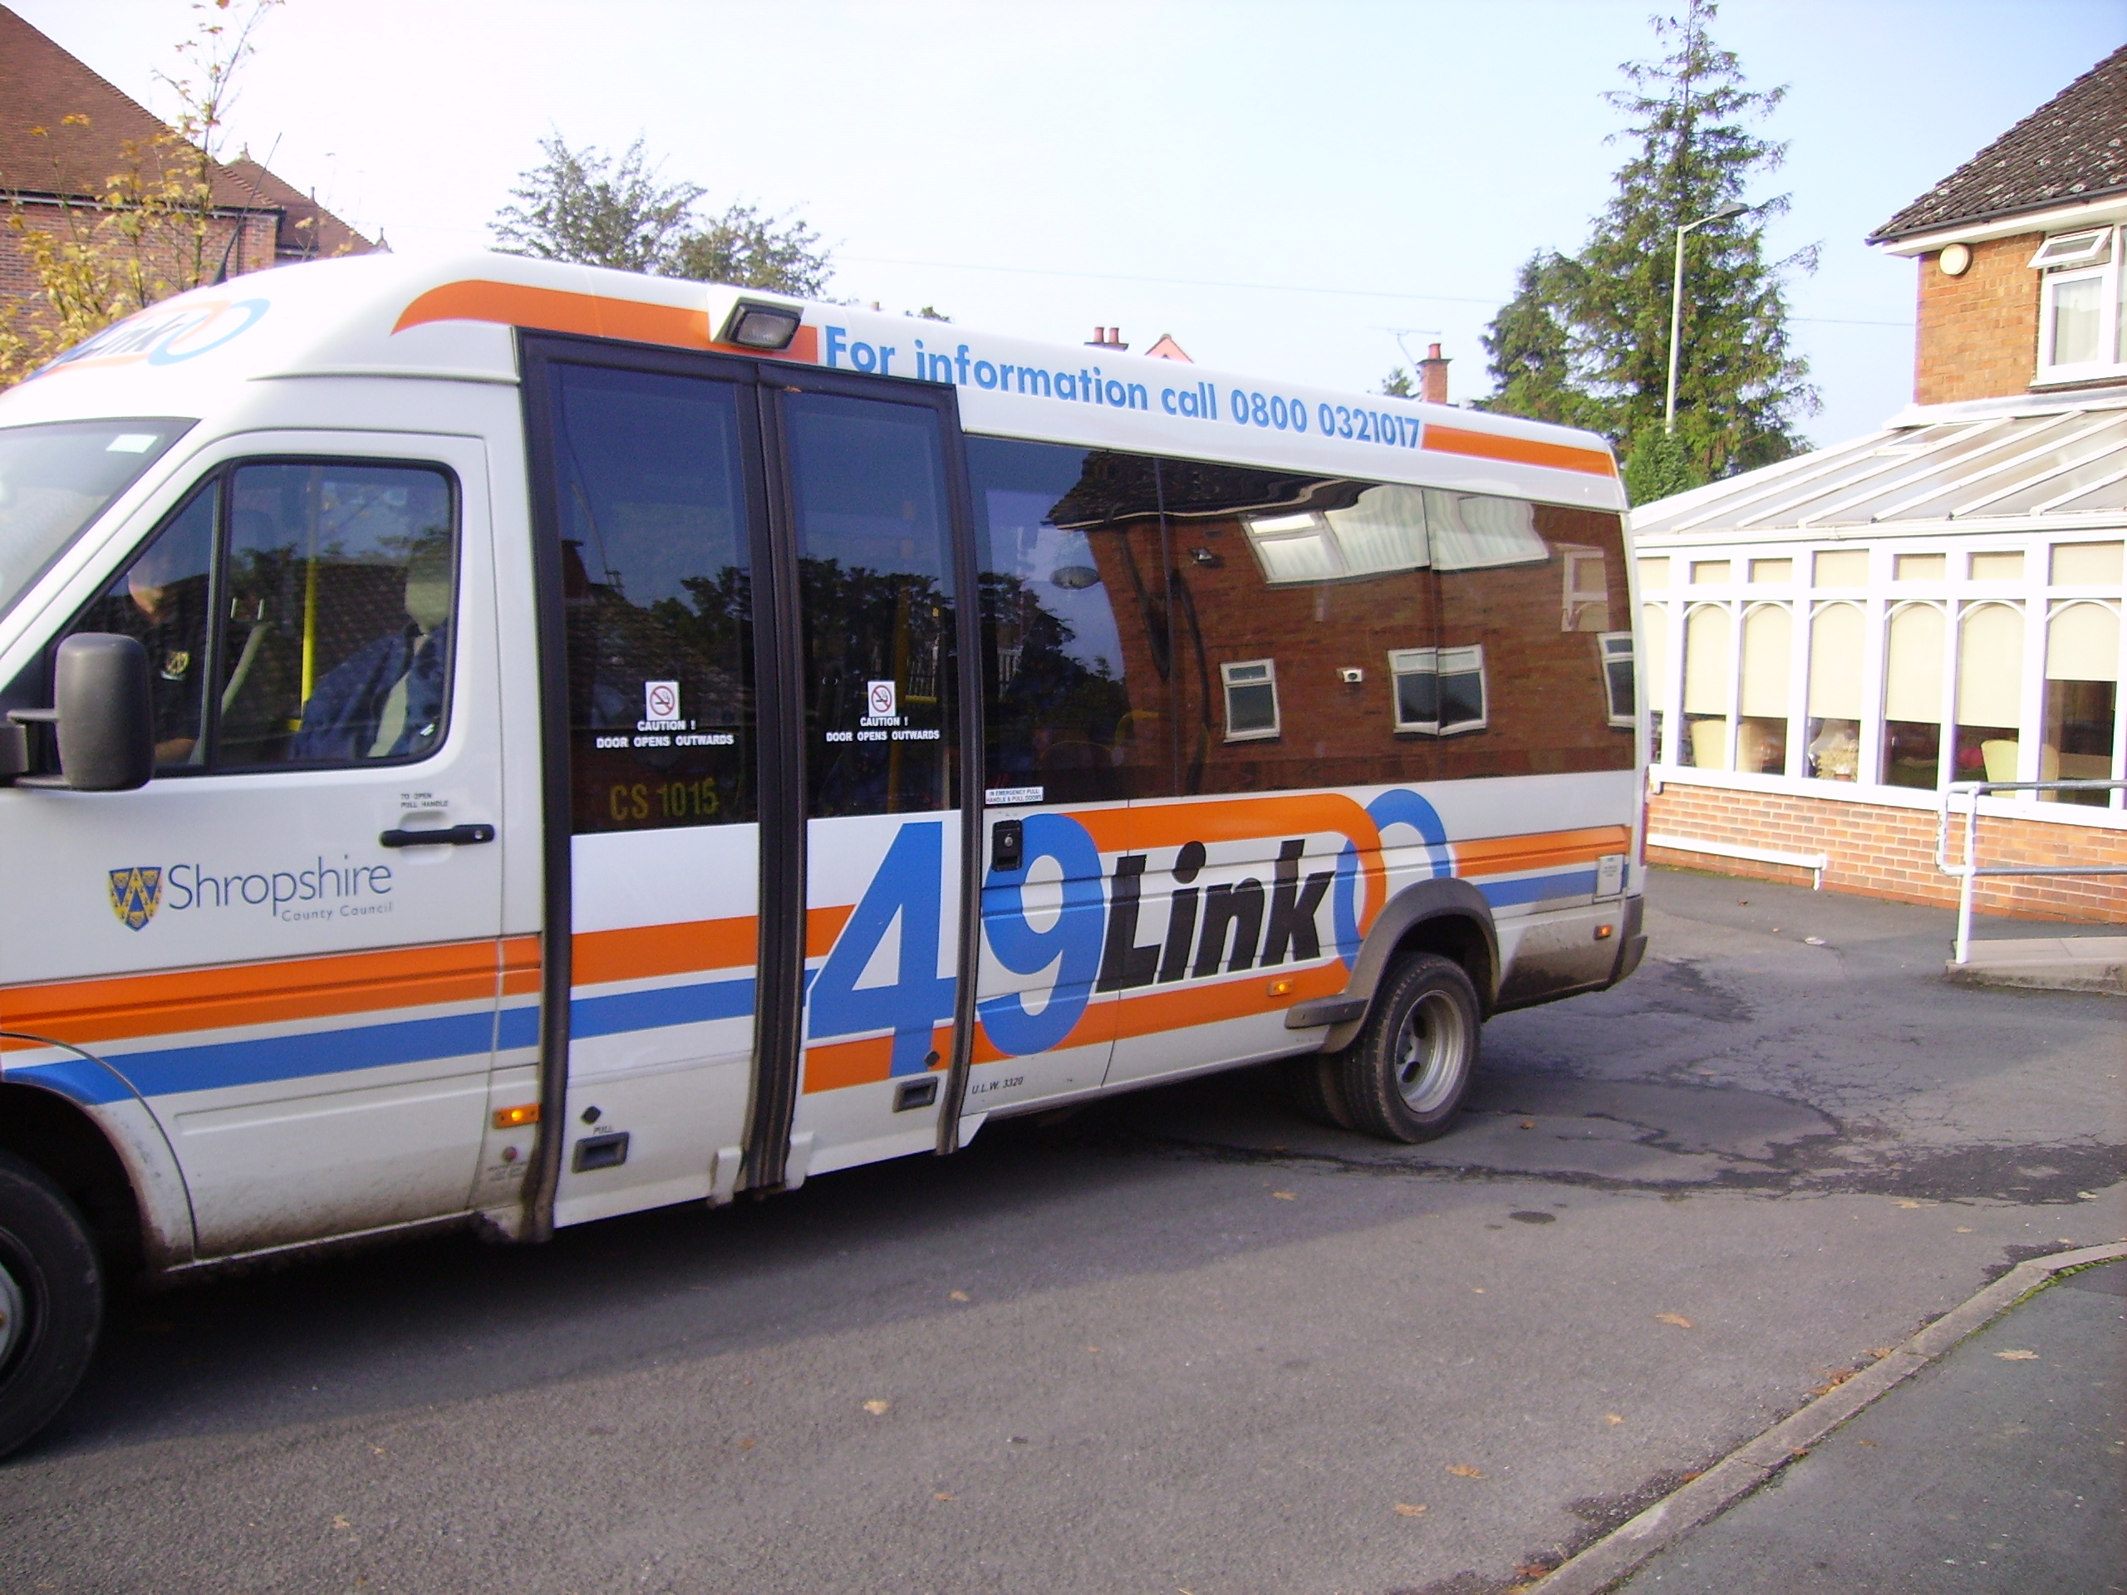

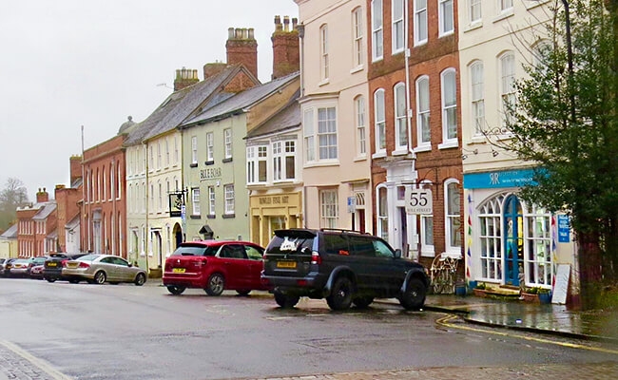

Notes:
Beautiful countryside, heritage – inward migration of older retirees, often affluent – raises house prices. Often have money but can’t buy desired services because not viable to provide.
Loss of younger people (family & carers) - – unable to earn enough to be able to afford to live locally.
Low unemployment yes but predominantly low wage, low skill employment: multiple part-time “portfolio” jobs – fit round family commitment – carefully appraised – working hours, security, transport costs
Poor transport infrastructure + broadband – need a car
Struggle to attract doctors, nurses, care workers to work in local GP practices and hospitals
Push to centralise to rationalise costs

Slide 5

To explore current housing & care problems facing older people in rural areas
To make recommendations to central & local government and other partners for solutions.

Slide 6
What barriers if older people want to move home?
Choice
Fear of charges
Ways to mix & match tenure
Rent family home out (protect inheritance)
  Scale vs viability
Range of products & services
Notes:
Choice, ways to enable fluidity across tenures, info
Fear of leasehold & service charges – good models exist (e.g. Commonhold or fully mutual freeholders – but not understood, explained or promoted).
Ways to mix & match tenure – step down/step up beds which enable discharge (& prevent admission) COULD flow into a purchase or a rental move … need courage re procurement, underwrite risks, skill social workers to maximise occupancy
Rent family home out (protect inheritance) & rent my retirement home with the proceeds
A range of Products & Services to promote independence
Issues about viability & scale in small market towns & no demand for an 80 apartment megalith – isolated not integrated

Slide 7
What wider policy developments might impact rural communities?
Move to centralise services to rationalise costs
Need to travel for appointments
Economic decline
Other cost saving measures
Lack of investment in basic infrastructure
All undermines the appeal and sustainability of the PLACE
Notes:
Move to centralise services to rationalise costs - e.g. Shrewsbury & Telford Hospitals … community hospitals become failing backwaters, harder still to attract staff – vicious circle of failing confidence. Clarity on service model.
Need to travel for appointments – but limited public transport - ambulance response times – 2nd rate services
Economic decline – loss of skilled work, lower wages, precarious employment contracts – leave for the city
Other cost saving measures – public transport, libraries, leisure centres
Lack of investment in basic infrastructure – mobile phone network, broadband
All undermines the appeal and sustainability of the PLACE

Slide 8
What would help to overcome barriers?
Above all – describe (and invest to deliver) a meaningful vision
Describe the minimum service offer
A regional economic plan that aims to sustain places
Find ways to enforce or reward collaboration around service offers in the PLACE
Look at unintended consequences of procuring individualised care packages
Enforce engagement from health and police in Data sharing protocols
Notes:
Above all – describe (and invest to deliver) a meaningful vision for the role of rural England .. Trains, roads, mobile phone coverage, broadband, investment strategies
Describe the minimum service offer – pragmatism – services will flow from local market towns, and invest to guarantee it
A regional economic plan that aims to sustain places
Find ways to enforce or reward collaboration around service offers in the PLACE – to build viable economies of scale and coherent service packages
Look at unintended consequences of procuring individualised care packages on viability of providers business models – promote clustering & partnering around the place
Enforce engagement from health and police in Data sharing protocols to enable strategic management of individuals within the place – and explore packages that make this work (e.g. ECINS)

Slide 9
Solutions we are working on
SUSTAIN consortium
Notes:
Representing all 5 LSVTs (former council housing stock) of the 5 former District Councils –
Unified service offer & recognisable brand
Operate out of sheltered schemes in every market town
Serves our own tenants & wider community – owner occupiers, tenants of other social & private landlords
The place to go for advice on how to remain independent in own home for longer
Issues: Need sensible joined up unity on the public estate – siting of hubs – competition – libraries, children’s centres, GP surgeries (same problem with “community connector services!)

Slide 10

Solutions we are working on:
Menu of services
Notes:
Come to sheltered hub for company – build trust over time
Quality assured/DBS checked adaptations & repairs service
Homelife, Domiciliary Care – clustering packages around schemes – make viable (appealing) work-streams for staff
Issues: Individualised brokerage, prevents coherent offer, joining up, economies that make sense
Falls Responder Service – (Herefordshire) CCG commissioned – then add a Mobile Responder service (subscription - £2.50 per week) to address other issues Issues: Ambulance call centre triaging; Need unified alarm monitoring service across county (procurement and “unfair competition” rules)

Slide 11
Solutions we are working on
Community and PLACE Capacity building
  Investing in Vol Sector – e.g.
    Mayfair (Church Stretton)
    Hands Together Around Ludlow
    Support VCSE in bid for Social Prescribing monies
    £40k per annum Community Fund
Issues: VCSE empire protection, unable to see bigger picture
  Invest in relationships with local governance structures e.g.
    Attend Local Joint Committees
    Promote development of locality governance and delivery structures
Issues: Public sector empire protection, unable to see big picture
Notes:
Community and PLACE Capacity building
Investing in Vol Sector – e.g.
Mayfair (Church Stretton) – we are their landlord & we buy services from them, we acknowledge them as the service provider for the place.
Hands Together Around Ludlow – we donated start-up funds.
Support VCSE in bid for Social Prescribing monies
£40k per annum Community Fund – dispersed by stakeholders
Issues: VCSE empire protection, unable to see bigger picture
Invest in relationships with local governance structures e.g.
Attend Local Joint Committees, try to develop shared vision and service offer – Dementia Friendly Ludlow initiative
Promote development of locality governance and delivery structures – Troubled families, early help, Sustainable Transformation plan – aim for unified view of Place, service delivery model, hubs etc
Issues: Public sector empire protection, unable to see big picture

