Slide 1
Housing Strategy in Lewisham
Jeff Endean, Housing Strategy Manager
Laura Harper, Joint Commissioner

Slide 2
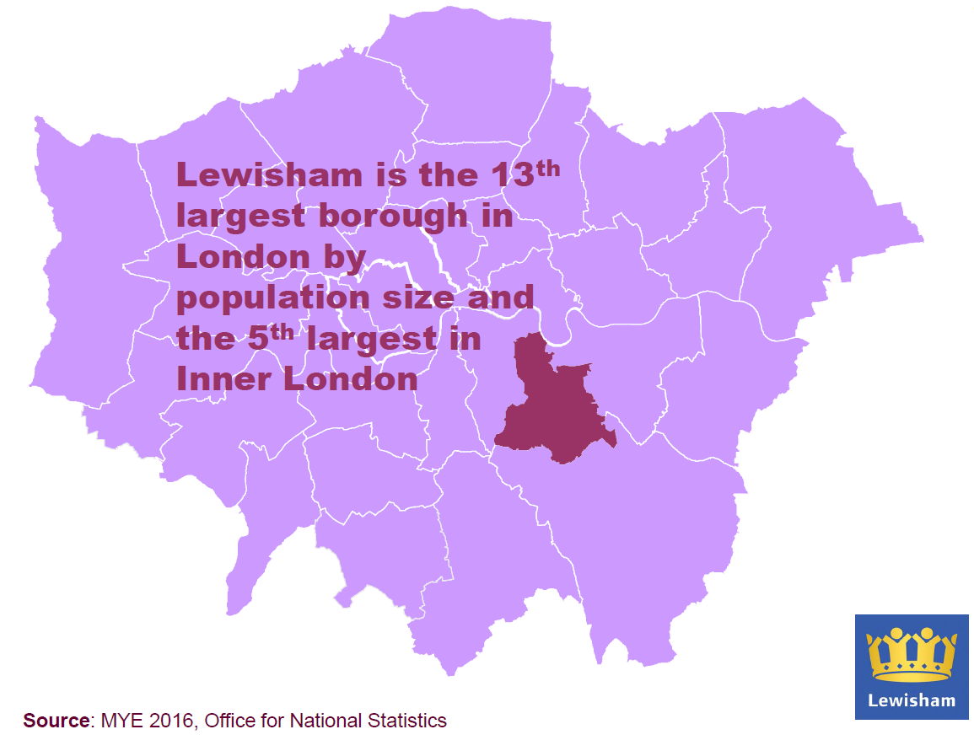

Slide 3
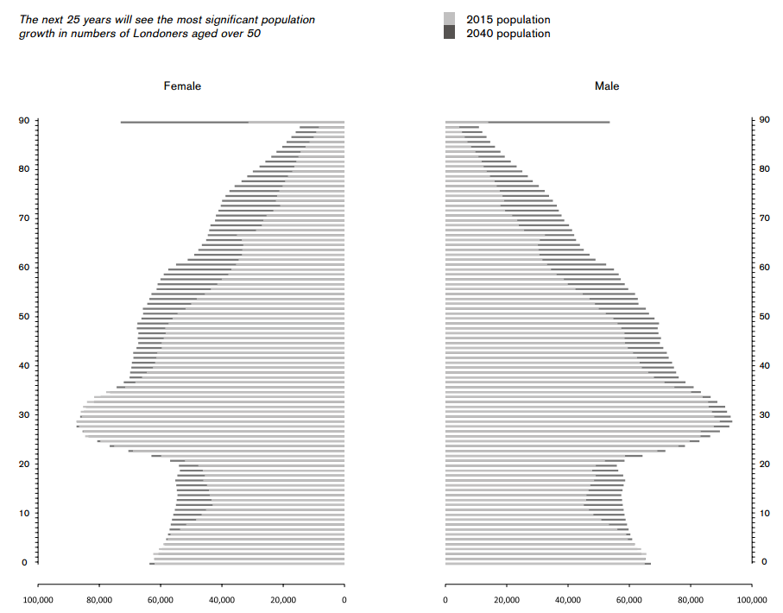
Population growth
The graph shows increased numbers of people aged over 50 in London.
Lewisham’s population will grow by 24% by 2030. The proportion of the population aged 65+ will be similar (around 9-11%) but it will still equate to an extra 12,300 people over 65 and an extra 1,400 people over 85.

Slide 4
The Housing Market
The housing market remains unaffordable for many residents in Lewisham. The average house price in the borough as of January 2018 was over £415,000, representing an 81% increase in house prices since 2010.
A 2-bed flat which would have cost £995 to rent in 2010/11, would now cost over £1,300 in Lewisham. There has been a significant decrease in the number of 2 bed properties available in borough that would be affordable on LHA, even fewer of which are actually available to households in receipt of housing benefit.

Slide 5
Tenure in Lewisham
49% of people aged over 65 in Lewisham are owner occupiers (14% own outright).
40% of wider population own their own home (14% outright).
44% of over-65s rent in the social housing sector, compared with 36% of wider population.
Numbers of over 65s in PRS are much lower at around 4%. 26% of under 65s rented privately at the last census they are getting older!

Slide 6
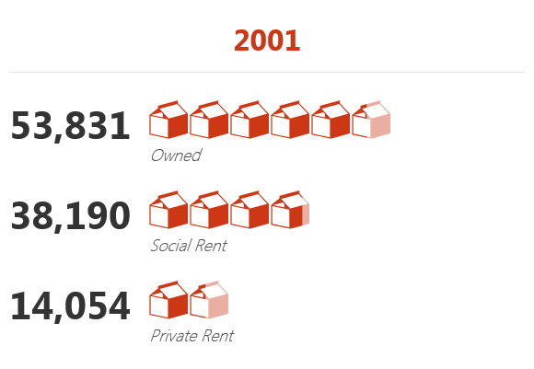
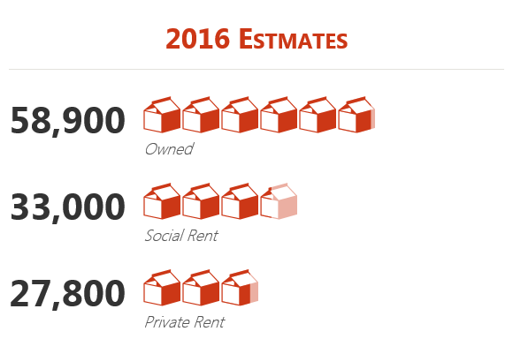
Tenure in Lewisham
Since 2001 the number of Lewisham households renting privately has doubled
Private Rented Sector now accommodates 23% of all households

Slide 7
What did we set out to do?
Vision
Our vision is that there will be a range of housing options for older people in Lewisham whether they are: active and pre-retirement; retired, independent and active; more frail and in need of support.
We want to help people to maintain their independence for as long as possible and we want people’s homes to be:
  suitable for their changing needs
  attractive, spacious and well located
  safe and secure
  affordable
  warm in the winter, comfortable in the summer
  helping to maintain and improve people’s health and wellbeing
Priorities
Develop a new standard for older people’s housing in consultation with older people
Improve sheltered housing quality and service
Build new extra care
De-commission in-house extra care
We wanted to, but didn’t, publish a formal strategy

Slide 8
We spoke to people
Older people in Lewisham said we should to develop housing that is:
“Not too big”
“situated near the shops, post office and bus stops”
“Homely”
With
“Good showers and bathroom”
“A shared lounge”
They also told us:
“Having to downsize possessions is a problem”
“Encouraging people to stay in their homes and share with other people is an alternative option”
“There aren’t enough options for home owners”
“Noise can be really difficult for some older people”
“Social isolation is a problem”

Slide 9
We developed a new standard
Housing for older people in Lewisham should be:
spacious
wheelchair accessible
self contained homes, with full bathroom facilities
“Care ready”
community focused

Slide 10
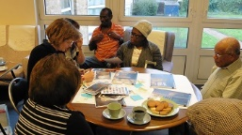
We improved our sheltered housing offer
We identified six sheltered housing schemes of the 18 managed by Lewisham Homes to trial a new investment standard
Commodore Court
Fairfields
The White House
The Vineries
Lawrie Park Road
Talbot Court
We transferred the floating support service from the Council to Lewisham Homes. They have re-shaped the service, developed new partnerships and animated the schemes

Slide 11
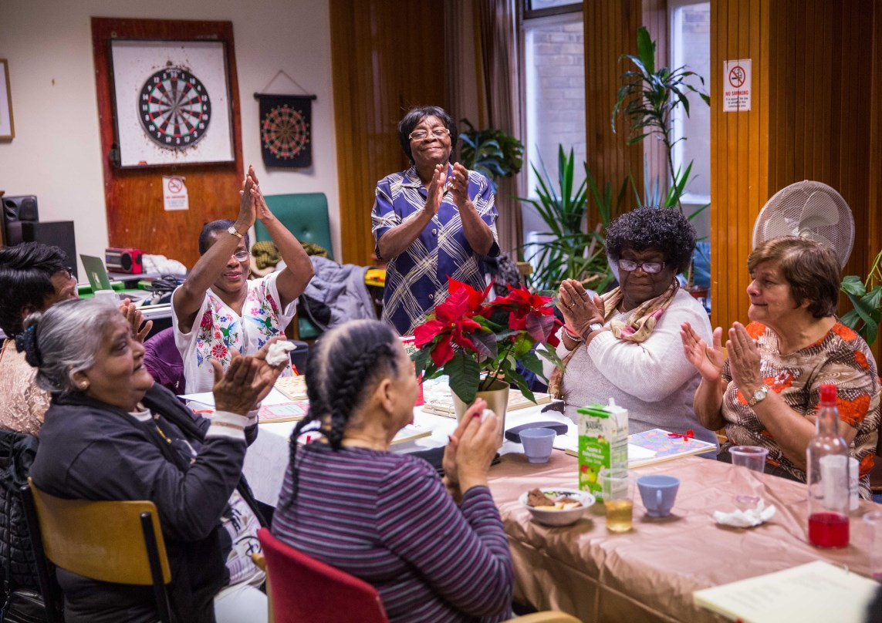
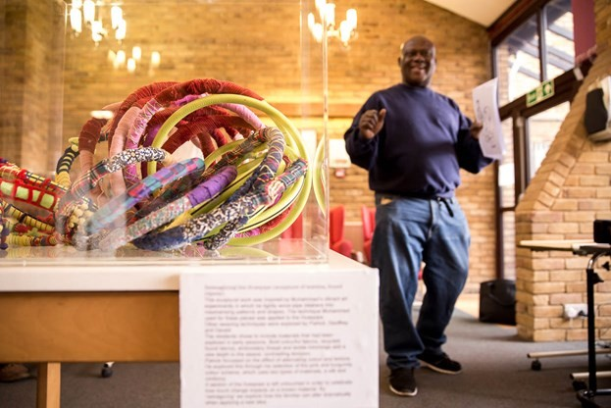
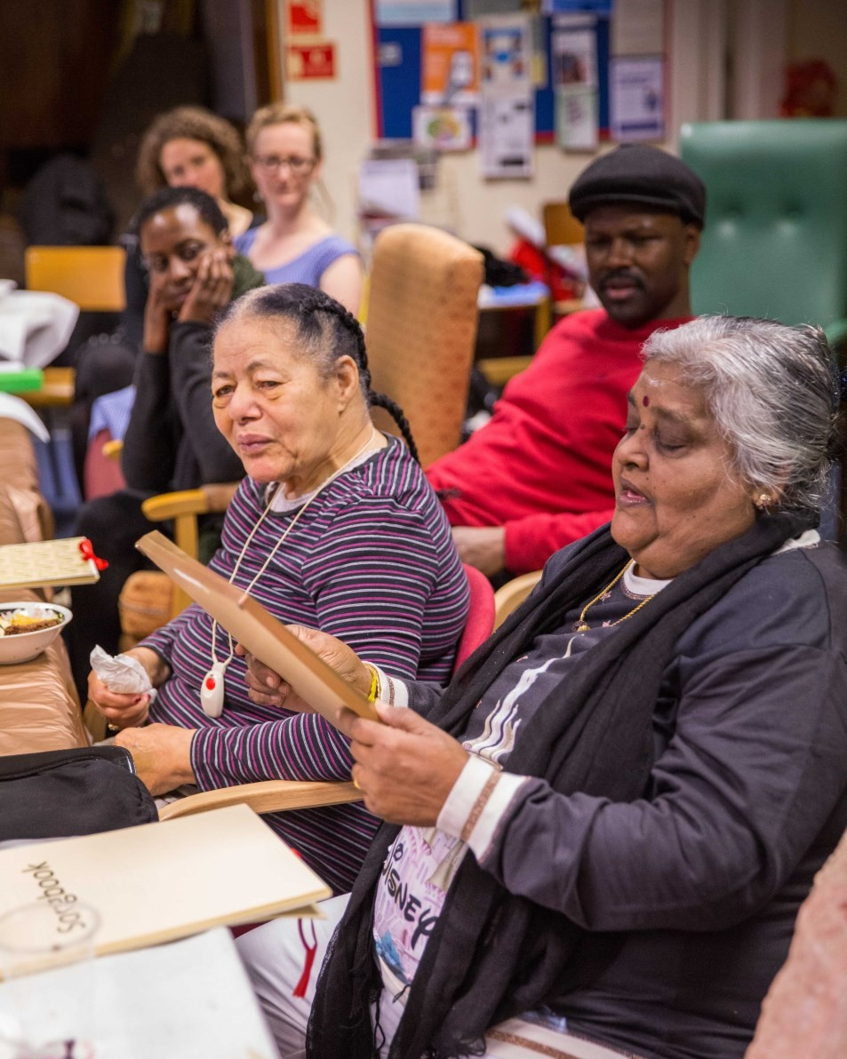
Meet me at Lewisham Homes
“Before these sessions did you think you could make a poem?
It’s the kind of thing you can do when you’re young. “And now?” Yes I could try”.
“Before there was nobody down here (the lounge) and it was in darkness. Now it looks much better and makes you feel much better”.
151 individuals
96 sessions across 4 schemes
981 attendances
“I feel proud and happy when I see what we have done”.

Slide 12
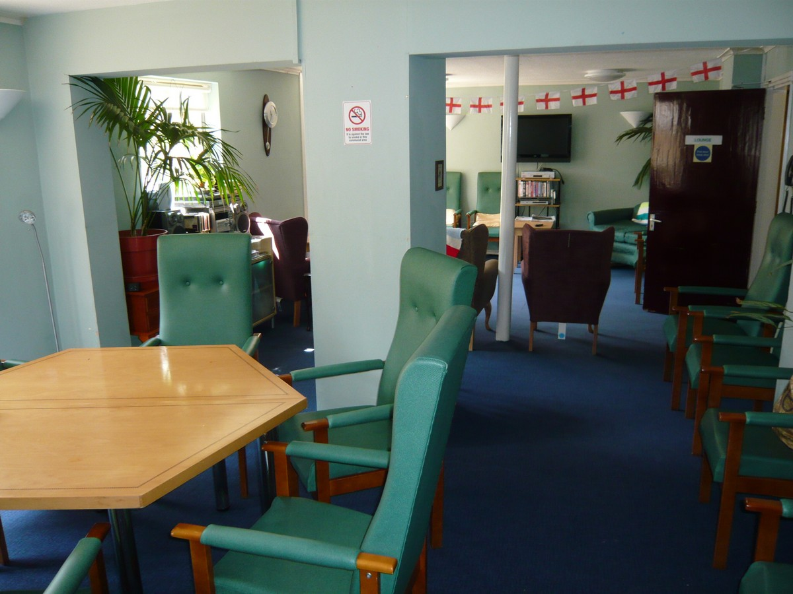
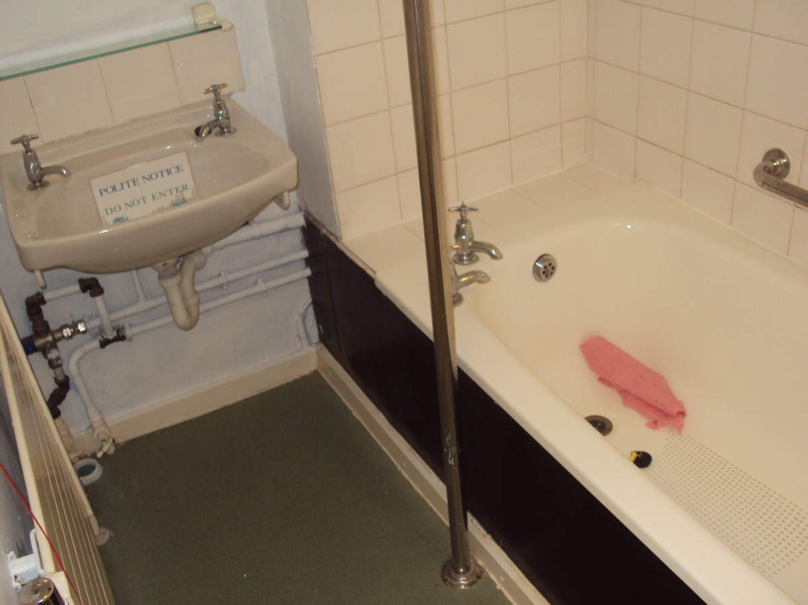
We closed our in-house extra care
Somerville and Kenton Court
55 units across two schemes in different parts of the borough
Poor quality – bedsits with shared facilities
High proportion of void units
Not meeting expectations
High cost of service
What did we learn?
Communication and transparency is key
Not everyone will be happy with change – but sometimes it’s needed
Having shared goals made working across team boundaries easier – decant officer, service staff, social workers

Slide 13
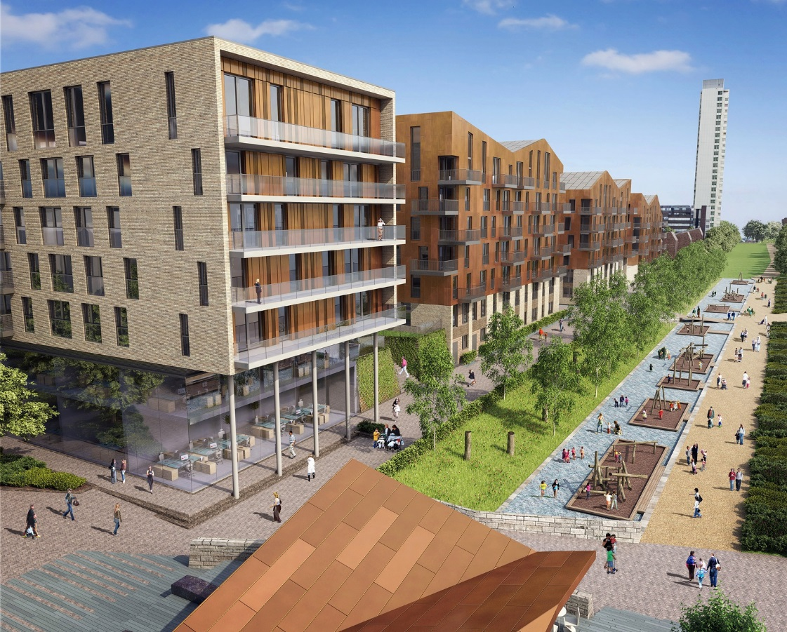
Conrad Court, Surrey Quays
Was built as part of a sec106 Agreement and Notting Hill purchased it.
Lewisham Joint Commissioning were involved quite late in the day and worked with Notting Hill to develop a model of funded Care and Support on site.
What did we learn?
You need to get the right people involved early

Slide 14
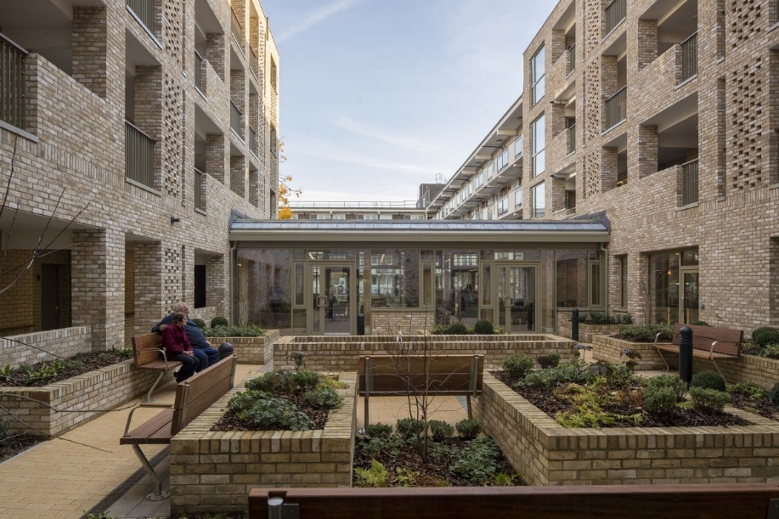
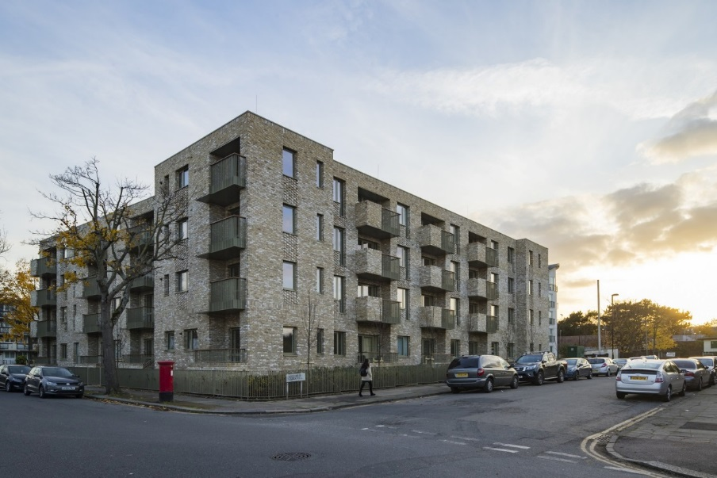
Hazelhurst Court, Beckenham Hill
Phoenix Community Housing with grant funding from the GLA and LBL
60 affordable units. 58 one-bed, 2 two-bed.
LBL Strategic role– building small and dense, building communities, chain lets
LBL Enabling role – leverage influence and funding, other capacity
What did we learn?
The people ASC are working with have high care and support needs
People coming thorough the housing route also can have care needs – but the middle group still under-represented
Choice-based lettings to newbuild extra care can release large properties for chain let

Slide 15
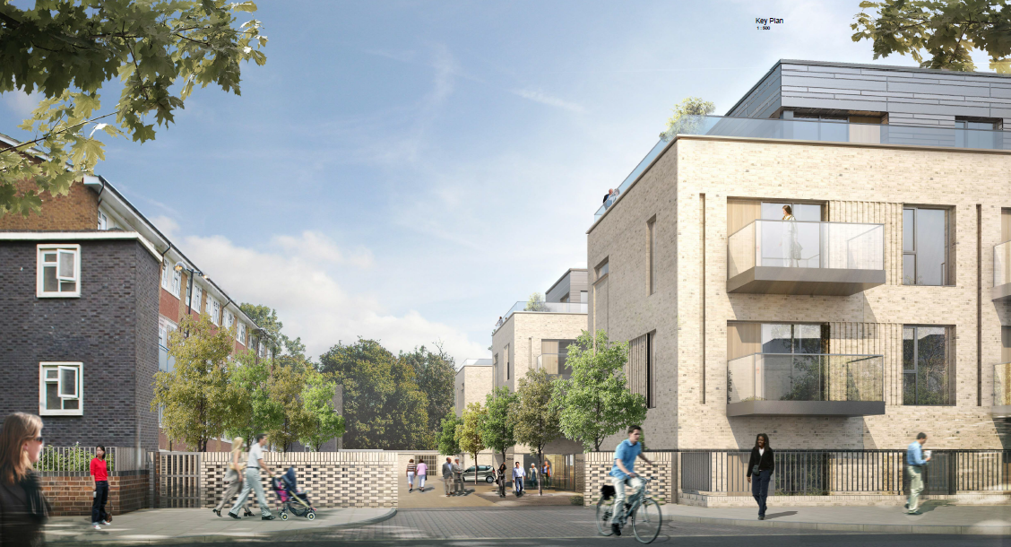
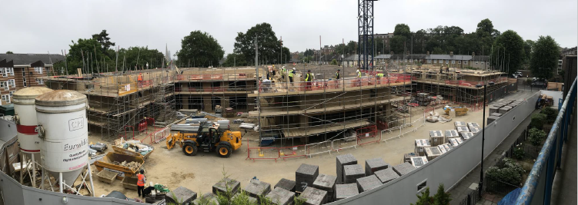
Campshill Road, Lewisham Park
One Housing Group
Completes June 2019
34 units for affordable rent
19 for shared ownership
Delayed due to funding uncertainty – from procurement to land deal. Ongoing discussions with One Housing about the model of care but likely to be core service funded through HB and attendance allowance, then DP for care.
What did we learn?
Perseverance is key!
Sometimes the simple option is the better option

Slide 16
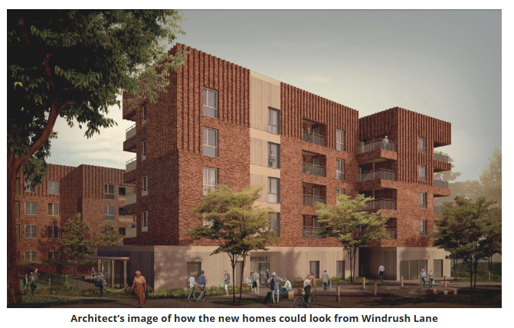
Futureproofing newbuild housing
New Homes on the Bampton Estate, Forest Hill

Slide 17

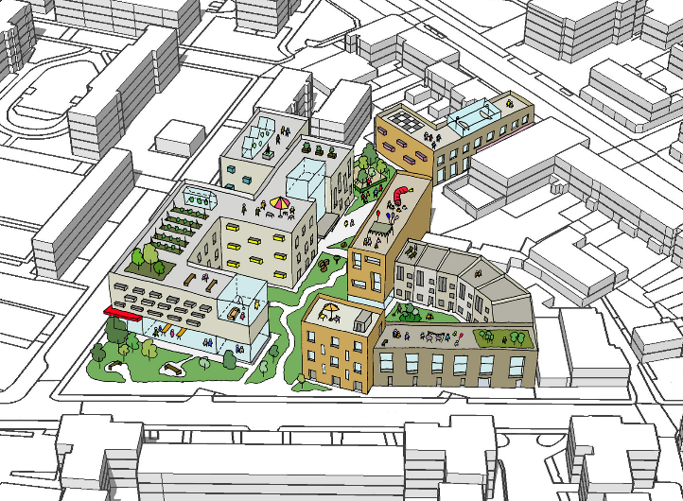
Where are we going?
Further work with planners to enable market-led development– not just state-led and social housing
Including housing for older people within plans for town centre growth
Diversifying the offer - tenure and type
Build on Besson street PRS model for housing for older people
More mixed and representative provision – eg. Tonic
Working with ASC to ensure that future housing and care needs can be met
And maybe we’ll actually publish a strategy now!

Slide 18
Questions

