Slide 1
Housing and the older BME population
Jabeer Butt, OBE, Race Equality Foundation
Nigel de Noronha, University of Nottingham
19th July 2018

Slide 2
Background
Race and ethnic identity are complex and contingent. Racisms develop in specific times and contexts
We know that social isolation is harmful, that older people are at greater risk, but not how this may affect ethnic groups differently
Older BME people face the ‘hostile environment’ created by government policies towards immigrants and those who may be seen as immigrants
Shifting policy agenda – Opportunity Age to ‘local approaches’

Slide 3
BME groups with younger age profile
Source: Standard table DC2101EW, 2011 census

Slide 4
Leading to growing older BME population
Ethnic group (‘000s) | 50-59 | 60-69 | 70-79 | 80 and over
White British | 2,958 (13%) | 2,811 (12%) | 1,931 (8%) | 1,536 (7%)
BME | 308 (8%) | 172 (5%) | 114 (3%) | 57 (2%)
White other | 104 (8%) | 64 (5%) | 38 (3%) | 29 (2%)
Indian | 79 (11%) | 48 (7%) | 29 (4%) | 12 (2%)
Pakistani | 37 (7%) | 18 (3%) | 12 (2%) | 4 (1%)
Bangladeshi | 11 (5%) | 7 (3%) | 4 (2%) | 1 (0%)
Black African | 33 (6%) | 13 (3%) | 6 (1%) | 1 (0%)
Black Caribbean | 44 (14%) | 22 (7%) | 24 (7%) | 9 (3%)
Source: Standard table DC2101EW, 2011 census

Slide 5
Housing deprivation
 | Age | Housing deprived
White British | 50-59 | 18,234 (6%)
 | 60-69 | 13,492 (5%)
 | 70-79 | 8,963 (5%)
 | 80 or over | 7,750 (7%)
BME | 50-59 | 8,371 (20%)
 | 60-69 | 3,071 (14%)
 | 70-79 | 1,916 (14%)
 | 80 or over | 710 (13%)

Slide 6
Cumulative disadvantage
White British most likely to live in detached or semi-detached housing, black African and Bangladeshi least likely to (68% compared to around 25% for over 50s and 65% compared to 20-25% for over 65s)
Occupational social class disadvantages BME groups because of higher levels of unemployment and routine occupation. In the case of Pakistani much higher levels of self-employment contributes
More white British own their home which is associated with lower levels of housing disadvantage. Bangladeshi, black African and Pakistani home owners are more likely to experience housing disadvantage. The lower rates of home ownership for BME groups aged 50-64 compared to those aged 65 and over suggest that levels of housing deprivation will increase over time.

Slide 7
Living arrangements
50 and over
65 and over

Slide 8
Living arrangements (deprivation levels)
Ethnicity | Couple | Single | Lone parent | Other
White British | 15,810 (8%) | 18,063 (4%) | 1,450 (14%) | 13,116 (8%)
BME | 1,851 (17%) | 1,655 (8%) | 214 (24%) | 6,672 (24%)
White other | 729 (15%) | 754 (8%) | 50 (20%) | 1,442 (22%)
Indian | 243 (15%) | 189 (4%) | 44 (24%) | 1,596 (16%)
Pakistani | 107 (21%) | 71 (5%) | 15 (23%) | 1,393 (27%)
Bangladeshi | 54 (38%) | 21 (6%) | 6 (32%) | 635 (37%)
Black African | 392 (39%) | 256 (16%) | 52 (37%) | 1,094 (44%)
Black Caribbean | 326 (11%) | 364 (12%) | 47 (20%) | 512 (20%)

Slide 9
Migration history
Overall different migration patterns with general tendency for more recent migrants to experience higher levels of housing deprivation
Complexity of these stories is masked by the inadequacy of the data available at national level
White other and black African ethnic categories are too broad to make meaningful inferences whilst all ethnic groups may include returning migrants with citizenship rights
At a local level the complexity of these stories needs to be unpicked to enable meaningful policy interventions.

Slide 10
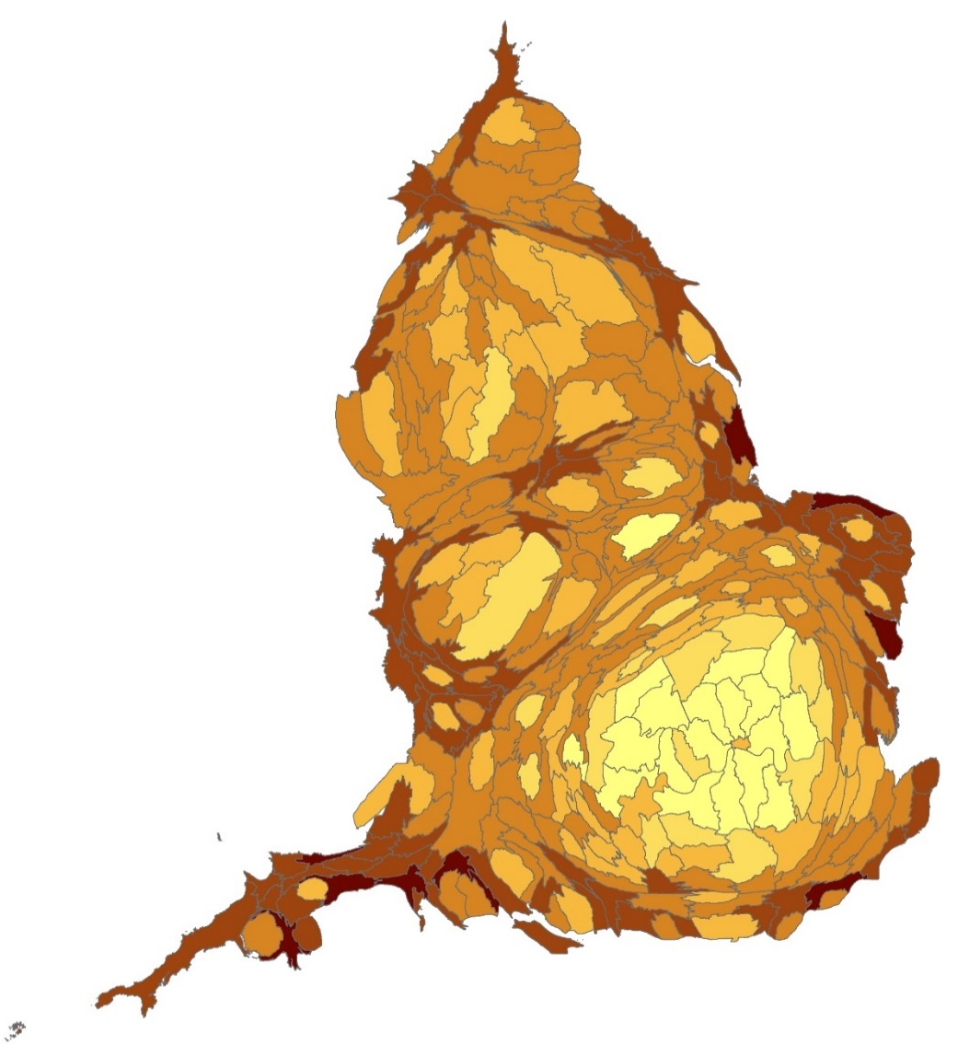
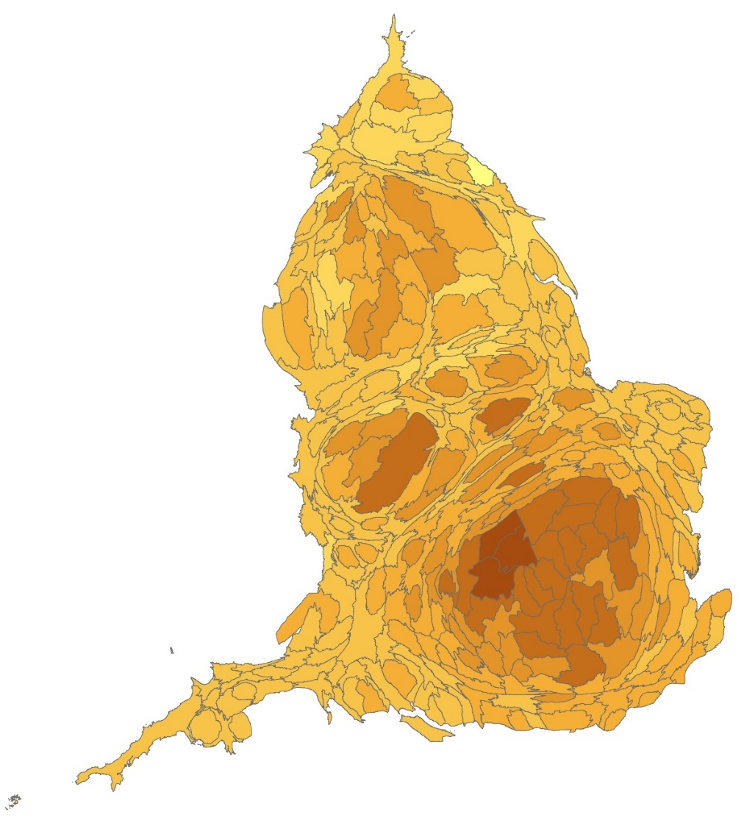
Where do older BME people live (1)
Standardised comparison of BME over 50s by local authority
Source: standard 2011 census table LC2109EW (ONS, 2013)
Standardised comparison of white British over 50s by local authority
Source: standard 2011 census table LC2109EW (ONS, 2013)

Slide 11
Where do older BME people live (2)
Ethnic group | Minimum | Maximum | Local authorities with concentrations
White other | 16% | 7 times | Kensington and Chelsea, Westminster and Enfield
Indian | 0% | 13 times | Leicester, Harrow, Brent and Hounslow
Pakistani | 0% | 9 times | Bradford, Slough, Pendle, Birmingham and Luton
Bangladeshi | 0% | 39 times | Tower Hamlets, Newham, Camden, Luton, Redbridge and Oldham
Black African | 0% | 12 times | Southwark, Hackney, Lambeth, Newham and Lewisham
Black Caribbean | 0% | 9 times | Lewisham, Lambeth, Brent and Hackney

Slide 12
Introduction
Growing older BME population
Increased risk of poor health in later life
Housing deprivation explained by
Cumulative disadvantage
Living arrangements
Migration to the UK
Concentrated in urban areas
Implications

Slide 13
Implications
We know that we
Need to understand the local population
Engage effectively with them to make sure we hear all voices as far as possible
Identify experiences, needs and aspirations
Design inclusive solutions and interventions
Evaluate and adapt to change

Slide 14
www.raceequalityfoundation.org.uk
www.better-health.org.uk
www.better-housing.org.uk
Find out more

