Slide 1
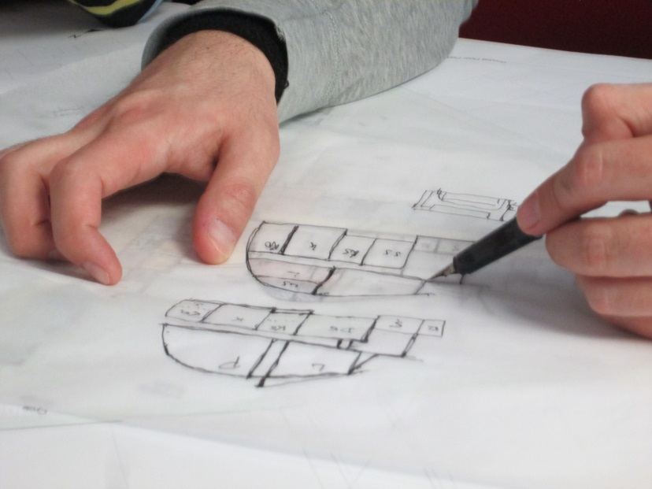
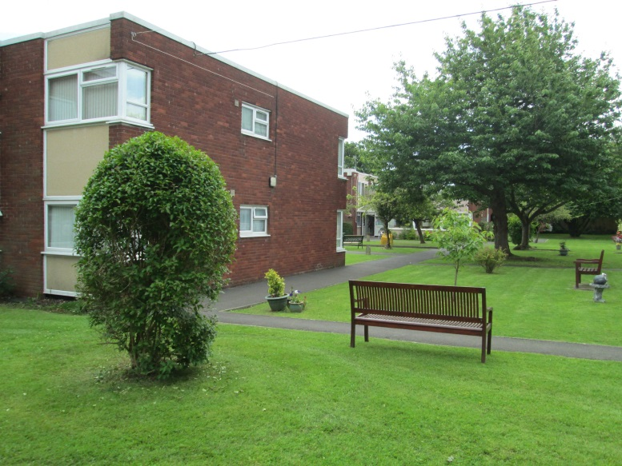
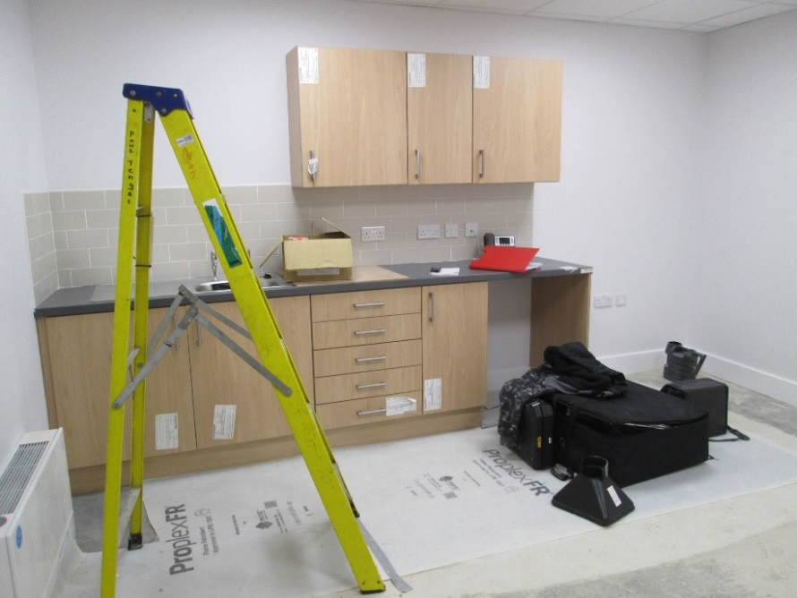

Architectural design for care in later life: following ‘buildings in the making’
Christina Buse, Sarah Nettleton, Daryl Martin (University of York)
Notes:
-presenting findings from a project ‘buildings in the making’ – working with Sarah Nettleton, Daryl Martin and colleagues at University of York
following the design and construction of care homes and extra care housing, observing the practices and processes of architects and others on the design and construction team
This presentation-how ideas about age friendly/dementia friendly design are put into practice on building projects, factors that constrain or enable good design
-disconnect between the processes of design and construction and experiences and practices of building users
-need for a more joined up approach, between design and practices of building users,
-also in terms of shared sense of vision and values of a project across the design and construction team, shared sense of who you are designing for,

Slide 2
Context of the study
Importance of architecture for well-being and quality of life (Day 2000, Torrington 2006)
  Growing research and guidance improving design for later life care (e.g. Dementia Services Development Centre 2011, Homes and Communities Agency 2009, The Kings Fund 2014)
Constraints on funding in the health and social care sector (Wenzel et al. 2018)
Architecture as contingent, shaped by competing demands, regulatory requirements (Imrie and Street 2011)
  How do architects translate ideas about care, well-being, age/dementia friendly design? What factors enable or constrain the implementation of principles for good design?
Notes:
Research has evidence how architecture can have implications for well-being and quality of life, for older people living in care settings

Slide 3
Buildings in the Making project
Team: Sarah Nettleton (PI), Christina Buse, Daryl Martin, Ellen Annandale, Sian Beynon-Jones (York), Lindsay Prior (Belfast), Julia Twigg (Kent), Mikaela Patrick, Chris McGinley (Helen Hamlyn Centre for Design)
3 year ESRC funded UK study (August 2015 until September 2018)
Methods:
-qualitative interviews 26 architectural professionals
-‘ethnography of practice’, following design projects 10-18 months, working with 9 practices
–observations - drawing sessions, design reviews, team meetings, building site visits and meetings, public and user consultations
-further interviews: clients, building contractors, developers, architects
Notes:
*focus on the role of the architect, what happens during the design and construction process
-design for older people – extra care, care homes
– ‘opening the black box’
*ethnography – qualitative method is spending time in a setting, observing what happens in that context

Slide 4
Imagining older people in architectural design
How do architects (and others on project teams) imagine the people they are designing for (Buse et al. 2017, Lewis 2015)?
  Written guidance, research, training
  Empathic work – putting yourself ‘in their shoes’
  Wider cultural images of ageing, sometimes stereotypical images
‘you can’t assume [people with dementia] want Chintz, why should they have chintz and thick curtains?
Developer/project manager, case study 3
Notes:
-how do you imagine when there is often a lack of contact with the person you are designing for? Architect – and others
Wider cultural images of ageing – tension positive images ‘active ageing’, negative images focus on dependency and decline
Shifting images, negotiated between members of the design and construction team
*on one project care home for older people with dementia – debate décor, whether to go for something more modern or traditional and ‘chintzy’– project manager challenges the building contractor who suggests older people with dementia need something more old fashioned or chintzy – ‘you can’t assume [people with dementia] want Chintz, why should they have chintz and thick curtains?

Slide 5
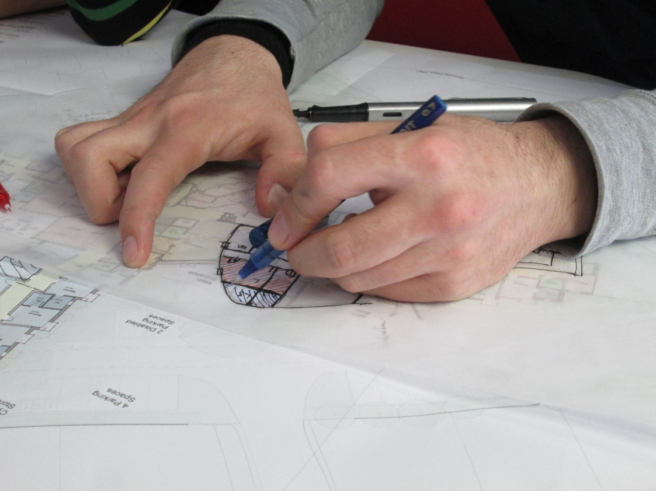
‘these are not flats, they are just bedrooms, people won’t have playing children or people playing instruments or having arguments, it’s just going to be one potentially quiet, single person living in there, so the acoustic requirements will be slightly lower.’
[fieldnotes, design session, case study 3]
Notes:
-Images of who building users are shapes decisions about mundane materials and aspects of the design, were often negotiated between different project team members
– in this case the thickness and acoustic requirements of walls between bedrooms in a care home – assumptions that an older resident will be a quiet single person who won’t be playing instruments or having arguments

Slide 6
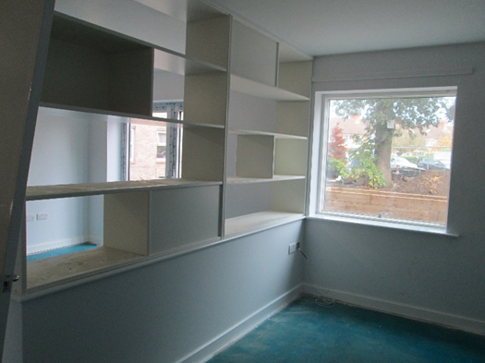
Supporting connections to biography and identity
Creating spaces for possessions, opportunities for personalisation, supporting identity (Fuggle 2013, Geboy 2009)
Physical environment providing opportunities for
activity, interaction, enacting everyday routines
‘every day activities often represent who we are and what we are about’ (Davis et al. 2009)
Notes:
-Architects also drew on guidance and research to try and think about the person they are designing for in a more nuanced way, lived experience of the place
-Trying to create connections to identity/biography, sense of place – without pre-empting who the person is
-creating space for possessions - bay window, memory boxes, memory shelves, partition walls
-everyday routines – tea bar, gardening – raised beds, shed– activity, hairdressers –laundry lines

Slide 7
Tension: cost constraints
…a care home, they ran out of money and the garden didn’t happen. I was gutted. And there was another very good, very modern and attractive care home in [name of place] designed by a very eminent architect, and money ran out and all they’ve got is paths going across a green desert, which is appalling…the importance of outdoor space for people in a care setting, or in hospitals… it’s been proven time and time again by research studies, how beneficial it is to get outside for your health
Architect, interview 5
Notes:
-value engineering – design and build contracts
-budgetary restrictions – limitations on funding for health and social care
*gardens and interior designs, importance for well-being
particularly likely to be cut – end of building projects
Gardens seen as ‘extras’ – not required for CQC inspections

Slide 8
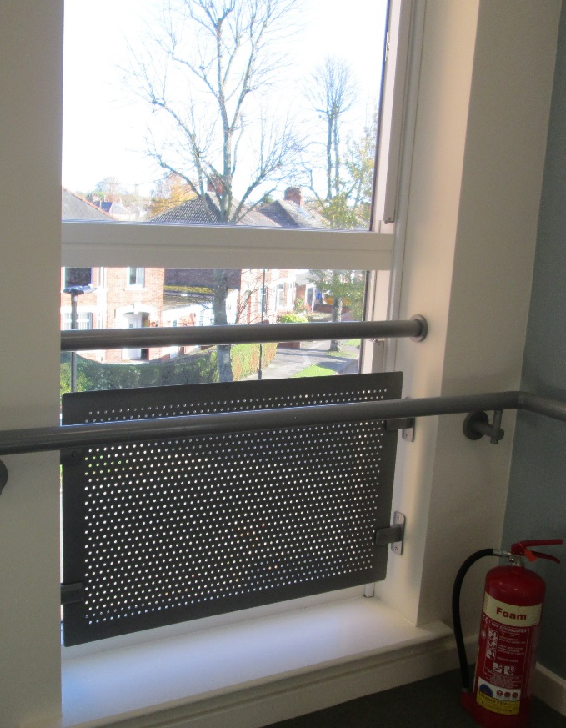
Tension: age/dementia friendly design vs. regulations
Clashes between guidance for best practice and
different regulations and requirements (also see Smith 2013)
  fire regulations
  BREEAM
  Planning
  Building control
Notes:
DSDC – Dementia Services Development Centre, Stirling
-Open plan areas, easy to navigate – fire regulations
-Breeam – BREEAM is sustainability assessment method, clients and/or planning departments may require building projects to meet a certain standard on this assessment: https://www.breeam.com/
materials – bay window
-Building control - windows

Slide 9
Designing for multiple building users
Multiple building users – who are you designing for?
Can be tensions between designing for different user groups:
  e.g. what sells to relatives, hotel-like finish vs. homeliness
  Staff need for a conducive space for work vs. residents need for homely space
  Independence and autonomy for residents vs. concern for safety
Residents
Relatives
Staff
Notes:
Challenge – meeting the needs of different building users, can sometimes conflict

Slide 10
Tension: autonomy vs. ‘risk’
The care homes director […] then asks the architects ‘is the staircase open?’ Brian [director of architecture practice 3] explains yes, the ‘central staircase is deliberately open’, it provides an easy route upstairs […] The care homes director says that the staircase does ‘look nice’, but she is ‘just concerned about people with high level needs wandering up there’ […] Brian says that it ‘would be shame to change that’, and asks ‘is a staircase a risk’? The care homes director explains that it is a risk in terms of ‘falling’, for people with high level needs who ‘don’t have the sensory perception’. [..] Karen [developer] says that the ‘issue of doors being closed’ was not the ‘vision’ for the care home, it was about the ‘idea of bringing in people’ […] and ‘having a community hub’.
[fieldnotes, project meeting 13.04.16]
Notes:
*wider tension literature on care practice and design for care settings – tension between supporting independence of residents and concern for risk, particularly in dementia care settings
-tension debated throughout the design and construction process
-example – design meeting architect and care home provider
*specialist dementia care home
-area on ground floor community hub – gym, shop, pub, hairdressers
– the architect had the idea of an open stair case to bring light into the building, allow easy access between the floors to the community area
- the care provider is worried about risk, and wants it secured or moved. The architect is not happy about this and there is some negotiation, but in the end he goes along with the care providers decision, who are positioned as the ‘expert’ and also the client in terms of delivery/operation.

Slide 11
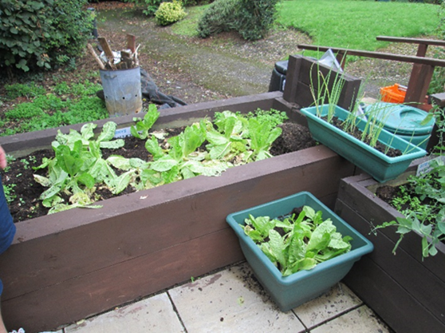
Design intention vs. operation
Door locking and outdoor spaces
  Concerns about liability, vulnerability of staff
‘Open door policy’ – but need staff to support residents getting outside (Chalfont 2005)
  Challenges – lack of staff time
  Care home ‘culture’ – garden not a priority/part of staff roles
Opening communal areas to the public vs. keeping secure

Slide 12
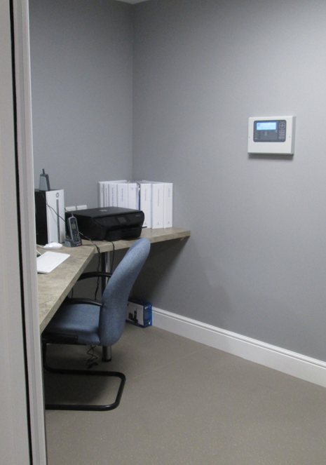
Buildings that ‘care for staff’ (Marshall 1998)
Less guidance/attention to design for staff needs
Caring for staff well-being has implications for quality of care, retention of staff – long term relationships
Laundry design in care homes – need to consider staff needs, overwhelming hot and noisy environment (Buse et al. 2018)
  Importance of windows or air conditioning
Staff rooms – often small to encourage interaction with residents
  But emotional nature of care work (Bailey et al. 2013, England and Dyck 2011) need for space to take time out
Notes:
Need for more integration between design and practice, interconnection between the needs and practices of people with dementia/older people living in the building and staff, designing caring/dementia friendly environments
- Marshall part of providing good dementia care environment, environments that care for staff, support them to provide care

Slide 13
User consultation
User consultation rarely happens – ‘end user’ not in place
Need for client ‘buy in’, allocation of time and funds
  Local authority projects and housing associations – more likely to consult users
Uncertainty about how to consult with people with dementia, often left out (exceptions like case study 9)
‘Obviously you can’t consult people with dementia.’ (Architect, Interview 10)
Less consultation with staff ‘on the ground’
Notes:
*suggests the need for more connection and engagement between design and practice, and the experiences of different building users - staff and residents
– user consultation can be a way to address this BUT…

Slide 14
Training and guidance in consultation
So I think there’s a huge amount of work to be done in training architects and design professionals to understand how they should engage more hands on and […] empathise with people…
(Interview 3)
Guidance and training for architects on how to consult
Connections between dementia studies research and architectural practice
  importance of engaging with people with dementia
  creative methods for including people with dementia (e.g. walking interviews, using material methods, observation)

Slide 15
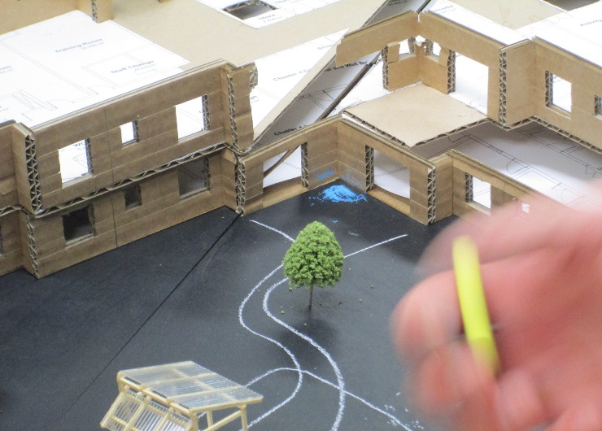
Example: connecting design, care practice and lived experience
New build dementia care home, consultation built into garden design
Collaboration landscape architect and artist
  Walk arounds, drawing ideas on to a model
  Including staff, sheltered housing residents, relatives and neighbours, design and construction team
Connecting design and practice
  Creating ‘things to do’ together outside – raised beds, shed, physiotherapy, pathways, activities
  Support for staff – time built into staff roles, additional support
Notes:
– ring fenced funding by commissioning council
Creating buy-in within the care home and wider community
Engagement between design, construction, residents and staff
-new build dementia care home, residents not in place, consulted with residents at other properties owned by the care provider, particularly the sheltered housing development which was adjacent to the care home

Slide 16
Advocating for buildings users
Debate - whose role is it to bring knowledge of designing for older people/dementia?
  Some architects saw their role as advocating for older people/people living with dementia
Where architects bring expertise about design for later life/dementia, this can be disrupted
  Change in personnel
  Procurement models - design and build without novation
Shared ‘vision and values’ of a project, age/dementia friendly design across design and construction team
Notes:
Also need for a more integrated approach within the design and construction team
Knowledge of dementia, and end users often seen as the role of the architect, rather than something that should be shared across the different trades and professions
Importance of creating awareness of dementia, and shared sense of the vision and values of a project across the design and construction team
*maintaining vision and values

Slide 17
Interviewer: And one thing that I’ve been asking the different people involved in the project is how they think about the end user, in terms of the older person or the staff and people who use the building. I was just wondering, as a contractor, is that something that you think about as part of your role?
Site manager: The answer’s yes, but if you asked me the same question 10 years [ago] I’d have said no. I’ve built enough care homes now to know what the end user requires, and then a bit more knowledge on dementia levels […] from building them and from the client, and being involved with the client’s staff, you get to know a lot more. Because once, we hand it over next Monday, this building will be theirs […] I will be still here involved with their staff, and you pick up bits what they’re saying. You’ve a different, I think I have a different view all together on dementia now than what I did have. But I think that’s a general thing throughout the world; I think people have a different view on it…out of the last three, two care homes I’ve built, they’ve actually had residents in before we’ve got away, so we do get involved with one or two of the residents, we have a bit of chat with them…
Site Manager, case study 6
Notes:
Contractor – developed an understanding of dementia through working with particular clients over a number of years, and engagement with staff and residents

Slide 18
Conclusions
Significant research and guidance on improving design for later life care, but various constraints in practice
Need for a joined up approach, connecting design, lived experience, care practice, requirements of different building users
Shared vision and values across the design and construction team
Notes:
Constraints – costs, regulatory requirements, disconnect between design and practice

Slide 19
If you want to read more…
Buse, C., Nettleton, S., Martin, D., and Twigg, J. (2017) Imagined bodies: Architects and their constructions of later life, Ageing & Society, 37(7), 1435-57.
Buse, C., Twigg, J., Nettleton, S. and Martin, D. (2018) Dirty linen, liminal spaces and later life: Meanings of laundry in care home design and practice, Sociological Research Online, http://journals.sagepub.com/doi/full/10.1177/1360780418780037
Nettleton, S., Buse, C., & Martin, D. (2018). ‘Essentially it's just a lot of bedrooms’: architectural design, prescribed personalisation and the construction of care homes for later life. Sociology of Health & Illness, https://doi.org/10.1111/1467-9566.12747.
Nettleton, S., Buse, C., & Martin, D. (2018). Envisioning bodies and architectures of care: Reflections on competition designs for older people, Journal of Ageing Studies, 45, 54-62.
https://www.york.ac.uk/sociology/research/current-research/nettleton,-daryl-martin-chrissy-buse/

Slide 20
References
Bailey, S., Scales, K., Lloyd, J., Schneider, J. and Jones, R. (2013) The emotional labour of health-care assistants in inpatient dementia care, Ageing and Society, 35, 2, 246–69
Buse, C., Nettleton, S., Martin, D., and Twigg, J. (2017) Imagined bodies: Architects and their constructions of later life, Ageing & Society, 37(7), 1435-57.
Chalfont, G.E. and Rodiek, S. (2005) Building edge: an ecological approach to research and design of environments for people with dementia, Alzheimer’s Care Quarterly, 6(4), 341-348.
Davis, S., Byers, S., Nay, R., Koch, S. (2009) Guiding design of dementia friendly environments in residential care settings: Considering the Living Experiences, Dementia, 8(2) 185–203
Day, K., Carreon, D. and Stump, C. (2000). The therapeutic design of environments for people with dementia: A review of the empirical research, The Gerontologist, 40(4), 397-416.
Dementia Services Development Centre. (2011) Dementia Design Audit Tool 2011. Stirling: Dementia Services Development Centre, University of Stirling.
England, K. and Dyck, I. (2011) Managing the body work of home care, Sociology of Health and Illness, 33, 2, 206-19
Fuggle, L. (2013) Designing Interiors for People with Dementia. Stirling: Dementia Services Development Centre, University of Stirling.
Geboy, L. (2009) Linking Person-Centered Care and the Physical Environment: 10 Design Principles for Elder and Dementia Care Staff, Alzheimer’s Care Today, 10(4):217–220.
Homes and Communities Agency. (2009) HAPPI Housing our Ageing Population: Panel for Innovation. London: Homes and Communities Agency. https://www.gov.uk/government/publications/housing-our-ageing-population-panel-for-innovation
Imrie, R. and Street, E. (2011) Architectural Design and Regulations. Oxford: Blackwell.

Slide 21
The Kings Fund (2014) Is your care home dementia friendly? EHE Environmental Assessment Tool. London: The Kings Fund. Available at: https://www.kingsfund.org.uk/sites/default/files/EHE-dementia-assessment-tool.pdf
Lewis, A. (2015). Designing for an imagined user: Provision for thermal comfort in energy-efficient extra-care housing. Energy Policy, 84, 204-212.
Marshall, M. (1998). How it helps to see dementia as a disability. Journal of Dementia Care, 6, 15-17.
Smith, A. S. (2013) Design for people with dementia: an overview of building design regulators. Stirling: Dementia Services Development Centre, University of Stirling.
Torrington, J. (2006) What has architecture got to do with dementia care? Explorations of the relationship between quality of life and building design in two EQUAL projects, Quality In Ageing – Policy, Practice And Research, 7(1): 34-48.
Wenzel, L., Bennett, L. Bottery, S., Murray, R., Sahib, B. (2018) Approaches to social care funding: social care funding options. Health Foundation Working Paper 2. London: The Kings Fund. Available at: https://www.kingsfund.org.uk/publications/approaches-social-care-funding

