Slide 1

The role of home adaptations in improving later life: The work of the Centre for Ageing Better
May 2018
Rachael Docking, Senior Evidence Manager
Notes:
I am senior evidence manager at the CFAB and I lead on our programme on homes and neighbourhoods
This session will provide a brief introduction to the Centre for Ageing Better, our key priorities and our programme on homes and neighbourhoods. It will further discuss our recently commissioned review of the evidence on home adaptations in later life, including key findings and recommendations, and what Ageing Better are working on now to ensure more people live in a suitable home that supports a good later life.

Slide 2
About us
An independent charitable foundation launched in Jan 2015
We are part of the network of What Works organisations
We are funded by an endowment from the Big Lottery Fund
We work for a society where everybody enjoys a good later life
2
Notes:
Where and why we started
Independent charitable foundation
Started after Lord Filkin completed his report “Ready for Ageing” – realised we were not
Won £50m from Big Lottery Fund
What Works organisations: work to improve the way government and other organisations create, share and use high quality evidence for decision-making. It supports more effective and efficient services across the public sector at national and local levels. (College of Policing, NICE guidelines, Education Endowment foundation)
Aim – to help everyone prepare better and ensure fewer people miss out on a good later life – for the first time in history >65 outnumber <16
We bring about change for people in later life today and for future generations.

Slide 3
Our work
Managing major life changes
Being in fulfilling work
Contributing to communities
Keeping physically active
Living in a suitable home and neighbourhood
Taking a local approach to ageing
3
Notes:
Our current live programmes although under a strategy review currently so this might be changed in the coming months
We've started work in a range of areas so far. We have projects underway looking at how to support more employers to be age-friendly, and how to get more unemployed people in their 50s and 60s back into fulfilling work. We're working on how to enable more people to adapt their homes in ways that allow them to maintain their independence for longer, and how to support more people to have positive experiences of retirement, plus many more: Won’t go into the details of our programmes of work but happy to discuss in the break
LOCALITIES – designing and testing things in a place

Slide 4

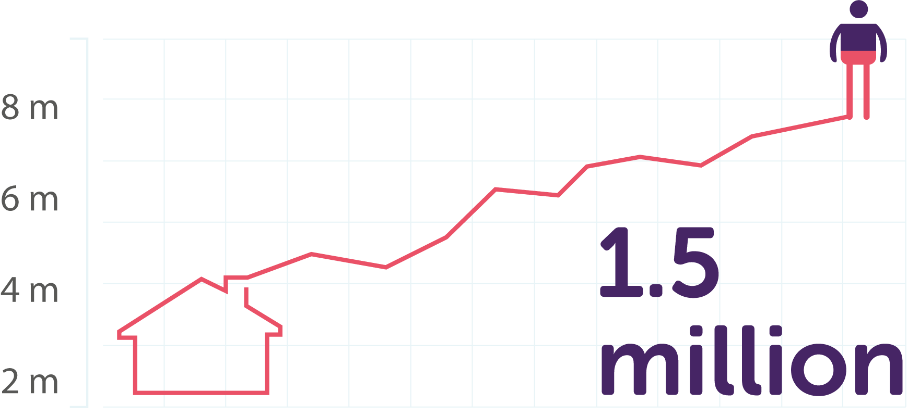
Homes headed by someone aged 85 and over are the fastest growing household
By 2025 there are projected to be 1.5 million households headed by someone aged 85 or over – an increase of 54% from 2015*
*Source: Ageing Better calculations based on: Department for Communities and Local Government (2016), ‘2014-based Household Projections: England, 2014-2039’.
Notes:
The homes we live in are crucial to our health and wellbeing
Homes that meet the demands of the ageing population will be increasingly in demand

Slide 5

Home is where most people want to be in later life
80% of homeowners aged 65 and over wish to stay where they are*
*Source: Lloyd (2015) ‘Older Owners Research on the lives, aspirations and housing outcomes of older homeowners in the UK’. London: Strategic Society Centre
Notes:
Want to stay in the homes they are currently living in

Slide 6
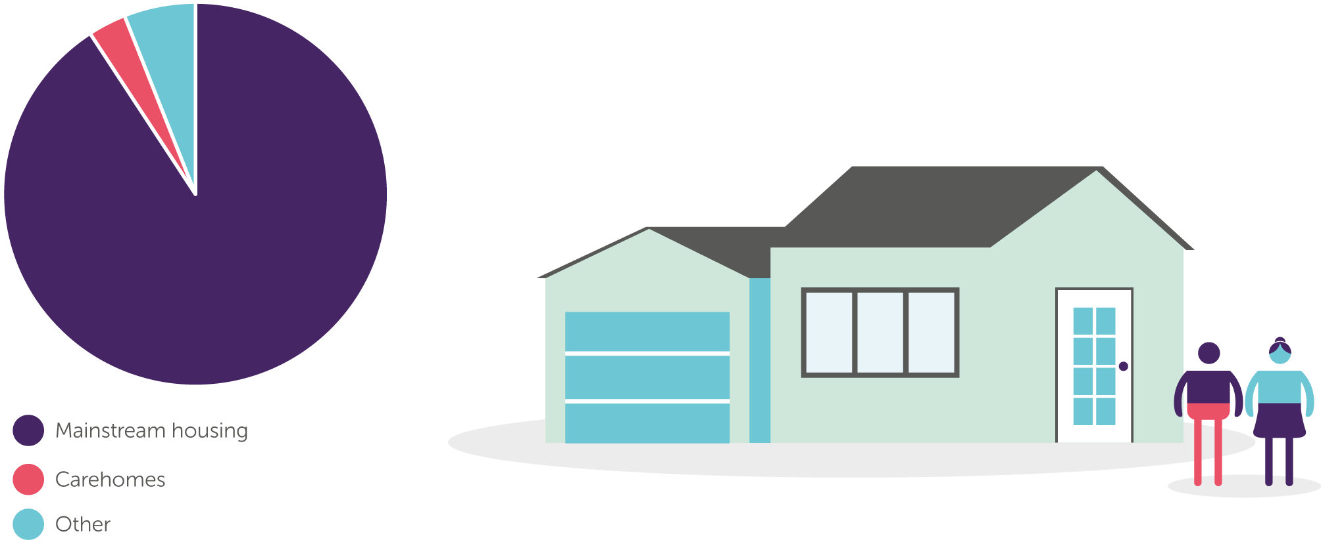
More than 90% of people 65+ live in mainstream housing*
80% of the homes we need by 2050 are already built**
*Source: ONS, 2014; **Source: Boardman et al, 2005
Notes:
Based on population projections
Which is why Ageing Better focused on mainstream housing

Slide 7

People spend a large amount of their time at home
People aged 85 and over spend and average of 80% of their time at home*
*Source: Schmitt, E., Kruse, A., & Olbrich, E., (1994) Patterns of competence and housing conditions - Some empirical results from the study “chances and limitations of independent living in old age.” Journal of Gerontology, 27, 390 - 398
Notes:
The older we get, the more time we spend in our homes and surrounding neighbourhood

Slide 8
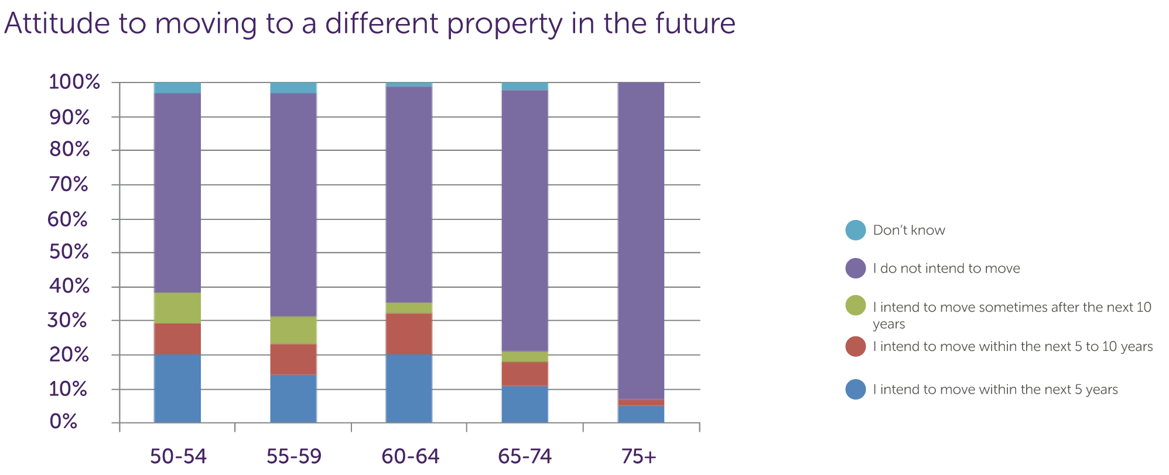
A large proportion of people do not intend to move
Source: Ipsos MORI survey of 1,389 people aged 50 and over. Later life in 2015 Centre for Ageing Better
Notes:
When asked about intention to move in the next 5 years, across age ranges a large proportion to do intend to move and this increases the older we get
So…..
Majority live in mainstream housing and do not intend to move
But….

Slide 9
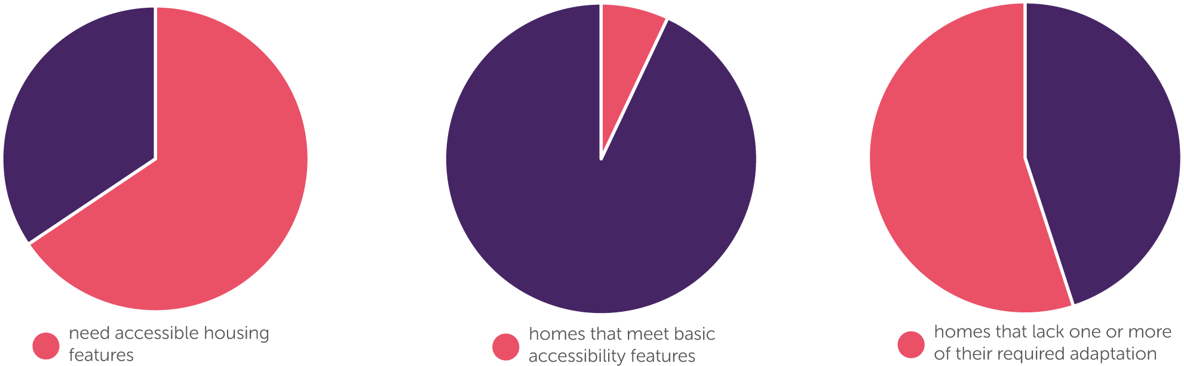
Current UK housing stock is not suitable, adaptable or accessible for people in later life
Only 7% of homes have the four key features of accessibility that deem them ‘visitable’ by disabled people*
*Source: DCLG (2016), English housing survey 2014 to 2015: adaptations and accessibility of homes report
Notes:
With small room sizes, steep internal stairs, baths rather than showers and steps outside – only 7% meet basic accessibility criteria
We have the oldest housing stock in the world

Slide 10
The % of people who have difficulty with activities of daily living increases with age
475,000
By people’s late 80s, more than 1 in 3 people have difficulty with 5 or more day to day activities
Notes:
at least one activity of daily living (basic routine activities like eating, bathing and dressing) increases dramatically from 16% at age 65 to around half of those aged 85
While many people will maintain good health and fitness for much of their later years, the likelihood of having one or more long-term condition or physical impairments, that make day-to-day life at home more difficult does increase with age.
By people’s late 80s, more than one in three people have difficulty undertaking five or more activities of daily living unaided (Marmot et al 2016). Installing aids and adaptations into people’s homes, such as grab rails and level access showers, can improve the accessibility and usability of a person’s home environment, maintaining or restoring their ability to carry out day-to-day activities safely and comfortably
There are currently at least half a million people in UK without the adaptations they need – underestimate – only those who identify themselves as having a disability
People often think of this as ‘other’ people, but the reality is that most of us can expect to have some level of mobility difficulty as we get older

Slide 11
Home adaptations improve people’s quality of life
£7000
V £29,000
Home adaptations have been shown to improve the quality of life for 90% of recipients
*Source: Heywood, F. and Lynn, T. (2007). ‘Better outcomes, lower costs. “Implications for health and social care budgets of investment in housing adaptations, improvements and equipment: review of the evidence”’. London: Office for Disability Issues/Department of Work and Pensions.
Notes:
Adapting and improving the home can vastly improve its accessibility and usability, maintaining or restoring our ability to carry out daily activities safely, comfortably and with dignity.
Benefits of adapting
Improvements in quality of life for 90% (SLIDE)
Relatively low cost home modifications can lead to:
26% reduction in falls that need medical treatment
Cost significantly less than residential care – average DFG is £7000 compared to average res care cost of £29,000

Slide 12
  Evidence review to understand the role of home adaptations in improving later life
  University West of England & Building Research Establishment
  Aim: systematically review the published evidence for the role of home adaptations in improving later life
What works
For whom
Under what circumstances
Why?
Notes:
What we did and why
Increase in national and local policy level interest on difference aids and adaptations make
Evidence people were using was out of date – self funders, OTS, LA etc.
There has been an uplift in DFG but want it spent wisely
Foundational piece of work to update evidence base to provide underpinning contribution to our work in this area
This review aims to provide an up-to-date analysis of evidence of the importance and effectiveness of home adaptations
Published and grey literature

Slide 13
Key findings
Minor adaptations
Repairs and home improvements
Person oriented
Timeliness
    Delays in installing
    Putting off installing
ROI of home interventions in preventing falls
Notes:
Minor – strong evidence they are effective and cost effective for improving a range of outcomes for people in later life, including improved performance of everyday activities, improved mental health and preventing falls and injuries
Major – less extensively studied, but some evidence they are effective in certain circumstances
Repairs – particularly effective when combined with necessary home repairs and improvements
Person oriented - tailored to the person – answering what they want, rather than what others assume they need.
Delays – installing adaptations can reduce effectiveness
Put off – good evidence people put off installing them until crisis, so as not to medicalise their home and change behaviour instead
ROI – installing adaptations and repairs to reduce falls on stairs can lead to savings of £1.62 for every £1 spent – payback of less than 8 months

Slide 14
What this means: Recommendations
Local sustainability and transformation partnerships
Local authorities – minor adaptations
Information and advice
Private and social rented
HIA and handyperson services
Retailers and designers
Notes:
These are split into who we want to do what – but we are now going to be engaging actively with these different groups to ensure change happens
STPs – majority don’t identify housing as a contributor to NHS transformation
Want all STPs going forward to have housing within their strategic plans
LA – focus not just on major but minor adaptations, delivered in a timely way and in combo with repairs, making use of flexibility in DFG, fund handyperson and HIA services
Info and advice – on how to access assessments and funding and adaptation, and tradespeople – as per the care act
Different tenures different issues – for example, in private rented sector need changed regulations to ensure people can access the adaptations they need
Retailers and designers – to improve design and visibility in mainstream market

Slide 15
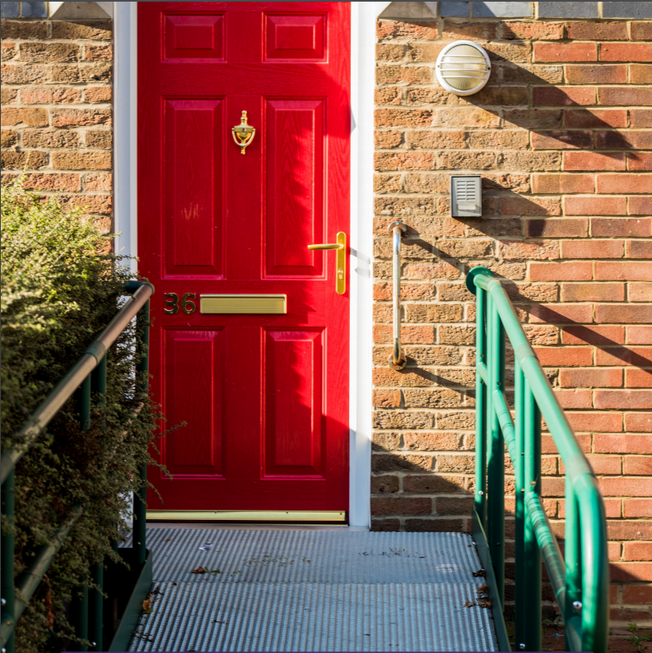
What Ageing Better are doing next
Primary Research
Call for Practice
Mainstream market
New housing
Supporting locality partners
Notes:
Primary research to bridge gap between evidence and what people experience on a day to day basis – I will leave Cathy to talk about that project
C&RE – identify high quality innovative practice in provision of adaptations for older people – gather and share, evaluate where needed – anything from DFG to info and advice
Evidence demonstrates poorly designed products often delay adaptations being put into the home. In 2018, we plan to work with mainstream retailers, designers, occupational therapists and others to improve the design of products and their visibility in the mainstream market
New housing – every new home that is built is a missed opportunity to improve the UK housing stock - working to influence local and national government so all new homes built to minimum accessibility criteria

Slide 16
What is happening externally?
Last spending review the DFG was increased
DHSC commissioned a review of the DFG
CLG Select Committee report on housing for older people
Social Care Green Paper due 2018
Industrial Strategy Grand Challenge: Healthy ageing
Notes:
As I mentioned earlier, there does feel like there has been a shift and an increase in interest at local and national policy level on the benefit of aids and adaptations – hope our work will keep backing that up
Some example things that have been happening over the last year and coming up this year:
DFG increase: In the last spending review the budget for the DFG was increased to enable greater access to home adaptations for more people
DFG review: ensuring DFG remains fit for purpose and funds allocated as effectively as possible
CLG report: Clear recommendations to Government based on very strong evidence, including: a national strategy for housing for OA, national advice service & HIA in every local authority
SCGP: Unsure where this will focus when it is published but Housing Minister has indicated it is likely to focus on improving current housing and innovation e.g. funding, product design etc.
ISGC and PM speech on the challenge: The Industrial strategy sets out grand challenges to put UK at forefront of industries of the future, one of the 4 key areas if healthy ageing, which includes innovative products and services to ensure more people can remain in their own homes, and innovative housing models and funding models to support that
PM speech reiterated the need for housing adaptations that make our homes safer as we get older, and innovative and well-designed products and services
Government are starting to listen, BUT MUCH MORE TO DO - still lots to do and we need to keep making the case of the role of home adaptations and their positive and often life-changing impact

Slide 17
Rachael Docking
Rachael.docking@ageing-better.org.uk
@Rachael_docking
Centre for Ageing Better
Angel Building, Level 3
407 St John Street, London, EC1V 4AD
020 3862 9195
www.ageing-better.org.uk
Registered Company Number: 8838490 & Charity Registration Number: 1160741
Notes:
Hand over to Cathy to talk about the project they have been working on, which I think really helps to demonstrate what people are experiencing and living every day and help us make a strong case for the changes needed

