Slide 1
A vision for our customers

Slide 2
Metropolitan in numbers
12th
Over 100
Largest provider of older people’s housing
Local authority areas covered
6,000
10,000
Supported and sheltered homes
General needs
homes housing
older people
Notes:
My name is Geeta Nanda and I am delighted to have taken over as CEO of Metropolitan Housing from TVHA where I was CEO for 9.5 years having worked in the sector for 30 years. I started off in mental health services before the days of care in the community and proudly expanded care and support services across housing associations particularly older people services in many organisations. Talk about early onset dementia at Octavia s an example of how HA’s have always been at the forefront of ideas.
At Metropolitan not only do we have 40k homes but we also have 6,000 specialist homes as well as 10,000 general needs homes that house older people.

Slide 3
About Metropolitan
What we deliver:
Supported and sheltered housing
Extra care
Floating support
Home from hospital
Mental health services
Learning disability services
Our partners:
Better Care Fund
Local Authority Commissioners
NHS
Notes:
Within the specialist area we do the following… and so we have a huge amount of expertise at what works and how we can make better outcomes for our people.

Slide 4
The challenges in health and social care
Changing government policy
Changing market
Capacity building and skills
Fragmented services across health, social care and housing
Access to land for supported housing
Councils forced to use emergency cash to pay for social care as funding shortfall grows – 24 Nov 2017
Social care at risk amid funding cuts, think-tank warns – 22 March 2018
Notes:
Not a day goes by when there is another headline about what is wrong with social care and the impact on the cost it has on other services. The latest one this week from the IFS is that councils face decades more austerity as spiralling social care costs account for half of all taxes raised by local authorities. With vulnerable older people facing patchy services to help for basic tasks. The impact being that services such as housing and bin collection and roads will be neglected.
The impact of that is that local authorities prioritise rice over quality. Add to that significant changes to HA’s funding on funding for supported housing and uncertainty as well as a further green paper on social care and not a lot gets done!
No one can dare think about the skills shortage and the Brexit impact. Is it right you can earn more in Lidls than in care or even on a building site.

Slide 5
Current thinking
Notes:
CQC regulation and local contract monitoring rightly demand high quality services and when they fail they measure rather than support the turnaround. The media have an insatiable appetite for documenting poor provision. Commissioners don’t routinely engage with us or customers in co-production as it results in unaffordable design of services. So we deliver against a specification which fails to meet against customer expectations as well as their family and their advocates. The lowest paid then have to deal with customers in services which cant and don’t meet their needs.

Slide 6
Outcome
Notes:
This is Joyce. She lives in social housing. She has a three bed terraced house and has been there since she got married. Her husband died three years ago. Before he died he looked after her as she was getting forgetful and was not eating properly or keeping appointments. This got worse when he died. Joyce only really knows her HA through the maintenance service. There is an annual gas check. One day Joyce s found by the police sitting in the park. She doesn’t really now where she is and so the police take her to hospital as she is confused and malnourished. She is diagnosed with dementia and so she has a plan to go home with some domiciliary care. When the care services attend her home they can see she cant be discharged as her home is in a poor state so the weeks in hospital become months. She eventually goes into a care home but by then she has deteriorated and then must move to nursing care a year later. She dies there and her home is re let back at the HA, for a young family.
The sticks and the outcomes go hand in hand..

Slide 7
Time for a rethink
Notes:
If we could rethink the way we work together then we could both save money and improve outcomes.

Slide 8
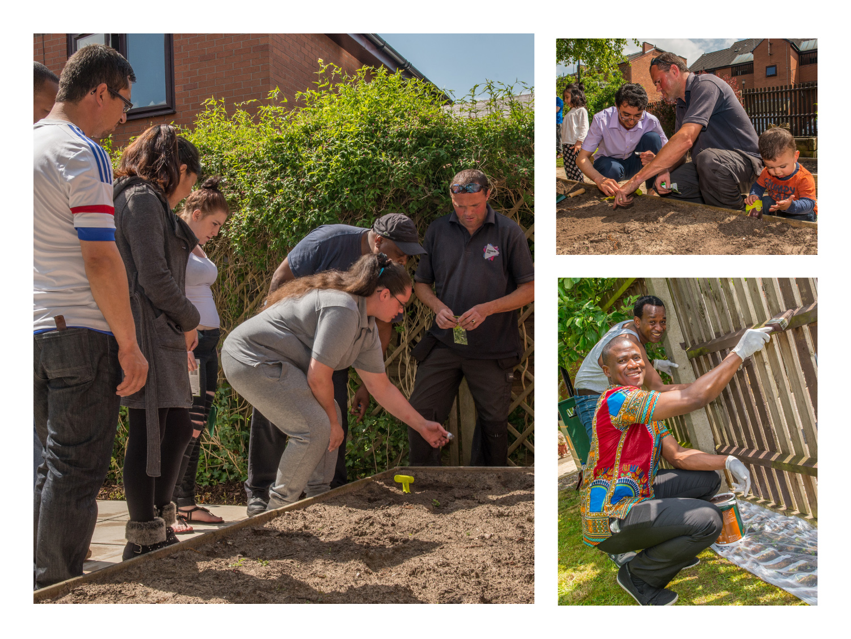
Think community and partners
Notes:
In Derby where we work we have over 1,000 street properties. In these streets some are owned and some are rented and some are run by G45 for migrants seeking asylum. The community is predominantly Pakistani with an increasing number of Roma and Eastern Europeans. It has a lot of ASB because of undiagnosed or unsupported mental health, hoarding, DV, substance abuse and so on. The community is unsupported and LA funds wasted pouring money into families with no outcomes at times.
Within this community we have two sheltered schemes, a community centre and supported living for those with mental health problems. As well as a service we fund ourselves for asylum seekers providing short term accommodation. So we have mental health workers, support workers for older people, community investment workers, housing teams, employment workers, community centre etc.
So we have the infrastructure to support people. The way commissioning works doesn’t look at what could be run through existing services.
If we look at older people commissioning services alone we :
Put key safes outside people’s homes, Move beds downstairs and fix rails to get people home from hospital, provide daily calls to check on wellbeing, signpost services, provide triage for those referred by GPs to have aids and adaptations.
Now wouldn’t it be wonderful if this happened in the same place rather than being commissioned differently by different boroughs.

Slide 9
Notes:
This is Joyce again! As we know she lives wither husband in Normanton. Her HA owns a sheltered scheme down the road. She gets a support visit prompted by her husband reaching his 75th birthday. It is noticed that her needs and his health deteriorating mean they could do with some support. They are encouraged to come to a weekly breakfast club. They get to know residents and so move into the scheme. Their home is freed up for a family. When Joyce deteriorates her scheme manager notices, and she gets support and she makes a daily wellness call to let us know she is ok. She keeps going to the breakfast club. When she goes into hospital for an operation the scheme manager works with the discharge team and handyperson to make sure the flat is ready, fitting a safe key so her care package is ready. Whilst she still deteriorates it is slowly and she stays in her community and is assessed regularly getting more care .
She dies in hospital but only having spent two weeks there
No nursing care, no empty 3 bed house, no care home and a happy ending.

Slide 10
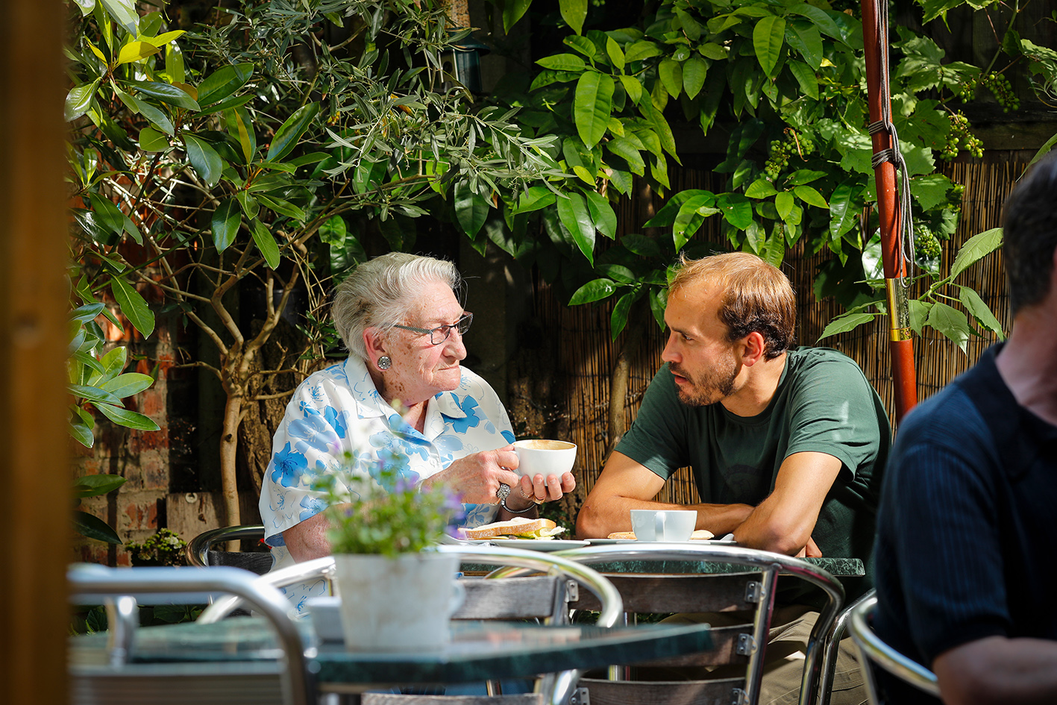
Waltham Forest Home from Hospital
Getting settled back at home
Someone to do the shopping, make a cup of tea and have a chat
Making sure customers get all the benefits they’re entitled to so that they don’t have to struggle financially
Dealing with correspondence and making applications
Notes:
Waltham Forest Home from Hospital service
Our Home from Hospital service can help people who are leaving hospital and going back home for the first time.
Many patients feel anxious about going home after a stay in hospital, especially older people or adults who feel vulnerable. They worry about how they’re going to cope, how they’re going to do the shopping, whether they might fall, how they’ll manage financially if they need to pay for help with cleaning, transport and other daily tasks.
That’s where our ‘home from hospital‘ service comes in. We can take care of all kinds of practical things so you don’t need to worry during those first few weeks back at home after a stay in hospital. What’s more, the service is free so paying for some dedicated support to help you get back on your feet at home is one thing you don’t have to worry about.
It’s not only practical support that many people need, especially those who live alone and don’t have family or friends nearby. After a period in hospital emotional support can make a big difference too as you settle back in at home and get into a daily routine. Our care and support workers provide a combination of support, depending on what customers find the most useful.
We help with:
getting settled back in at home
someone to do the shopping, make a cup of tea and have a chat
making sure you get all the benefits you’re entitled to so that you don’t unnecessarily have to struggle financially, such as Housing Benefit or Attendance Allowance
dealing with correspondence and making applications, such as registering with Dial-a-Ride and other services
speaking to people on your behalf, for example if you need your landlord to carry out an adaptation or repair
arranging a community alarm, smoke alarm and other security features
much more!
Everyone’s different and every customer we deal with has their own individual needs. Our service is really flexible which means we can provide the support that’s right for the individual.
[The service is available to Waltham Forest residents registered with a Waltham Forest GP who are admitted to Whipps Cross, Barts and the London hospitals.]

Slide 11
Housing brings:
Ability to join up health, social care and housing
On the ground understanding of customers and their needs
Financially strong with a secure income stream
The vision to enable our customers to be more independent
Notes:
We are at the point of crises in health and social care which can’t be resolved by doing less of doing less of what didn’t work before. We need to do more but smarter. We need to join the dots and we need to put housing at the centre of this working with what exists.

