Slide 1
PRS – NO LONGER THE MISSING OPTION? Workshop for Housing LIN Conference 23 March 2018
Jenny Pannell Charlotte Cook Housing LIN Associate Partner

Slide 2
Market rent housing – no longer the missing option?
Try our quiz while we wait for everyone: there are prizes
Hands-up exercise: Are you already offering, promoting or funding market rent housing for older people? Or thinking about doing so in the future?
Presentation:
What can market rent housing offer – to older people, local authorities, housing associations, investors and private providers?
Who is doing what? Examples of all-age and later life housing for market rent
What about … PRS’s poor reputation? Demand? Affordability? Lack of secure tenancies? Where will the finance come from?
Discussion, Summing up

Slide 3
Is PRS no longer “the missing option”?
Prevailing mindset on tenure & older people (mainstream & later life housing) was:
rental options = social/”affordable” housing (housing associations & local authorities)
market options = home ownership + perhaps some shared equity/ shared ownership
PRS = problems, poor reputation, not many older private renters so not on the radar
BUT our new PRS Briefing3 shows how this is changing … and who is now interested:
more older people
some local authorities and their housing companies
some housing associations and charities
more private sector investors, developers and providers
Notes:
Under-researched, not on radar:
PRS often not on radar for OP housing (e.g. HAPPI 3);
no links between Build to Rent/PRS & housing for older people (e.g. reports LGA, GLA, govt)
But compared to our workshop back in 2014, is this starting to change?

Slide 4
So…what does it offer to …
Older people and their families? “PRS resurgent – hooray! I speak as a 75 year old keen to move …” Chair of Newcastle upon Tyne Elders Council
Local authorities? “Many people unable to afford sky high rents can’t join the register for social housing” Camden Council
Housing associations? “We are here to provide housing for the squeezed middle as much as people at the bottom end” Genesis
And to investors and private providers? “PRS isn’t just for 24-35 year olds, it’s for 25 to 90 … you should have a mixture of ages” HUB (London property developer)

Slide 5
So what does it offer to …older people and their families
Push factors for market-rent as an option can include:
divorce/relationship breakdown (‘silver splitters’)
financial issues (especially home-owners moving to a more expensive area)
older people ineligible for social rented housing (post-Brexit returners?)
older PRS tenants in unsuitable housing
Pull factors can include:
keeping control of housing equity, no service charges or ‘event’ (exit) fees
greater accessibility and flexibility of renting
downsizing/upsizing, moving to a more convenient location
for facilities/culture/family support etc

Slide 6
So what does it offer to … local authorities?
Responsibility for planning future housing provision for their whole population (including older people) and across all tenures:
SHMAs, local plans, JSNAs, local market position statements … many using the LIN SHOP@ tool …
… so NOT just extra care housing!!
In many areas, shouldn’t market rent be one of the tenure options to meet these responsibilities?
Central Bedfordshire Council:
‘investment prospectus’
invites investment in a range of options for older people, including open market extra care for private rent as well as for sale

Slide 7
Examples: Local authority initiatives
Local authority housing companies: can provide housing for older people: Housing LIN client looking at this, also
London Borough of Camden Camden Living: intermediate rental properties (instead of shared ownership); interest from older as well as younger people
Stoke on Trent City Council Fortior Homes: council has identified shortage of private rent retirement housing

Slide 8
Examples: Later life housing
Girlings Retirement Rentals: part of the Places for People group, funding from Aviva Investors, lifelong assured tenancies: 2,600 properties, 600+ retirement developments
Birchgove Life: on-site (Kent) with first assisted living development, backed by Bridges Fund Management, investors include UK local government pension funds
Evermore: first community in Wigan due to open in 2019
Belong: not-for-profit with 6 villages in the North West;
offering choice of tenures: most people choose
market rent rather than full or shared ownership

Slide 9
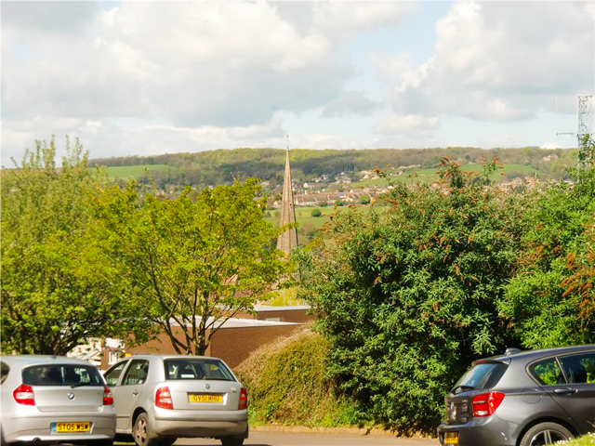
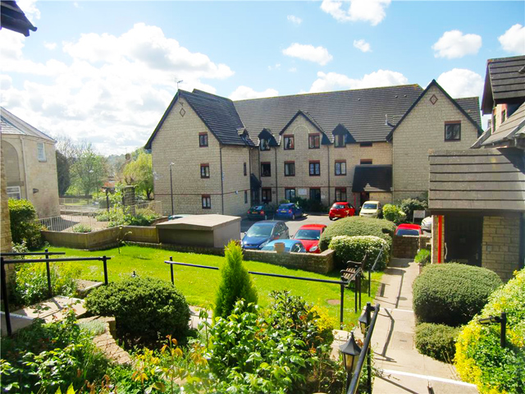
Examples: Later life housing: Girlings
Stroud
Notes:
Major barrier – who are you pitching to and what are you pitching
What is “the look” – not housing with care but housing for older people
PRS often seen as only for renty – somethings or poor quality shoddy properties, absentee or constantly changing landlords, not the high quality product it could/should be

Slide 10
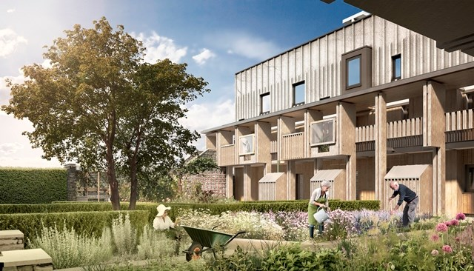
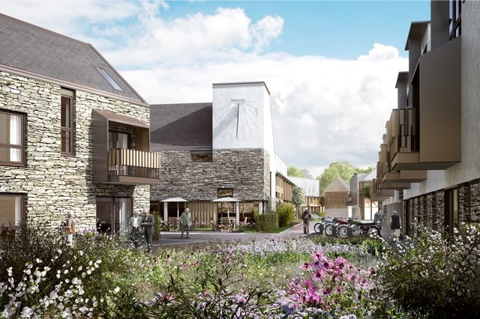
Examples: Later life housing: Girlings
Pegasus Life, Tetbury
Notes:
Major barrier – who are you pitching to and what are you pitching
What is “the look” – not housing with care but housing for older people
PRS often seen as only for renty – somethings or poor quality shoddy properties, absentee or constantly changing landlords, not the high quality product it could/should be

Slide 11
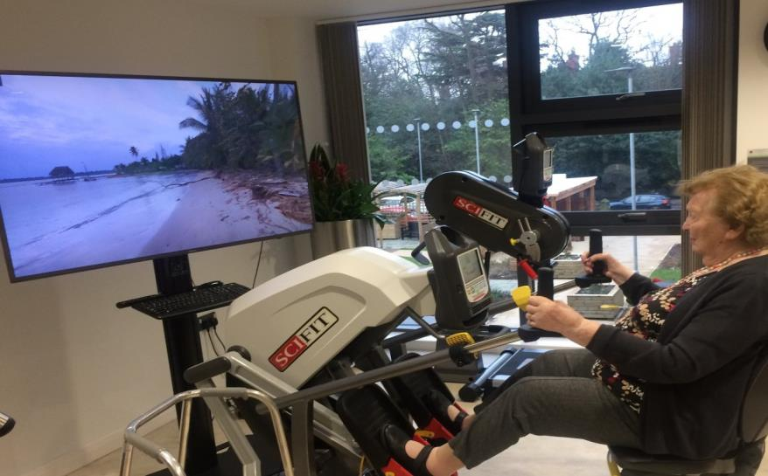
Examples: Later life housing: Belong

Slide 12
Housing associations and Build to Rent … Love it…or hate it?
Some say “We don’t believe that private renting is a charitable activity”
Some have used the opportunity of Build to Rent options (mostly in London and the South East and for younger people):
L&Q
Thames Valley/Fizzy Living
Genesis
A2 Dominion (our example)

Slide 13
Examples: Build to rent
A2 Dominion: Bristol, Oxford, Southampton, London, South East; housing association partnerships/joint ventures with developers including Crest Nicholson
Grainger: Newbury urban village, including housing for older people, 200+ homes mainly for market rent; partners: West Berkshire Council and Network Rail
Greystar: Greenford, London Borough of Ealing: nearly2,000 homes & community facilities, derelict industrial sites; 75% for market rent:
30% affordable housing via shared ownership and
Discounted Market Rent

Slide 14
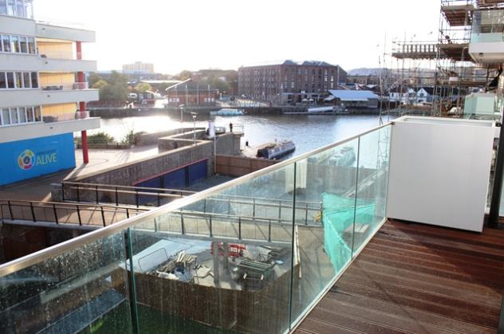
Examples: Build to rent: A2Dominion
Bristol Waterfront

Slide 15
Examples: Build to rent: Greystar
Greenford

Slide 16
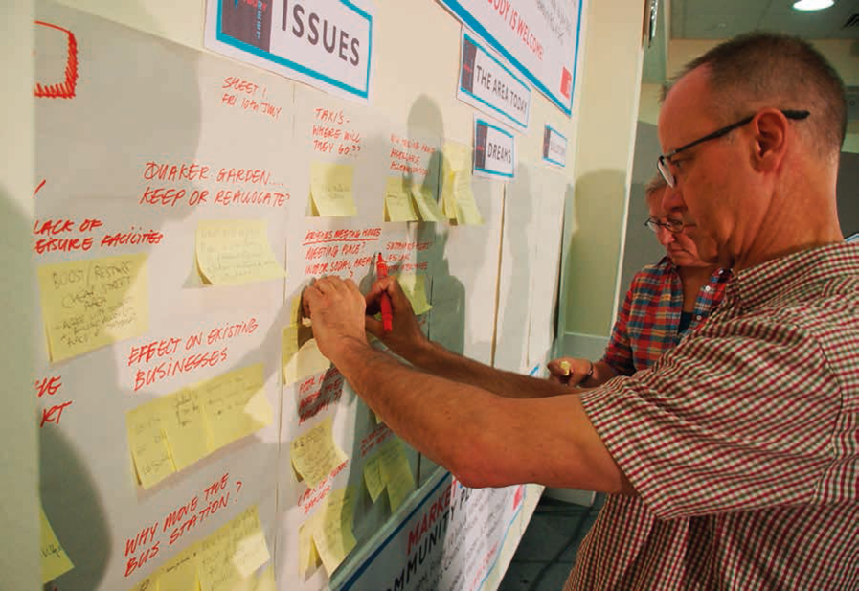
Examples: Build to rent: Grainger, Newbury
“A mix of accommodation to support a balanced Community
Market Street is designed as a mixed development with
a unique identity, providing new houses and apartments
houses for all ages: single people, families, young couples,
retirees and the mobility impaired.”

Slide 17
Build to Rent
developments at scale (100 units +)
purpose built design for rating
on site staffing with strong management ethos
on site amenities
“community feel”
Notes:
Consider:
Public policy supported drive o expand rental market, with introduction of longer term investors to the same.
To separate use classes therefore look at questions of cost to residents for the community/amenity space.
But no up front fees and certainty of tenure/time (albeit with early break clause for tenant)
for mobile professionals but also OP and families etc.
Policy Support –
Encourage LAs to plan proactively for BtR
Supporting affordable private rent i.e. discounted market rent (DMR)
Ensuring long term family friendly tenancies
and
Affordable Housing and Viability Supplementary Planning Guidance – allows councils to look at the differing £ structure on the BtR development.

Slide 18
Is long term finance available to develop housing for market rent?
The rise of the “ethical” investor
Notes:
Consider:
Certainly we are seeing greater move into provision of supported and extra care accommodation, and OP are a buzzing market.
Lenders will take interest where they can see a not too risky acquisitions or where can balance the risk against future reward.
Certainly a move away from the more usual mainstream cross- subsidising from sales on a standard development scheme; private developers look in an “in and out” build and sell; now seeing longer term investors and interest, especially from REITS.

Slide 19
Will longer term or assured tenancies be available?
security v return of investment
AST v AT
political push
Notes:
Consider:
Social housing tenancies moving from open ended AT to fixed term, to encourage review of necessity/need
Private sector – AST is the norm, but much political will (especially Labour party promoted) give enhanced security of tenure.
Therefore for PRS OP middle ground – to appease fears of loss property for potentially vulnerable people – to encourage too for move?
But: Landlord concern under AT – save if Tenant behaving, what is the issue to remain in occupation? Grounds for possession include e.g. property needed back for own family etc. so why would corporate be concerned?

Slide 20
Doesn’t the PRS have a poor reputation?
Problems for older private tenants in some PRS:
poor quality housing – damp, cold
difficult to get repairs/improvements/adaptations
unaffordable (rents, rent increases)
insecure (esp. assured shortholds), fear of eviction
lack of suitable alternative housing/advice/help to move
So can institutional investors and housing associations deliver higher quality PRS housing suitable for older people?

Slide 21
Will it be affordable for older people?
It depends! On landlord organisation, rent levels and other factors
Less likely for those relying mainly on state retirement pension and benefits, with little savings …BUT (for example) many Girlings tenants have limited incomes
More likely for those in the middle/higher income quintiles with occupational/private pensions and savings/investments …
Discounted Market Rent accepted as affordable housing provision, Build to Rent: flexible (option to staircase up/down if income changes); may not accept nominations; inclusive rent, no service charges; suits s-ingle ownership/professional management BTR model

Slide 22
What is the evidence of increasing demand?
More evidence on likely increasing demand from national data, especially latest English Housing Survey report 2018 on private renters, and other recent smaller surveys (e.g. Knight Frank, NLA, Countrywide, LSL/Your Move)
Girlings and extra-care providers with market rent offer still report high demand
Feb 2017 LIN survey found more evidence of interest and demand, from older people’s forums, local authorities, providers
Much research (esp. on ‘downsizing’) only asks if people want to buy! BUT
Strutt Parker/Octopus Healthcare ‘Platinum Generation’ survey (1,000 respondents aged 65+) found 17% interested in retirement rental housing; over 40% interested in ‘try before you buy’ rental offer

Slide 23
Discussion
We have selected a few key issues:
PRS poor reputation? Increasing demand?
Affordability? Security/length of tenure?
Sources of long-term finance?
We have given some examples in mainstream
(all-age) and in later life housing, so what do you
think of them?
Is there an appetite for more of this? Who is biting?

Slide 24
THANK YOU
Jenny Pannell
Housing LIN Associate
Charlotte Cook
Partner
SOLICITORS AND PARLIAMENTARY AGENTS Minerva House 5 Montague Close London, SE1 9BB DX 156810 London Bridge 6 020 7593 5000 020 7593 5099 www.wslaw.co.uk

