Slide 1
Town Planning and the Care Sector
What are the problems and what is being done to address them?
John Sneddon, Managing Director
Iain Warner, Director

Slide 2
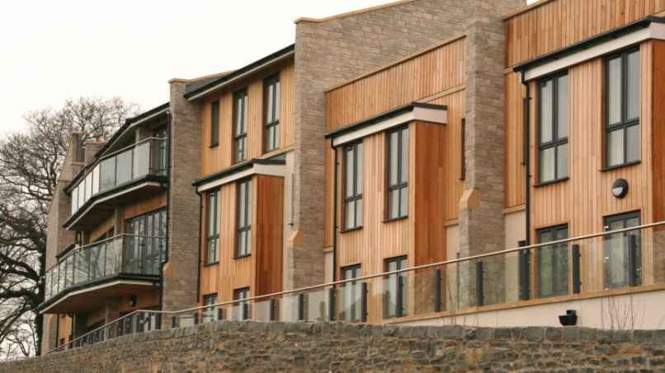
Who are we?
Town Planning consultants guiding our clients through the planning process to a successful outcome.
Specialising in the intricacies of applications for care developments for public and private sector.
Horfield Lodge, Bristol
MHA, 2014

Slide 3
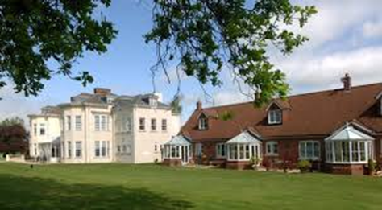
Planning: some context
Significant shortages of housing for the elderly
Pressures on adult social care
2% of total housing stock purpose-built
for older people
Planning response? No separate use class for specialist housing
Lime Tree Village, Rugby
Retirement Villages, 2011

Slide 4
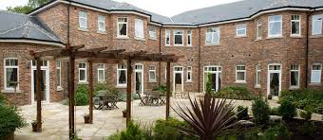
Use Class Order:
Definition, Importance and Issues
C2 / C3 definition
Differences between LPAs
Lack of clarity / certainty
Issue being determined on a case by case basis
Perceived manipulation
Controls on individual sites

Slide 5
Common Response's from LPA’s on C3 v C3
These extra care units can be used independently
- they are just standard dwellings
You can get care in standard dwellings
Our policy says “all residential developments”

Slide 6
Use Class Order
Use for the provision of residential accommodation and care to people in need of care (other than a use within class C3 (dwelling houses)).
Use as a hospital or nursing home.
Use as a residential school, college or training centre.
Definition of care
“personal care for people in need of such care by reason of old age,
disablement, past or present dependence on alcohol or drugs or past
or present mental disorder…”

Slide 7
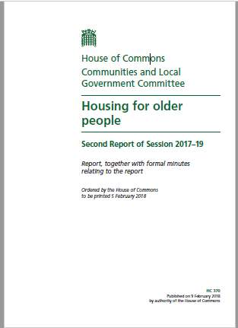
CLG Select Committee
Very useful recommendations drawing from a range of experts:
Chapter 3: Housing and Health
Chapter 4: Staying Put
Chapter 5: Moving Home
Chapter 6: Housing Options
Chapter 7: Planning & Supply
Notes:
Chapter 3 – link between housing and health
This is useful for us as it carries many of the same messages that we have been saying for some time regarding the health benefits that extra care housing can provide. It will be interesting to see whether or not any recommendations regarding mentioning extra care housing in the social green paper will come through as this could certainly add weight in planning statements for such uses.
Chapter 4 – Staying put
This chapter sets out clearly the pressures that we will be under to deliver specialist housing in the future. 93% of older residents still live in mainstream housing; over 65s will account for 74% household growth up to 2037; and presently only delivering 2.8% of housing as retirement housing. It doesn’t take a mathematical genius to work out the extent of the problem based on these figures alone.
What is interesting is the mention here of the private rented sector and this was something that was a big focus of the ARCO conference in 2017 with some new providers breaking into this sector of the market as it is currently poorly provided for.
Chapter 5 – Moving home
The evidence here demonstrates a desire for older people to be able to buy specialist housing with a big focus on two bed units. This is consistent with most developers and in some way endorses the approach of Woking Council who have a policy stating that for C2 developments at least 50% of a scheme should be 2 bed.
It highlights that one of the issues is getting older people to look at this alternative housing provision earlier given that the majority of people moving are between 75 and 80, which in many ways is too late.
It appears that the current shortfall nationally of specialist housing is between 15,000 to 20,000 units. This is hardly surprising when you consider the planning barriers we face in trying to deliver such schemes.
The previous DEMOS and Legal & General evidence of between 2.6 to 3.29 million households that could become available through older people downsizing/rightsizing was discussed, albeit that the effects of this on the wider housing market were open to debate (paragraph 72). The benefits though are nevertheless agreed, which is always a good argument to have especially when trying to promote exceptional circumstances for schemes (based on a recent discussion I have had with Chris Young and strategic promotion of a green belt site through the local plan).
Chapter 6 – Housing options
There is a suggestion that a common language is needed to describe the particular product to ensure that the specialist housing is more widely understood. Extra care housing is already the more generic term encompassing assisted living/independent living/close care housing.
Housing LIN suggest the specialist housing shortfall could be up to 400,000 by 2037. At present it is recognised that there is a particular shortage of privately developed schemes with the concentration focussed more in housing association provision and charitable sector.
The health and wellbeing benefits have specifically been recognised, referring to work undertaken by the International Longevity Centre and Aston University/ExtraCare Charitable Trust.
The impacts of CIL are noted as well as discussion on event fees and service charges.
The importance of adopting HAPPI principles was discussed and it would be sensible practice to include within our future submissions a checklist of how schemes meet the guidance so that we can demonstrate this readily to Council’s who might not fully understand.
Chapter 7 – Planning and supply
There is support for greater emphasis in the NPPF to make delivery of housing for older people important in both plan making and decision taking.
Central Bedfordshire have been highlighted as good practice setting out a challenging target of providing 3650 specialist dwellings alongside 5400 mainstream houses. The approach of some Councils requiring delivery of specialist housing on all schemes over 15 dwellings (the report does not say if this is in addition to Affordable Housing or as an option instead of).
There are links drawn with the need for more support and the additional guidance under the Neighbourhood Planning Act (paragraph 122). These are very powerful recommendations and would be a positive for ensuring increased deliverability in the sector.
Unsurprisingly there is an entire section on viability relating to CIL and also use class. There is the reference here to creating a new sub-class for specialist housing most likely in the form of extra care housing which I remain supportive of but uncertain it will be achieved as little progress has been made in the last 10 years or so where I have been involved at various stages trying to argue this.

Slide 8
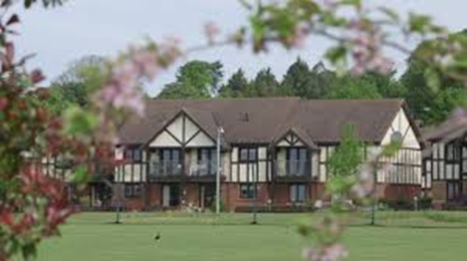
Planning for the Right Homes in the Right Places: Government Response, 2018
The Government recognises respondents’ concerns about the definition being linked to retirement age.
Proposal to include:
Planning for the needs of people seeking to move to more suitable accommodation at an earlier age, enabling them to live independently for longer.
Preparing guidance for local authorities on how their local development documents should meet the housing needs of older and disabled people in accordance with the requirements of the Neighbourhood Planning Act.
Intention to build on existing guidance that sets out how the needs for different types of housing should be addressed and add further information where this would assist with the identification process.
Westbury Fields, Bristol
St Monica Trust Ltd, 2003

Slide 9
National Planning Policy Framework
Para. 50: plan for the needs of different groups in the community such as older people
Para. 62: identify the size, type and tenure of
homes required, including for older people
Older people: People over or approaching retirement age, including the active, newly-retired through to the very frail elderly; and whose housing needs can encompass accessible, adaptable general needs housing (…) through to the full range of retirement and specialised housing for those with support or care needs.
Draft NPPF Changes

Slide 10
Community Infrastructure Levy (CIL)
What is it?
Problems with definition and calculation
Some best practice
Inconsistency

Slide 11
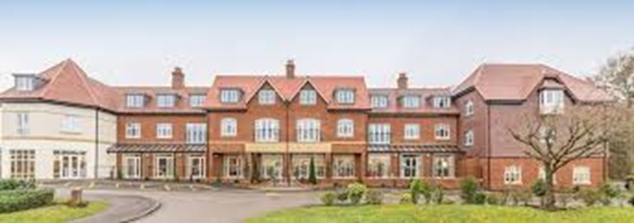
Future developments in planning for
older people
Methodology to calculate supply and demand for specialist housing
Implications for affordable housing
Key appeal decisions
Elmbridge Village, Surrey
Retirement Villages, 2017
Monica Wills House, Bristol
St Monica Trust, 2006

Slide 12
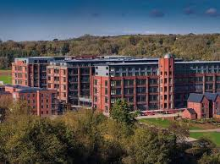
Discussion
The Chocolate Quarter, Former Cadbury Factory, Bristol
St Monica Trust, 2017

