Slide 1


Help at the touch of a button – connected communities the Guinness way
Wendy Wells, Head of Policy and Business Implementation
Manuela Gruse, Retirement Living Manager

Slide 2

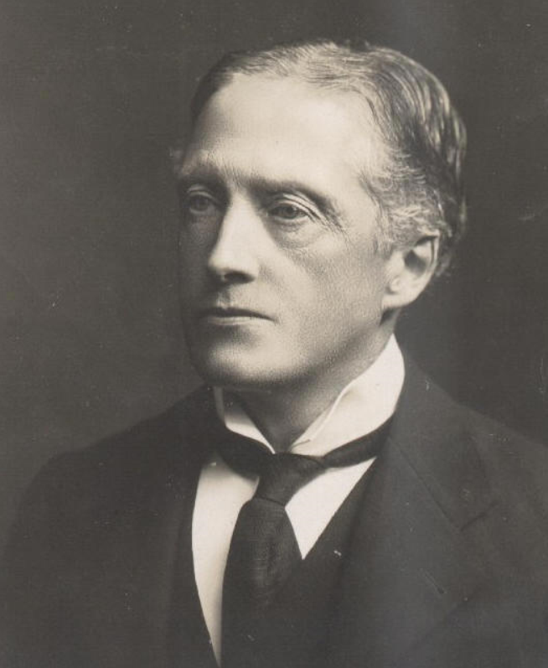

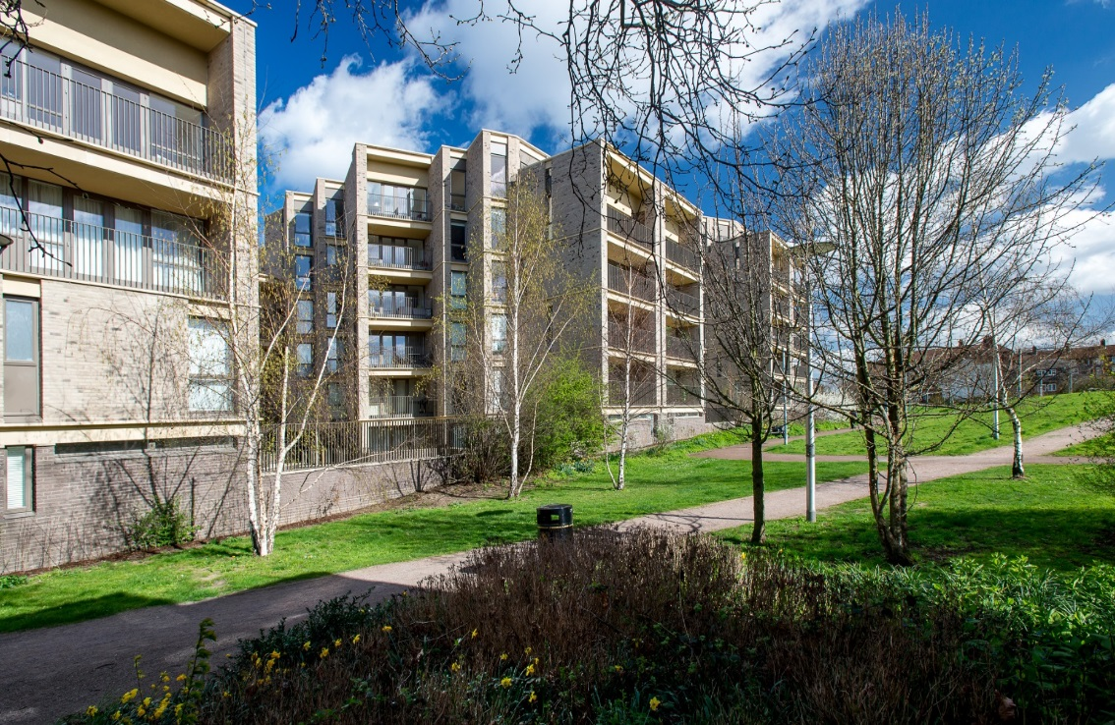
140,000 Customers
66,000 Homes

Slide 3

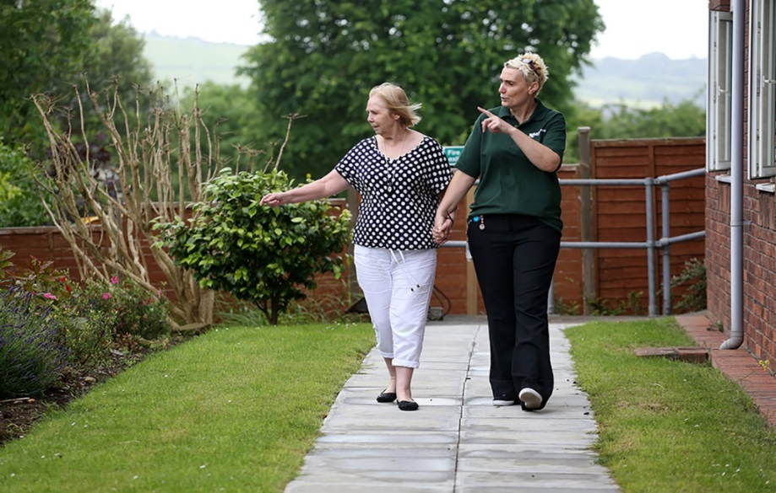
Vision
The Guinness Partnership Vision: We are here to improve people's lives and create possibilities for them.
Guinness Care is a charitable subsidiary of The Guinness Partnership Limited (TGPL) delivering a wide range of care and support services enabling people to live as independently as possible.

Slide 4
Guinness Care Values
We care for our customers
Our care services enable people to choose to live as independently, happily and healthily as possible
We want our customers to be able to determine how to live their lives, in whichever way each individual chooses
We believe that care is a service as well as a response to a need

Slide 5
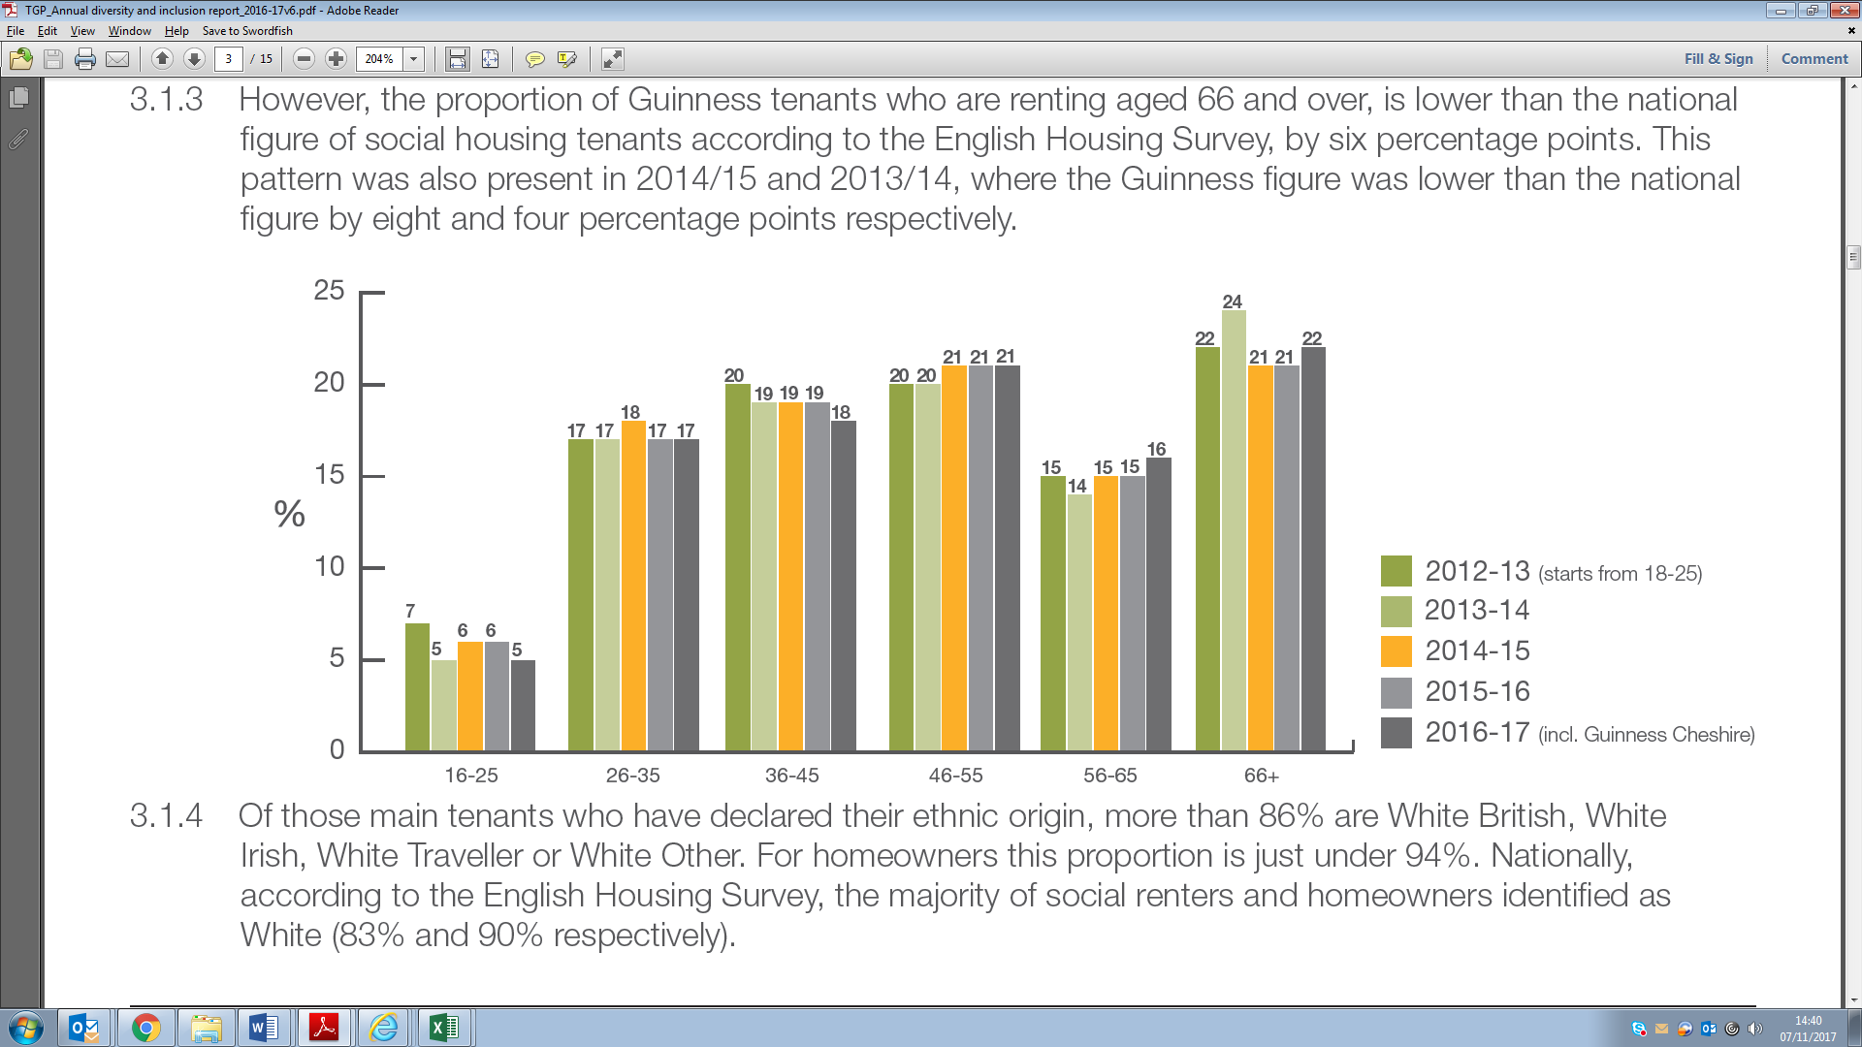
WHO are we here for? Our current customers
Age profile over recent years
The largest age group is 66+ (22% in 2016/17). Even though it’s our largest group, it is lower than the national average by six percentage points.
 | 0 to 15 years (%) | 16 to 64 years (%) | Aged 65 and over (%) | UK population
1976 | 24.5 | 61.2 | 14.2 | 56.2m
1986 | 20.5 | 64.1 | 15.4 | 56.7m
1996 | 20.7 | 63.5 | 15.9 | 58.1m
2006 | 19.2 | 64.9 | 15.9 | 60.9m
2016 | 18.9 | 63.1 | 18.0 | 65.6m
2026 | 18.8 | 60.7 | 20.5 | 69.8m
2036 | 18.0 | 58.2 | 23.9 | 73.4m
2046 | 17.7 | 57.7 | 24.7 | 76.3m
Source: Office for National Statistics
The big leap in age is forecast to come between now and 2036.
Crudely applying that to Guinness’ current customers means we will have about 10,000 more over 65’s

Slide 6
Age Structure of UK Population
Mid-2014 and mid-2039
(Source – Office for National Statistics)

Slide 7
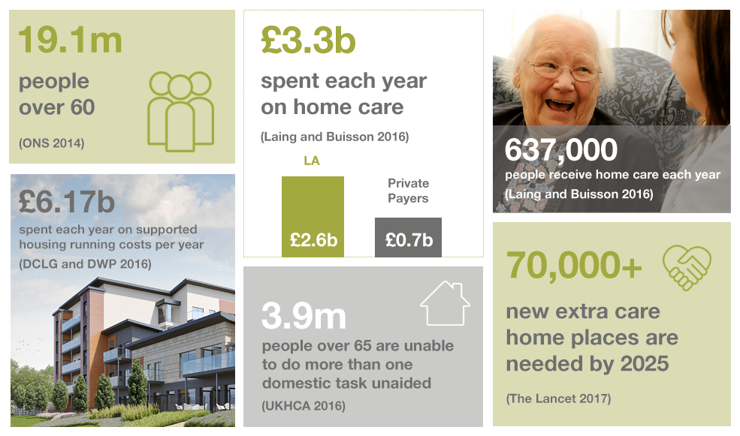
Huge challenges in care – the broad market position
A reminder of challenges and needs:

Slide 8
Improved life expectancy
Vastly improved life expectancy, one of the great triumphs of the last century, looks set to be one of great challenges of this one.
Between 2015 and 2020, the general population is expected to rise 3%
- aged over 65 are expected to increase by 12% (1.1 million)
- aged over 85 by 18% (300,000)
- centenarians by 40% (7,000)
Cheshire West and Chester has a higher proportion of older residents than the England average with 19.9% of our population aged 65 or over compared to the England figure of 17.3%.
This proportion is forecast to increase over the next ten years to 23.5%. In other words, around one in five people are currently aged 65 or over, by 2023 we forecast this will be closer to one in four.
(Source – Parliament.uk)

Slide 9
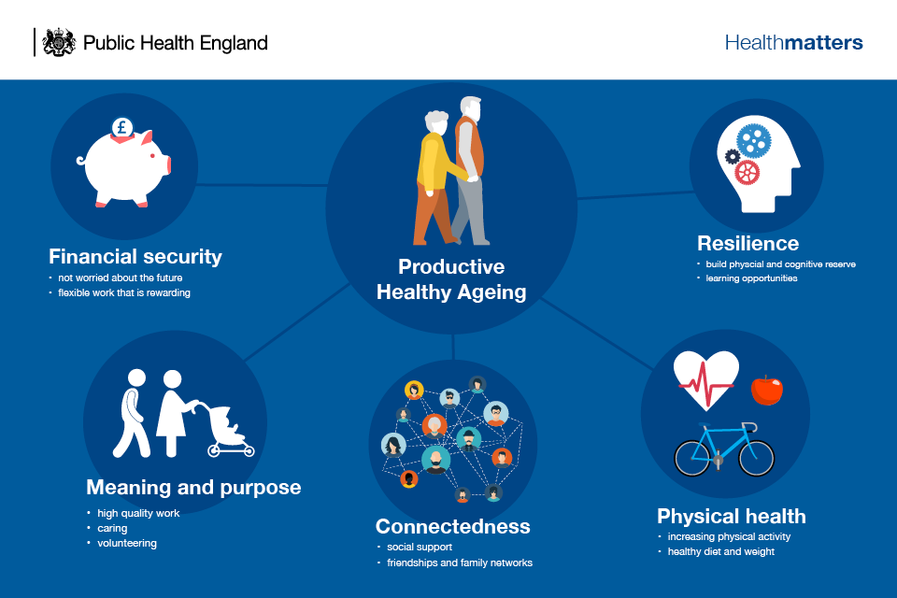

Slide 10
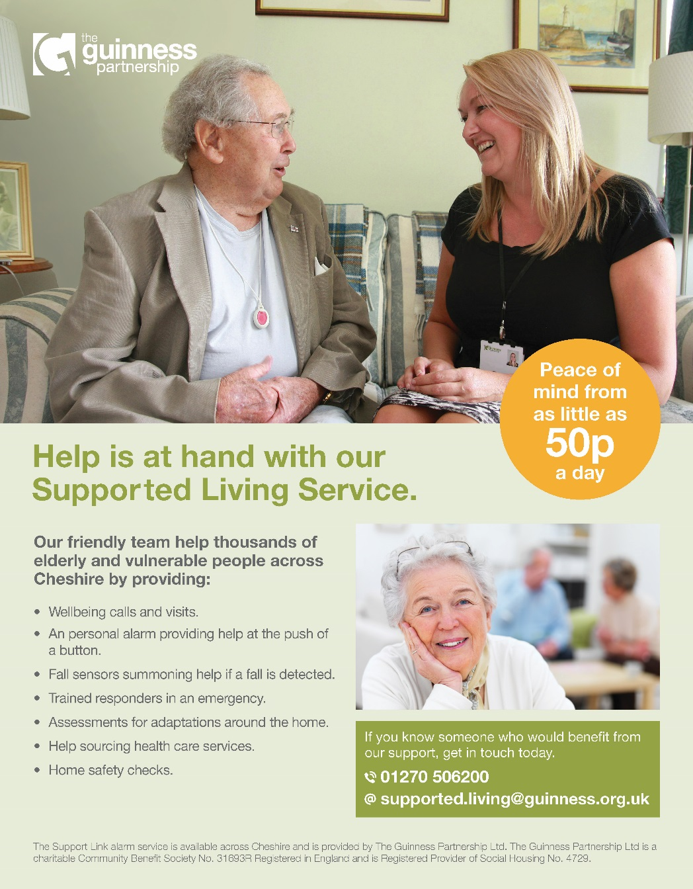
What is the mobile support service?
Wellbeing calls and visits
A personal alarm providing help at the push of a button
Fall sensors summoning help in a fall is detected
Trained responders in an emergency
Assessment for adaptions around the home
Help sourcing health care services
Home safety checks

Slide 11
Why did we set it up?
Heightened awareness of the ever increasing age and frailty of our customers who were not living in sheltered housing or extra care schemes.
We wanted to ensure that those older, frailer customers in general needs properties would receive a similar support to those customers living in specialised housing
We wanted to offer a person centred service to customer which would enable them to stay as independent as possible, for as long as possible in their chosen home
Keen to expand our service and include private customers who were not living in Guinness owned homes.

Slide 12
How did we go about it?
We consulted with existing customers who were served through our hard wired systems and local warden as this service was becoming financially unsustainable
We designed the purpose of our service and our service offer around customer feedback
Purpose: “help me to fulfil my chosen lifestyle, to be as independent as I can with the reassurance that if I need your support you are there for me”
We offered a more flexible and cost effective service with additional equipment
Initially set up with the support of Supporting People funding
We partnered with Tunstall Response who offered a cost effective service and were able to serve a larger customer group
We completed a “system intervention” to ensure that the service is customer centred, personal and meets the need of every customer.
We “built” a mobile solution for staff to ensure that admin time in the office is kept to a minimum

Slide 13
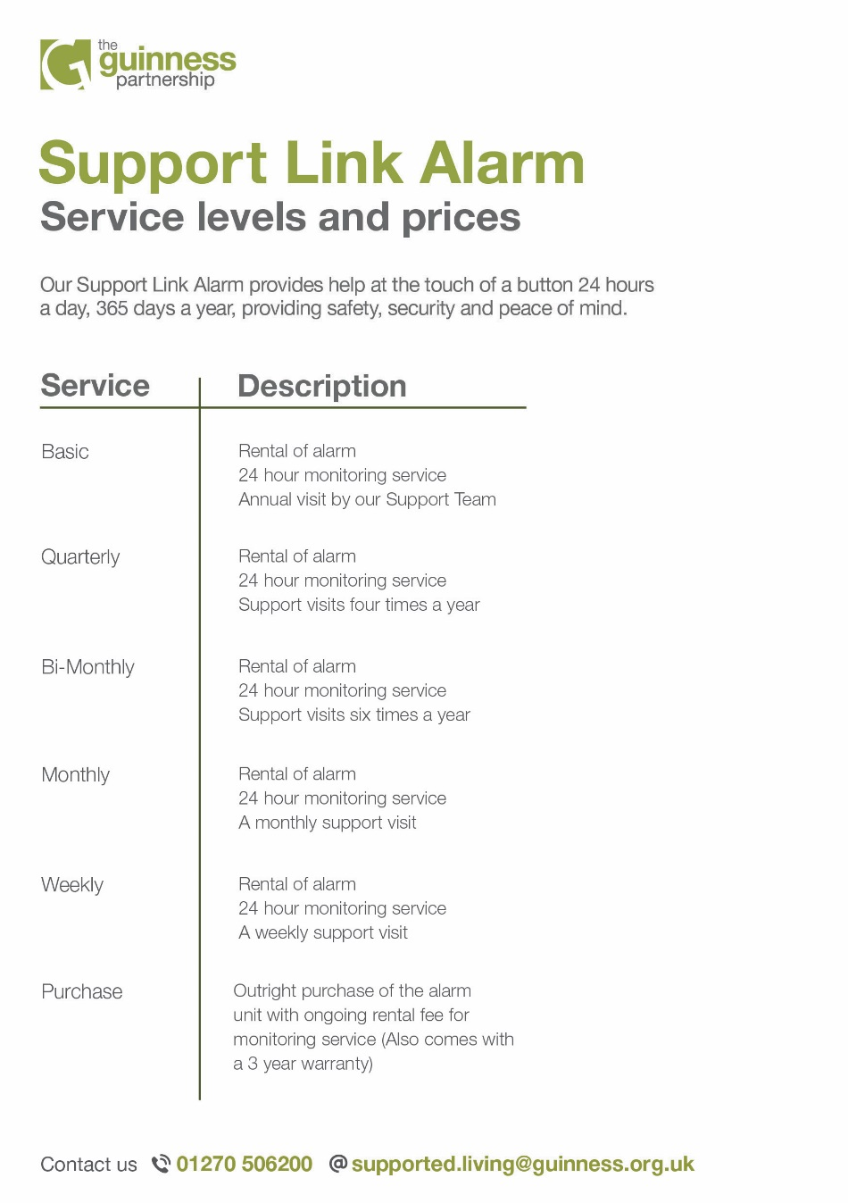
Level of service depends on cost to the individual
Can be as flexible as rental of equipment and 1 visit per year to purchasing equipment
Current breakdown %
Support with funding

Slide 14
Any Questions?

Slide 15
Our Contact Details
Wendy Wells
wendy.wells@guinness.org.uk
Manuela Gruse
Manuela.gruse@guinness.org.uk
Follow us on Twitter @GuinnessCare
@YourGuinness
Follow us on Facebook Guinness Care
Guinness Partnership

