Slide 1

Our Priorities - Digital & Dementia
Improving our performance and services

Slide 2
Contents
About Housing & Care 21
A digital evolution
New ways of working
Improving the resident experience
Becoming a dementia-friendly organisation
Influencing the sector

Slide 3
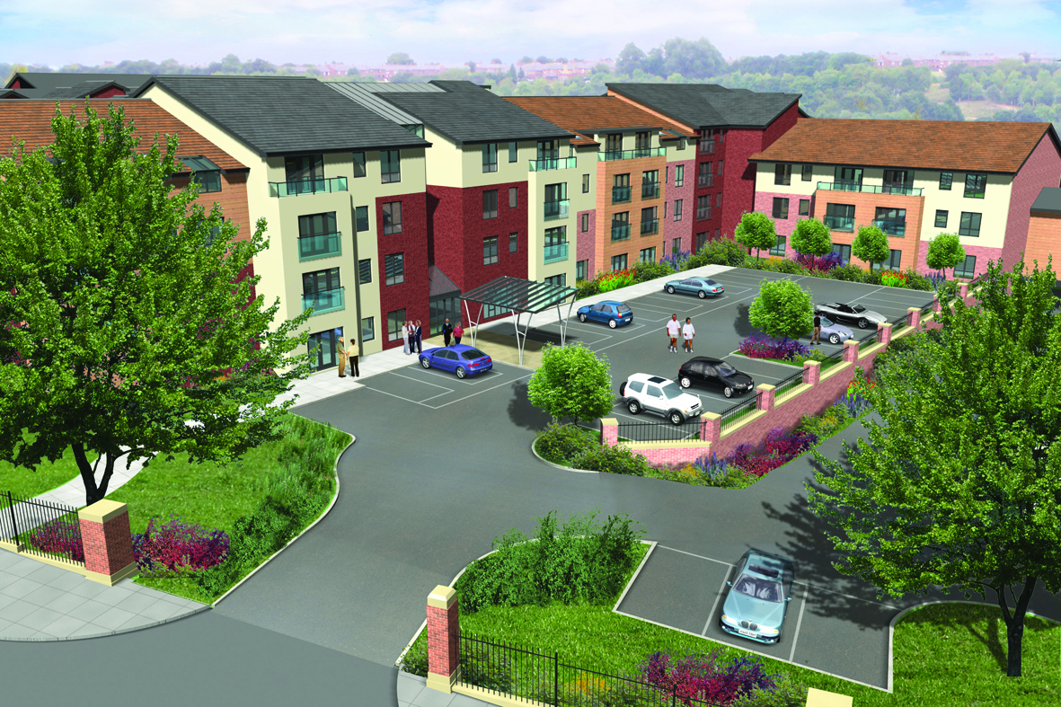
Housing & Care 21
Our purpose is to:
Provide contemporary housing and care services to meet the needs of older people of modest means
Older people’s specialist housing provider
Manages c. 20,000 properties
  135 Extra Care schemes
  Over 350 Retirement Housing
  schemes
34,000 hours of care each week
70 registered services
Over 150 local authority areas

Slide 4
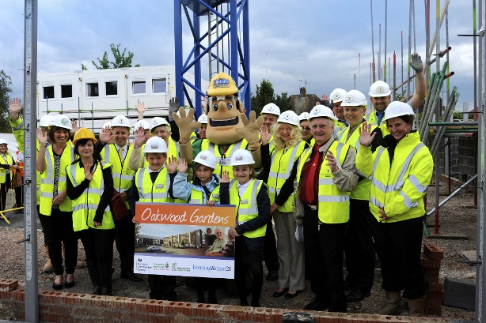
A developing organisation
By 2021
  2,021 new Extra Care properties
  210 new Retirement Housing
  properties
400 per annum thereafter
30 schemes in the pipeline
  New and infill Extra Care & Retirement Housing
  Trialling offsite manufacturing in Nuneaton
  Same design brief irrespective of geography
Notes:
Richard Onslow Court in Nuneaton – infill
Size – down to financial viability and demand analysis
Planning process can be very lengthy and the way some developers treat S106 i.e. as a separate developer rather than being policy compliant and fulfilling the S106 obligation for social housing.
Only 22% of LA’s have an older people’s housing strategy (Age UK)
Gifted land a decade ago used to be about 95% of all land, now more like 50%.
The approach now is for developers to bring a package to us

Slide 5
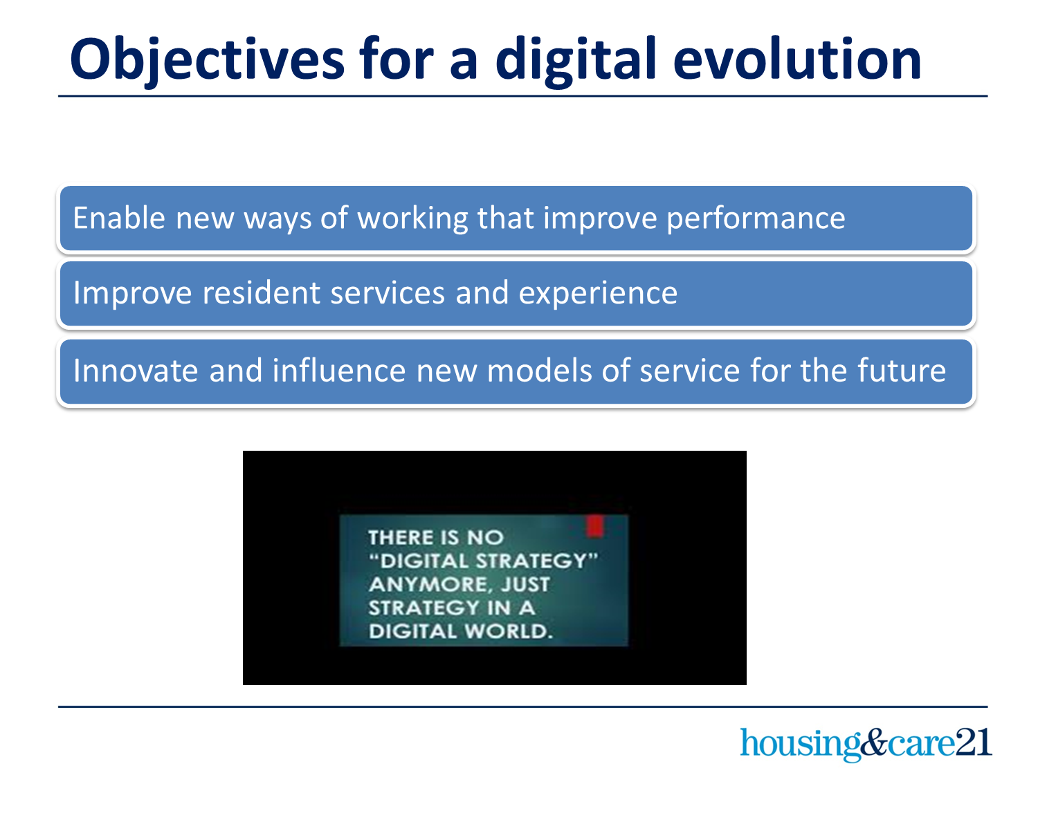
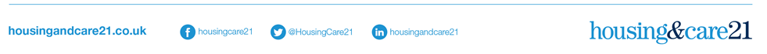
Objectives for a digital evolution

Slide 6


Enabling new ways of working
Commitment to a devolved operating model that values the Court Manager service
Using technology to enable mobile working that is more responsive

Slide 7

Enabling new ways of working
Refresh core housing, asset management and finance systems
PEBBLES

Slide 8


Improving Resident experience
Digital inclusion for residents, helping them access services
Resident self serve option via website: in scope for PEBBLES

Slide 9
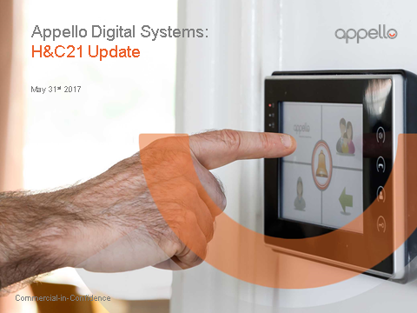
Improving Resident experience
Digital end to end Emergency Call Systems:
- Fast connection time
- No call queuing
- Improved speech quality
- Full colour video calling
- Remote access / diagnostics
In development:
- Mirror application on mobile devices (tbc)
- Management panel on tablet (tbc)
- Central server and routers (tbc)
- Improved hardware
- Improved pendant and wrist band options
- Development of Appello supported software (tbc)
Installations:
- More than 80 completed
- 40 to be installed 2017/18

Slide 10
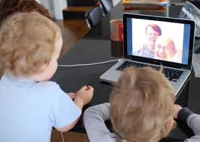

Improving Resident experience
Promoting social inclusion for residents
WiFi on Courts:
- To support PEBBLES
- Open service in Extra Care

Slide 11

Improving Resident experience
Virgin Media Connections:
- Free connections
- Wayleave signed for 8,500 properties
- Resident choice / consultation
- Works and making good by VM contractors
- Superfast broadband and media packages
- No commitment by residents to purchase
- VM paid £25k for resident engagement

Slide 12

Exploring the future
Working in partnership with Sheffield University’s Centre for Assistive Technology and Connected Healthcare
Workshop to explore technology options
Technology to enable new service models
Options to trial / pilot in HC21 services

Slide 13

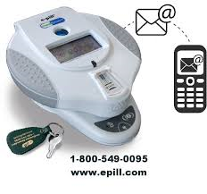
Exploring the future….
Lifestyle monitoring and alarm system that supports ‘absent until needed’ model of support service
Medication dispensing systems to prompt and record medication (removing risks of human mistakes?).

Slide 14


Investing in innovation
Exploring technology that can support new service models for the future
Making our Courts digital – WiFi as part of PEBBLES; digital call systems (in SIP budget); Virgin Media (free)
Improved ways of working = PEBBLES phase 1 and phase 2. Budget envelope of £5m

Slide 15



Our work around dementia
Sponsorship of DAA and Housing LIN conference
Sponsorship of APPG on older people’s housing
Walking with purpose research
Annual conference for academics and practitioners
18th October 2018, Birmingham

Slide 16
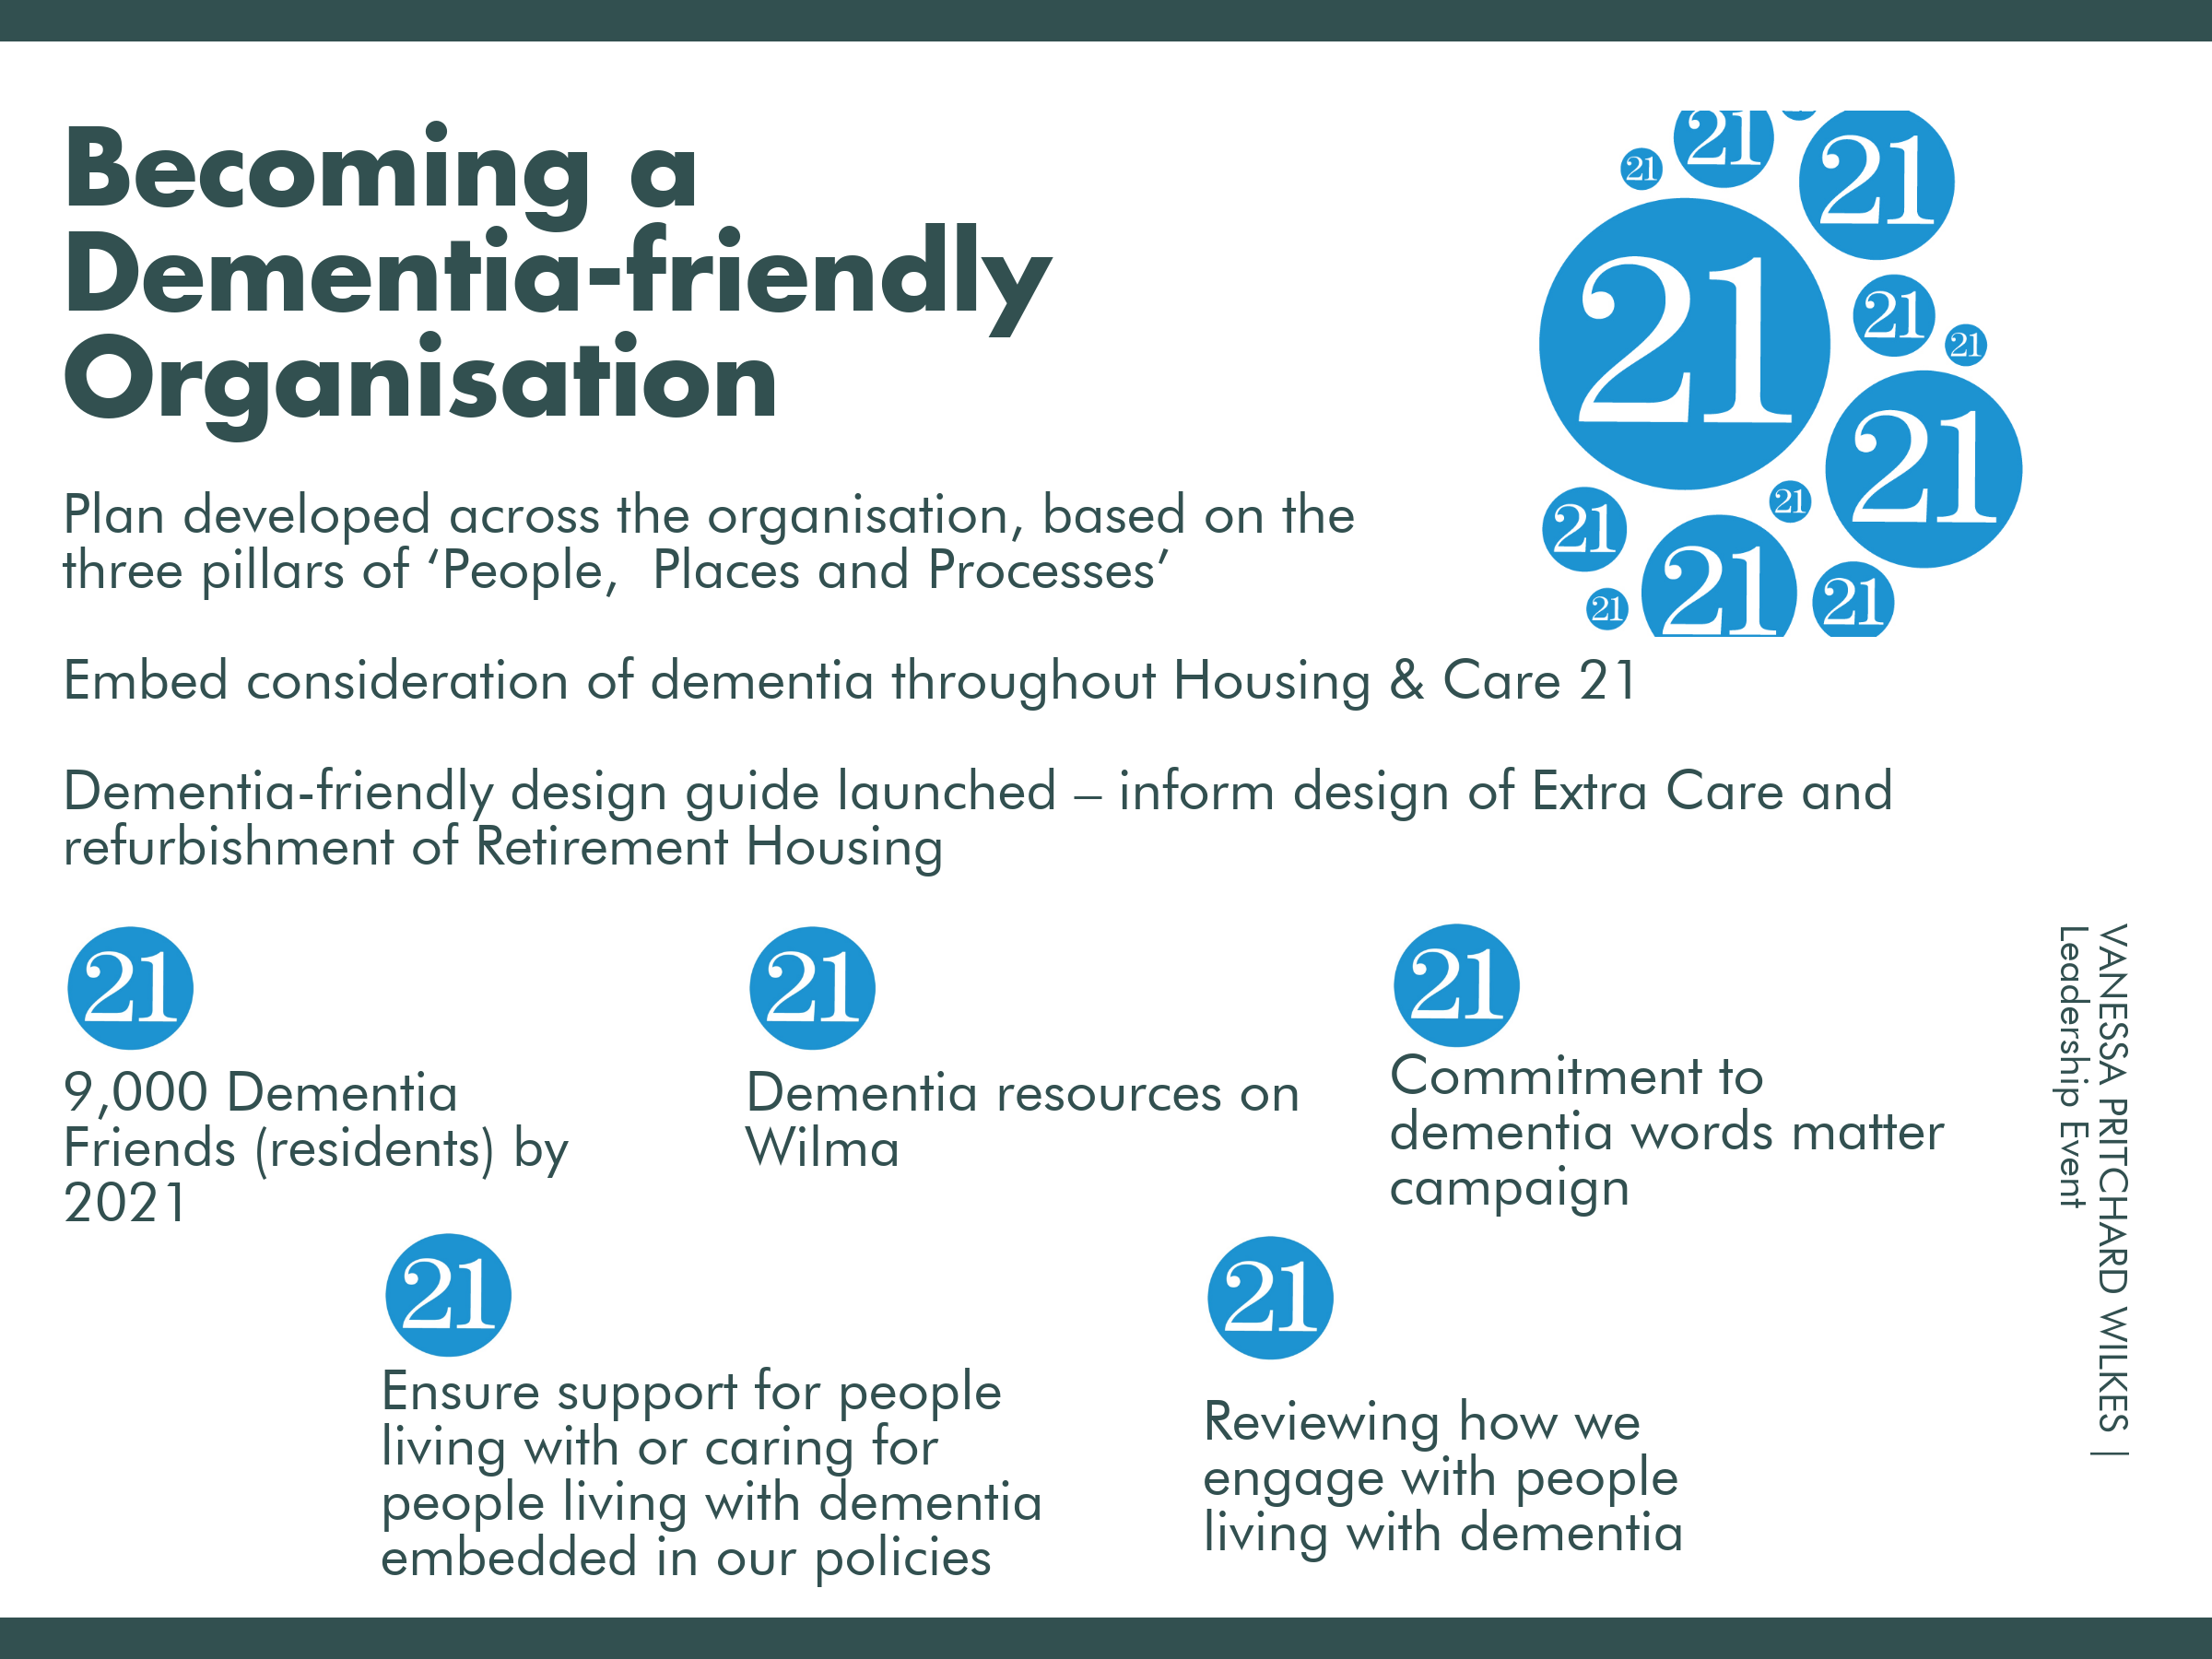
Becoming a dementia-friendly organisation
Plan developed across the organisation based on the pillars of people, places and processes
Embed consideration of dementia throughout Housing & Care 21
Dementia-friendly design guide informs the design of new builds and refurbishment of Retirement Housing

Slide 17
Influencing the sector

Slide 18

Thank you
Any questions?

