Slide 1
A registered charity since 1988
Notes:
Purpose of the PP – benefits to older people in your area

Slide 2
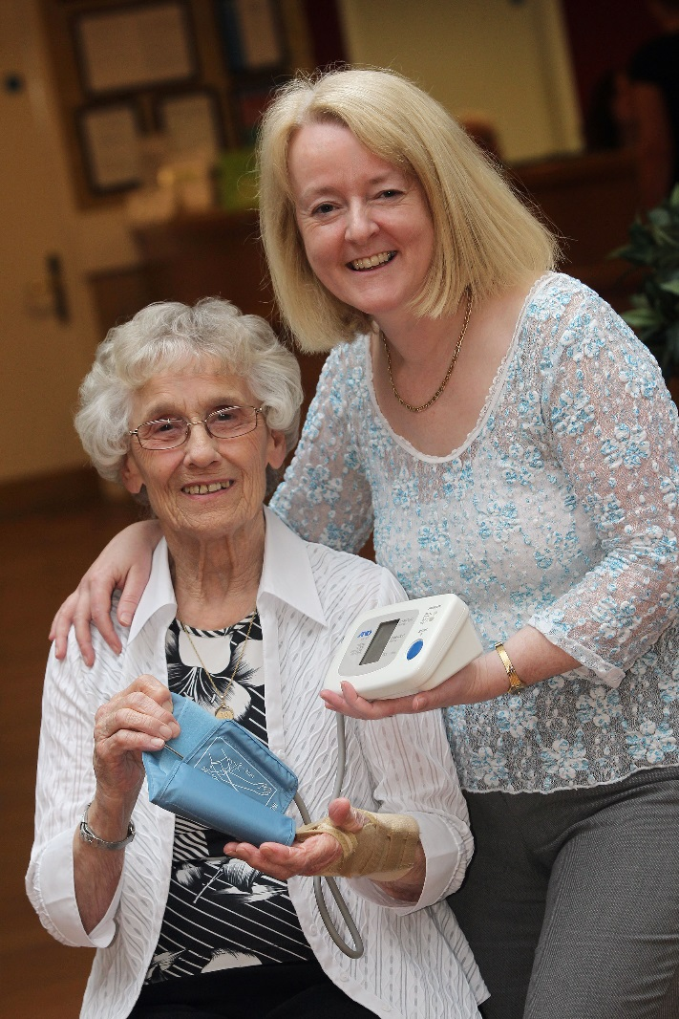
“
The ExtraCare Charitable Trust model combines health and care, support and preventive strategies, in an environment in which active engagement is very accessible.
Professor Carol Holland, Director,
Aston Research Project
”
Notes:
What’s in it for Wolverhampton?

Slide 4
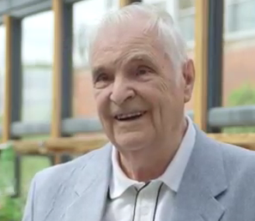
Well-being service
Proactive health screening and well-being services providing help and advice to stay fit and well
Arthur’s story
Notes:
Benefits to our residents

Slide 5
The Aston Research
Notes:
Formed in 2009 the Aston Research Centre for
Healthy Ageing seeks to advance successful ageing
by understanding, predicting and preventing
age-related degeneration.

Slide 6
What did it do?
3 year longitudinal study comparing 162 new ExtraCare residents with a control group of 33 people living in their own homes in the community.
Considered the effects of ExtraCare’s integrated approach on health and well-being, cognition and their influences on social functioning and independence over time.
Compared the effect of the ExtraCare model on care needs and care costs.
Notes:
RESEARCH
PURPOSE
Retirement communities are an important arena
to promote healthy ageing. The development
of these communities may help to promote
independence by sustaining both physical and
mental well-being. Little is known about how
such innovative housing models, with integrated
health and social care, impact on outcomes for
older people and the overall costs of care and
support. This three-year longitudinal study sought
to compare changes over time in care needs and
care costs for new residents of The ExtraCare
Charitable Trust with a control sample living in
the community. It also sought to examine the
effects of the integrated approach deployed by
The ExtraCare Charitable Trust on health and
well-being, cognition, social functioning and
independence over time.

Slide 7
Findings
The ExtraCare model reduces total NHS costs for individuals from when they move in to 12 months late (costs for the control group do not change)
Notes:
The ExtraCare Charitable Trust model can result
in significant savings for NHS budgets – over a
12 month period total NHS costs (including GP
visits, practice and district nurse visits and hospital
appointments and admissions) reduce by 38% for
ExtraCare residents in the sample across the period.

Slide 8
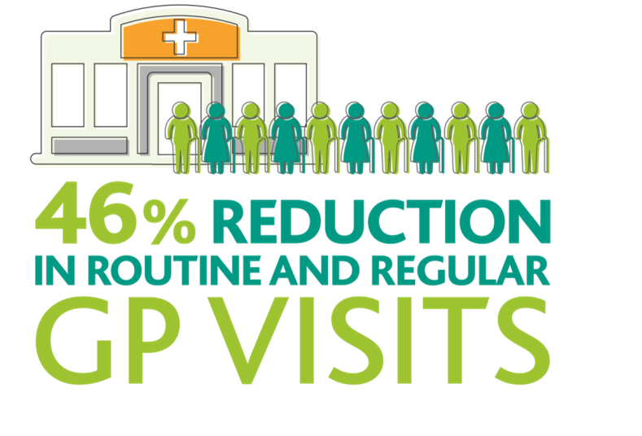
Findings
‘Growth in the older population is resulting in unprecedented pressure on GPs’ The ExtraCare model’s Well-being Service helps relieve pressure on GP surgeries
Notes:
The ExtraCare Well-being Service provides accessible,
informal (drop-in) support, offering preventative healthcare
and ongoing day-to-day chronic illness care. ExtraCare
residents used their GP more than the control sample at
3 and 12 months due to their relatively poorer health. During
the 12 month period ExtraCare residents’ routine and planned
GP appointments reduced by 46% whilst drop-ins to the
Well-being Service increased. Whilst this is not directly related
at an individual level it does strongly support the drop-in
Well-being model.

Slide 9
Findings
‘People over the age of 65 account for two-thirds of emergency hospital admissions i.e. 2 million admissions = 70% of bed days’ Living at ExtraCare is associated with a significant reduction in the duration of unplanned hospital stays
Notes:
The ExtraCare Charitable Trust model is
associated with a significant reduction in the
duration of unplanned hospital stays, from an
average of between 8-14 days to 1-2 days,
promoting the efficient use of hospital beds.

Slide 10
Findings
New residents at ExtraCare show a reliable initial improvement in aspects of memory – and this is maintained over time
Notes:
At baseline new ExtraCare residents had more difficulties with cognitive functions, independence, health perceptions, depression and anxiety than the control sample. After three months these differences have reduced and some have disappeared, with significant improvements in psychological well-being, memory and social interaction for the ExtraCare residents. At 18 months there is a 10.1% improvement in ExtraCare residents’
autobiographical memory.
Whilst age had an impact on cognition (memory etc) for both
ExtraCare residents and the control group, age only had an impact on change in functional limitations for control participants. This is a function of the fact that decisions to move into ExtraCare are needs related rather than
age related, but is also strong confirmation that age has less impact on self-perceived ability to cope when living in the integrated, supported environment provided by The ExtraCare Charitable Trust.

Slide 11
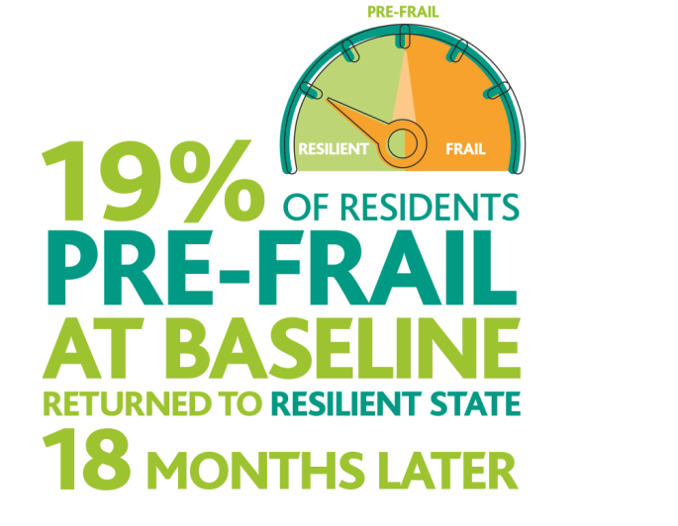
Frailty
A significant proportion of ExtraCare residents who were ‘pre-frail’ at baseline have returned to a ‘resilient’ status 18 months later
Notes:
Frailty, and especially
‘pre-frail’ states are
changeable - however,
a significant number
(19%) of new ExtraCare
residents designated as
‘pre-frail’ at baseline
had returned to a
‘resilient’ state 18
months later.

Slide 12
You said, we did
Notes:
Wellbeing ambassadors

Slide 13
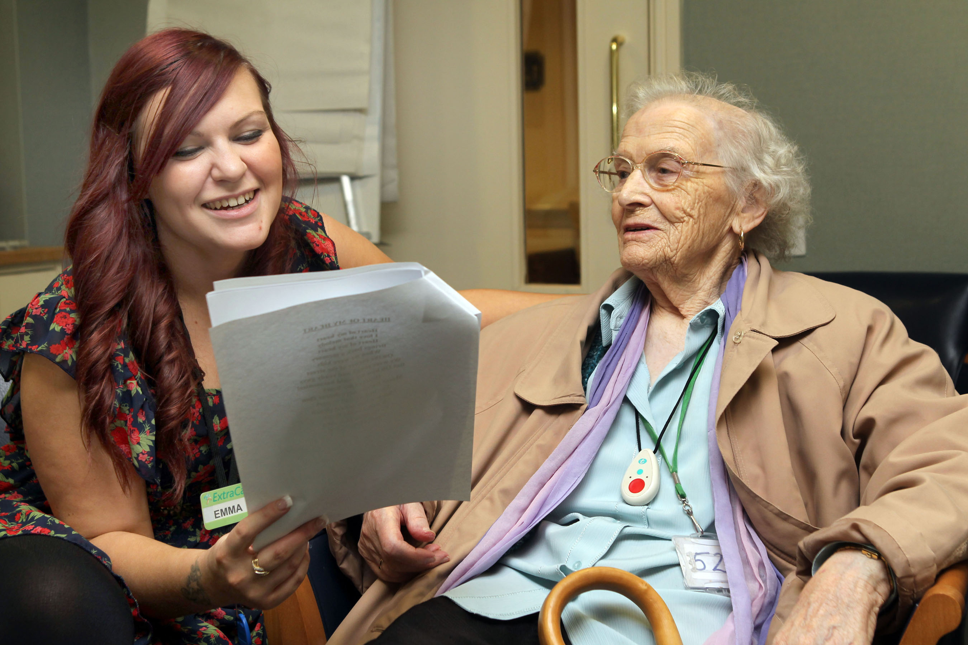
You said, we did
Notes:
Joint working re depression

Slide 14
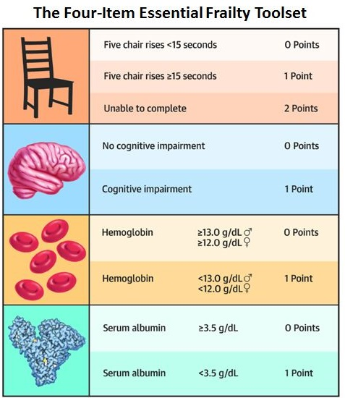
Frailty tool
Notes:
Frailty Calculator

Slide 15
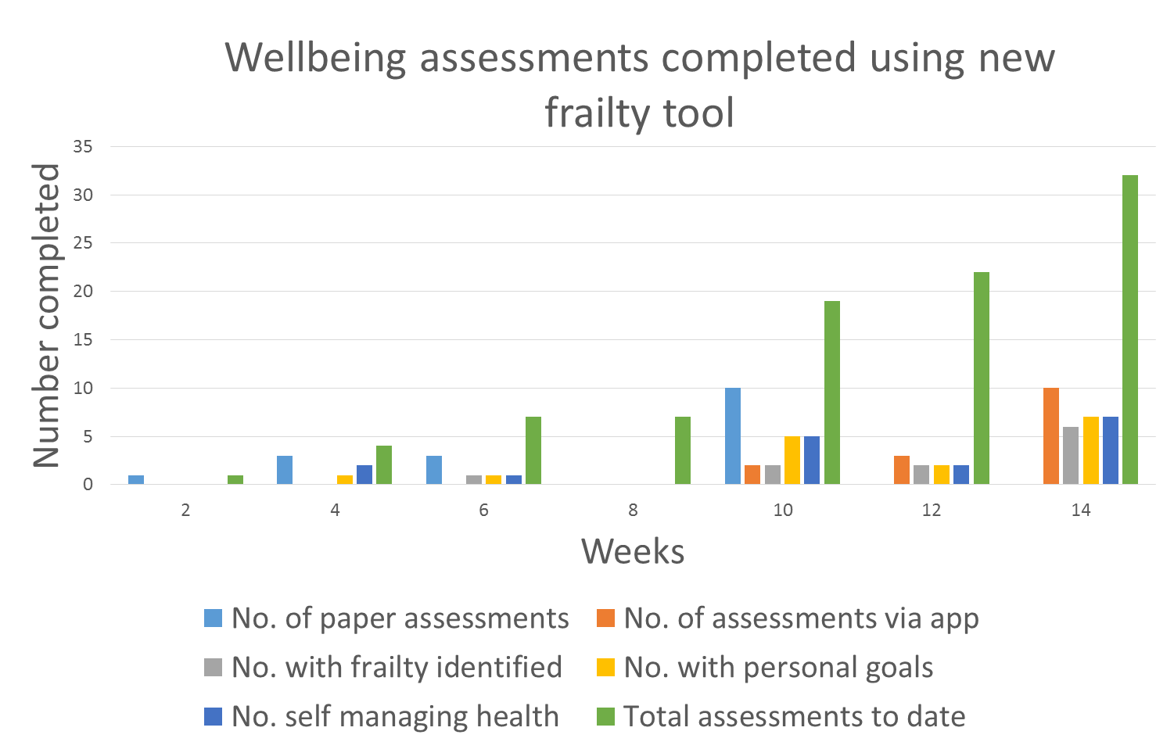
Piloting the app

Slide 16
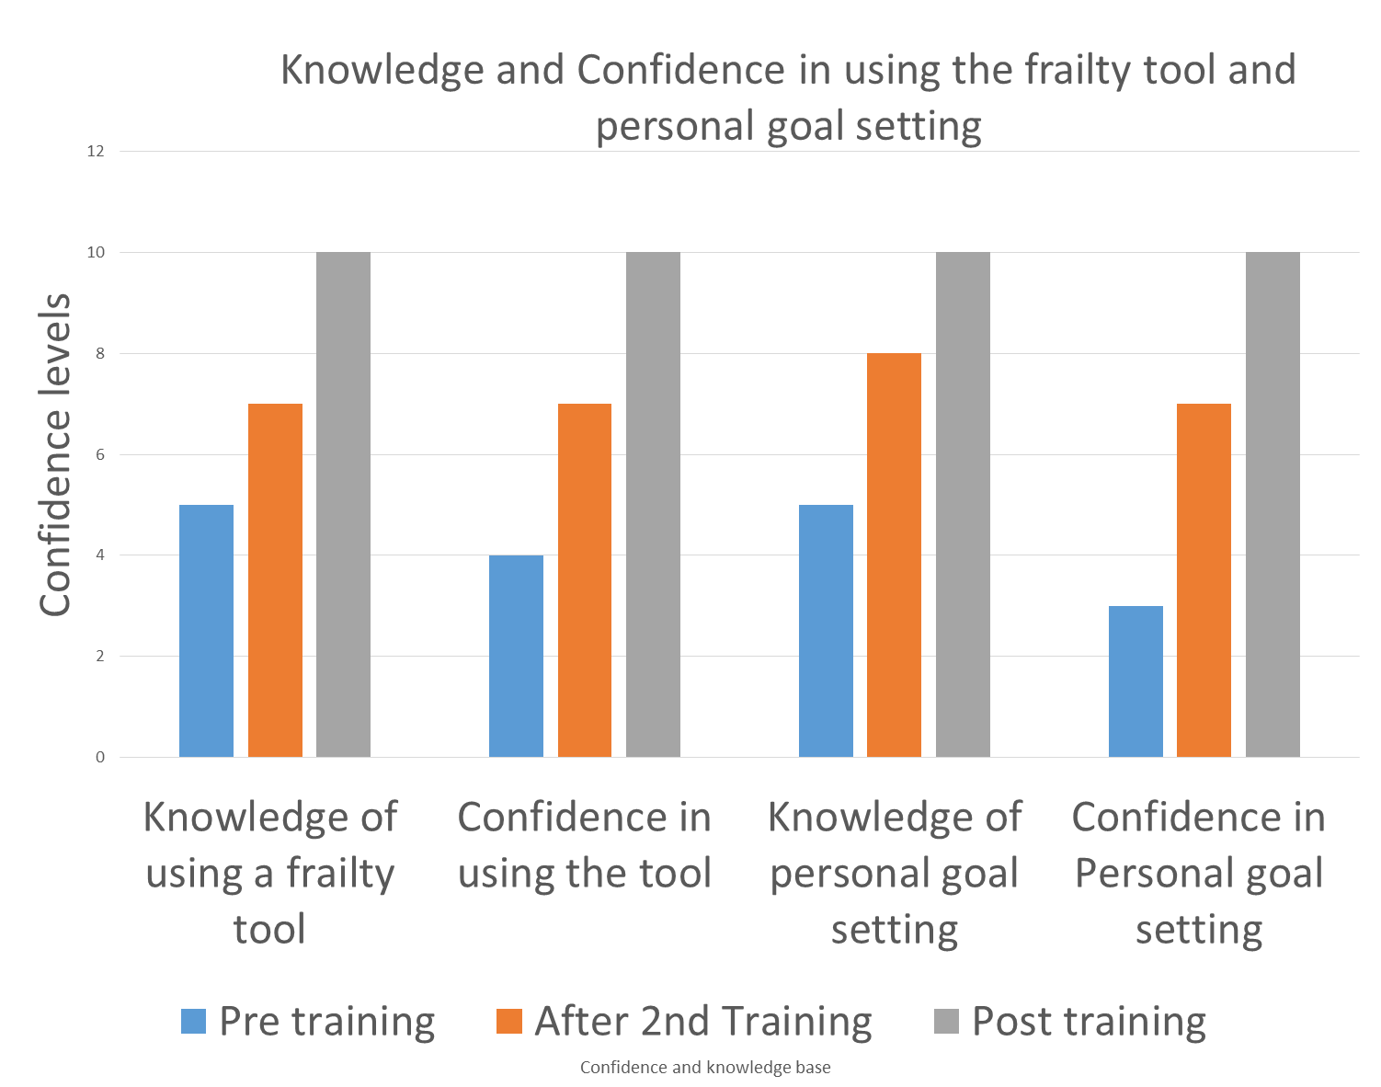
Piloting the app

Slide 17
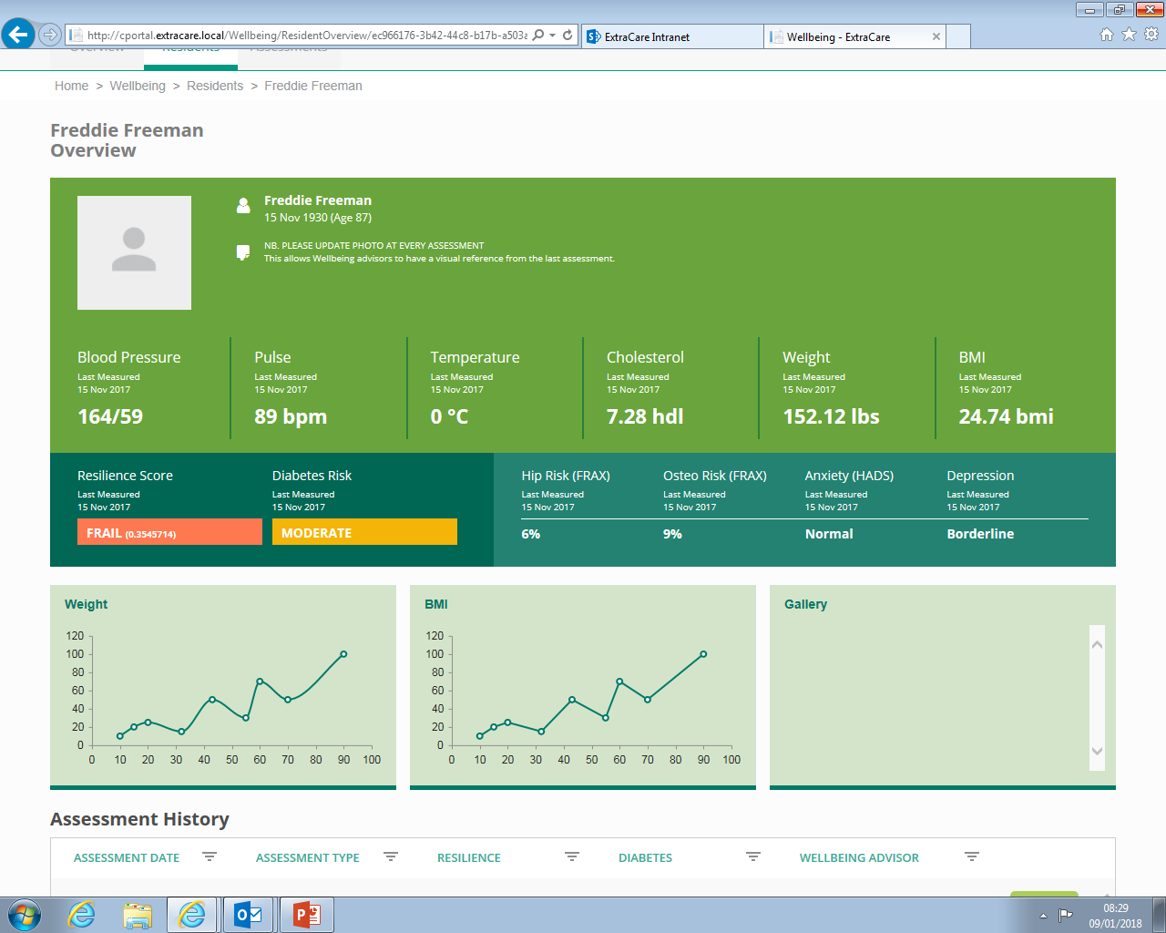
Resilience tool (frailty calculator)

Slide 18
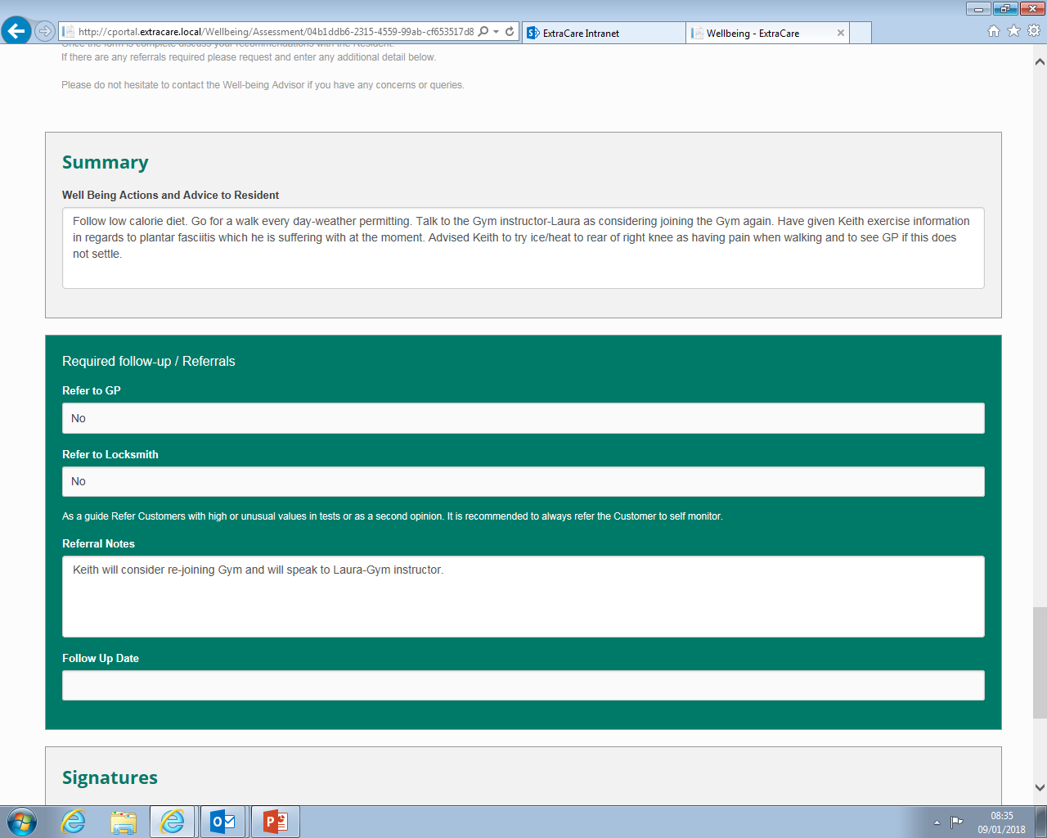
The Wellbeing app

Slide 19
What is resilience?
Robust (not frail)
Currently you are robust (not frail) and have few or no frailty risk factors. It is important that you continue to maintain your physical and mental health because your risk of becoming frail may increase as you get older. This may lower your resistance to illness and stress
Frailty is not an inevitable part of ageing and there is much that you can do to reduce your chance of becoming frail in future. Taking part in physical, social, and intellectually stimulating activities are all good ways of improving your health

Slide 20
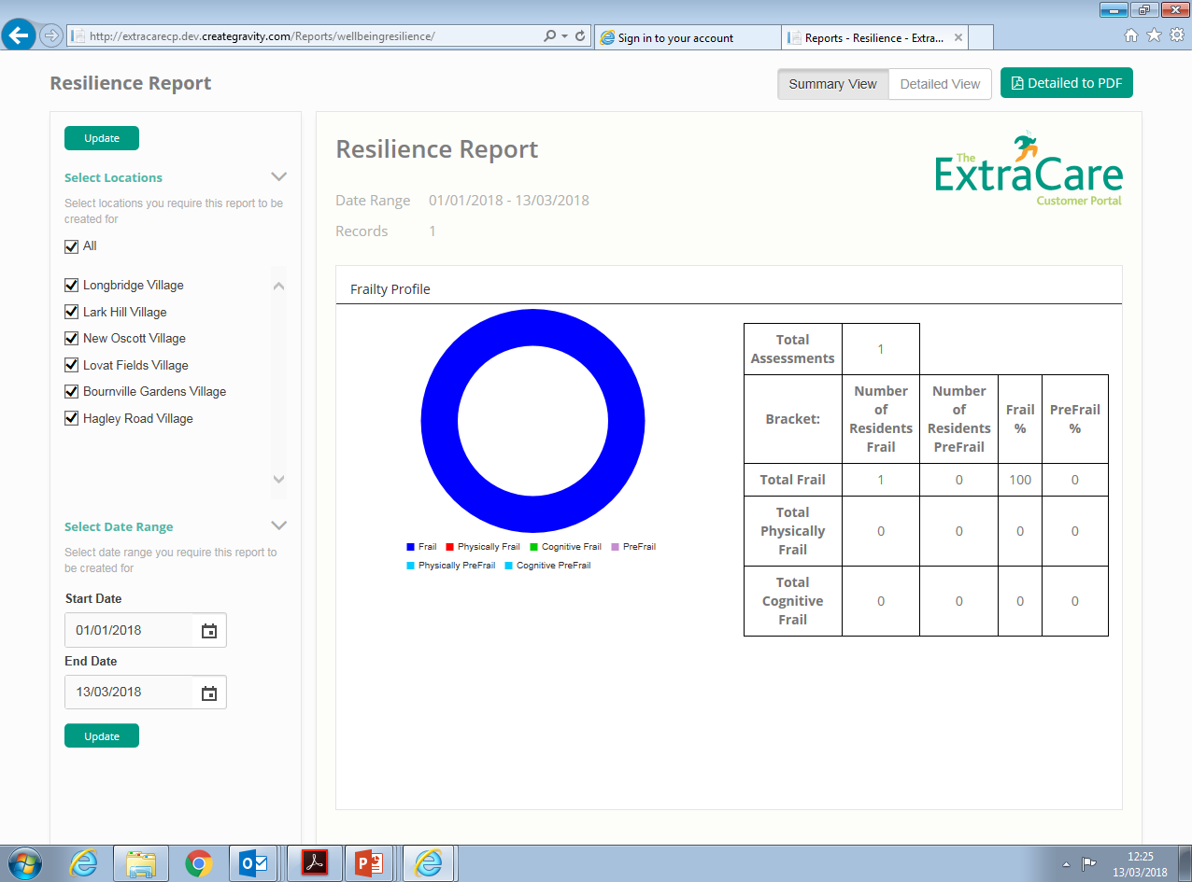
Resilience

Slide 21
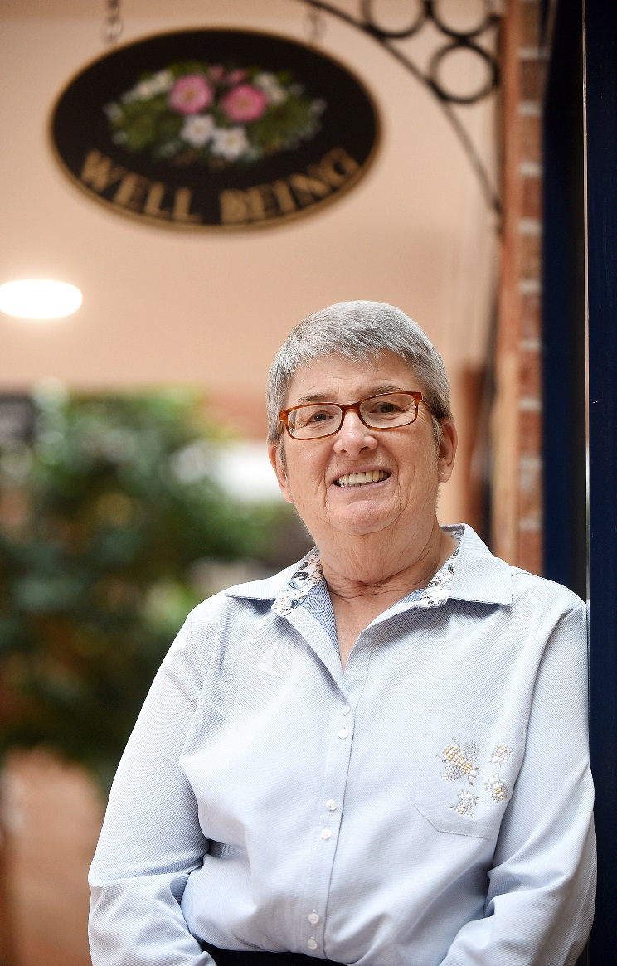
Resident story
Ann’s blog;
diagnosed as pre-frail
with an increased risk
of diabetes
Notes:
Play the VT from the resident here

