Slide 1


Slide 2
Is part of The ENGIE Group

Slide 3

ENGIE is a supplier of energy, services and regeneration, for homes and business in the UK.
Our 1700 employees improve the lives of our customers and our communities, by creating better living and working environments.

Slide 4
ENGIE is focused on three key activities:
Energy
Services
Regeneration
We combine these capabilities for the benefit of individuals, businesses and communities throughout the UK.

Slide 5

ENGIE enables customers to embrace a lower carbon, more efficient and increasingly digital world.
To do this, we go beyond a traditional energy supply and facilities management approach

Slide 6

Our customers benefit from our energy efficient and smart building solutions alongside the provision of
effective and innovative services.
We transform neighbourhoods through regeneration projects and the supply of
Reliable, flexible and renewable energy.

Slide 7
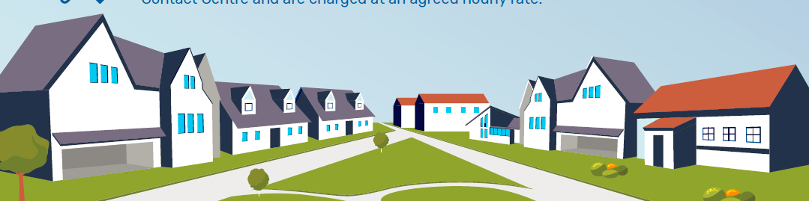
ENGIE acquired Keepmoat Regeneration in May 2017, to build upon the delivery of sustainable infrastructure and services across the UK.
The Regeneration team have over 25 years experience in delivering excellent
major regeneration and construction projects

Slide 8

Our customers will always be given the greatest value energy tariffs along with excellent customer services.
We strive to provide the latest technology and introduce innovative ways to help customers to save money and provide more control over energy usage.

Slide 9

All of our tariffs include our “Rate
Rollover Promise” which means that we will always transfer customers to the cheapest comparable
deal as the tariff expires.
Our Energy Control plan provides customers with a smart heating control system , which keeps them in control even if they are away from home.
“Solving the issues that can create fuel poverty for older persons”

Slide 10
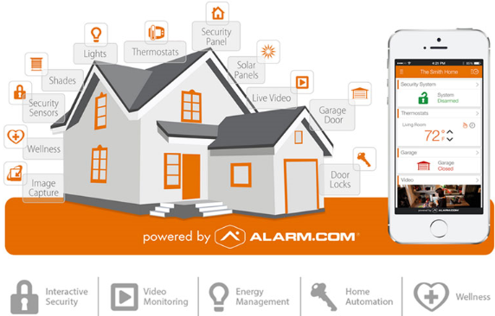
ENGIE are driving forward the latest in digital innovation to connect housing, people, home care, health care, social care and services.
We do this with a view to accident prevention, and enabling our customers to have long term independence and well being.
The connected home

Slide 11
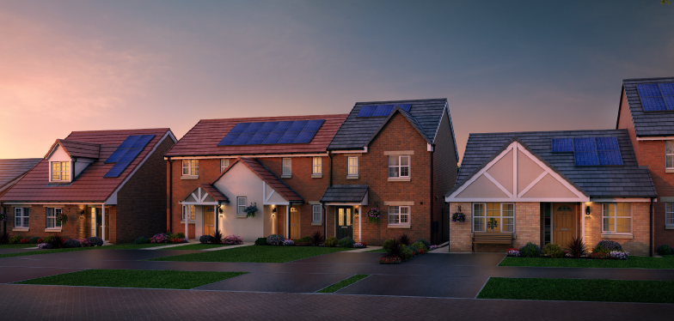
Our products are designed using qualitative and quantitative data from people who are over 55 years, with broad spectrum of housing and mobility needs.
We were reactive to feedback and our homes and street scenes are designed with the help of the people for whom they are intended.

Slide 12

What makes us different?
Customers pay for services that they need or want, which keeps the standard service charge cost to a minimum – they simply cover the costs
There is only a small peppercorn ground rent that extends to full extent of the lease 999 years
There is no transfer fee
plus Values are based on bricks and mortar

Slide 13
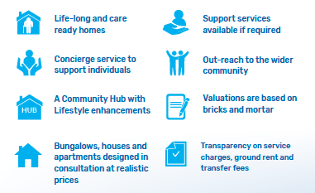

Slide 14

Our flexible house type designs, mean that you can choose the way you want to live now. The homes are adaptable and designed to enable mobility aids such as through floor lifts. This enables our homes to adapt to changing needs and enable people to remain independent for longer
Virtual concierge will provide support outside normal office hours to help customers who need support with a health crisis, security or urgent property maintenance issue
The community hub is convenience on the doorstep, with health, well-being services, community activities, coffee shop and depending on location, a pharmacy, shop and library. The community activities are based around the feed back the individual communities provide
The Lifestyle co-ordinator is a friendly face, who will support our customers with obtaining the correct level of services that will meet their individual and specific needs. The Lifestyle co-ordinator is based in the hub and will liaise with internal and external service providers to arrange what is needed. They will be able to arrange long term property adaptations to meet mobility needs too
The connected home can provide discrete health care monitoring, through touch point digital innovation. This helps to keep our customers safe, secure and confident to remain independent for longer
“ we aim to ensure that our customers can age well and remain
independent for longer!”

Slide 15

The fundamental ethos of our business, is about helping people. Pressure selling is not acceptable.
We would like customers to be provided with the information, that will enable them to make an informed decision.
We work with combined health and support services in partnership, for the benefit of our customers and the wider community

Slide 16
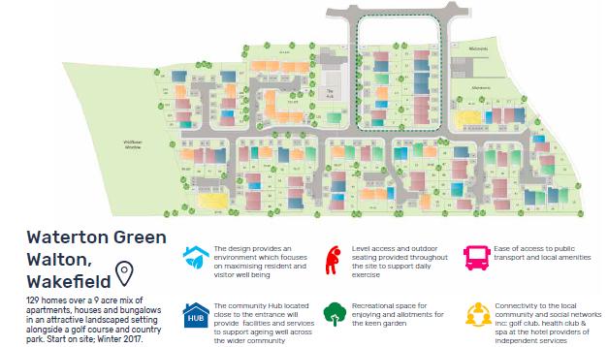

Slide 17
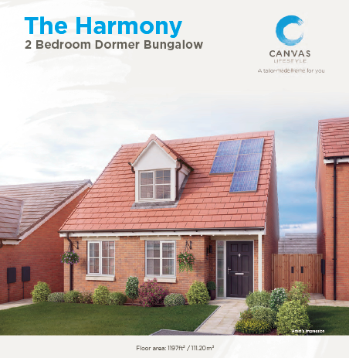

Slide 18
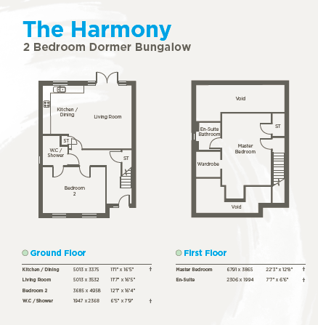

Slide 19
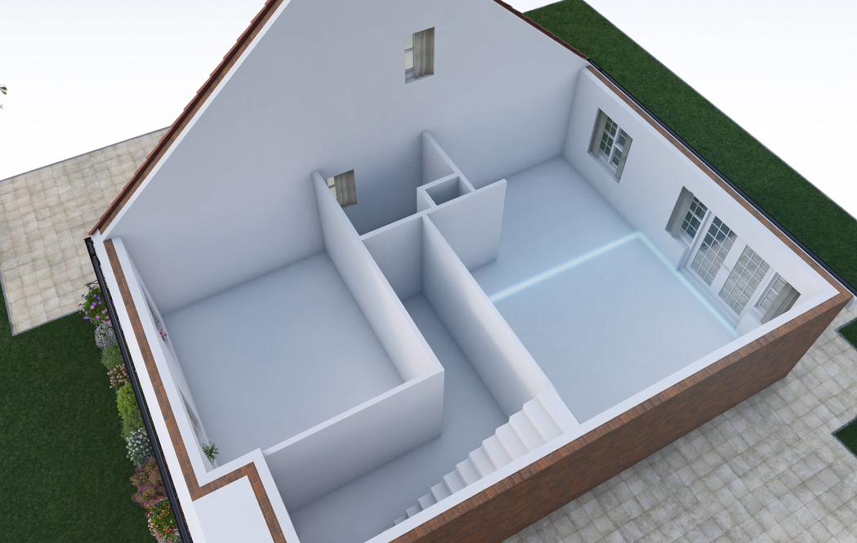
Customers can choose to have walls added, bathrooms changing to wet rooms, electronic mobility kitchens plus much more

Slide 20
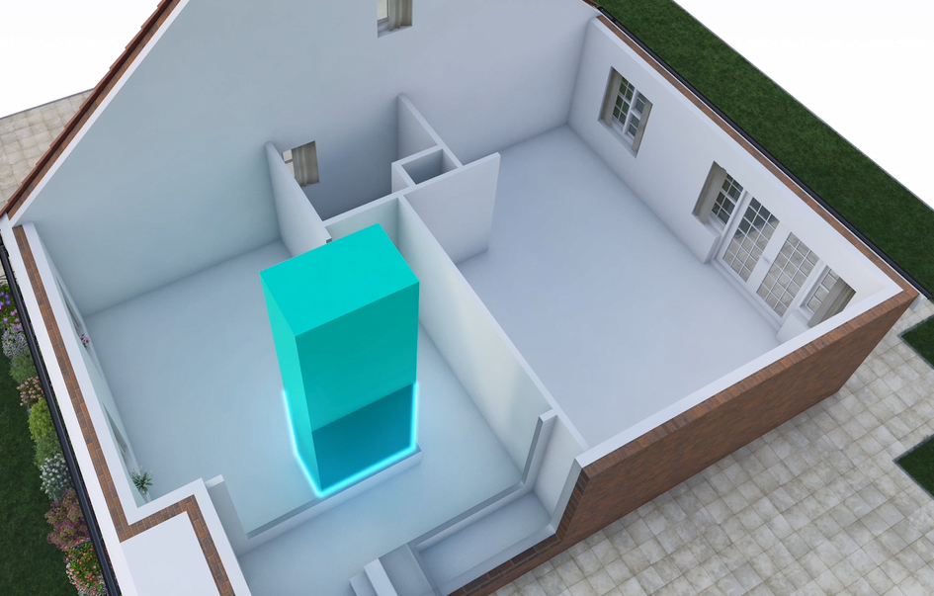
Our homes are designed to accept through floor lifts or stair lifts now or in the future.
These features are aiming to ensure that we future proof the properties and ensure our homes will enable people to remain independent for longer.
These homes are aspirational and meet the needs of all customers and they are care ready for tomorrow

Slide 21

What makes us different?
Housing, digital innovation, home care, health care, social care, utilities and services all under one umbrella!

Slide 22
Working in partnership with
Local authorities
Health Authorities
Clinical commissioning groups
Planners
Local community groups
To ensure we achieve the best solutions, to ensure we can integrate developments and services with the needs of the wider community

Slide 23
SUMMARY
About ENGIE
How utilities, services, housing, health care and social care are linked together to provide an holistic service
How ENGIE work in partnership to enhance the needs of the communities in which they develop
Our differences, business ethics and passion for delivering an innovative solution to meet the needs of people over 55 years old
How digital technology works to support our customers
The business model inc community hub, support to ensure homes meet specific mobility needs
Life long homes, meeting aspirations and long term care needs
superb locations with linked service provisions
Housing, digital innovation, home care, health care,
social care, utilities and services all under one umbrella!

