Slide 1
CQC review

Slide 2
Specifically the CQC will focus on:
How people over the age of 65 move around the health and social care system, including delayed transfers of care
The experiences of people living with dementia as they move through the system but not residents with mental ill-health or learning disability
The ‘pain points’ across the health and social care system, in other words those areas where people experience hand-offs, delays and multiple processes
An assessment of commissioning across the interface of health and social care and governance and processes that accompany that
Their findings will be reported in a 15-20 page report to the Health and Wellbeing Board and there will be an expectation that an action plan is developed to address recommendations. An improvement ‘offer’ will also be made to the system.
A national report will be published summarising all of the reviews in the spring 2018

Slide 3
Areas of Focus to underpin KLOEs : Key system pressure points
Pressure Points:
Maintenance of peoples health and well being in their usual place of residence
Multiple confusing points to navigate in the system
Varied access to GP/ Urgent Care centres/ Community care/ social care
Varied access to alternative hospital admission
Ambulance transfers
Discharge planning delays and varied access to ongoing health & social care
Varied access to re-ablement
Slide 3

Slide 4
Timeline for the 6 week review
Formal notification 31st July 2017 to Chief Executive
Submit contact data and the LSOIR - 25th Sept
Week 3 - focus groups with citizens, system intelligence, voluntary sector, universal services.
Week 6 - review week starts on site 16th October – case studies, visits, focus groups, interviews
Full report to Health and Wellbeing board –beginning of December)

Slide 5
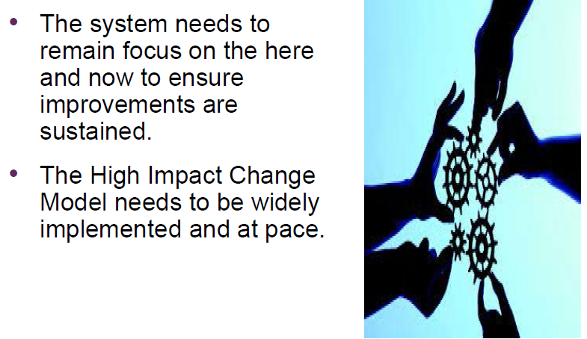
Findings

Slide 6
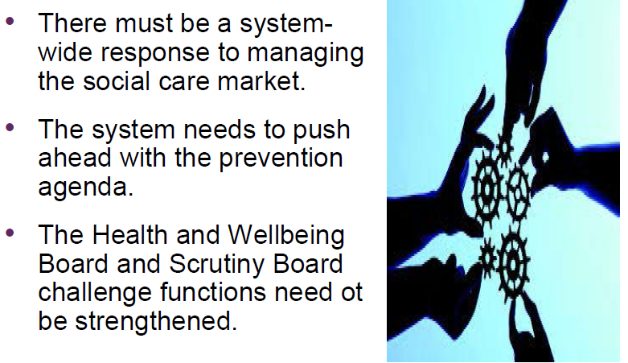
Findings

Slide 7
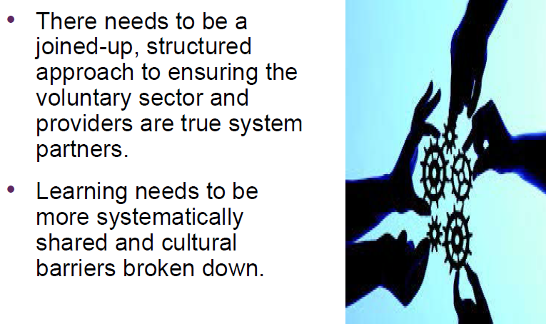
Findings

Slide 8
Action Plan
Focuses on:
Maintaining well-being in usual place of residence
• Crisis management: Preparation for winter & urgent care
• Step down, return to usual place of residence and/or admission to a new place of residence
• Challenge and scrutiny
• Market management/commissioning
• Intelligence and evaluation
It has been developed by :
Trafford Council
Trafford Clinical Commissioning Group
Manchester University NHS Foundation Trust
Pennine Care Community NHS FT
Salford Royal NHS Foundation Trust
Healthwatch Trafford
Trafford Health and Wellbeing Board

Slide 9
Action Plan
Signed off by the Health and Wellbeing Board last week
High Level Impact plan features strongly and has produced significant improvements in DTOC performance
New focus on attendance and admission avoidance
Remodelling support at home and reablement
Pathways and prevention – role of housing and homes
Stronger partnerships with independent sector

