Slide 1
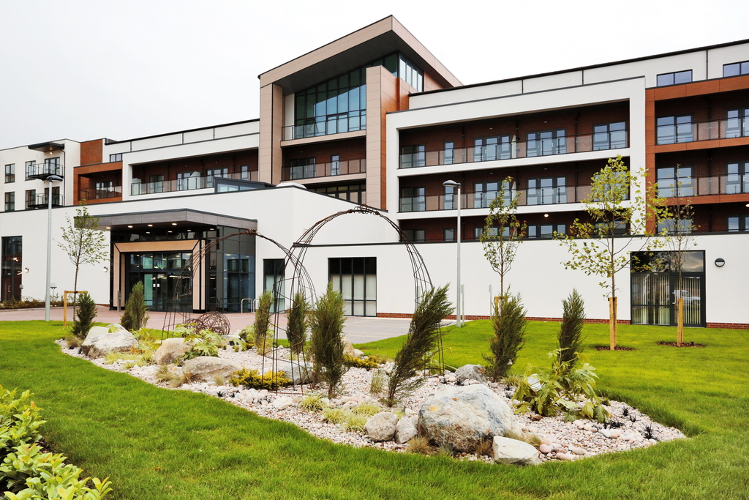
Longbridge Village

Slide 2
ExtraCare Charitable Trust
Our Charity
The ExtraCare Charitable Trust was established in 1988. We are a charity that supports over 4,400 older people in 30 locations across the country.
Our Charity’s Vision: Better Lives for Older People.
Our Charity’s Mission: Creating sustainable communities that provide homes older people want, lifestyles they can enjoy and care if it’s needed.
Any surplus funds that we generate are used by the charity to support residents' housing, health and well-being, and to develop new villages.

Slide 3
ExtraCare’s Birmingham Cluster
The Birmingham Cluster
Longbridge Village is the fifth of five Birmingham villages planned between 2010 and 2017 as part of a £250m development programme between registered charity The ExtraCare Charitable Trust and Birmingham City Council.
New Oscott Village, Erdington (opened 2010)
Pannel Croft Village, Newtown (opened 2012)
Hagley Road Village, Edgbaston (opened 2013)
Bournville Gardens, Bournville (opened 2015)
Longbridge Village, Longbridge (opened 2017)

Slide 4
Longbridge Village
The Village
A partnership between ExtraCare Charitable Trust , Birmingham City Council and The Homes and Communities Agency (£1.5m contribution)
260 individual homes. 109 one bed and 151 two bed apartments
89 for outright leasehold purchase. 119 for shared ownership. 52 available for social rent.
A vibrant community which is home to a wealth of facilities. Our community is diverse, with people from different backgrounds and with differing needs for care.
Our facilities are open to people over the age of 55 from the wider community, which ExtraCare positively encourages.
Village opened in July 2017.

Slide 5
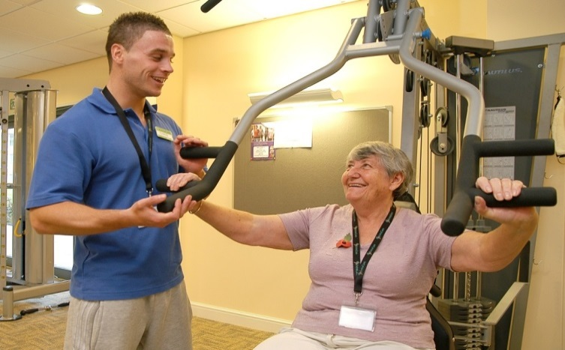
Longbridge Village
The Facilities
Café Bar/Bistro
Village Hall
Hair Salon
Beauty Salon
Village Shop
Licensed Bar
Library/I.T. Suite
Greenhouse
Arts & Crafts
Guest Suite
Fitness Suite
Laundrette
Hobby Room
Well-being Suite
Locksmith Service

Slide 6
Longbridge Village
Well-being Service
Well-being service supports all residents to be pro-active in managing their own health.
Well-being assessments typically cover a range of tests and common conditions including blood pressure, cholesterol, diet, fitness, sleep, diabetes and osteoporosis.
Aston Research:

Slide 7
Longbridge Village
Activity Programme (Examples)
Yoga
Tai Chi
Dancing
IT
Snooker
Choir
Craft
Evening entertainment
The activity programme will differ from location to location. There may be a nominal charge for some of these activities.

Slide 8
Longbridge Village
Care Service
There will be care staff on site 24 hours a day in the event of an emergency.
The village will provide care for up to a third of all residents living in the village.
Enriched Opportunities Programme. Residents receiving care will also include people with a dementia diagnosis, where we are confident we can meet their needs and they can live safely in our community.

Slide 9
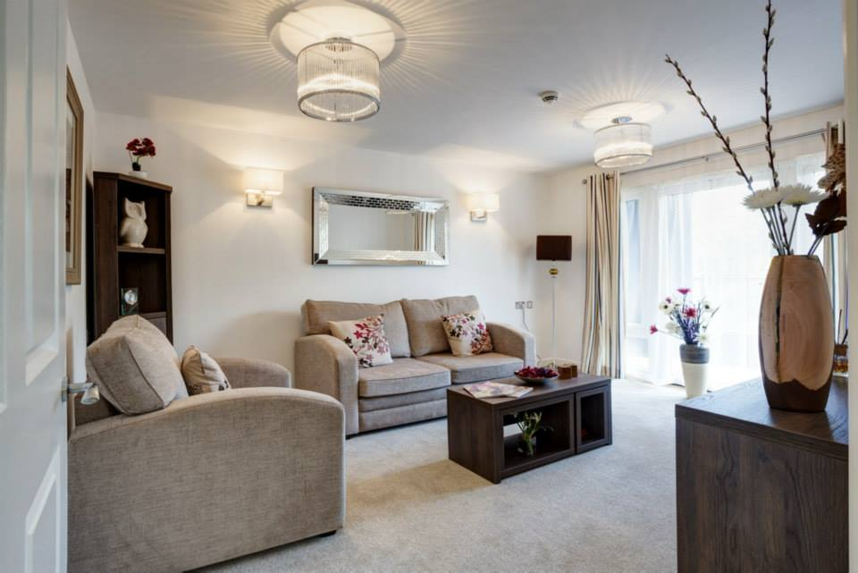
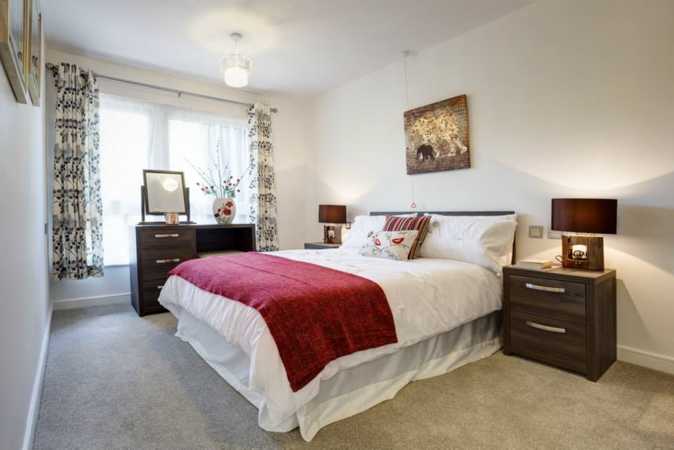
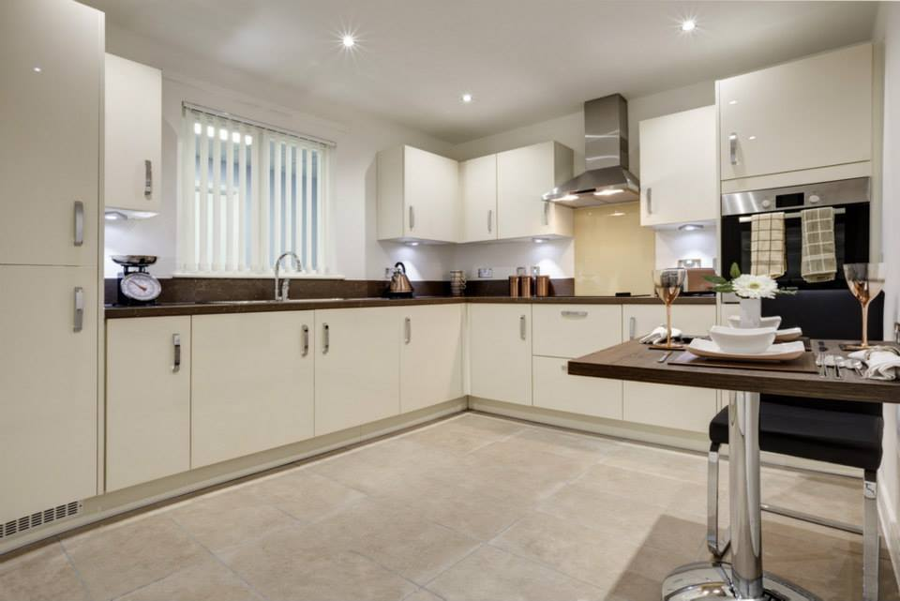
Longbridge Village
The Apartments
Most sales properties have either a patio area or balcony
Flat and level accessibility
CCTV connected to personal TV for guest entry
Easy to reach switches and fittings
Shower rooms have slip-resistant floors
Security key card access
Kitchen with integrated fridge freezer, washer dryer, oven and hob
10 year NHBC structural guarantee

Slide 10
Sales Information (Nov 2017)
Purchase Prices
1 bed | Shared Ownership | From £79,980
1 bed | Outright Ownership | From £199,950
2 bed | Shared Ownership | From £122,475
2 bed | Outright Ownership | From £244,950
Weekly charges and deferred fees apply.
Shared ownership properties are subject to a weekly rental charge. Depending on your individual financial
circumstances, residents may be eligible for assistance in meeting these costs. Please speak to our Welfare
Benefits Advisor for more information. An outright purchase will have no weekly rental charge.
ExtraCare will offer shared ownership properties on a ‘need’ basis.

Slide 11
Sales Information (Nov 2017)
Weekly Charge
£130 for a one bed apartment and £132 for a two bed.
The weekly charge includes a service charge, community charge, maintenance charge and amenity charge.
Affordable Living. For residents renting a home and claiming full housing and council tax benefit, the weekly housing costs start from £46 per week for a one bedroom apartment.
Notes:
Additional Charges
Stamp Duty
Council Tax
Contents Insurance
Telephone/Internet/Broadband
TV Licence
Maintenance of white goods
Care (subject to contract)
Rent (proportionate to your level of ownership)
Locksmith service
The above are not included in the weekly charges paid to ExtraCare.

Slide 12
Five Birmingham villages. The story so far…

