Slide 1
Flexible Care & the Funding Challenge
Liz Alvey
West Midlands Housing LIN
13 December 2017

Slide 2
Flexible care and the funding challenge
More Questions Than Answers!
Where are we now?
How did we get here?
Where are we going?

Slide 3
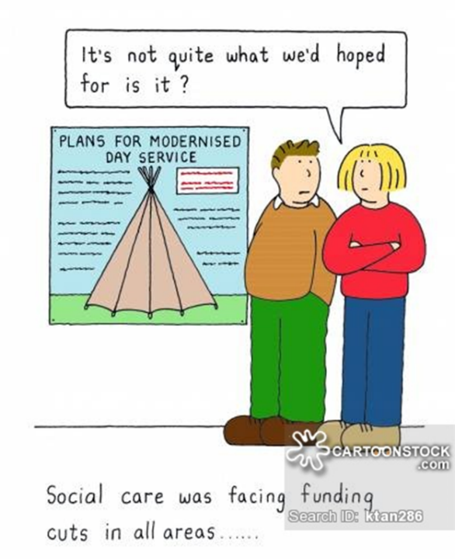
Flexible care and the funding challenge
Where are we now?

Slide 4
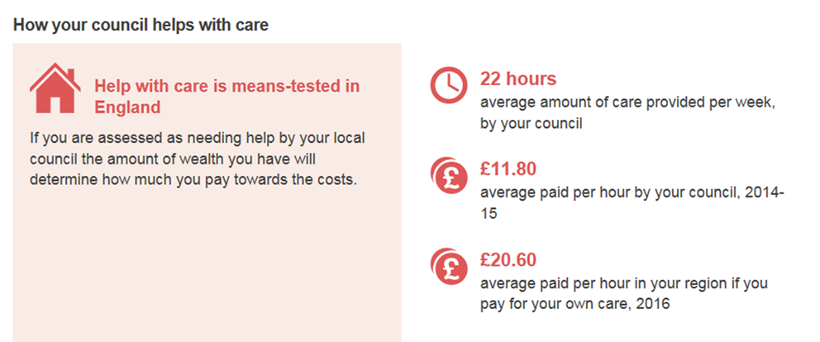
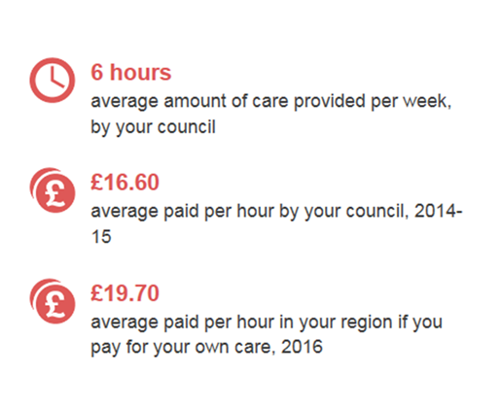
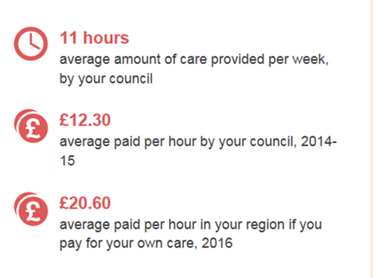
Flexible care and the funding challenge

Slide 5
Flexible care and the funding challenge
How did we get here?

Slide 6
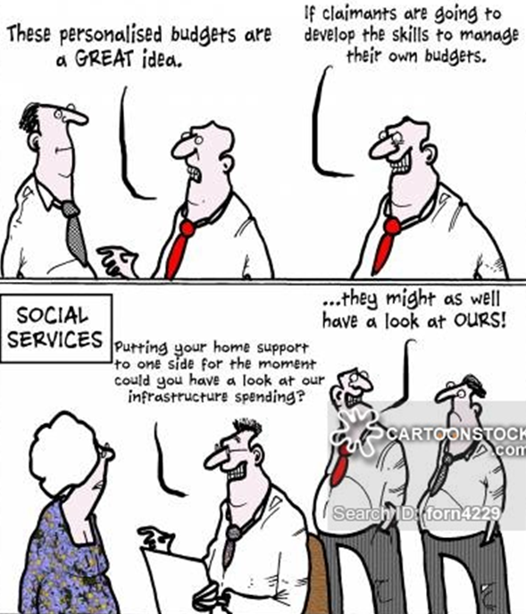
Flexible care and the funding challenge
Where are we going?

Slide 7
Flexible care and the funding challenge

