Slide 1





New Models of Care- Darlington

Slide 2
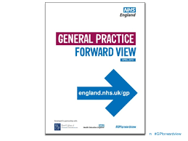


Context/Background
We need to change the way care is delivered to patients to meet the Five Year Forward View by 2020
This means bringing care and treatment as close to home as possible and reducing the use of secondary care
This will be achieved through New Models of Care delivered in community hubs (with teams wrapped around patients) resulting in an integrated model of delivery by 2020
Darlington was selected as one of 10 healthy new town sites- opportunity to accelerate and test new models of care
Notes:
The general practice view and five year forward view signalled a move towards breaking down the barriers between health, social care and physical and mental health, with more services provided in the community and closer to home through the provision of new models of care
NHS England recognise that not one size fits all and thus the changes to the way in services are delivered will be different depending on the needs of the local community and the resources available to implement them
‘New models of care’ pivotal in the delivery of the forward view
Responding to the changing requirements of a health and care system
Differing types of care models being piloted through 50+ vanguard sites:
Integrated primary and acute systems
Enhanced health in care homes
Multi-speciality community providers (we will show you a video on this later)
Urgent and emergency care
Acute care collaborations
Darlington Selected as one of ten Healthy New Town ‘demonstrator’ sites :-
Shaping health communities
Rethinking how health and care can be delivered
Opportunity to accelerate the development and implementation of New Models of Care

Slide 3
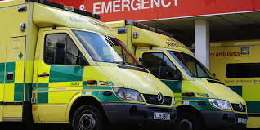
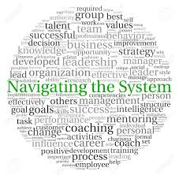
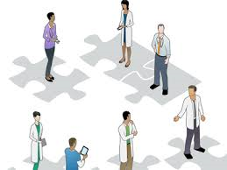

Case for change
Notes:
The vision for new models of care for Darlington is built upon listening to patient and public feedback and considering where improvements are needed to develop a more joined up way of delivering services.

Slide 4
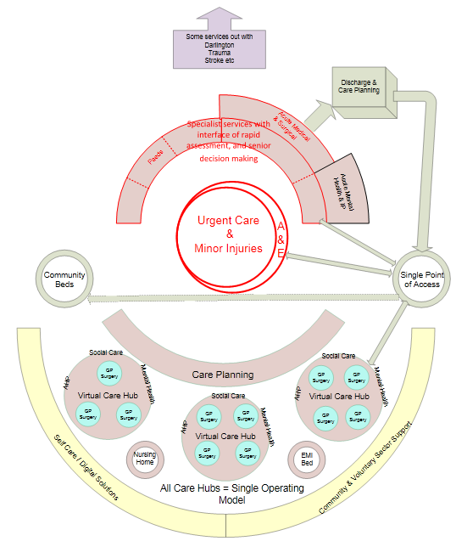
Darlington 2020 blueprint
Notes:
Previous engagement with range of stakeholders and patients
To progress the blueprint required the development of the vision for new models of care
The vision provides the foundation for developing a new model of care
Collaborative working and commitment to the direction of travel from stakeholders is required if the model is to be a success

Slide 5
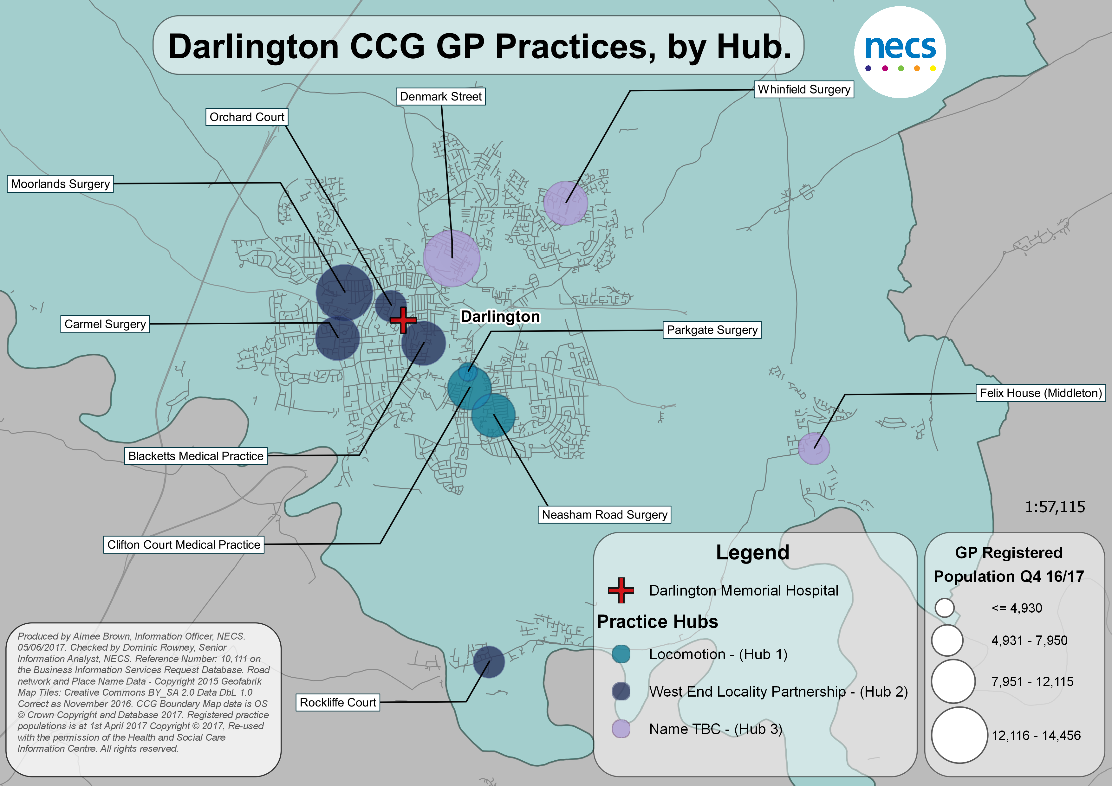
Primary Care Hub Configuration
Notes:
Talk in here about how services need to naturally form and support communities within hubs
How the GP hubs are the foundation of how a new model of care will be designed commissioned and operationalised

Slide 6
Notes:
Extended teams offering more straightforward access to a wider range of health and care closer to people’s home
Centred, where possible, around GP practices and community care hubs
Supports a population based around a natural community of care
Supports and promotes self-care and prevention
Designed and delivered by a partnership approach
Bringing together primary, community and adult social care providers with commissioners of health and social care
Reflects the system priorities of Sustainability and Transformation Plans
New models of care will be adopted across Darlington to ensure equitable access to services for patients, aligned to the needs of the local population and not just the needs of the Eastern Growth Zone (original healthy new town site)

Slide 7
What will working in a new way mean?
https://www.youtube.com/watch?v=0topjOy2U-M&feature=youtu.be

Slide 8
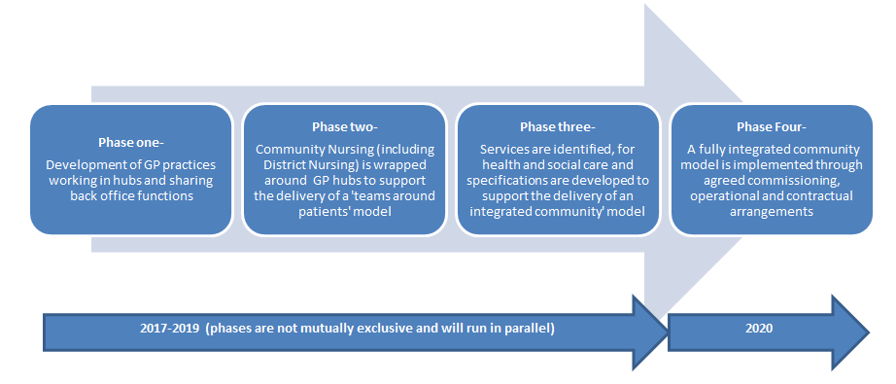
Timescale towards implementing the new model of care

Slide 9
Any questions?

