Slide 1
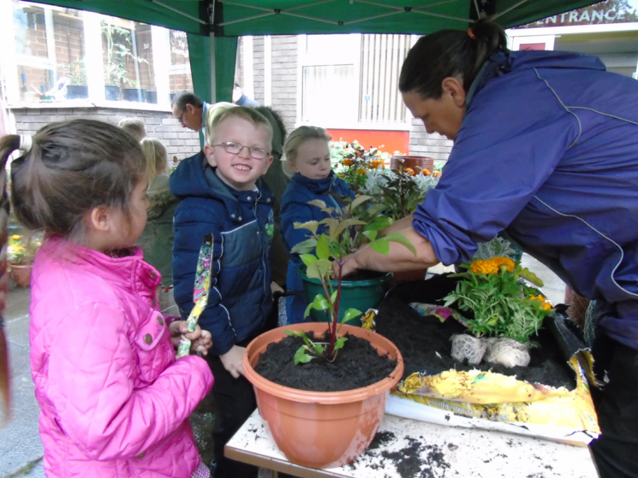
Ken Davies, Housing Strategy Officer
Red Hall Neighbourhood Renewal Strategy

Slide 2
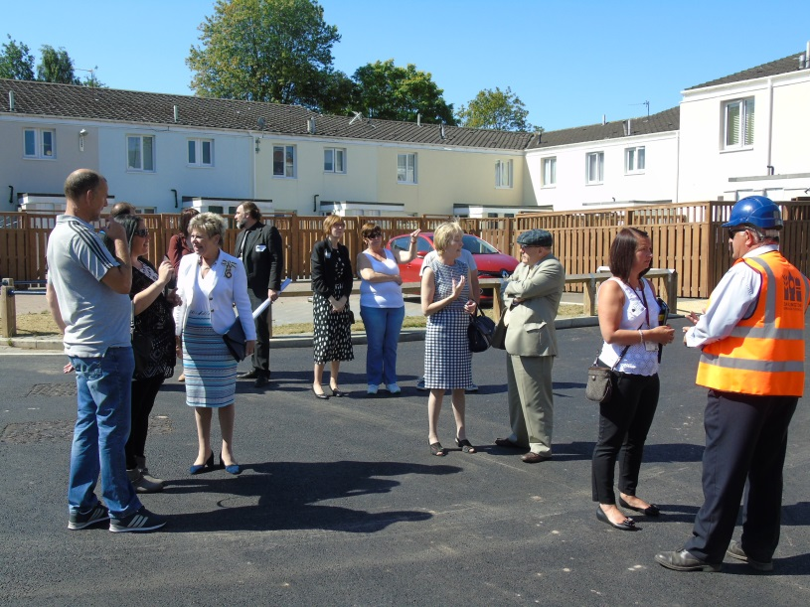
Joint Architects - Not Victims
Approach to community development in Red Hall
Strategy
Moving forward

Slide 3
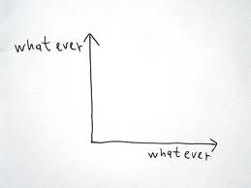
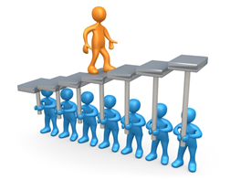
It’s about people too!
Improving buildings is the easy bit
Apathy and Mistrust
or Hope and Trust?
How were we going to do it?

Slide 4
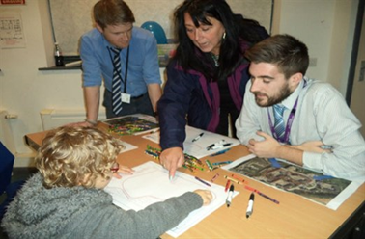
Strategic Context

Slide 5
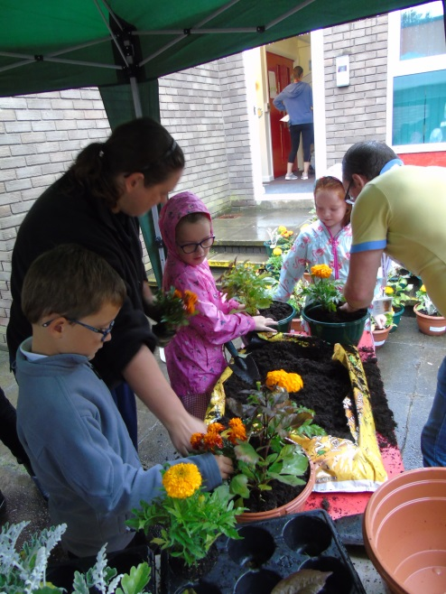
Egan Principles
Governance
Transport & Connectivity
Services
Environment
Economy
Housing & the Built Environment
Social & Culture
Who was going to deliver?

Slide 6
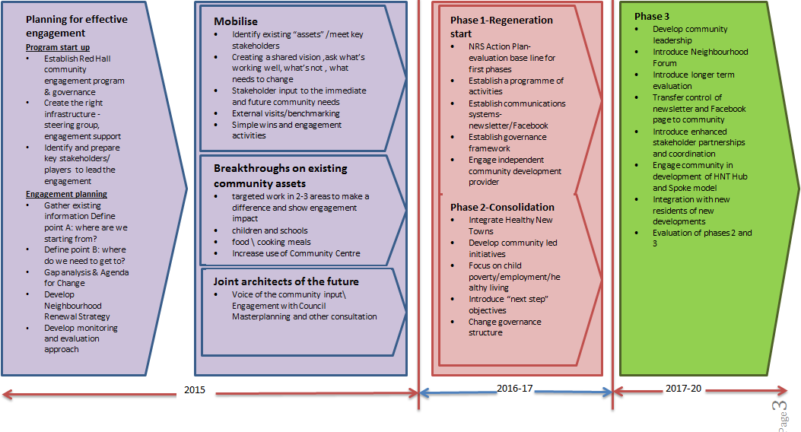
Joint Architects - Not Victims

Slide 7
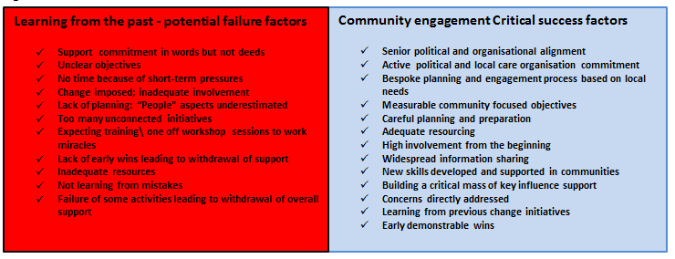
Failure and Success

Slide 8
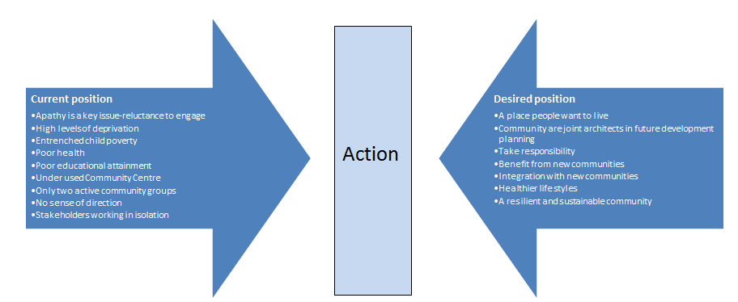
Yesterday v Tomorrow

Slide 9
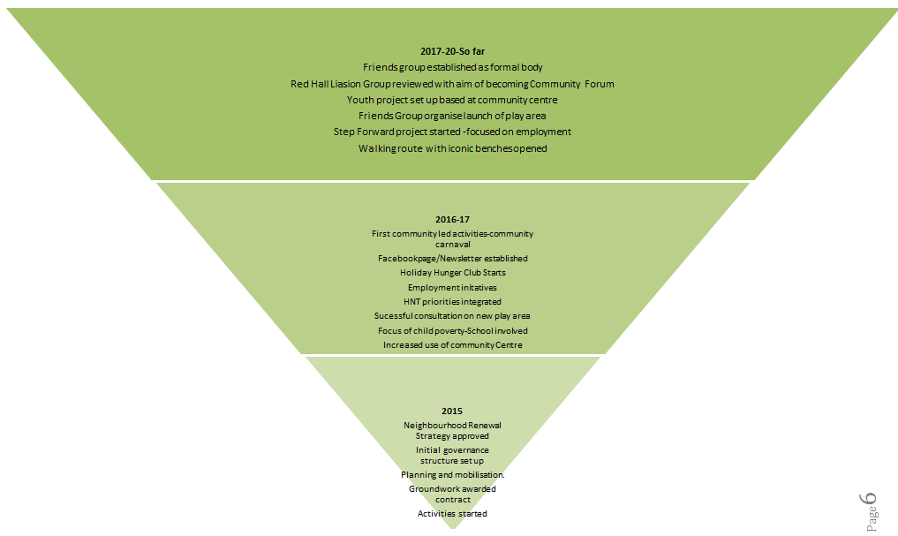
Achievements

Slide 10
Summary
This process will take time; as one resident said “this is a marathon, not a sprint”
A Sustainable Community is a huge ambition that needs to be developed as a “whole systems approach”. It has to be inclusive
Success depends on evaluation to know we are ready for the next step. We are constantly learning
Community control is critical to our aims

