Slide 1
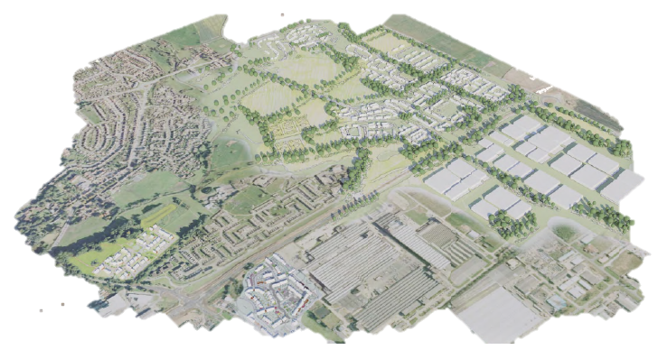
Darlington
Eastern Growth Zone

Slide 2

Proposed Burdon Hill
Eastern Growth Zone
Proposed Developments
Proposed Stables Site
Proposed Lingfield Point
Millfields Development

Slide 3
To A19
Whinfield Rd
A66
To A1
North
Stockton Rd
Transport & Movement
Vehicular
To A1
South
B6279
To Darlington Town Centre
To Local Services

Slide 4
To A19
A66
To A1
North
Transport & Movement
Pedestrian & Recreational
To A1
South
To Darlington Town Centre 1.2 miles
To Local Services 0.8m

Slide 5
Informal Green Spaces
Community Facilities
Red Hall Nature Reserve
Green Infrastructure
River Skerne Corridor

Slide 6
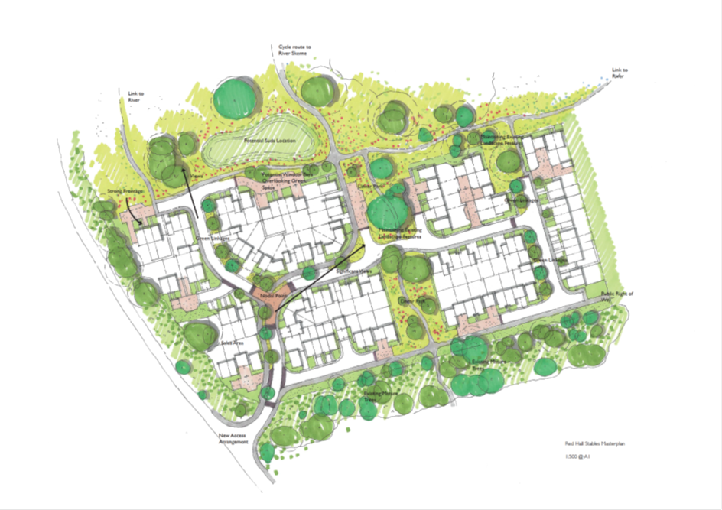


The Stables Site

Slide 7
To Post Office – 8 minute walk
To Supermarket – 6 minute walk
To River Skerne Corridor
To Informal Green Spaces
The Stables Site
Design Principles
To Primary School -
4 minute walk
To Convenience Store – 6 minute walk
To Darlington Town Centre - 25 minute walk

Slide 8
The Stables Site
Design Principles

Slide 9
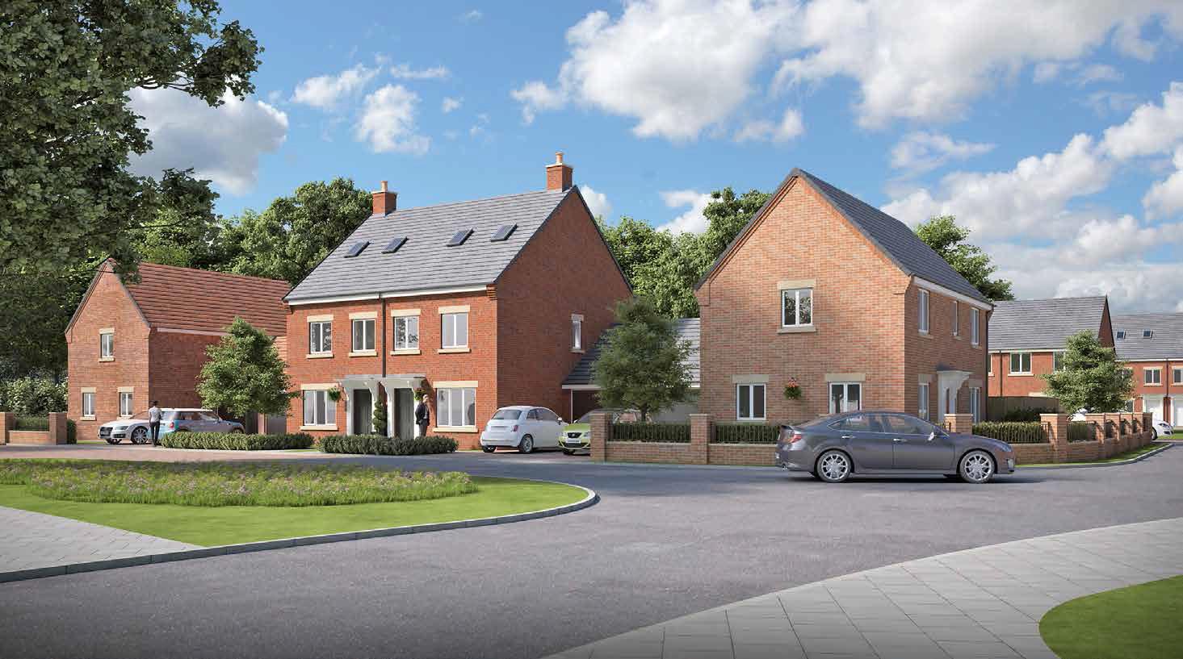
The Stables Site
Design Principles
High quality development complimenting the existing mature landscape setting with active frontages throughout.

Slide 10
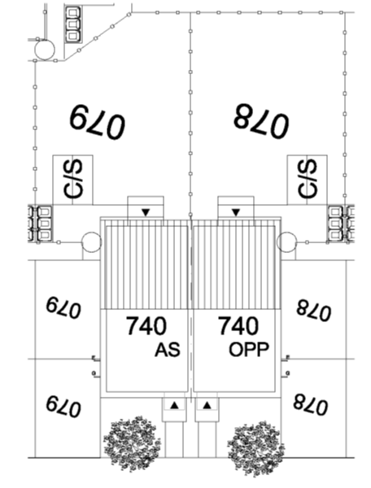
Every Dwelling Benefits From;
Private Amenity Space in Rear Garden
Cycle Storage in Shed in Rear Garden
Dedicated Bin Storage Area Within Rear Garden Sufficient To Meet Darlington Standards
In Curtilage Parking With The Ability To Be Extended to 3300mm Wide for Disabled Access
Level Access to Front of Property
Private Amenity Space to Front of Dwelling Forming Defensible Space Between Private and Public Realm
The Stables Site
Design Principles

Slide 11
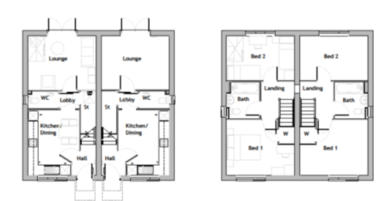
All Dwellings Proposed on the Development are Designed to Lifetime Homes Standards.
This enables the homes to be adapted to cater for different needs throughout someone's lifetime by including such design features as;
Ground gulley in GF WC to enable conversion into a shower room.
Cut out in floor joists to allow a through the floor lift to be installed if required.
Bathroom/W.C. walls lined with plywood to enable future fitting of grab handles.
Space standards incorporated to ensure wheelchair turning areas are accommodated.
Sufficient space to accommodate a bed on the ground floor if required.
The Stables Site
Design Principles

Slide 12


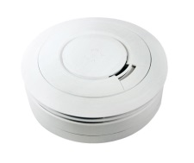
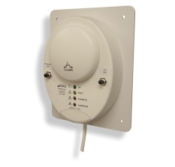
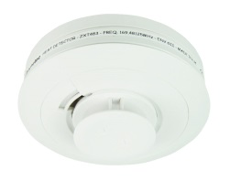
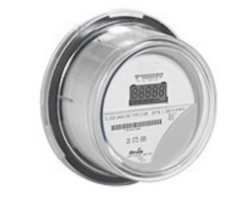
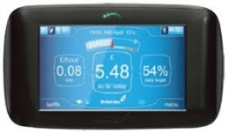
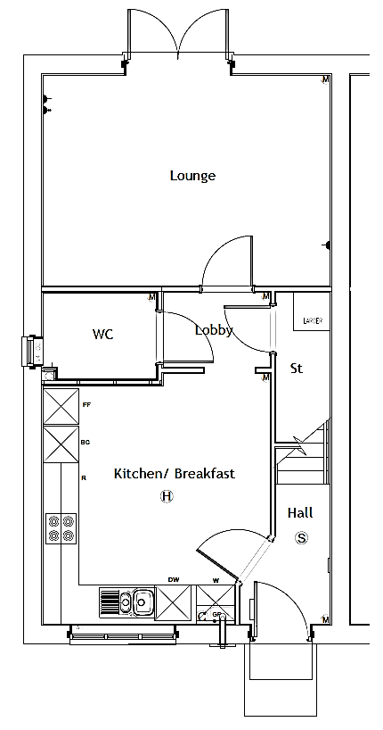
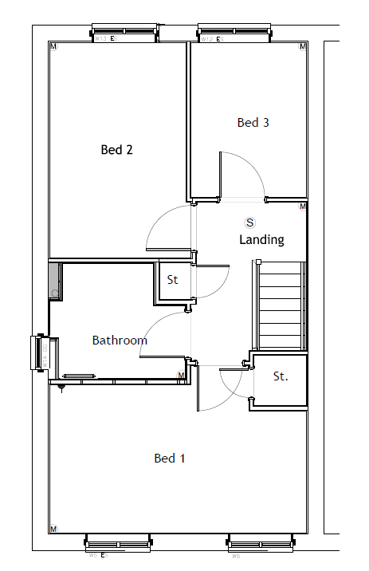
1
2
3
4
5
6
7
1)Smoke Detectors: located in the hallway and landing and require a hard wired connection.
6)PIR Sensor: movement sensor located in the corner of each room, where appropriate. Requires a hard wired connection.
6
6
6
The Stables Site
Technology
7
2)Carbon Monoxide /Gas Detectors: located next to the boiler (in the kitchen) and require a hard wired connection.
7)Home Alarm Unit: located in the living area, near to the television point and other sockets. Connected via a power socket and data point.
9
6
1
6
6
3)Heat Detectors: located in the kitchen and require a hard wired connection.
6
6
4)Smart Meters: located on the exterior in the meter position and require a hard wired connection.
8
3
1
5)Smart Reader: located in the hallway. Transmits data from the Smart Meter using an Infra Red connection.
5
2
6
6
4

Slide 13
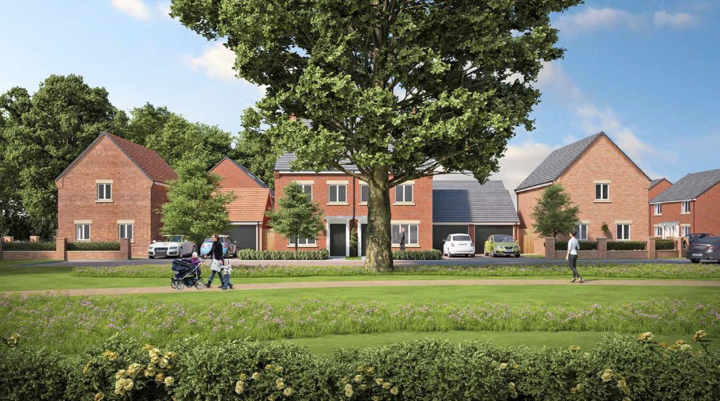
Social Infrastructure
High quality public realm
Natural surveillance
Local services
Transport & Movement
Excellent walking & cycling links
Safe, well lit routes
Cycle storage to each dwelling
The Stables Site
Conclusion
Green Infrastructure
Compliment the existing mature landscape
Access to recreation facilities
Create habitats
Economy
Access to employment opportunities
Supporting town centre
Placemaking
Legible and permeable environment
Natural surveillance
Local services
Healthy Food Choices
Opportunity for Local Food Production
Local services within walking distance

