Slide 1
Darlington Borough Council Housing Services Veruta Barlow Housing Services Manager

Slide 2
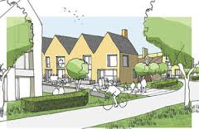
We will cover:
Overview of the area
What were the issues
What have we done
Future of Red Hall
Notes:
What we intend to cover in this presentation is:
•The overview of Red Hall, what were the issues and why we decided to go ahead with the works, what have we done and what is the future for Red Hall

Slide 3
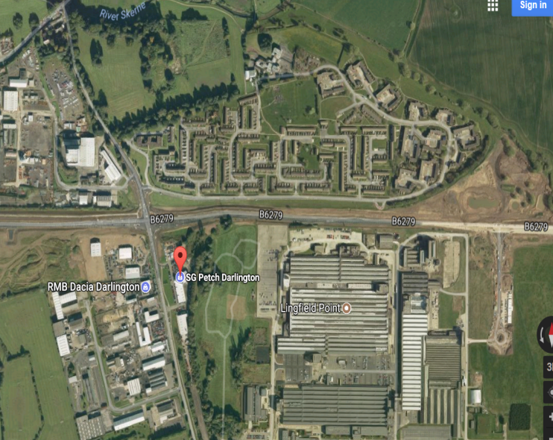
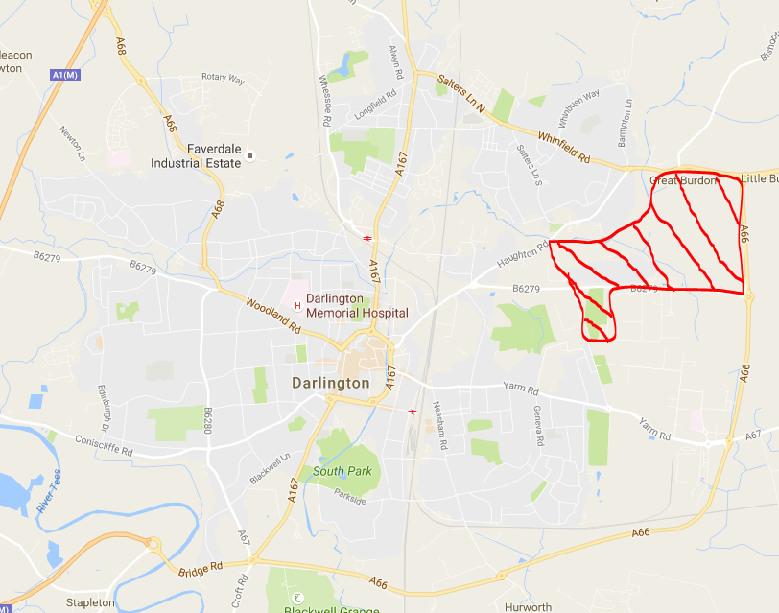
Overview of the area
Notes:
Darlington has a great history of innovation, partnership and community life, our aim is to carry this spirit forward into the future. We recognise that regeneration is about both the people and the place. It is concerned with preserving and strengthening all that is good about life in Darlington, whilst tackling what needs to be improved to build a better quality of life for everyone across the borough community.
Housing choice is an important condition for economic growth, and it is important to align and co-ordinate housing development, economic growth, and population changes. In Darlington, this means expanding the stock of affordable housing, making sure that future housing development meets the needs of an ageing population and making all new dwellings carbon neutral.
Due to the impact of rising prices in a low wage economy, Housing Services have recognised and are working towards increasing the supply and range of affordable social housing as well as improving generally the range and choice of their housing stock.
Red Hall was recognised as being in the top 2% of deprived areas in the country therefore our aim in Red Hall was to create a sustainable community. Red hall is geographically located in the north east of Darlington on the outskirts of the town itself. It was isolated from the Town Centre with a poor transport infrastructure and until recently only had 1 main road from the town.
Highlighted on the screen you can see the new road which has been highlighted in red, also the map highlights how far away from the town centre Red Hall is located.

Slide 4
Properties
642 properties built in 1960’s and 70’s;
One third owner occupation;
28 Housing Association Sheltered Housing apartments;
Non Traditional design
Notes:
DBC commissioned 642 properties to be built on Red Hall within the 1960s – 70s coming to full completion in 1977. The area was deemed very prosperous due to the close proximity of large scale industry ie Payton & Baldwins and Rothmans factories. The area was new and select with a high demand of interest from residents and was deemed to be “trendy” as it was out of the Town. Over time there was a good mixture of tenure on the estate with a high proportion of owner occupiers, alongside social and privately rented accommodation, there were a selection of Housing Association Sheltered Housing apartments on the estate.
The decision was made to adopt the non-traditional, Radburn design, which was popular at that time, due to ease, speed and costing.

Slide 5
Radburn Design
Notes:
The Radburn design is typified by the back gardens of homes facing the street and the fronts of homes facing one another, over green spaces. The houses are grouped around small cul-de-sacs, each of which has an access road coming from the main roads. The remaining land inside the cul-de-sac is park area, the backbone of the neighbourhood. The living and sleeping sections of the houses face toward the garden and park areas, while the service rooms i.e. kitchens face the access road.

Slide 6
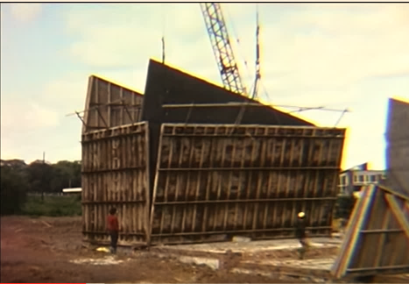
Off site construction- Low risk…apparently
Notes:
Construction was mainly off-site which reduced costs and speeded up the build, it was also supposed to be low risk, health and safety. Large panels were constructed, then transported on site and put together like a huge jigsaw

Slide 7
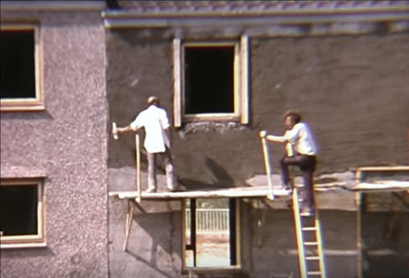
Health and Safety 1960’s style
Notes:
H & S 1960’s style
As you can see things have changed dramatically, I don’t think the HSE would agree with this process nowadays

Slide 8
Health and Safety 1970’s style
Notes:
No change for 70s style either
If anyone wants any DIY tips, the construction video is on You Tube!

Slide 9
What were the issues?
Poor thermal efficiency;
Low value homes, selling for around £50k – less than Borough average;
Demand reduced due to local factories closing, leaving numerous voids;
Radburn design fell out of favour;
High crime and ASB;
Poor reputation built.
Notes:
North east residents spend 6% above the national average on heating their homes. This is partly due to climatic factors, but poor home insulation is also a factor, particularly for people on low incomes and older people living in older houses. We recognised that our properties were offering little or no assistance in this area.
Property values had depreciated, leaving some residents in negative equity. This was further compounded by the loss of local industry leaving residents on low or nil income
The demand for the area had reduced, this left numerous void properties, especially in the courts which were predominantly of a Radburn design. These empty properties attracted ASB and crime and detracted from the general appearance of the estate leading to a further decline in the reputation of the area

Slide 10
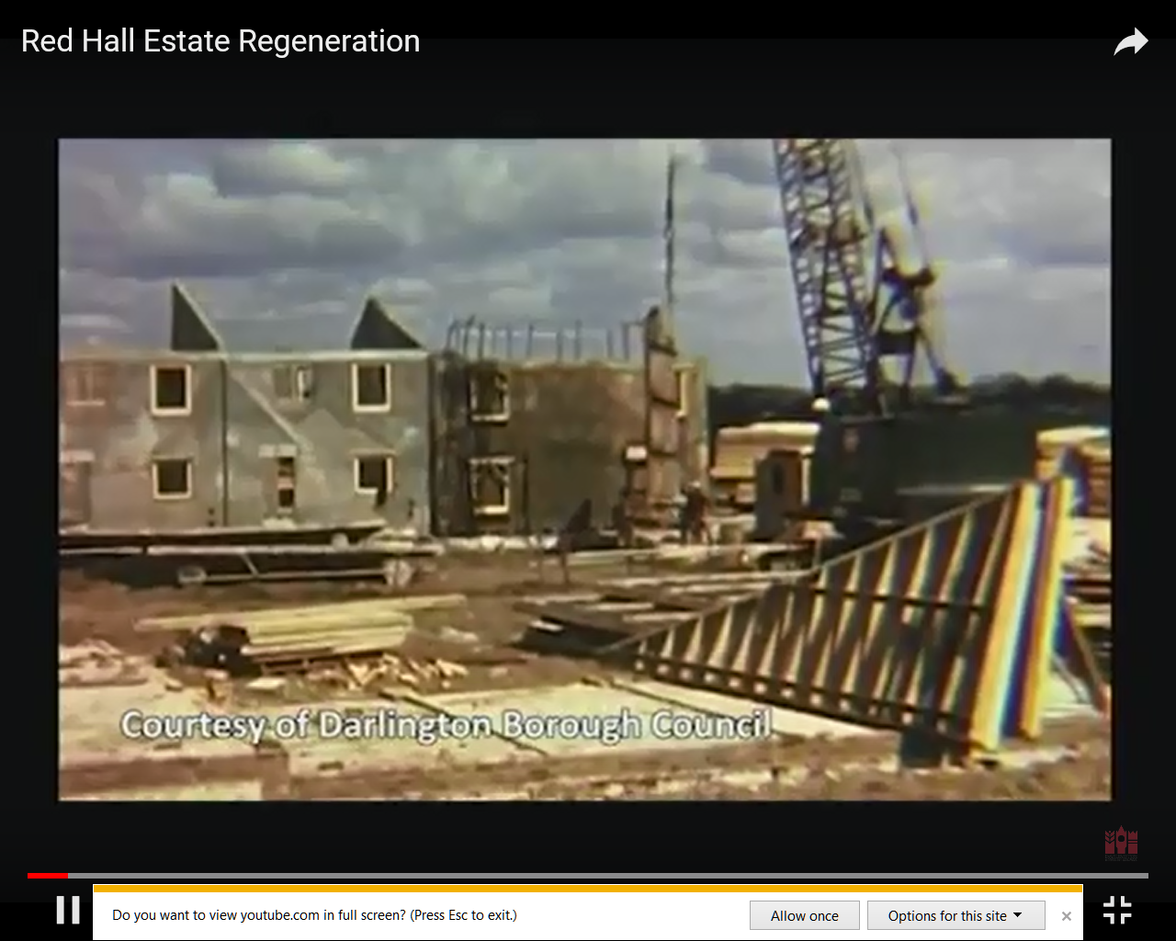
Video
https://youtu.be/aceEDuxBQmQ
https://youtu.be/nDcnPUu-F-4
Notes:
We will now go to a short video which outlines some of the issues which have been highlighted. This video was filmed in 2015.

Slide 11
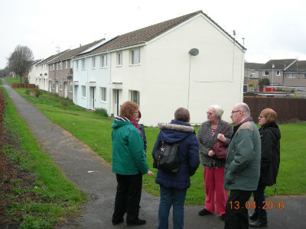
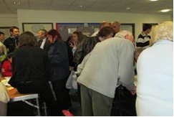
Resident consultation
Extensive resident consultation was completed throughout, key issues from them included;
Lack of safe playing areas for children;
Crime/policing
Thermal insulation
Transport
Notes:
Following on from our extensive resident consultation in 2013/14 the decision was made to demolish 56 properties, mainly within the courts, and replace them with 40 new family homes and apartments which better suited demand and modern living.

Slide 12
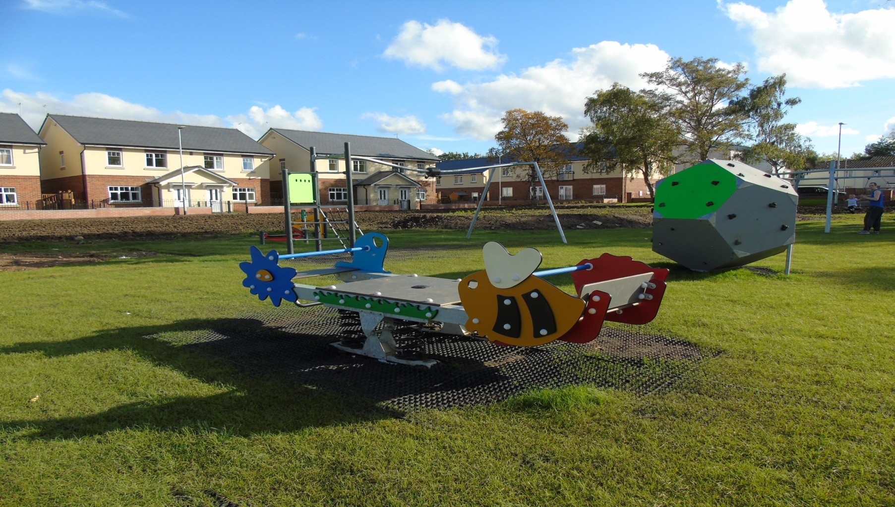
New build Play Area
Notes:
Residents also raised concerns about a lack of facilities for younger children to play as the existing play park had deteriorated so residents and children alike on the estate chose the equipment to be placed on the play park.

Slide 13
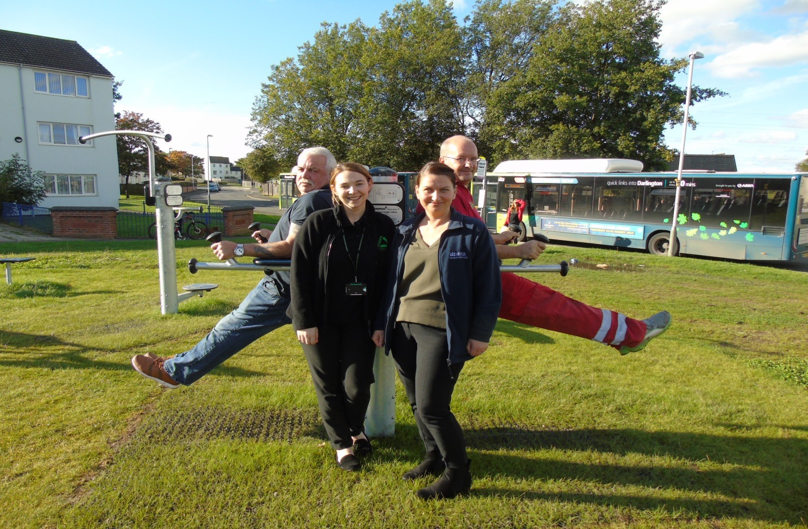
Outdoor Gym
Notes:
Recognition that older children also lacked facilities was also highlighted so we introduced an outdoor gym for them. Both areas have proven to be very popular with residents and are both being well utilised.

Slide 14
What have we done?
All properties on the estate are on a 20 year cycle for new kitchens and bathrooms;
All heating systems replaced with energy efficient condensing boilers every 15 years;
To date £11.5m spent on the Red Hall regeneration
Notes:
We have so far spent £11.5 million on the Red Hall Regeneration. This has been funded from the Housing Revenue Account and we also received £770,000 funding from the Homes and Community Agency towards new builds. We were awarded £250,000 from the Estate Generation Fund, to cover the funding of various feasibility studies and community engagement.
Along with this funding we also applied and were successful in our bid for Healthy New Towns funding, this was for improvements to footpaths to the value of £40,000 and a further £10,000 for outdoor Gym equipment.

Slide 15
Improvements
External wall insulation (EWI)
Double glazing
Composite doors front and rear
Partial demolition of courts
Back to fronts
New Build apartments and family homes
Notes:
We carried out external wall insulation to improve the thermal efficiencies to the properties. We also recognised that residents requested double glazing and new front and rear doors.
Partial demolition of the courts – several of the courts were demolished to accommodate the new build and address the lack of demand within the area
Back to fronts – this was to make the area a more traditional layout
We also went on to build new apartments and family homes

Slide 16
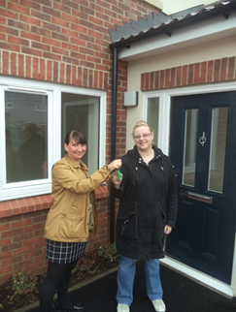
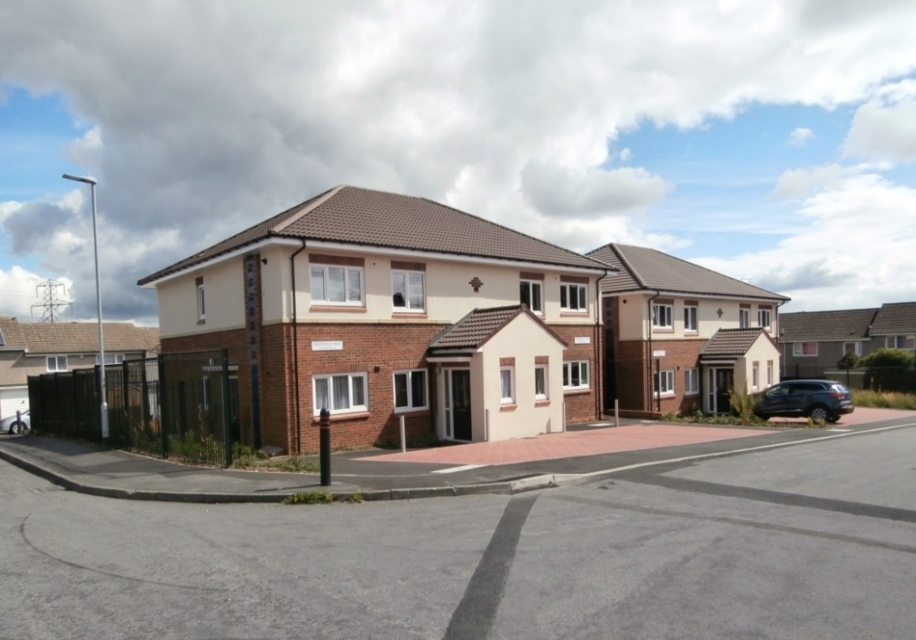
New Build
40 Council Houses and Apartments:
12 apartments at Badminton Close;
8 apartments at Deepdale Way;
20 family homes and apartments (1 x 5 Bed adapted house) at Anfield and Aintree Courts;
All phases completed in Autumn 2017
Notes:
Refer to slide - The ground floor flats were purpose built to meet the needs of those that had mobility issues, they are fitted with level access facilities, wider doors and ramped access to the property. All houses were designed to meet Lifetime Homes requirements.

Slide 17
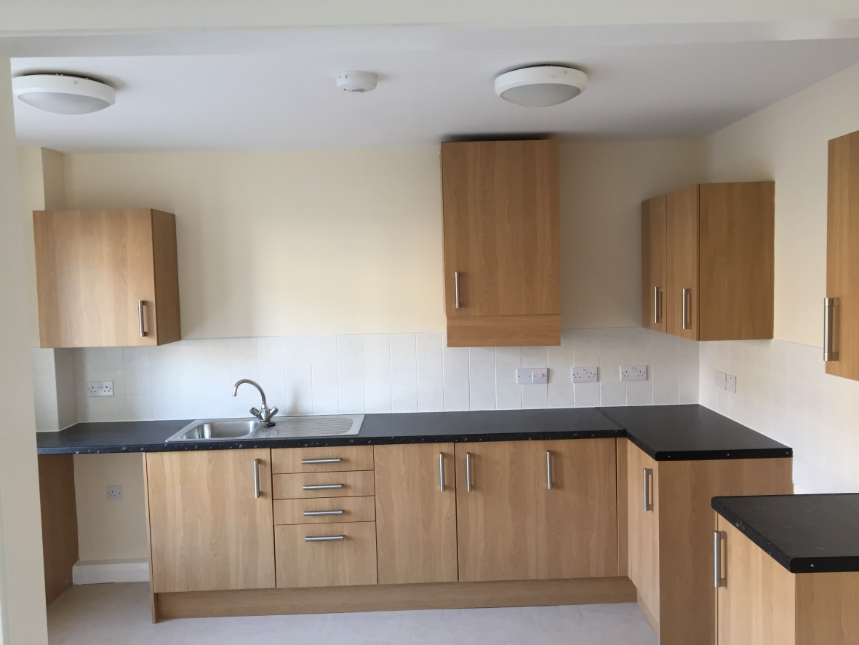
New Build
Notes:
members of the 3 tenant panels visited the new flats on Red Hall., Chair of Customer Panel commented: “pleasantly surprised at how good the houses external appearance managed to completely change the whole area. More people need to see the difference these changes have made to Red Hall and they will I am sure be amazed.”

Slide 18
Notes:
We actively went out into the area and promoted our new build which proved positive as demand exceeded expectation. We went from nil demand to double figures placing a bid on our properties.
Feedback has been excellent on the new build, we have also used several properties as a show home for prospective new tenants, Red Hall is again the place to be.

Slide 19
Conclusion
Notes:
As a result, hopefully Red Hall will continue to be a place where people will choose to live, work and relax, it is about renewing a sense of belonging, of being part of a vibrant, confident and active community.
Regeneration cannot be an overnight success; it requires dedication and commitment by all those involved, especially the residents of the estate.
We are committed to improving the lives of our residents and putting Darlington back on the map.

