Slide 1
Building the right home
Housing Choices, Housing Cares
5th July 2017
12th December 2016

Slide 2
What is ‘Transforming Care’?
The Transforming Care programme aims to transform care and support for people with learning disabilities and/or autism by:
Reducing the number of people in inpatient facilities by 35-50% by March 2019
Building up community services to prevent future admissions
Notes:
BRS set out planning assumptions which TCPs should look to implement by March 2019 in order to reduce reliance on inpatient facilities and a new financial model to implement the service model, in which local transforming care partnerships use the total sum of money they spend as a whole system on people with a learning disability and/or autism (including the specialised commissioning budget and NHS continuing health care) to deliver care in a different way that achieves better results. In 2015, 48 Transforming Care Partnerships (TCPs) were established across England to improve community capacity and reduce the need for specialist hospital care by March 2019.

Slide 3
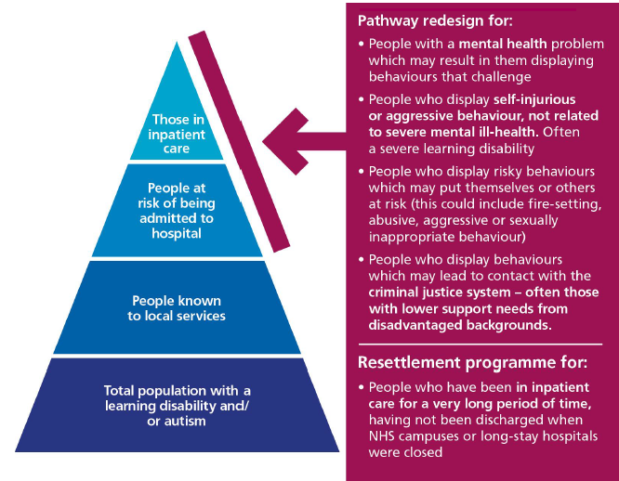
Who are these services aimed at?
Notes:
Also this does need to be a pathway redesign programme, rather than a bed closure programme, which is why engaging with housing providers and local housing teams is vital for ensuring there is a home and local services to enable someone to continue living in the community both now and in the future.
Individuals do not ‘slot neatly’ into any single grouping – they overlap, people’s needs change over time, and often a large part of the challenge for local services will be to understand what combination of factors lies behind an individual’s behaviour.
There’s an overwhelming number of people who have been failed by this system.

Slide 4
Building the right support
1. I have a good and meaningful everyday life.
2. My care and support is person-centred, planned, proactive and coordinated.
3. I have choice and control over how my health and care needs are met.
4. My family and paid support and care staff get the help they need to support me to live in the community.
5. I have a choice about where I live and who I live with.
6. I get good care and support from mainstream health services.
7. I can access specialist health and social care support in the community.
8. If I need it, I get support to stay out of trouble.
9. If I am admitted for assessment and treatment in a hospital setting because my health needs can’t be met in the community, it is high-quality and I don’t stay there longer than I need to.
Notes:
However, that choice and movement isn’t there. What I am repeatedly coming across are situations where lack of suitable accommodation is preventing someone leaving hospital, or a lack of foresight around the suitability of someone’s living environment has lead directly to them being in hospital – noisy surroundings, cramped conditions, lack of outdoor space. This can only be addressed through appropriate planning. Not just individual planning for those already in hospital – indeed sometimes that point is already to late and a case by case approach makes it difficult to procure housing – but strategically so that providers can be proactive, so that operational groups can be set and opportunities in new developments taken advantage of.
They can’t just hear about the one person being discharged in 9 months, they need to hear about the overall need for accommodation as well as how this fits with existing community services and local planning for the needs of people with a learning disability and/or autism. Otherwise a provider will be concerned about the future, will the person be happy there, if they’re not how can they be supported, what other options are there in place. You just cannot think about housing in isolation of other services, and the other way around. You can’t have good accommodation options in place without the appropriate community services.
That also means that we’re supporting someone to live a normal life on a normal street, as settled as possible and it’s there home, not a provider’s home – maybe in a house, maybe a block of flats. That sense of home, security is absolutely vital for someone who may have never had that and it can take a while to create. And we might even get it wrong, but that is the goal. We not creating new campuses, we can’t keep falling back on existing institutions hospital or otherwise – we’re not interested in moving people from one institution to another, too much of that happens already.
One thing that is good to know is that the housing sector get this and they have some good ideas about how it can happen – we just have to get that dialogue going.

Slide 5
How many homes do we need, where and when?
Does the TCP know the accommodation needs of al existing inpatients?
Is there a good understanding of existing supply of accommodation?
Does the TCP have the levers and partnerships to action their plan?
Do commissioners have a clear overview of different housing providers and their offer?
Are there systems in places to enable to procurement of housing?
Notes:
Region
No. of people requiring new arrangements:
North
880
South
450
London
310
Midlands and East
760
These numbers are modelled from data from March 2015 to July 2016 and projected forward. Probably an underestimate and only looks at those being discharged from hospital between July 2016 and March 2019.
Although numbers are small from a housing perspective, not all of these people will be able to live in a supported housing scheme. They ill require a variety of options: purchased individual properties, shared accommodation, supported housing/extra care, shared ownership,

Slide 6
Contact details
Amy Swan
National housing lead - NHS England
amyswan@nhs.net; 07730 371076
Notes:
Do not leave this room without an action – a personal action that you have to do … soon. TCPs are not interested in talking shops. These are complex issues and systems, but the commissioners in this room are very action focused and they’re looking for solutions and action.

