Slide 1
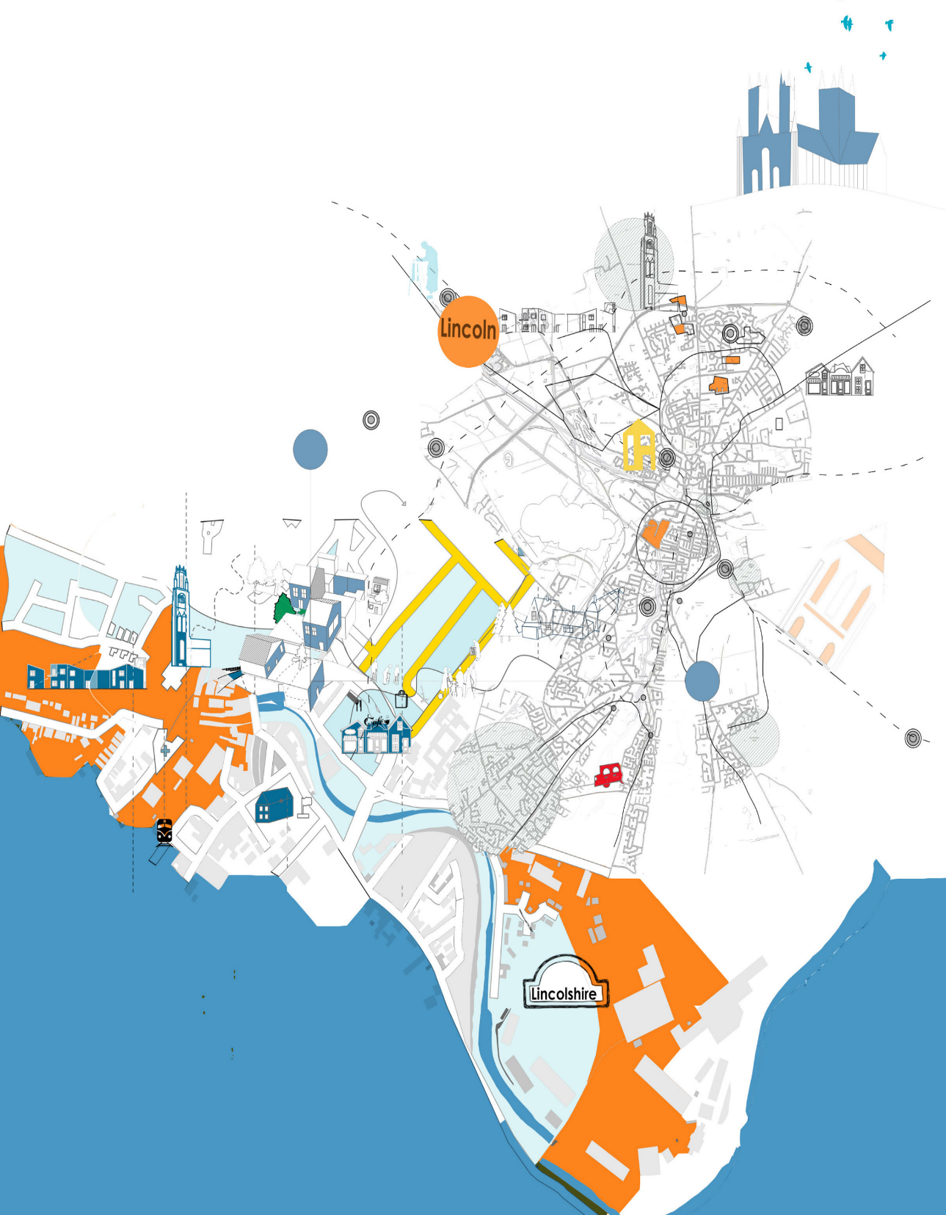






IDEAS FOR CHANGE 2017
EXTRA CARE HOUSING IN LINCOLNSHIRE
Dr Primali Paranagamage
Senior Lecturer
School of Architecture and the Built Environment
University of Lincoln

Slide 2

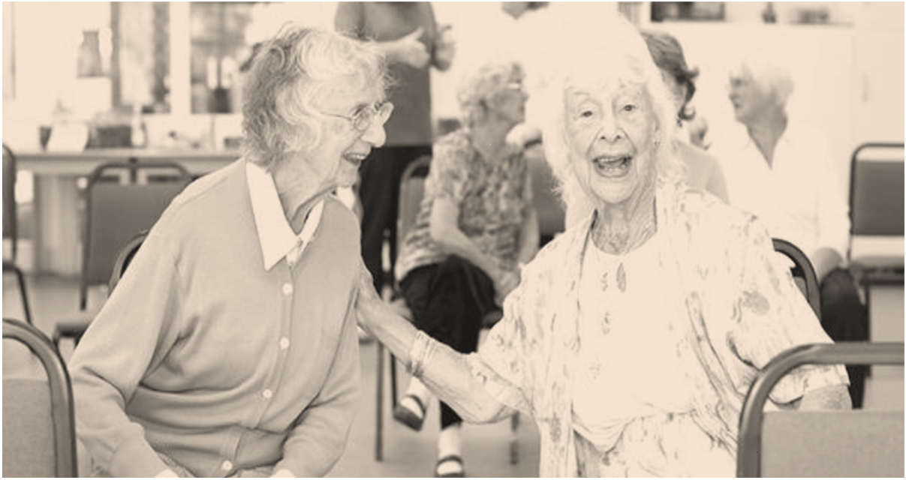
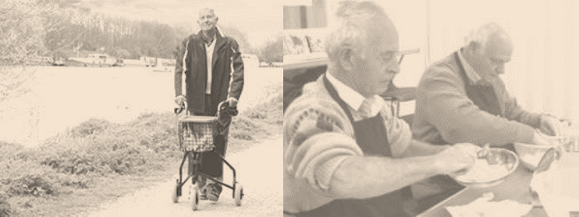
2
COMPETITION BRIEF
Develop guidelines to inform innovative design of Extra Care Housing in Lincolnshire in three steps
1 Understand : Changing national and local needs
2 Build : An integrated evidence-based approach to the problem
3 Translate: Convert steps 1 and 2 into design principles

Slide 3
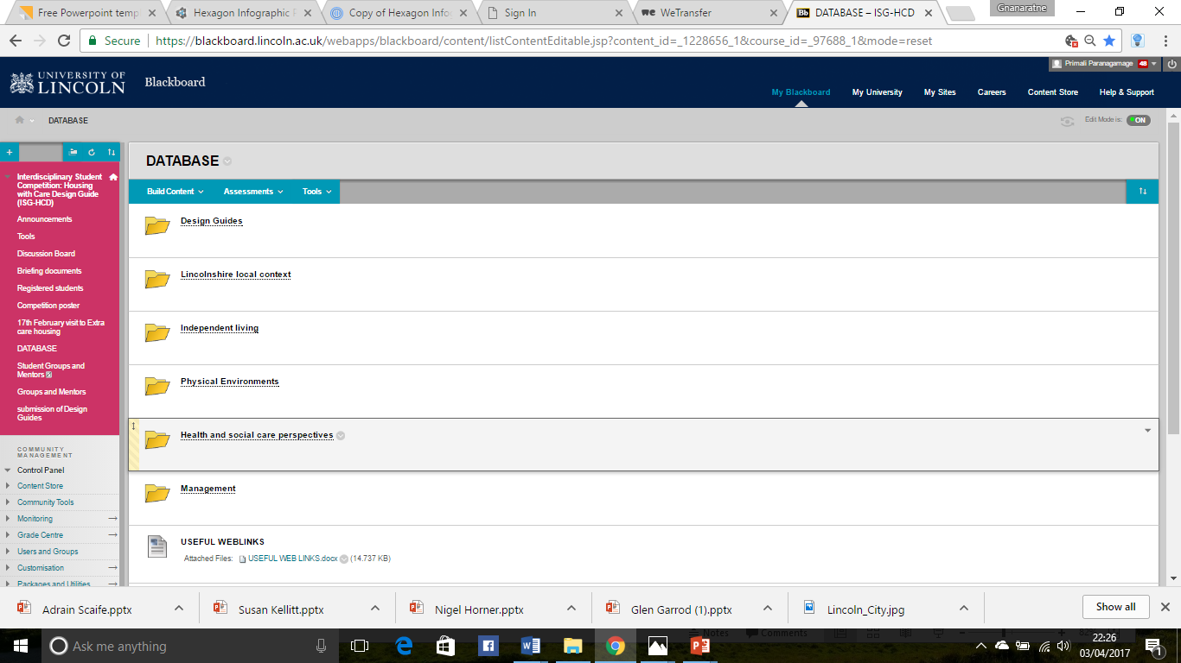
3
ONLINE PORTAL
https://blackboard.lincoln.ac.uk/webapps/blackboard/content/listContentEditable.jsp?content_id=_1228656_1&course_id=_97688_1&mode=reset

Slide 4
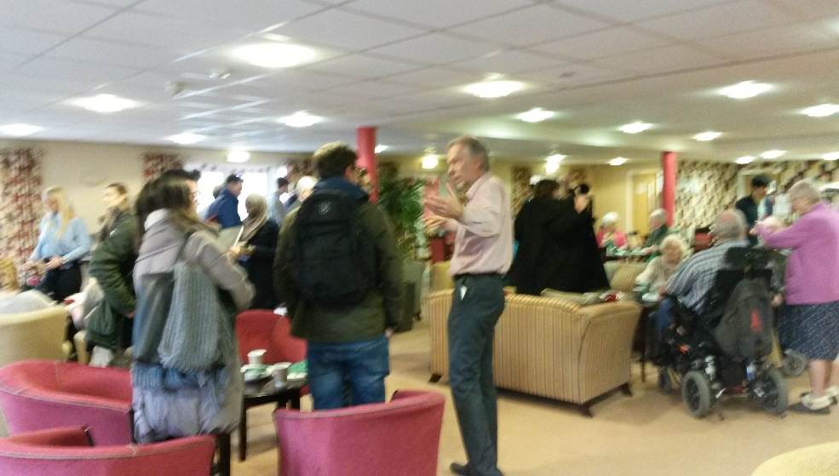
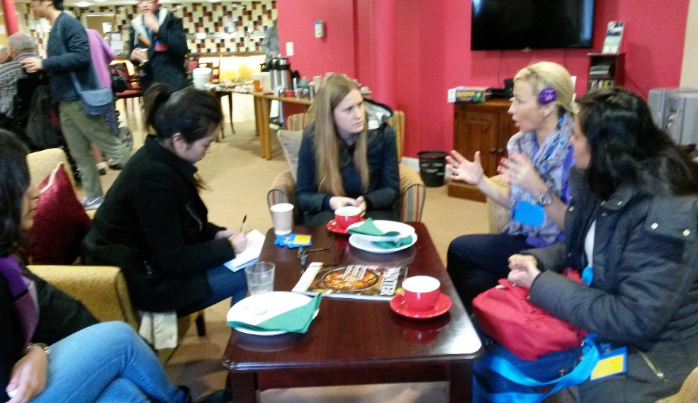
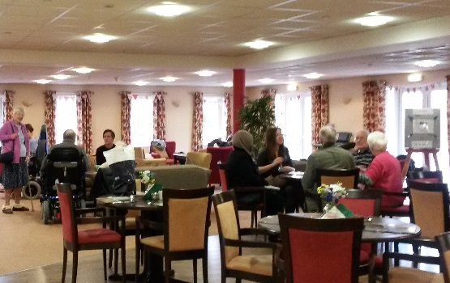
4
INTERVIEWS
WITH RESIDENTS AND CARERS

Slide 5

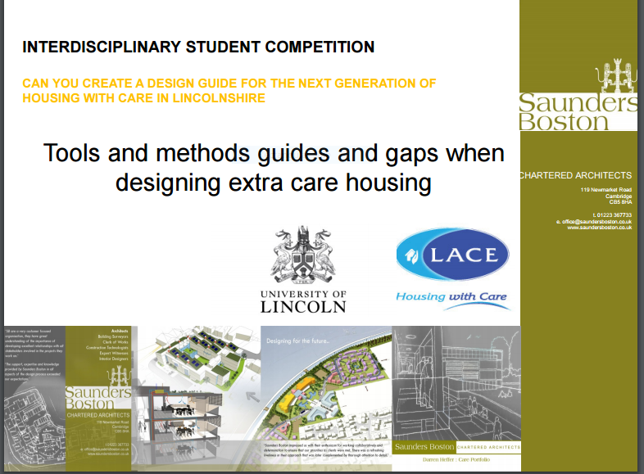
5
WORKSHOP 1: Sponsor’s perspectives
How the ageing and the care of the elderly has changed and the role of the carer
Nick Chambers
CEO
LACE Housing Association
Darren Heffer
Director
Saunders Boston Architects
Nick Green
Associate Director
Saunders Boston Architects
Notes:
.

Slide 6


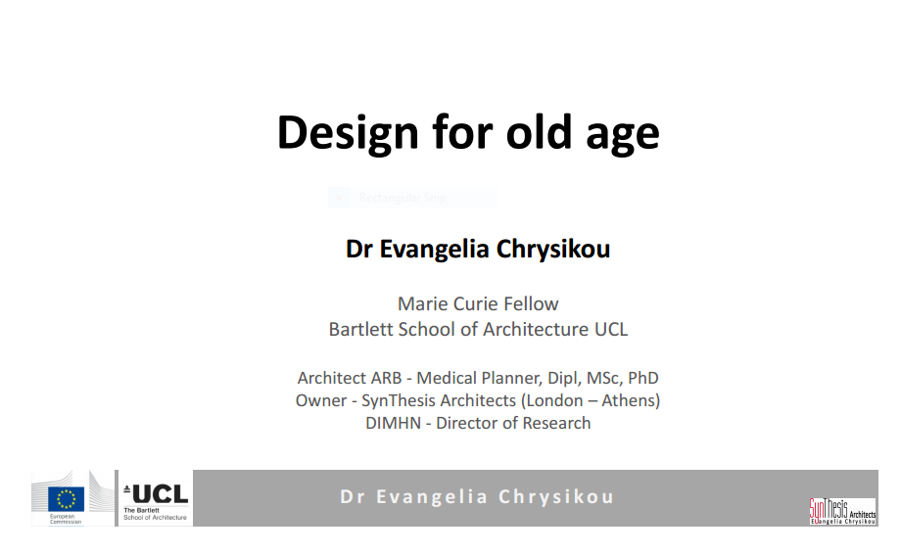
6
WORKSHOP 2: housing perspectives
Jeremy Porteus
Director
Housing LIN
Adrian Scaife
UK Product Marketing Manager
Tunstall Healthcare
Evangelia Chrysikou
Marie Curie Research Fellow
University College London

Slide 7
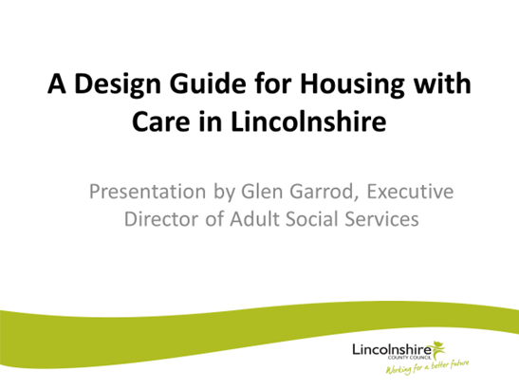
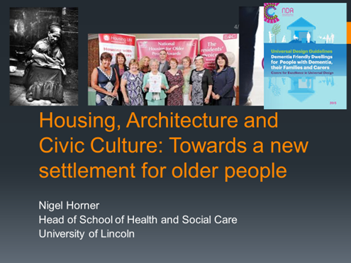

7
WORKSHOP 3: health and care perspectives
Glen Garrod
Director of Adult Social Services
Lincolnshire County Council
Nigel Horner
Head of School of Health and Social Care
University of Lincoln
Susan Kellit
Operations Manager
Age UK Lincoln

Slide 8
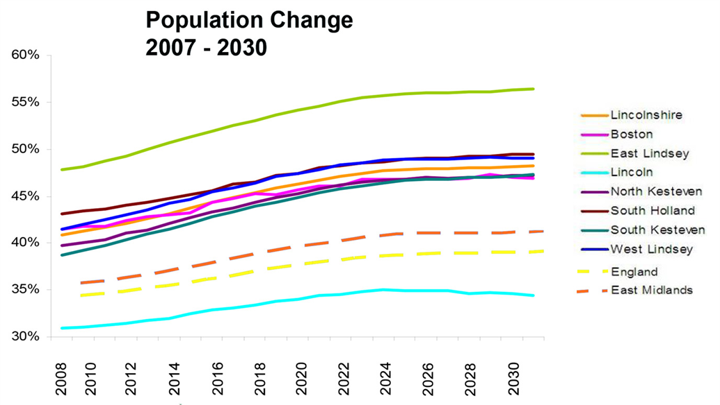
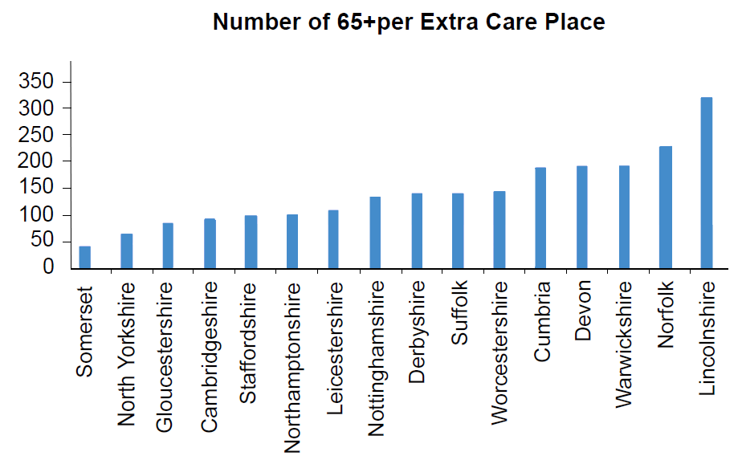
8
CURRENT POSITION
Population change over 50’s¹
Number of 65+ per extra care place²
% of over 50s
Number of people
1. Excellent Ageing Lincolnshire 2010
2. www. Housingcare.org

Slide 9

9
STAKEHOLDER VIEWS
Older people in rural communities like to stay where they are because that’s where they have their networks. Uprooting and moving away from your own community in the later stages of life is not necessarily the best answer.”
“people come to extra-care housing usually for a couple of years with a high level of need. Whereas the concept of extra-care was intended to be a balanced community of needs and abilities, partly mutually sustaining...”
“of older people in rural communities expressing a housing need,… looking to downsize but … stay in their own community. They’ve got no alternatives, really. That’s part of the challenge for Lincolnshire ...
“we’re recognising that older home owners are aware of their housing circumstances and hear about allowing older people to downsize and their homes would be recycled and could be available”

Slide 10
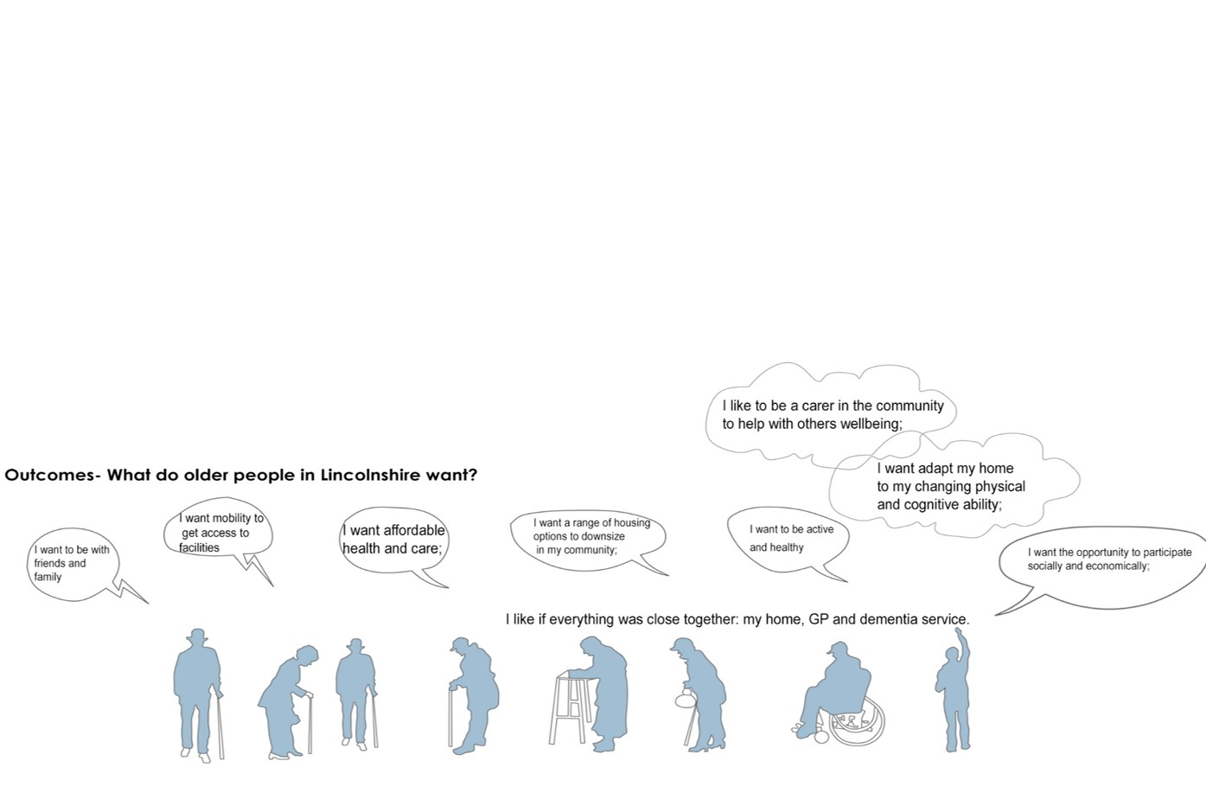
10
IDENTIFIED NEEDS

Slide 11
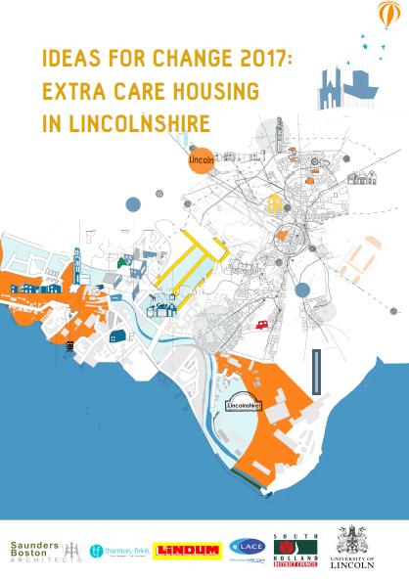
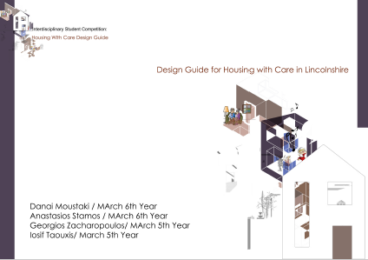
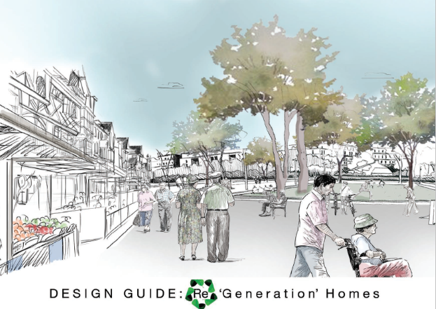
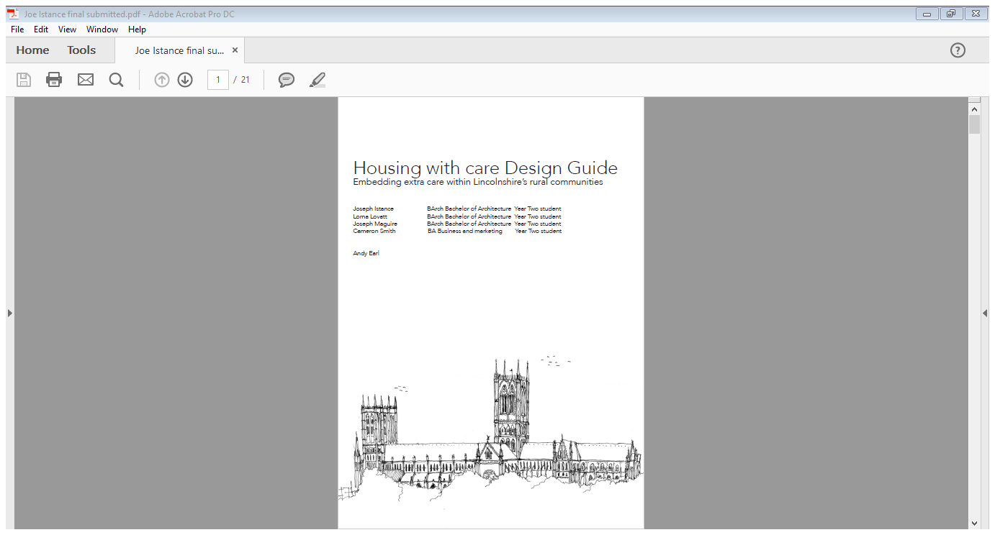
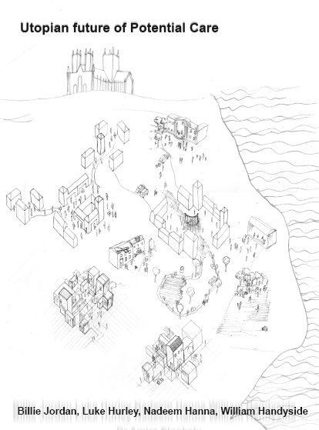
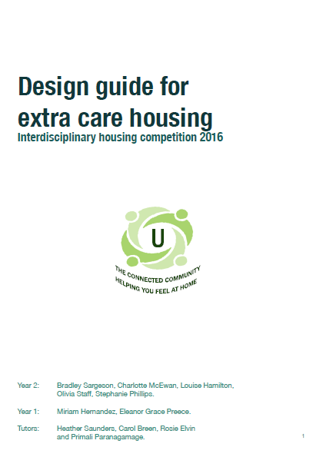
11
FIVE DESIGN GUIDES
Notes:
.

Slide 12
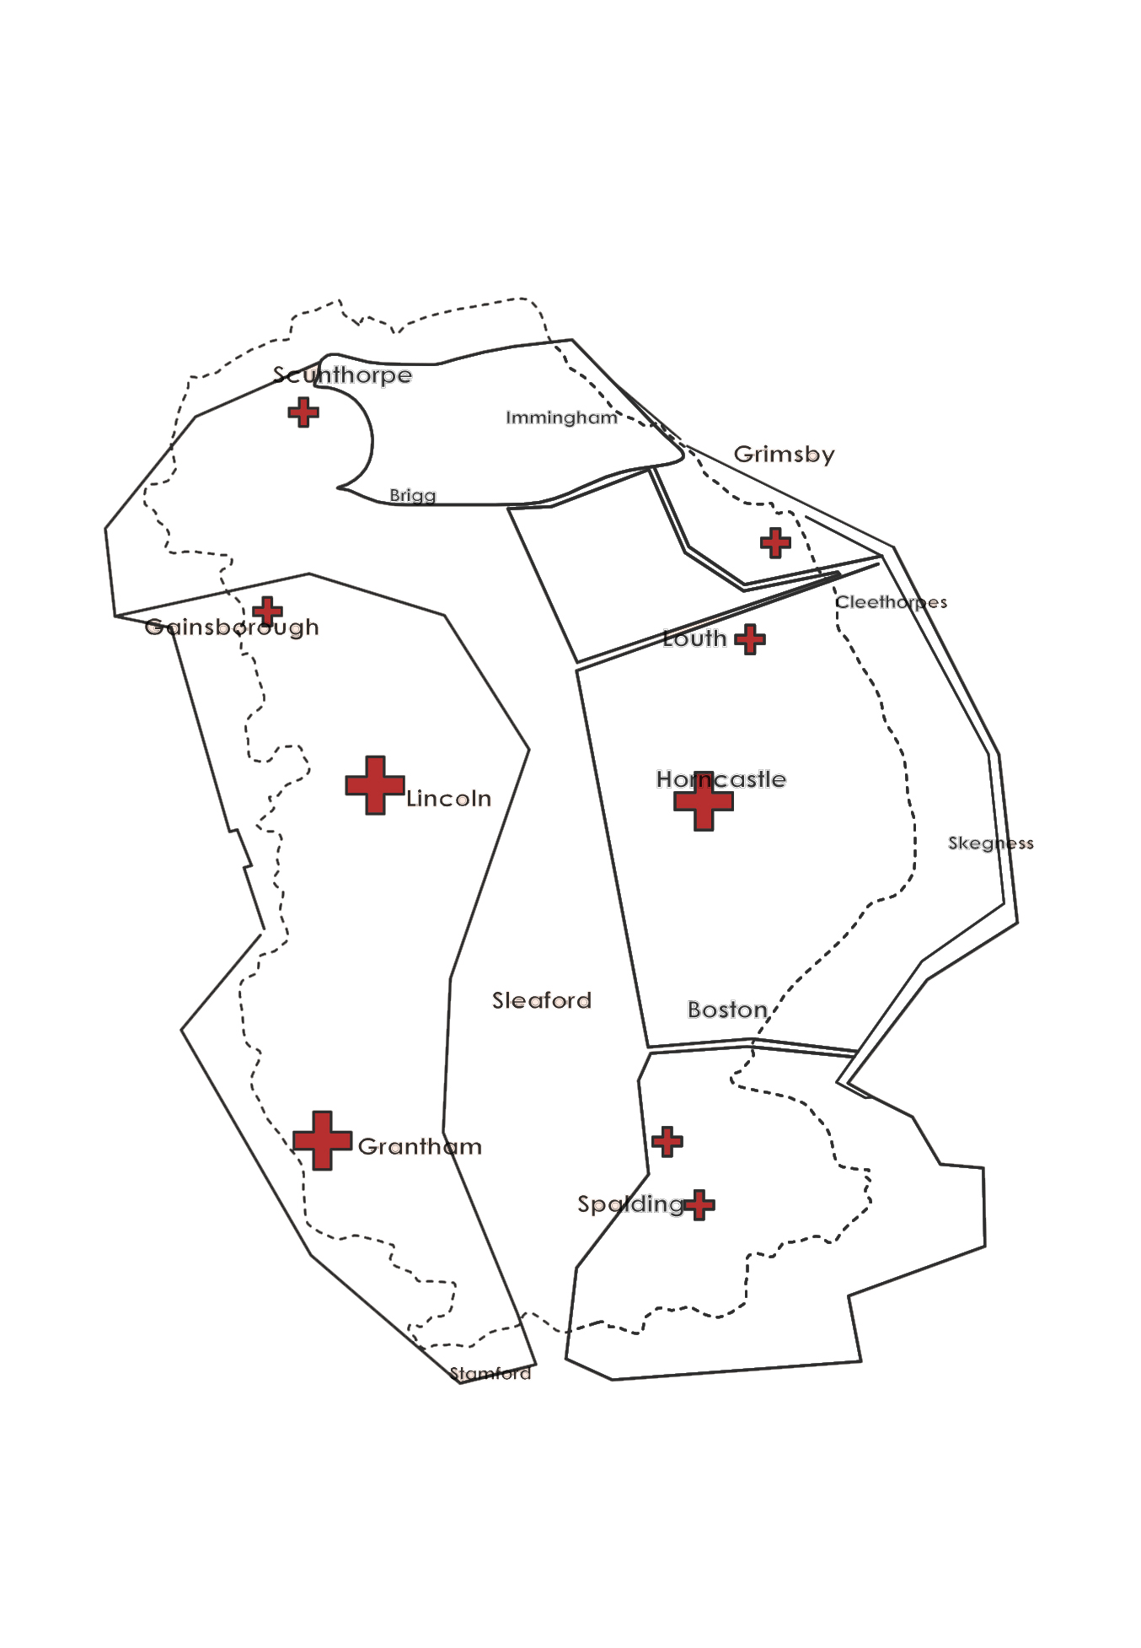
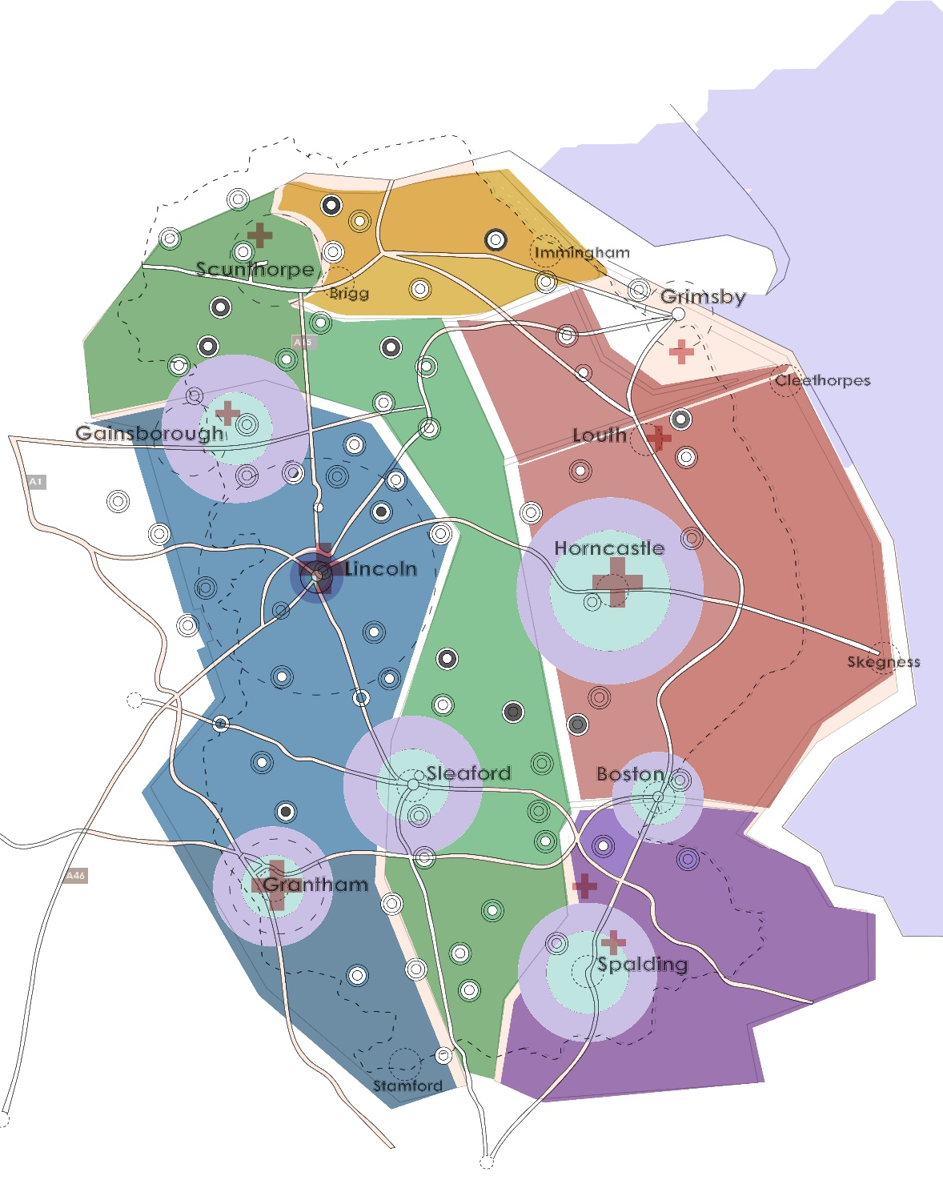
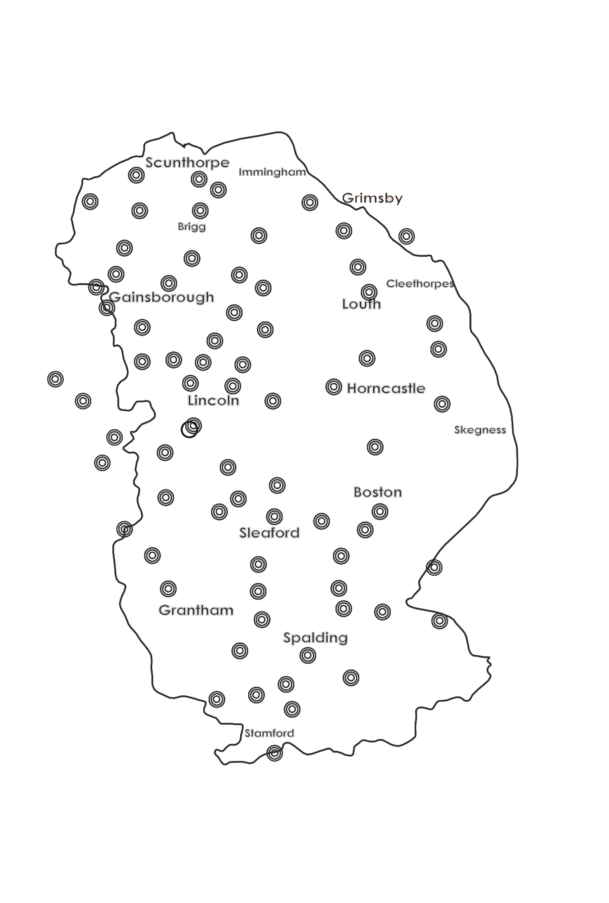
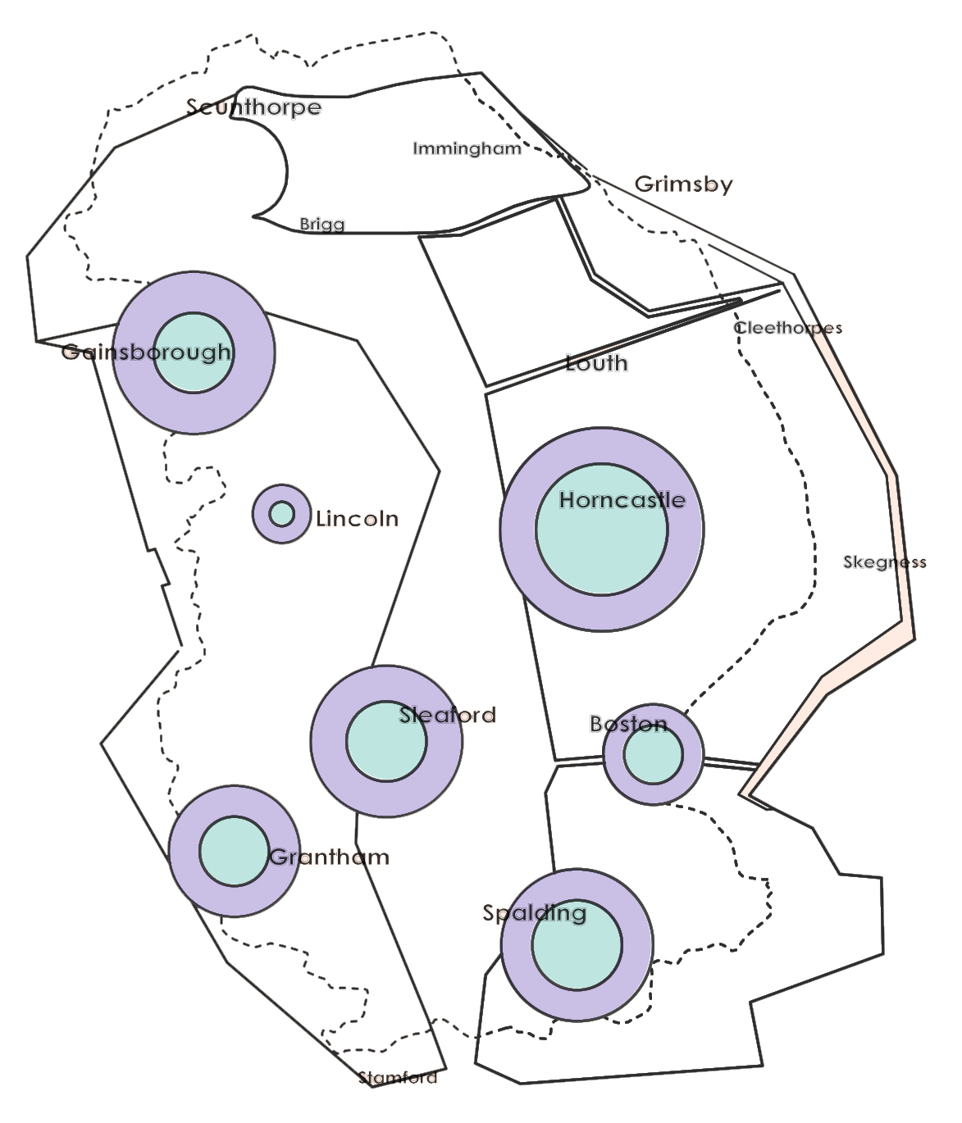
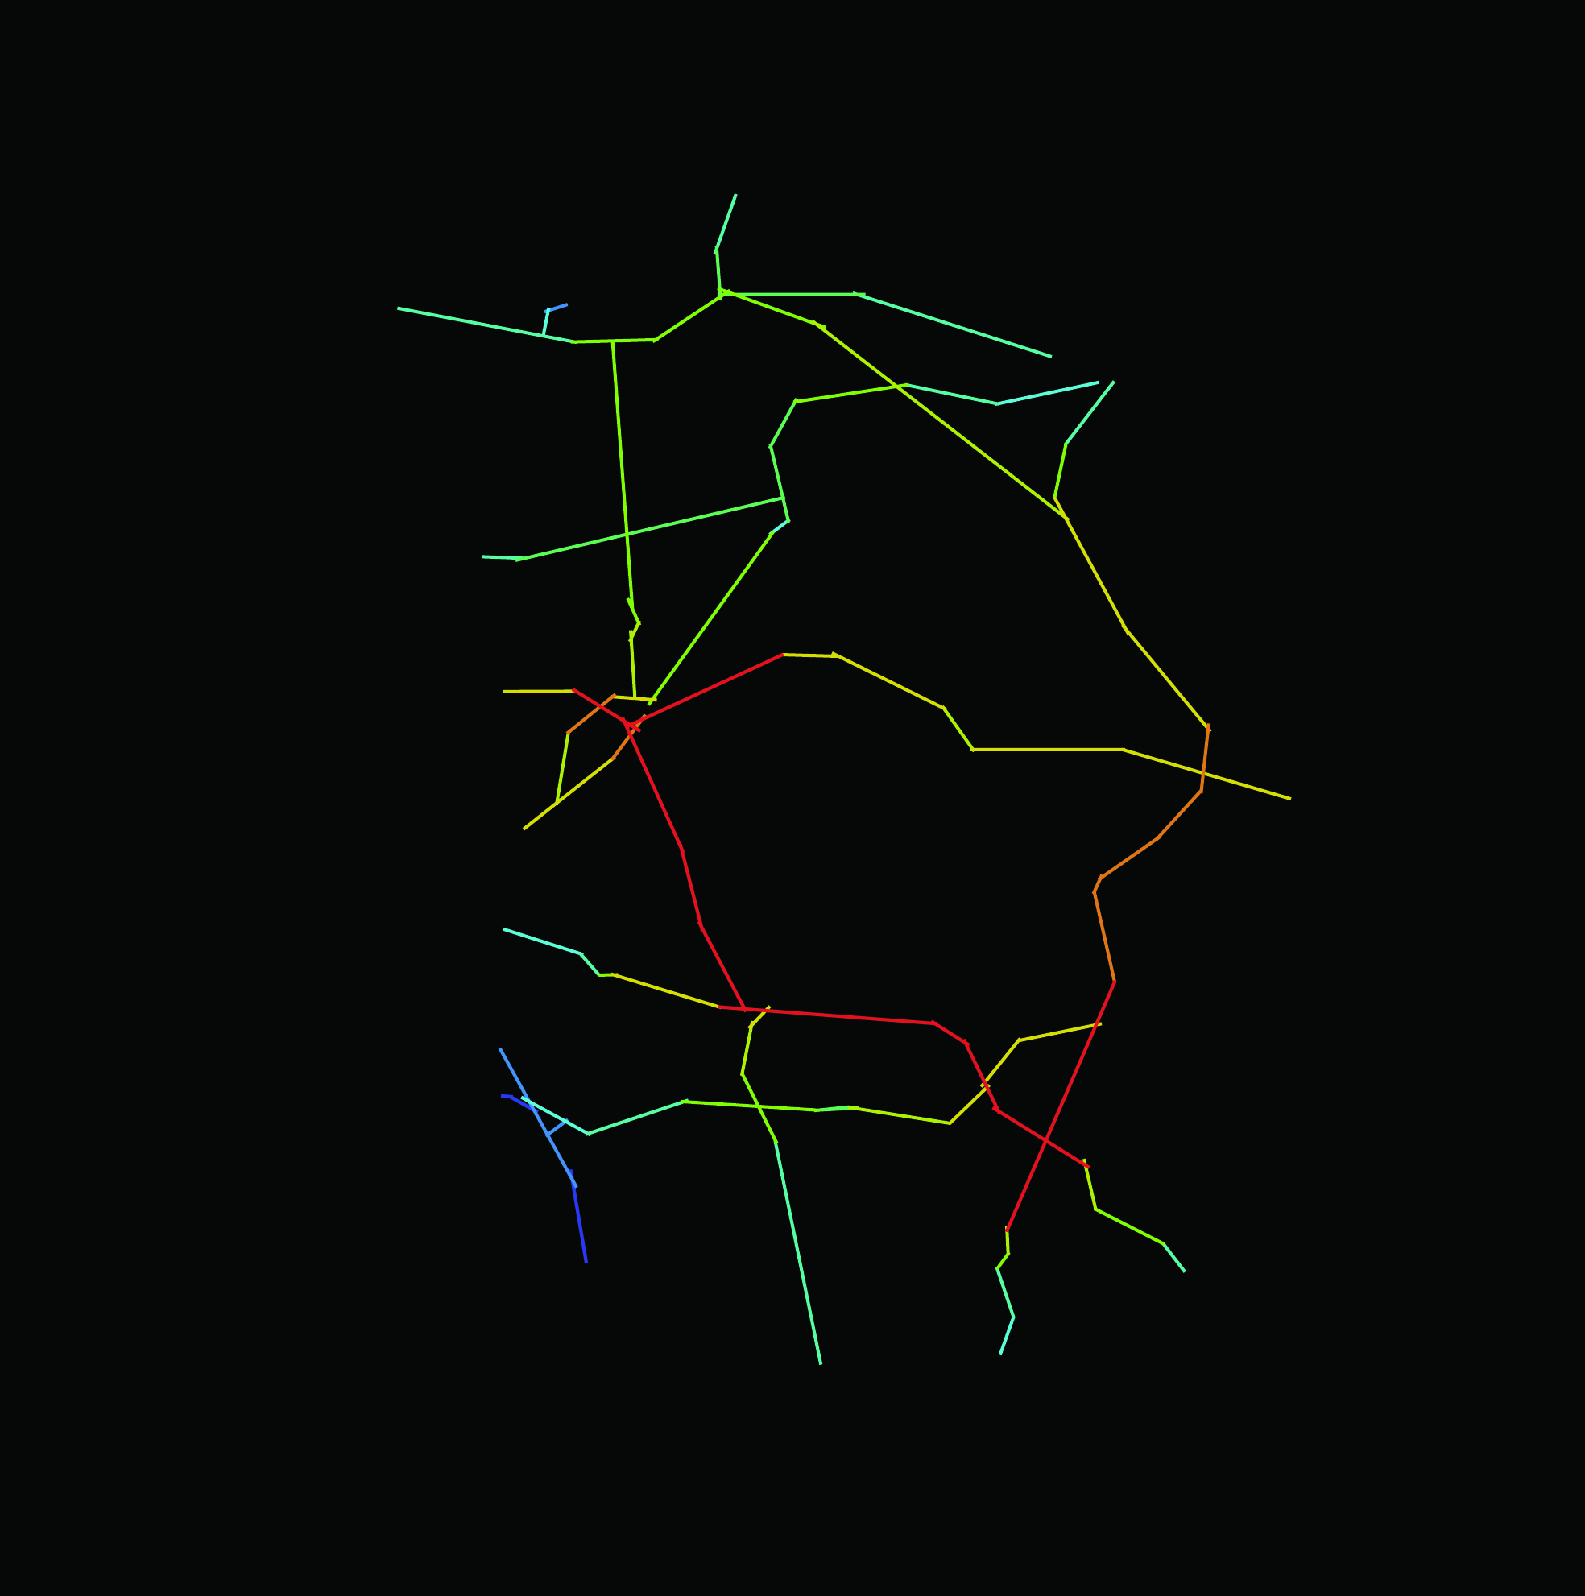
Macro scale
12
A. INFRASTRUCTURE
A.1 Older people’s services infrastructure mapping

Slide 13
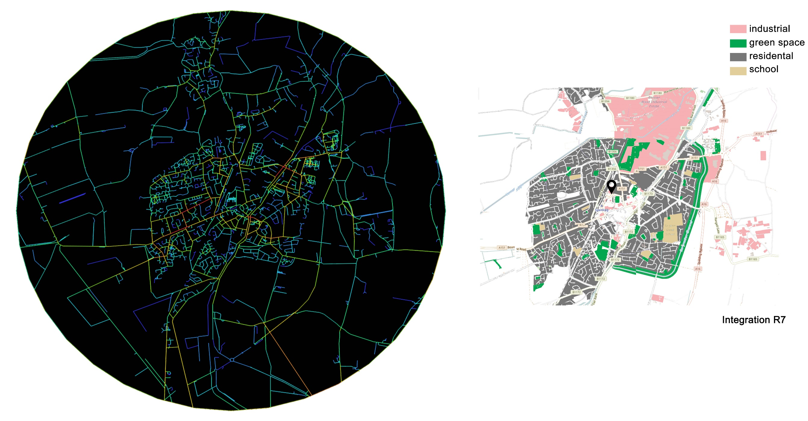
Micro scale
13
A. INFRASTRUCTURE
A.1 Older people’s services infrastructure mapping

Slide 14
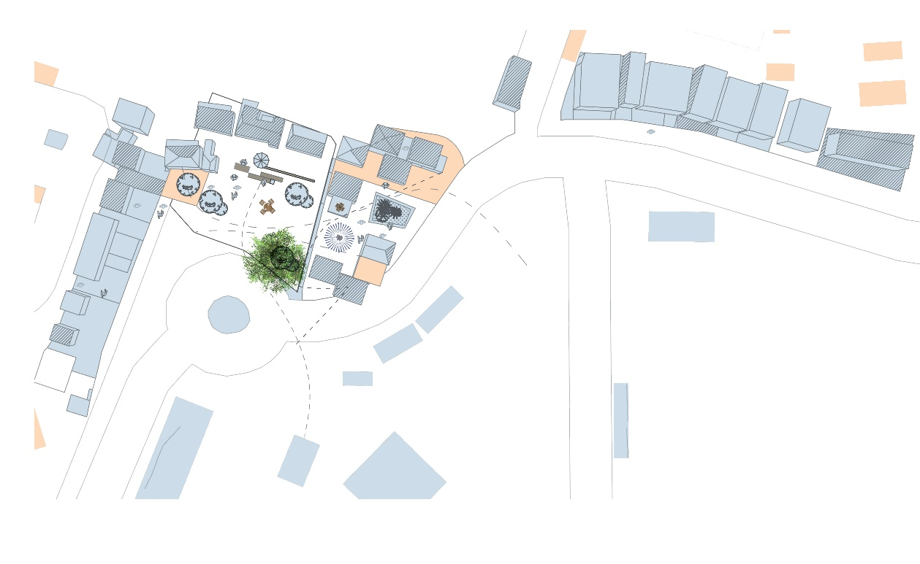
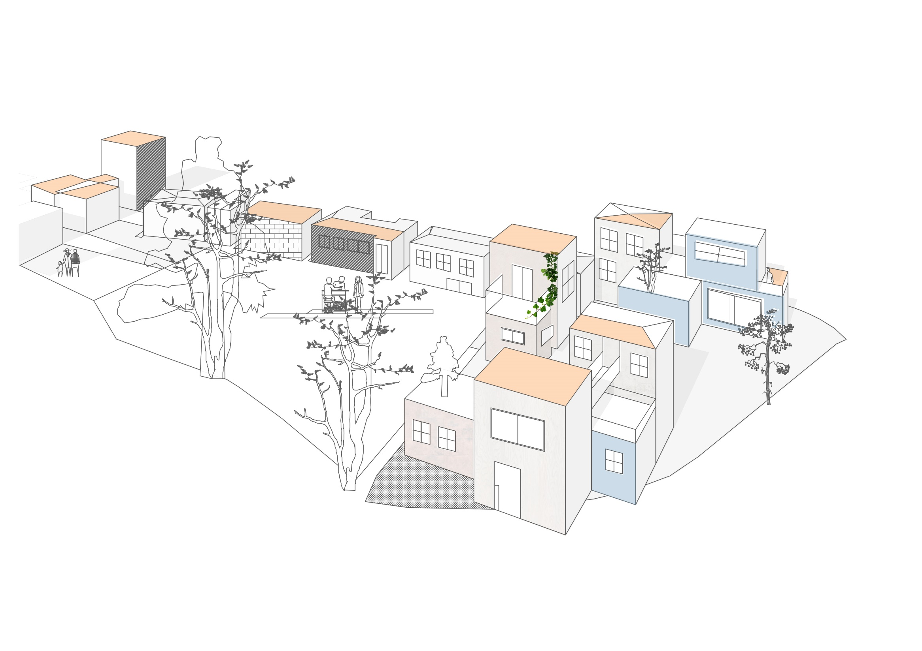
Micro scale
14
A. INFRASTRUCTURE
A.1 Older people’s services infrastructure mapping

Slide 15
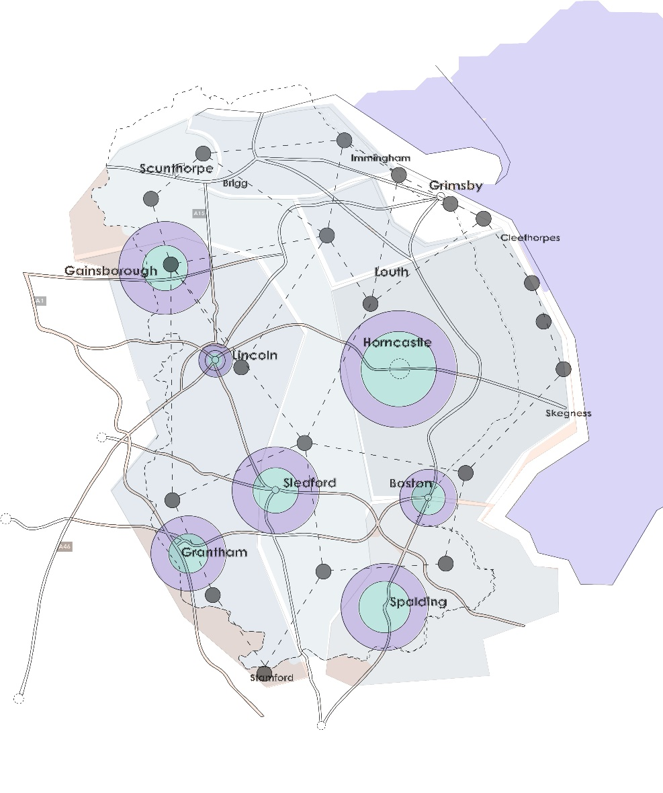
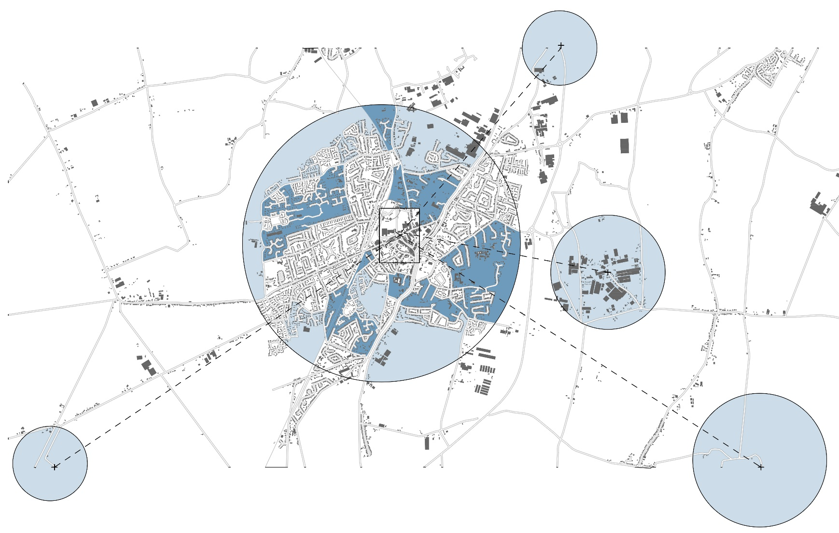
Care network hub and spoke model
15
A. INFRASTRUCTURE
A.2 Extra Care Housing network
Notes:
.

Slide 16
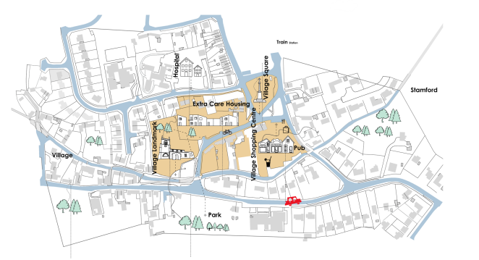
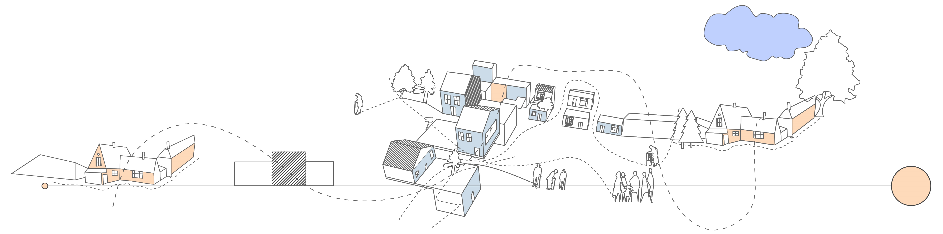
16
B. DE-INSTITUTIONALISATION
B.1 Segregation and institutionalisation
Town
Extra Care community hub

Slide 17
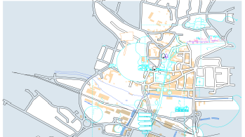
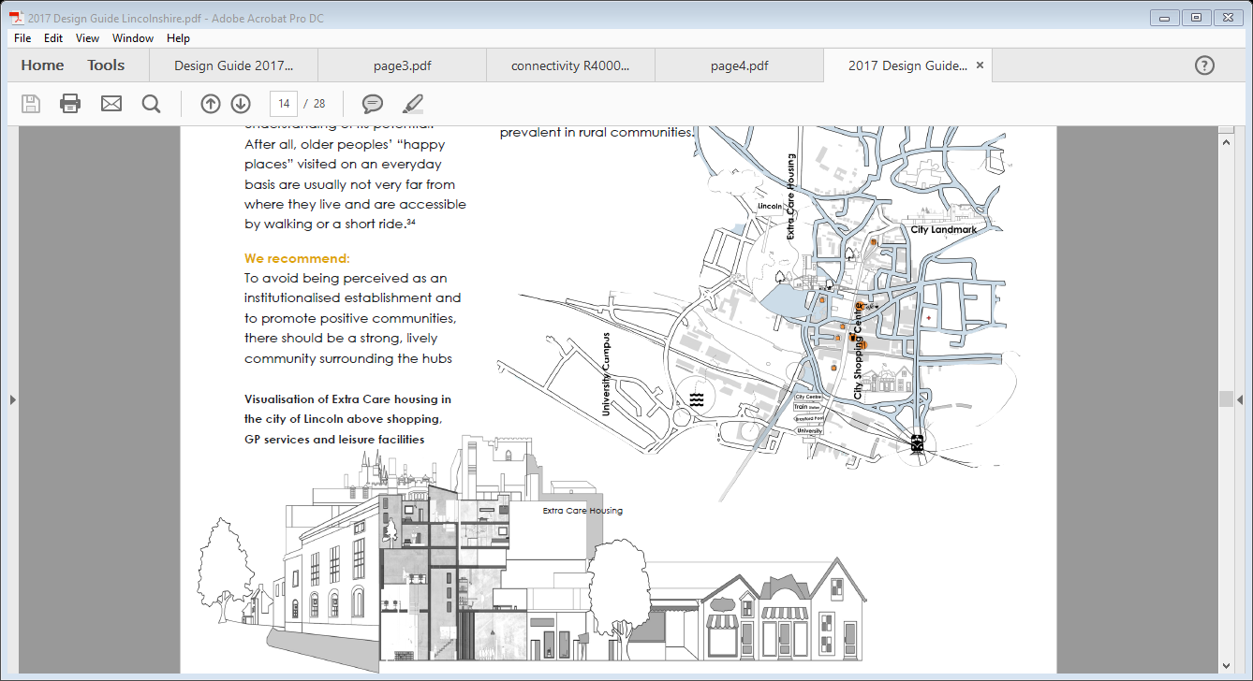
17
B. DE-INSTITUTIONALISATION
B.1 Segregation and institutionalisation
City
Extra Care community hub

Slide 18
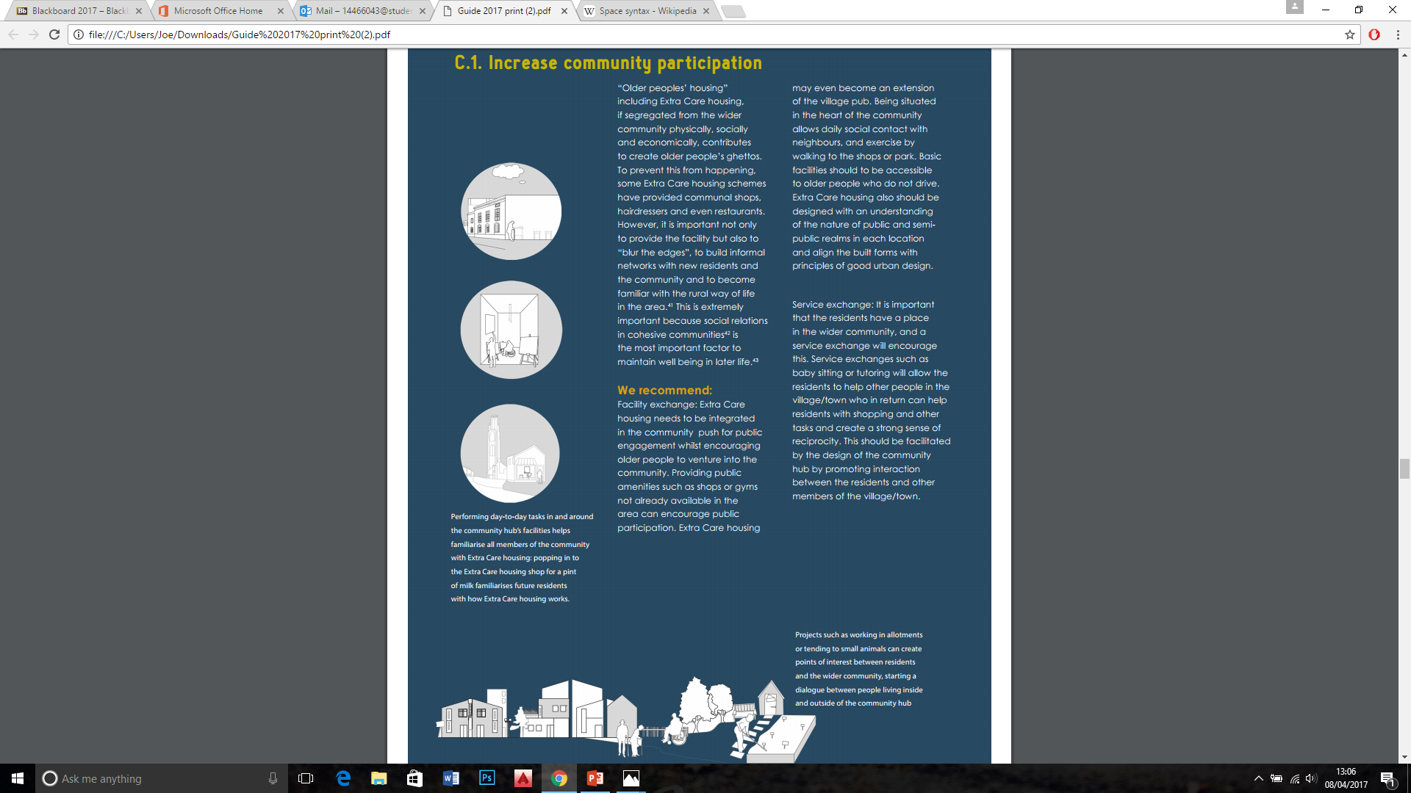
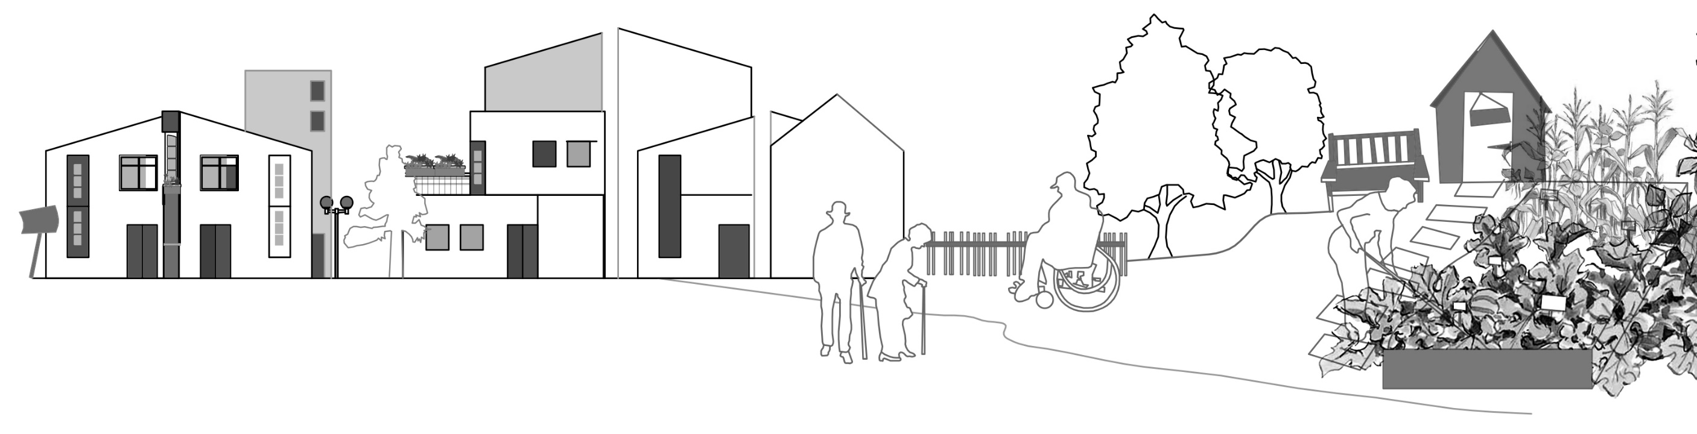
C. Community integration
18
C.1 Increase community participation
Day to day task in an around the community hub

Slide 19
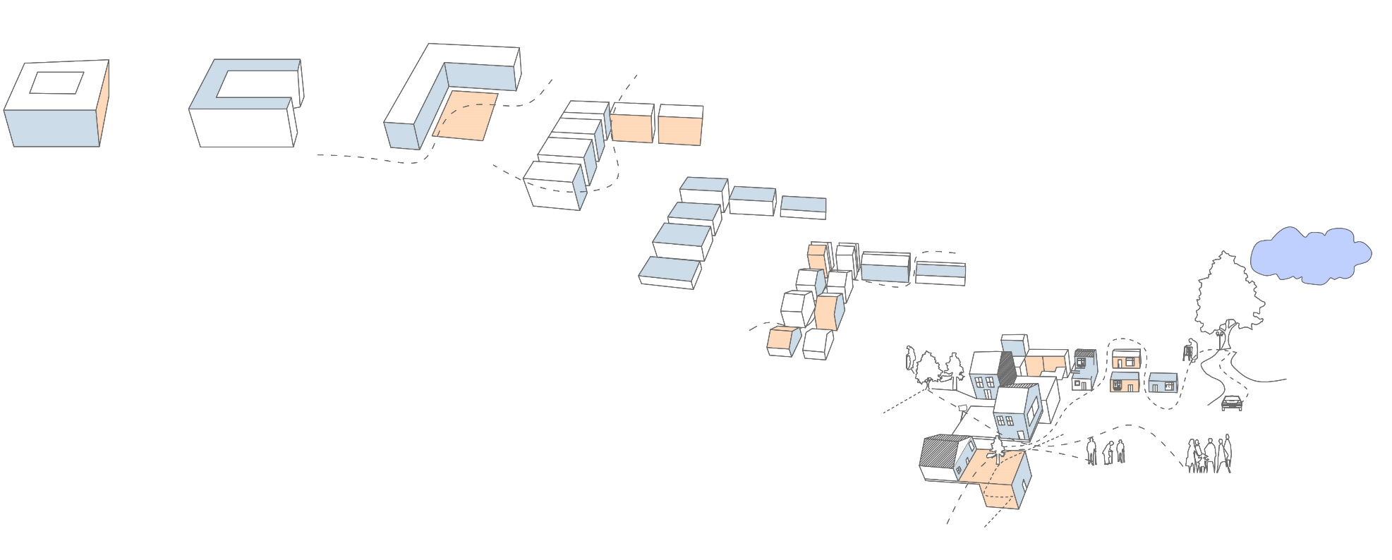
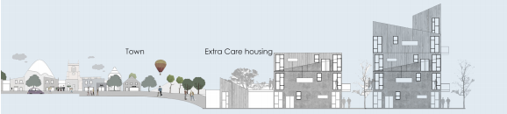
C.2 Sensitive development
C. Community integration
19
Notes:
.

Slide 20
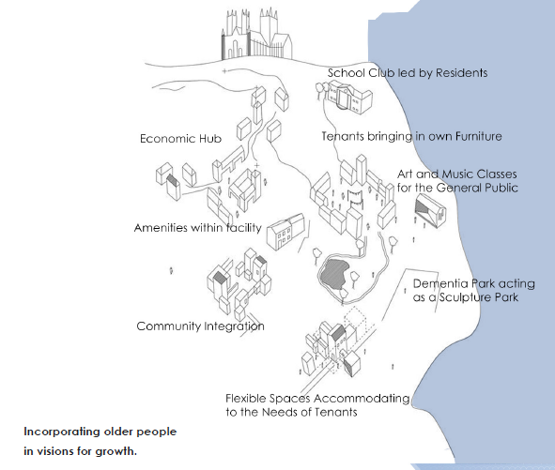
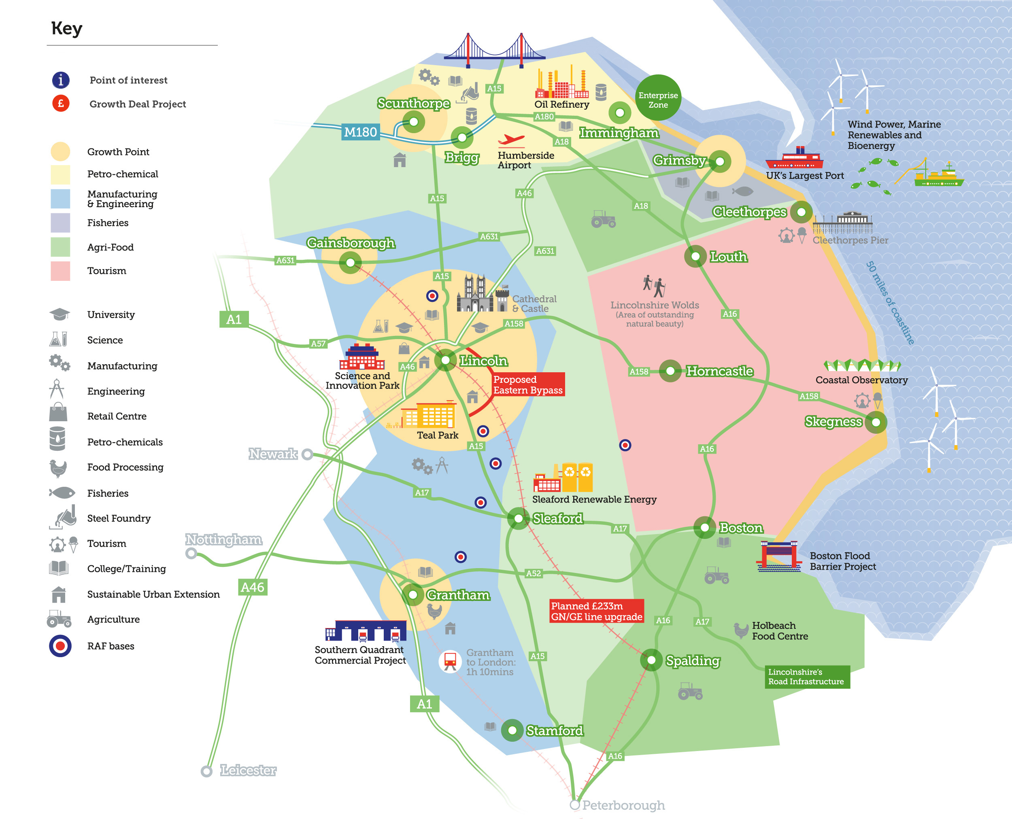
D.1 Visions for the future
D. OPPORTUNITIES NOT PROBLEMS
20
https://www.greaterlincolnshirelep.co.uk/

Slide 21
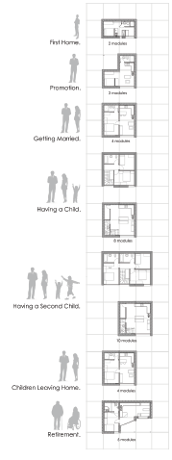
21
D. OPPORTUNITIES NOT PROBLEMS
D.2 Loneliness and isolation

Slide 22
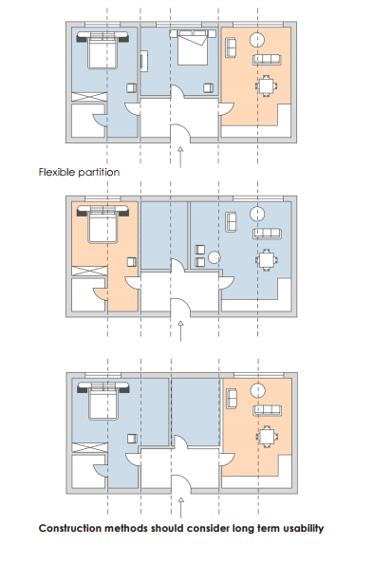

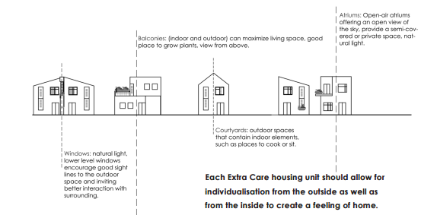
22
E. INDEPENDENCE
E 2 Homeliness and flexibility

Slide 23
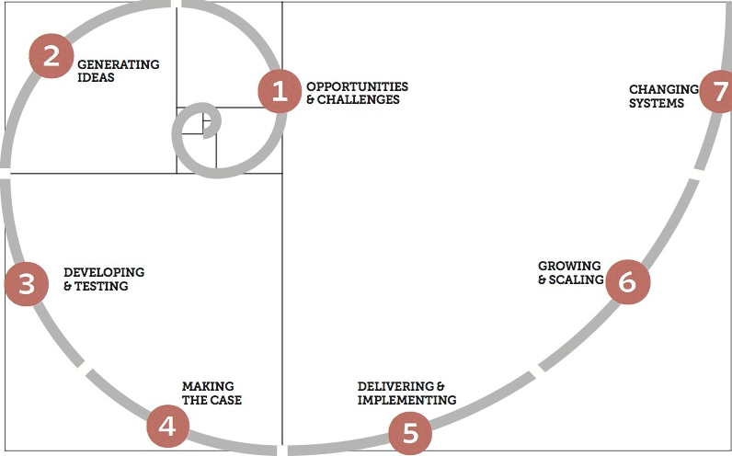
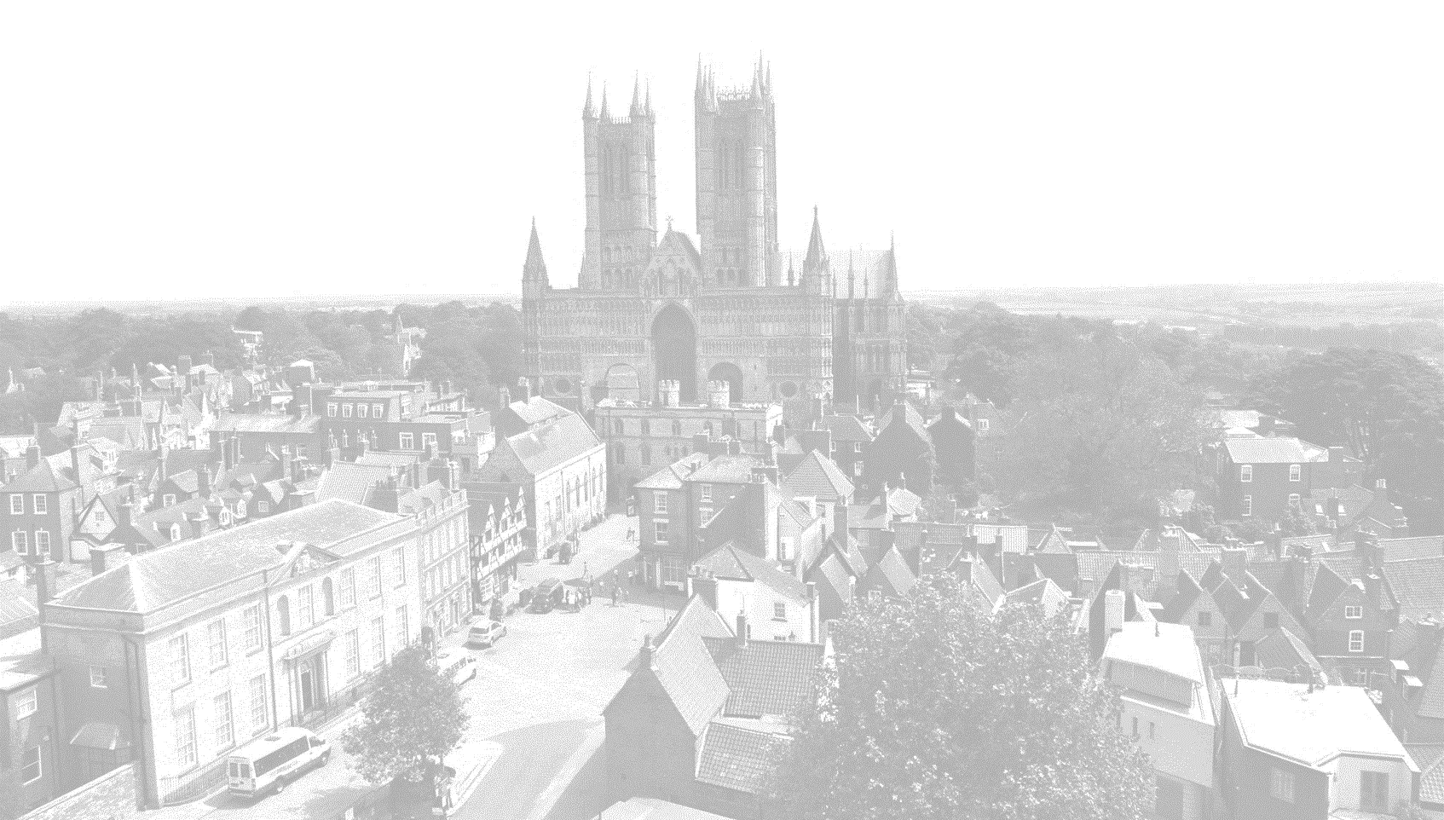
23
SOCIAL INNOVATION CYCLE
The Open Book of Social Innovation, March 2010

Slide 24
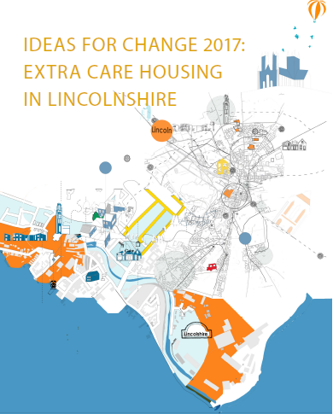
Thank you for listening.
Any questions?
If you would like to have a digital copy of this document
please email me
pparanagamage@lincoln.ac.uk

